Slide 1

Follow Up Session: Curriculum and Legislation
Dolores Davison, ASCCC Vice President
Laura Metune, Vice Chancellor, Government Relations

Slide 2
Budget Process
Release of Governor’s Budget
January 10
Legislative Analyst’s Analysis
January
Budget Subcommittee Hearings
February - May
Governor’s Revisions
May 15
Budget Subcommittee Final Actions
May
Conference Committee
June
Legislative Actions
June 15
Governor’s Consideration
June 15 - July 1
Implementation
July 1 – June 30
Agency Submittals of Requests
September

Slide 3
Legislative Process
Legislative Counsel
January
Bill Introduction
February
First House Policy & Fiscal Committee
March - May
First House Floor Vote
May
Second House Policy Committee
June-July
Second House Fiscal Committee
August
Legislative Deadline
Aug 31/Sept 15
Governor’s Consideration
October
Implementation
January 1
Agency Submittal of Requests
December

Slide 4
Governmental Relations Division
Board of Governors is responsible for advocacy before state and national legislative and executive agencies on behalf of community colleges.
Procedures and Standing Orders guide the Chancellor in representing the system on policy matters.
Chancellor’s policy positions are guided by the Vision for Success, the Budget and Legislative Request, and prior policy positions.
Government Relations division seeks feedback from stakeholders, Consultation Council and the Board prior to taking policy positions.

Slide 5
Recent Legislative Priorities
Higher Education Policy Focus
Coordination Data Sharing
Equity in Access and Outcomes
College Affordability
Notes:
First Year of 2-Year Legislative Session
Governor Newsom’s (First Term)
Legislative Changes
8 New Senators (28/10 – 2 vacancies)
8 New Assembly Members (61/19)

Slide 6
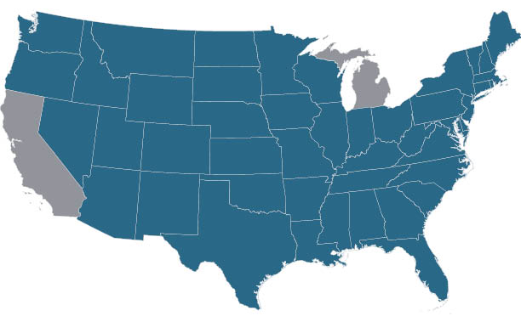
The State of Statewide Higher Education Coordination
States without a SHEEO or coordinating body

Slide 7
2019 Legislation on Coordination
AB 130 (Low) Establishes the Higher Education Performance and Accountability Commission as the statewide postsecondary education oversight, coordination, and planning agency.
SB 3 (Allen) Establishes the Office of Higher Education Coordination, Accountability, and Performance as the statewide postsecondary education coordination, oversight and planning entity.
Similar bills have been vetoed by Governor Brown in recent years. No funding included in budget to support this effort.

Slide 8
Intersections of Coordination and Curriculum
What are the implications if a coordinating entity:
  Reviews new programs and labor market needs?
  Reviews new curriculum for workforce alignment?
  Reviews transfer articulation?
  Approves new programs and facilities?
Who should be represented on a coordinating body?
Who should the coordinating body be accountable to?

Slide 9
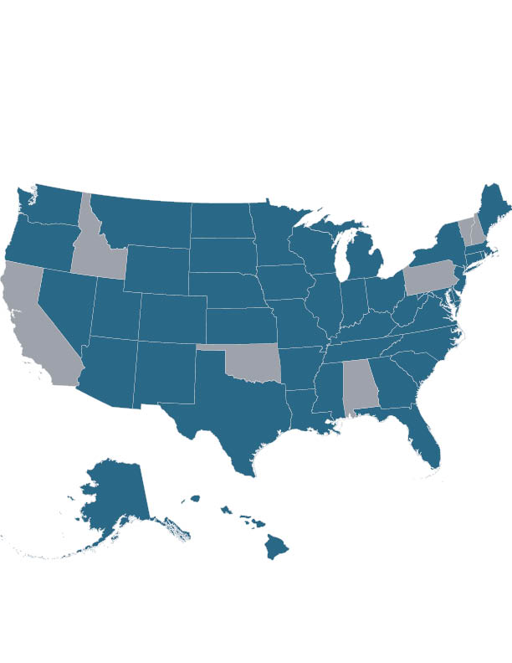
The State of Statewide Ed-Workforce Data Systems
State with an SLDS
Alaska and Hawaii both have SLDS

Slide 10
2019-20 Budget Action on Data Sharing
Cradle-to-Career Data System to connect information from education entities, employers, and other state and local agencies. Office of Planning and Research serves as fiscal agent ($10 M).
Establishes planning workgroup:
  K-12: Board of Education, Department of Education, Commission on Teacher Credentialing
  Higher Education: CCC, UC, CSU, AICCU, Student Aid Commission, Bureau for Private Postsecondary Education
  Workforce: Employment Development Department, Labor and Workforce Development Agency
  Public Services: Health and Human Services Agency
  Technology: Department of Technology, California School Information Services
Planning facilitator to convene advisory groups of end-users to provide additional input
Workgroup is directed to prioritize implementation of the data system:
  Phase 1: K-12 and higher education
  Phase 2: Workforce
  Phase 3: Early care and education
  Phase 4: Health and human services and other data connections.
Progress report to the Department of Finance and the Legislature by October 1, 2020

Slide 11
Intersections of Data and Curriculum
Can intersegmental data help align K-12 and higher education curriculum?
Would labor market outcome data inform curriculum?
Does knowing success of students after they transfer help inform planning for lower-division curriculum?
When data shows poor outcomes for students, how should curriculum respond?

Slide 12
Equity in Access and Outcomes
Dual Enrollment
Access and Assessment
Student Centered Funding Formula
Adult Learners
College Promise

Slide 13
Dual Enrollment
AB 30 (Holden) - Encourages greater participation in the College and Career Academic Pathways (CCAP) Program by streamlining the process for developing partnerships, authorizing one student application, and extending the sunset date.
AB 1729 (Smith) - Creates a special exemption from the 5% cap on principal recommendations during summer sessions for high school students in IGETC, GE Breadth and courses in a CE pathway.
SB 554 (Roth) - Authorizes adult education students (K-12 or Non-Credit) to dual enroll at a CCC as a special admits if they take courses to complete their high school diploma or high school equivalency.
SB 586 (Roth) – Requires a CCD and school district providing CCAP career technical education pathways to consult with their local workforce development board to determine which pathways align with regional and statewide employment needs prior to voting to approve a CCAP agreement.

Slide 14
Access and Assessment
AB 751 (O’Donnell) – Requires the SPI to approve nationally recognized high school assessments (SAT or ACT) in lieu of the 11th grade Smarter Balanced Assessment.
AB 239 (Salas) – Extends authorization for the Multi Criteria Screening Tool, an assessment used by nursing programs that have more applicants than capacity. The assessment uses a variety of factors such as academic performance, work experience, veterans status, foreign language proficiency etc.
ACR 64 (McCarty) – Requests CSU and UC study the usefulness and need for the SAT and ACT to determine student admissions.

Slide 15
Student Centered Funding Formula
Major Policy Changes in the 2019-20 Budget Act
Distribution Formula: 70% base allocation, 20% supplemental access allocation, 10% success allocation.
Success Allocation:
  Counts only the highest award earned in the same year; students must be enrolled in the district in the year the award was granted.
  Requires a student who transferred to a four-year university to have completed 12 or more units in the district in the year prior to transfer.
  Calculates the student success allocation based on three-year averages of each of the measures in the allocation.
Extends the existing “hold harmless” provision of the SCFF through 2021-22.
Charges the Chancellor’s Office with determining the final funding rates for 2019-20 consistent with these policy adjustments.

Slide 16
Focus on Adult Learners
No bills are currently moving – the Legislature has focused on:
Adult “Promise” Programs
Credit for Military Experience
Credit for Prior Learning
Competency Based Education
Online Education
Support for Student Parents (financial aid and child care)

Slide 17
College Affordability
Cost Components Students Living Independently
Textbooks | $1,791
Transportation | $1,242
Room and Board | $12,492
Personal/Misc. | $2,916
SUBTOTAL | $18,441
Tuition ($46 Unit) | $1,380
TOTAL | $19,821
Financial Aid Components for Community College Students Maximum Award % Students Receiving
Promise Grant | $1,380 | 43%
Pell Grant | $6,095 | 22%
Cal Grant B Access | $1,672 | 5%
12+ Units (SSCG) or | $1,298 | 3%
15+ Units (SSGC) | $4,000 | 0.5%
Total Financial Aid | $13,174
Unmet Need | $6,674

Slide 18
#Real College Survey
Food insecurity is the limited or uncertain availability of nutritionally adequate and safe food, or the ability to acquire such food in a socially acceptable manner.
During the 30 days preceding the survey, 50% of students reported food insecurity
41% skipped meals or cut size of meals for financial reasons
12% did not eat for at least one whole day because they didn’t have enough money
Housing insecurity includes a broad set of challenges such as the inability to pay rent or utilities,
or the need to move frequently.
Sixty percent of survey respondents experienced housing insecurity in the previous year
32% reported experiencing a rent or mortgage increase
28% reported not paying the full cost of utilities
28% reported not paying the full rent or mortgage

Slide 19
College Affordability Legislative Efforts
2019-20 Budget Actions:
  Competitive Cal Grants
  Expansion of College Promise (2nd Year)
  New Grant for Student Parents
Pending Legislation (“two-year” bills)
  SB 291 (Leyva) – California Community College Financial Aid Program
  AB 1314 (Medina) – Cal Grant Reform and Expansion
Food and Housing Insecurity
  AB 302 (Berman) – Safe Parking on CCCs
  AB 612 (Weber) – DSS/CCCCO MOU for CalFresh Restaurant Meals Program
  SB 173 (Dodd) – DSS standardized form for CCC, CSU and UC workstudy student participation in CalFresh.
Textbook Affordability

Slide 20
What does all of this mean for curriculum?
As responsibility is added to California Community Colleges and the Chancellor’s Office, we must work together to ensure adequate resources are also provided to our students and our colleges.

Slide 21
Questions

