Slide 1
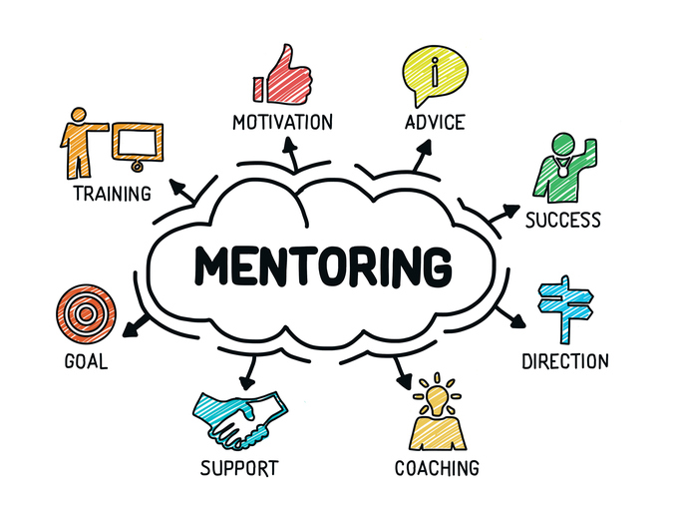
Developing Proactive Methods to Mentor Minority Students to Enhance Their Learning Experience and Success via Guided Pathways
Jay Parnell, ASCCC Part-Time Committee, San Bernardino College
Carrie Roberson, ASCCC North Representative
Erik Shearer, Studio Arts Faculty, Napa Valley College
Eric Wang, Part-Time Faculty, West Los Angeles College

Slide 2
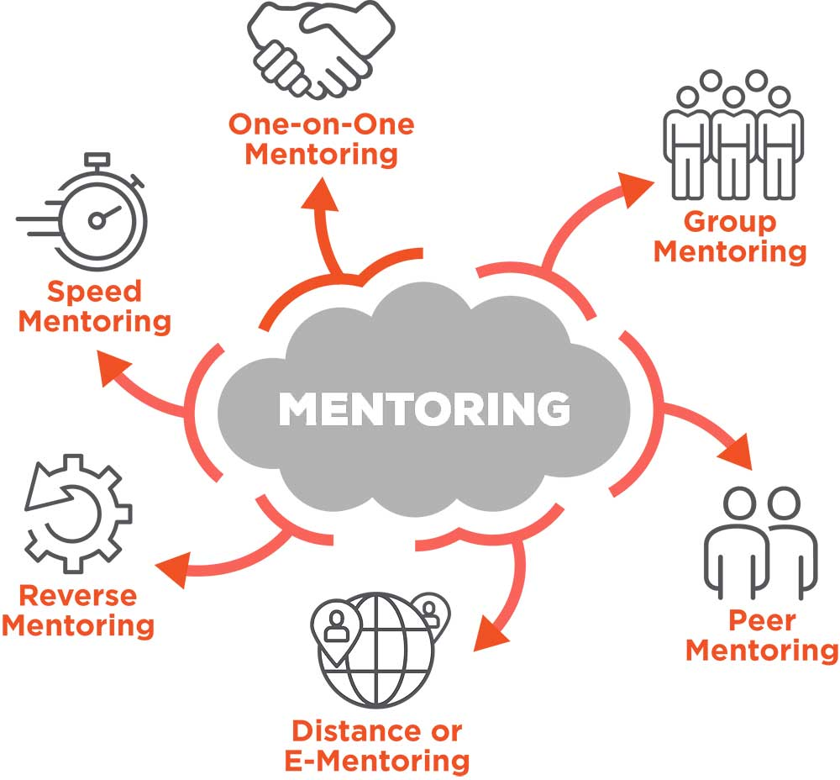
Today’s Discussion!
As a faculty member in higher education, there are numerous responsibilities
that you undertake to humanize the educational experience for students.
Increasing student success and completion by mentoring is among one
of them. In this session, we will discuss alternative approaches to helping
students stay on the path through proactive and intrusive faculty mentoring
approaches. Come join us for an engaging discussion on the promotion
of a faculty mentoring culture through shared best practices and support
approaches to help achieve student and faculty connectedness to attain
student completion.

Slide 3
Mentoring
The knowledge, advice, and resources a mentor shares depend on the format and goals of a specific mentoring relationship. A mentor may share with a mentee (or protege) information about his or her own career path, as well as provide guidance, motivation, emotional support, and role modeling. A mentor may help with exploring careers, setting goals, developing contacts, and identifying resources. The mentor role may change as the needs of the mentee change. Some mentoring relationships are part of structured programs that have specific expectations and guidelines: others are more informal.
(University of Washington) https://www.washington.edu/doit/what-role-mentor

Slide 4
Important Mind Frame
Effective mentoring includes "the ability and willingness” to:
value the mentee as a person;
develop mutual trust and respect;
maintain confidentiality;
listen both to what is being said and how it is being said;
help the mentee solve his or her own problem, rather than give direction;
focus on the mentee's development and resist the urge to produce a clone."
(American Psychological Association)
Notes:
The concept of mentoring is SIMPLE, but successful implementation can be challenging.

Slide 5
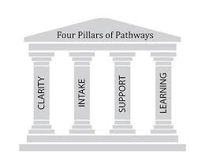
Guided Pathways Model
Mapping pathways to student end goals.
What courses are necessary to complete a program or qualify for transfer, how long completion will take, and what opportunities for employment or further education they will have at the end of the program
Helping students choose and enter a program pathway.
What courses are necessary to complete a program or qualify for transfer, how long completion will take, and what opportunities for employment or further education they will have at the end of the program
Keeping students on a path
Both students and advisors can see students’ plans mapped out through graduation and keep track of students’ progress. If students get off track or have trouble in a course, alert systems bring these issues to advisors’ attention so they can steer students toward academic or other supports. Colleges also try to remove institutional barriers such as inconvenient schedules or cancelled classes.
Ensuring that students are learning.
Programs are designed around a coherent set of learning outcomes, rather than as a collection of courses. Program learning outcomes align with requirements for success in further education and employment in a related field. Colleges track student learning outcomes and work to improve teaching.
Association of American Colleges & Universities https://www.aacu.org/diversitydemocracy/2017/fall/bailey

Slide 6
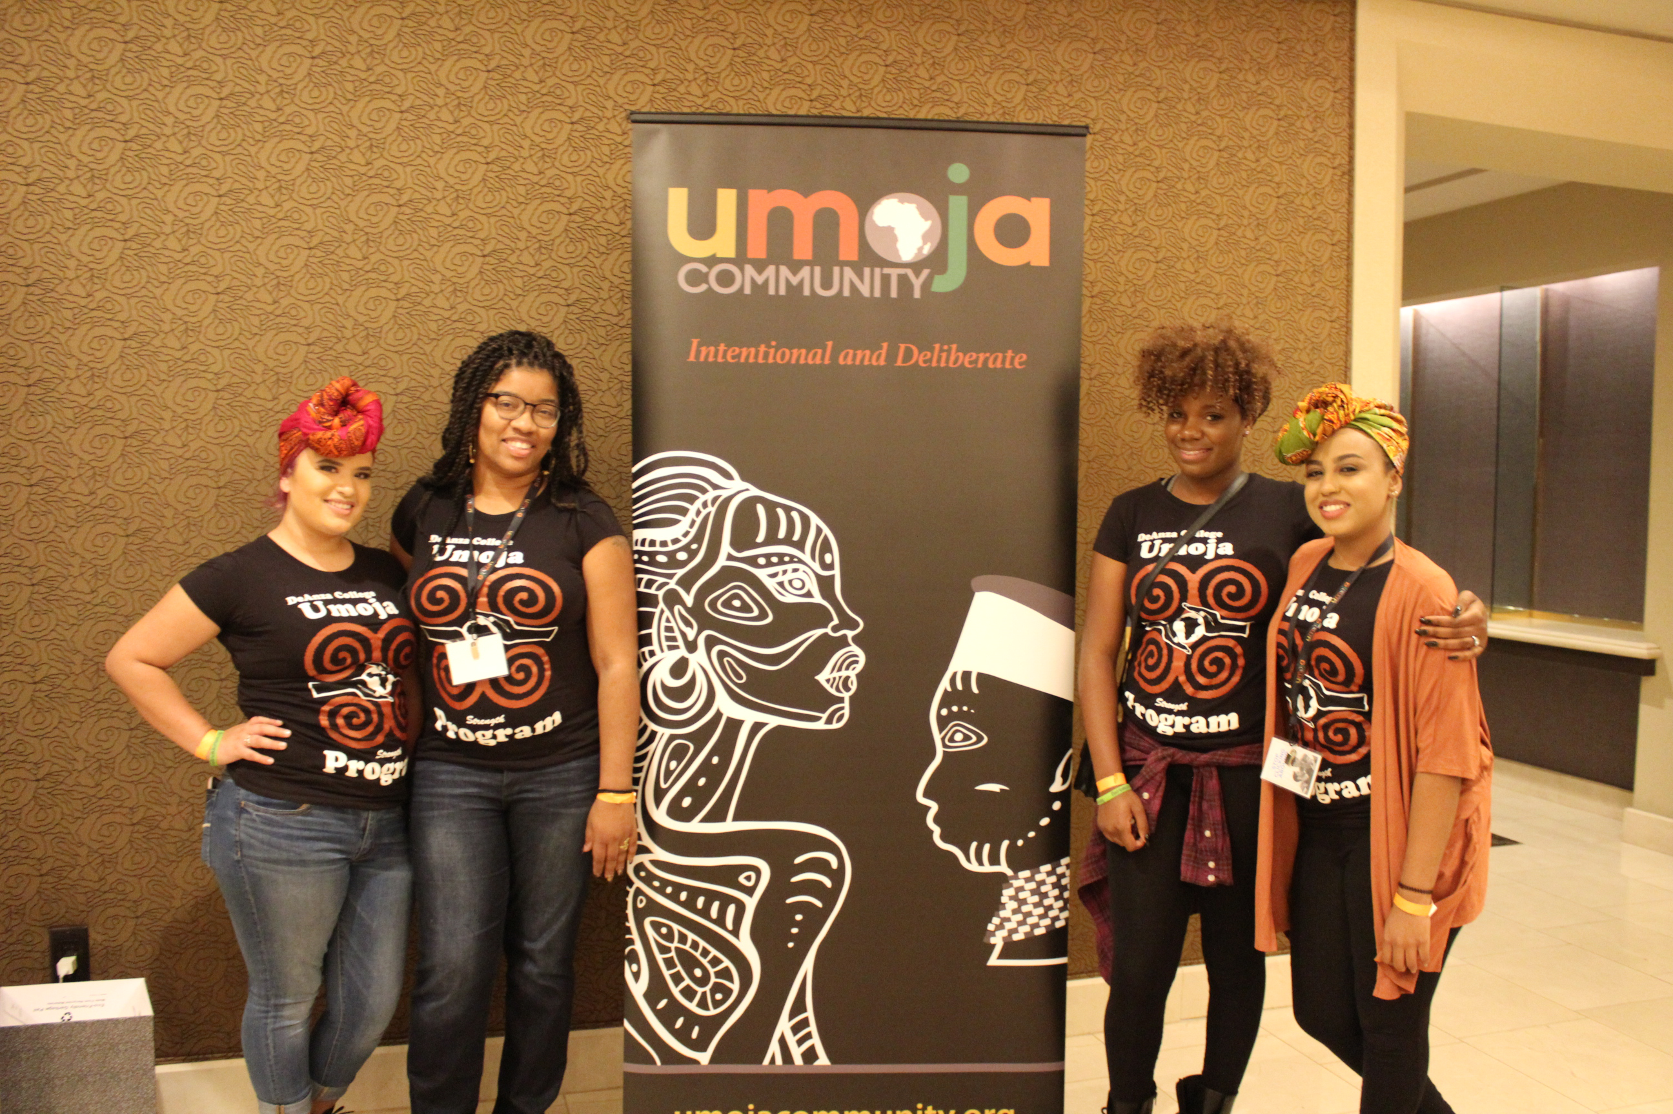
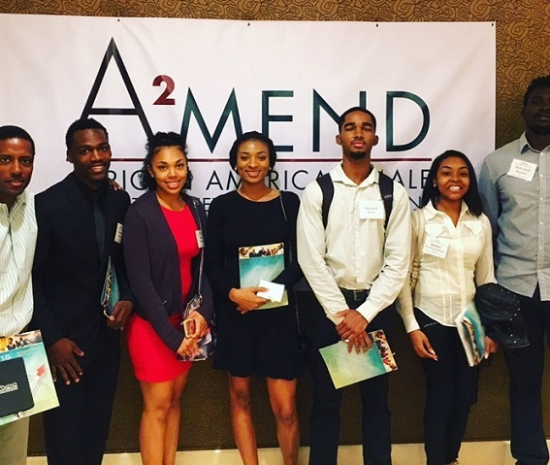
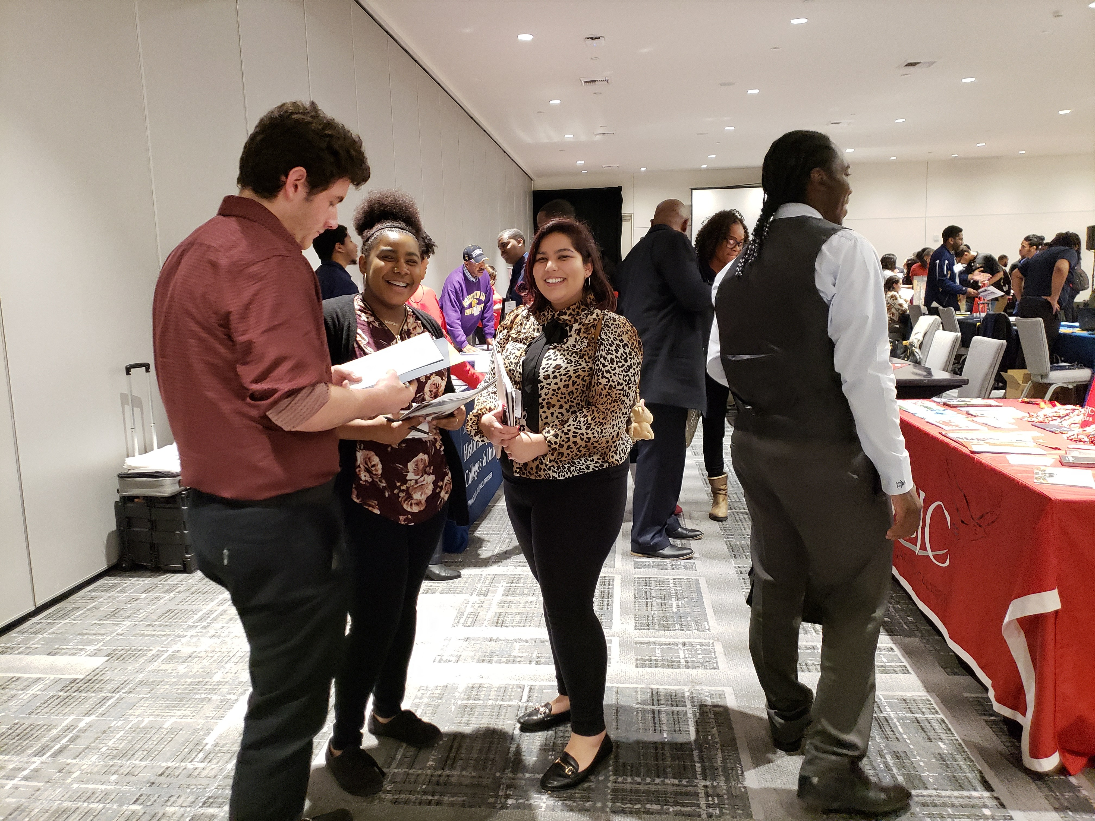
Collaborative Efforts to Support Student Success!
Programs and Services in collaboration with Colleges and Universities
Community Asset Base Organizations
On-campus support groups and clubs

Slide 7
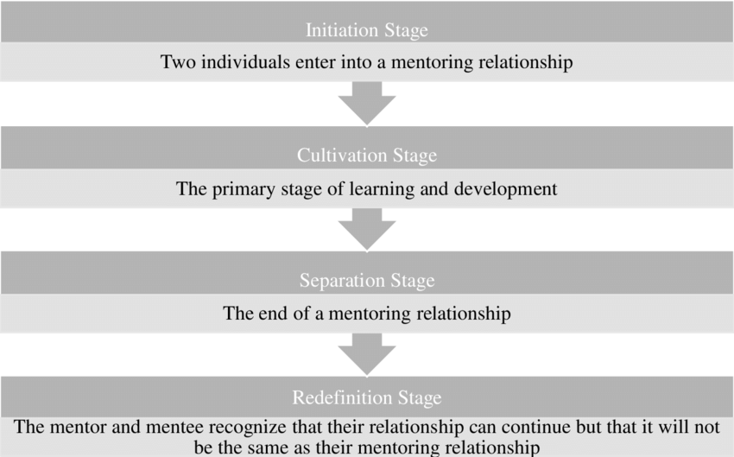
Relationships matter!
“Diversity has become a top priority in corporate America.”Thomas D.A. Havard Business Law
He found that minorities who plateaued in middle management received mentoring that was basically instructional; which helped them to develop skills only. By contrast, minorities who became executives enjoyed fuller developmental relationships with their mentors to support broader initiatives to create and enhance conditions that foster the upward mobility of minority professionals.
The truth about mentoring minorities. Race Matters
Thomas DA.
Harvard Business Review
Harvard Business School, Boston, USA

Slide 8
How can faculty demonstrate:
Support
Direction
Coaching
Set Goals
Training
Motivation
Advice
Measure Success
Pair in groups and discuss methods you as a faculty member used to support/mentor a student to enhance their success via Guided Pathways.

Slide 9
Discuss these particular methods as a faculty member used to support/mentor a student to enhance their success via Guided Pathways.
Notes:
Pair in groups

Slide 10
THANK YOU FOR YOUR TIME!
Jay Parnell, ASCCC Part-Time Committee, San Bernardino College
Carrie Roberson, ASCCC North Representative
Erik Shearer, Studio Arts Faculty, Napa Valley College
Eric Wang, Part-Time Faculty, West Los Angeles College

Slide 11
Resources
(University of Washington) https://www.washington.edu/doit/what-role-mentor
(American Psychological Association) https://www.apa.org/pi/disability/resources/mentoring/tips-mentors
Association of American Colleges & Universities https://www.aacu.org/diversitydemocracy/2017/fall/bailey
The truth about mentoring minorities. Race Matters
Thomas DA.
Harvard Business Review
Harvard Business School, Boston, USA
https://www.ncbi.nlm.nih.gov/pubmed/11299697

