Slide 1
The Disciplines List – What Works and What Could Be Improved
Sam Foster, Fullerton College
John Freitas, Los Angeles City College
Eric Narveson, Evergreen Valley College
Spring 2017 Plenary Session
April 21, 2017
San Mateo Marriott

Slide 2
Today, we will…
Review the basics of faculty minimum qualifications and the Disciplines List.
Review the current process for revising the Disciplines List.
Discuss what works about the current Disciplines List revision process and what could be improved.
Discuss what works about the current Disciplines List format and what could be improved.

Slide 3
Current MQ Requirements, the Disciplines List, and How It’s Revised

Slide 4
Minimum Qualifications “Hierarchy”
Faculty must meet minimum qualifications to work at a California community college.
“Basic MQs” for credit instructors, counselors, and librarians are the minimum degree and experience requirements specified in Title 5 §53410.
Discipline-specific MQs in the Disciplines List
Define the fields of study or professional experience to required to fit within a discipline.
Must conform to the degree and experience requirements of §53410.

Slide 5
Minimum Qualifications “Hierarchy” (Sec. 53410 – credit instructional faculty, librarians, counselors)
Basic MQ
Master’s degree
Bachelor’s degree plus two years professional experience,
Associate’s degree plus six years professional experience
Discipline-Specific MQ
Humanities - Master’s in Humanities
Biotechnology - Bachelor’s in biological sciences, chemistry, biochemistry or engineering, plus two years of professional experience
Bookbinding – any bachelor’s degree plus two years/associate’s degree plus six years professional experience

Slide 6
Local Qualifications May Exceed State MQs
A district may establish additional qualifications that are more rigorous than the state-established MQs.
However, local MQs cannot be less rigorous than the state-established MQs.
Local decisions to exceed state MQs should be made based on sound pedagogical and curricular reasons, not “just because.”
Beware of unintended consequences!
The point is to get the broadest possible pool of minimally qualified candidates!

Slide 7
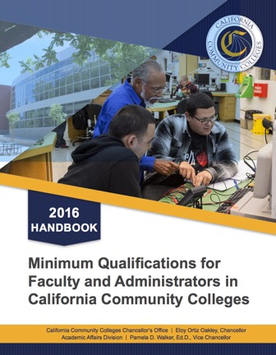
Discipline MQs and the Disciplines List
http://californiacommunitycolleges.cccco.edu/Portals/0/Reports/2016-Minimum-Qualifications-Report-ADA.pdf

Slide 8
What is a Discipline?
Faculty must meet the MQs for the discipline of the faculty member’s assignment.
A “discipline” is defined as a grouping of courses that share common academic or vocational preparation, which are typically defined by a degree or degrees (MFA, MA, BA, AS, etc.), or specific professional preparation.
Discipline is from the perspective of faculty preparation.
Not the same as local departments or subject areas.
The Disciplines List specifies the minimum qualifications for each discipline.
All courses must be assigned to at least one discipline from the Disciplines List.

Slide 9
Courses, Disciplines, and MQs – Oh My!
Discipline
Defines required academic preparation and professional experience for faculty
Assignment of Course to Discipline Defines the MQs needed to teach the course.
Courses
What the faculty teach…curriculum!

Slide 10
Organization of the Disciplines List
Disciplines Index (New for 2016!) A-Z reference list of all disciplines, including associated Ed Code and Title 5 citations as appropriate, and the page number where found. There is no longer the ”blended list” that shows all MQs together.
Disciplines requiring a Master’s Degree, including relevant MQs for EOPS, DSPS, health services, and learning assistance/learning skills faculty.
Disciplines requiring a specific Bachelor’s or Associate’s degree plus the requisite professional experience, including noncredit MQs from Title 5.
Professional experience is always required, even with a master’s degree or higher.
Disciplines requiring any Bachelor’s or Associate’s degree plus the requisite professional experience.
Professional experience is always required, even with a master’s degree or higher.
All relevant Ed Code and Title 5 language on MQs, including for academic administrators.

Slide 11
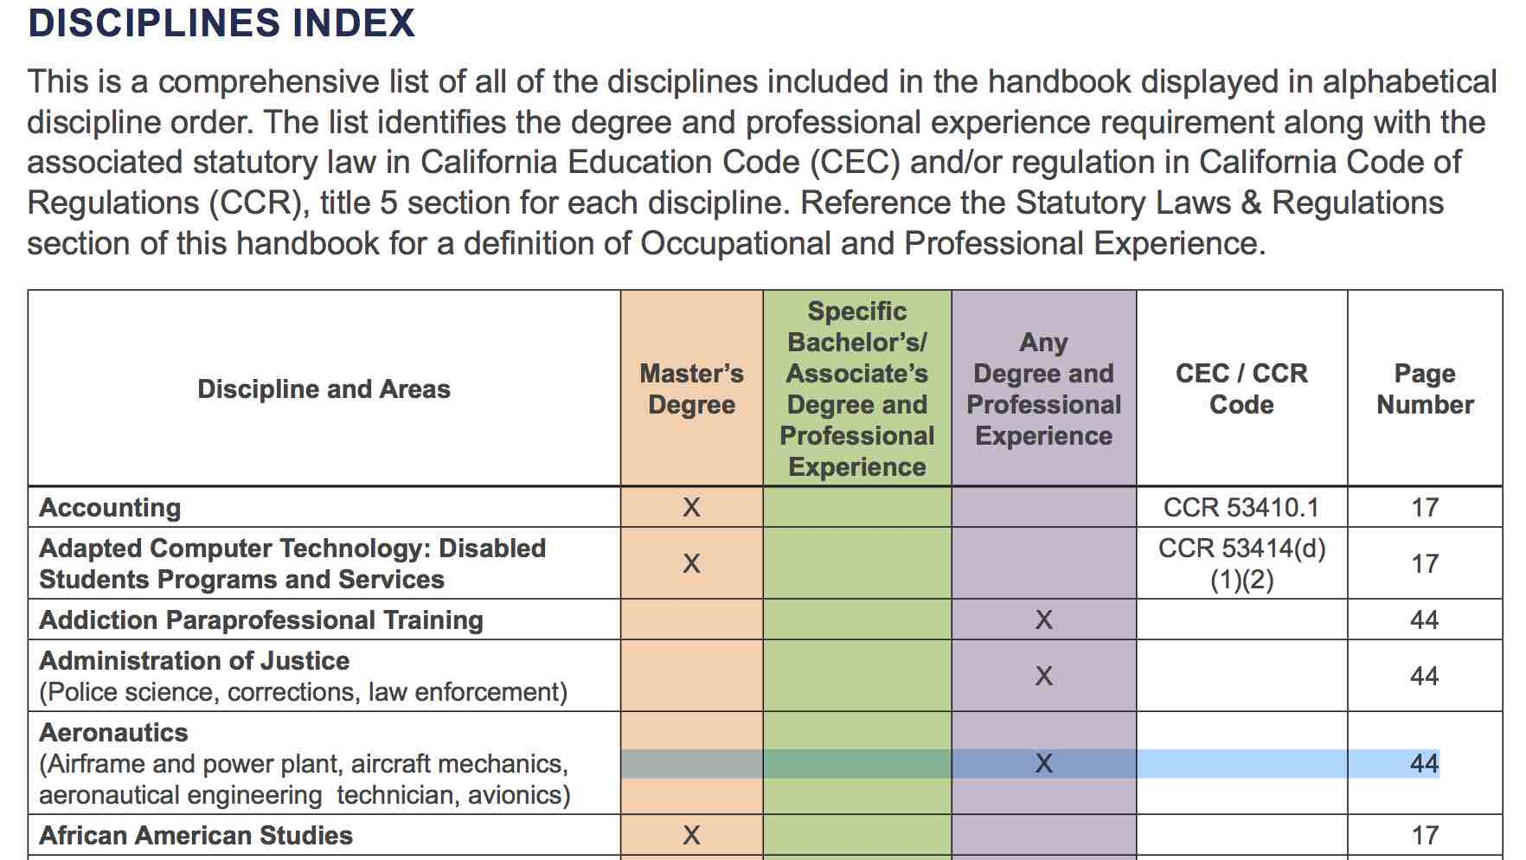
Disciplines List Index (New for 2016!)

Slide 12
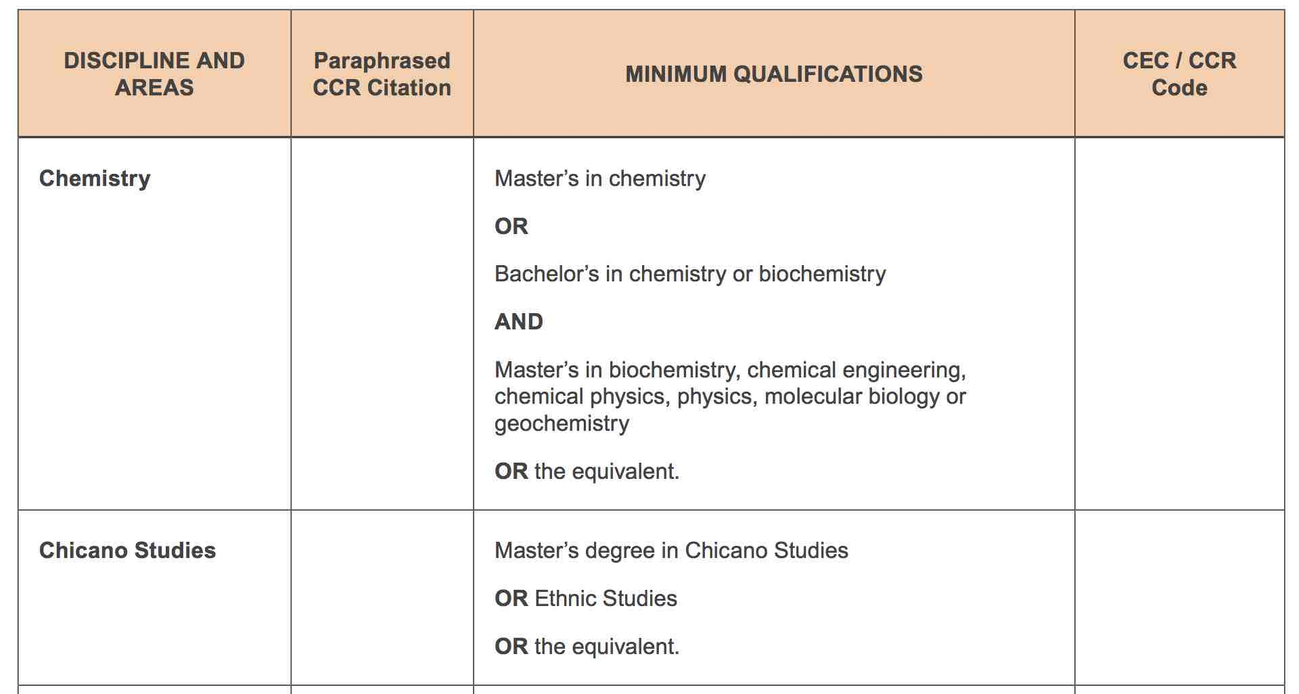
Master’s Degree List Sample

Slide 13
Non-master’s List - Specific bachelor’s or associate’s degree sample

Slide 14
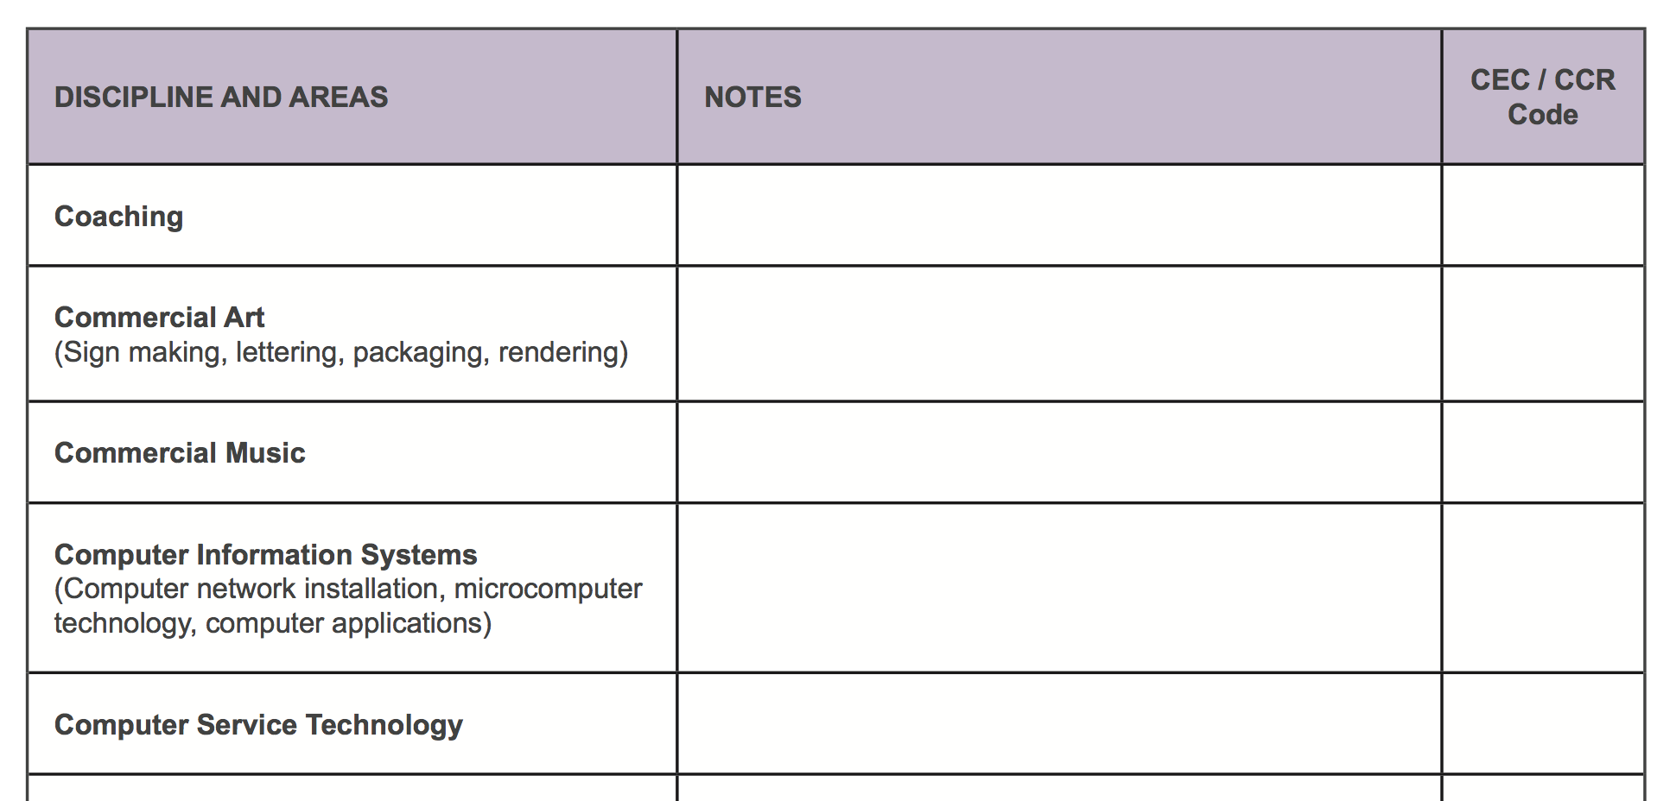
Non-master’s List - Any bachelor’s or associate’s degree sample

Slide 15
Process for Revising the Disciplines List
Revisions can be proposed by:
Local senates…should be initiated by faculty discipline experts.
Faculty through discipline or professional organizations.
Proposals must have a second from a senate from another district!
Proposals require consultation with statewide discipline organizations.
The ASCCC does not make proposals. It only facilitates the process.
Reviewed and revised annually (new!) – Proposals are submitted and received by September 30.
Proposals received after September 30 are held until the next revision cycle.
Proposals must go through two hearings – fall and spring plenary session.
Vote at spring plenary session.
ASCCC consults with CCC constituencies and makes recommendations to BOG.
Two readings by the BOG - BOG shall rely primarily on the ASCCC – Ed Code §87357.

Slide 16
Discussion Time! – Disciplines List Revision Process
What is your experience with the Disciplines List process?
Based on your experiences, is the process easy/clear to navigate, or was it difficult?
If you found the process difficult, why was the process difficult?
Are there aspects of the process that are confusing?
Does the process allow changes in disciplines to be reflected in a timely manner?
Do you have suggestions for improving the process?

Slide 17
Discussion Time! – Disciplines List Format
Have you used the Disciplines List to research minimum qualifications for a specific discipline?
How easy was it to find the information that you were looking for in the Disciplines List? Are there any improvements that could be made?
How easily were you able to match the specific discipline you were researching to the title of that discipline in the List?
What changes could be made to the Disciplines List content or format to make it easier to use locally?

Slide 18
Contact Information and Resources
Our contact information:
Sam Foster – sfoster@fullcoll.edu
John Freitas – freitaje@lacitycollege.edu
Eric Narveson – eric.narveson@evc.edu
Stacey Searl-Chapin – schapin@msjc.edu
Some useful resources:
ASCCC Disciplines List information page - http://asccc.org/disciplines-list
2016 Disciplines List – http://californiacommunitycolleges.cccco.edu/Portals/0/Reports/2016-Minimum-Qualifications-Report-ADA.pdf
Disciplines List Revision Handbook – http://www.asccc.org/sites/default/files/DLHandbook_Final_0.pdf
Archived Disciplines Lists - http://asccc.org/disciplines-list-archives

Slide 19
Questions?
Thank you!

