Slide 1
Dual enrollment – how do we continue to move students through this pathway?
Cheryl Aschenbach, ASCCC Secretary
Dolores Davison, ASCCC Vice President
Notes:
Introductions, Temperature of the Room (Michael), Pass our Stickie Notes for Questions (Donna)

Slide 2
Breakout Description
The expansion of dual enrollment programs for special admits and CCAP students creates a unique opportunity in a Guided Pathways framework. Review the different ways colleges can partner with K-12s to offer dual enrollment, and then discuss ways to leverage dual enrollment to help students clarify and enter their pathways.

Slide 3
What Is Dual Enrollment?
High school students taking colleges courses while enrolled in high school
Can take various forms –
Middle College/Early College
Special admits
CCAP agreements
Notes:
Donna

Slide 4
Middle/Early College
Generally a cohort model of students who benefit from a college rather than high school environment
Students take a mix of courses including high school requirements and college courses
In many cases, students graduate with high school diploma as well as an AA degree

Slide 5
Traditional Dual Enrollment
Students are special admit students
Subject matters can be GE, CTE, advanced courses
Classes can be offered
On college campus or satellite, through including Distance or Online Education
Individual students
Cohorts
On high school campus before or after school

Slide 6
College and Career Access Pathways (CCAP)
Created by AB 288 (Holden, 2015)
District level agreement to offer Dual Enrollment
Intended to reach broader range of students, not just highly gifted or advanced scholastic or vocational work
Emphasis on college and career readiness and CTE and transfer pathways
Reduce the number of students needing remedial math and English instruction at the community college level

Slide 7
CCAP Agreements
Added a new option for Dual Enrollment
Does not replace existing models
Colleges can continue with existing dual enrollment programs
Colleges can continue with existing dual enrollment agreements and have CCAPs

Slide 8
What does CCAP allow that is different?
Provides added flexibility in three areas
Limit enrollment in college courses taught on high school campus to high school students
Raise maximum units per term for special high school admits to 15 college credits (but no more than 4 courses)
Provide CCAP students same enrollment priority as Middle College High School students
Notes:
Kim

Slide 9
What does CCAP not allow?
A community college district participating in a CCAP partnership shall not provide physical education course opportunities to high school pupils
A community college district shall not enter into a CCAP partnership with a school district within the service area of another community college district, except where an agreement exists, or is established
A community college district participating in a CCAP partnership is not required to provide the same services at the high school campus that are on the college campus (but may choose to do so).

Slide 10
Benefits to Students
Complete high school and college credits at same time
Introduction to/preparation for college life for a smoother transition to college
More time for career and/or college major exploration
Address skills gaps and improve study skills/academic knowledge
Increased confidence and motivation to persist
Students experience the benefits of a college education
Notes:
Donna

Slide 11
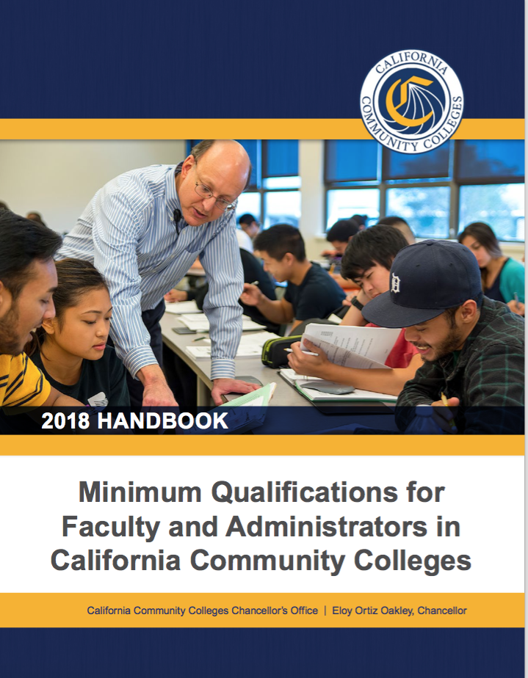
Faculty
All CCAP faculty must meet MQs for the discipline in which they are teaching.
Who teaches class?
High school teacher
College teacher
What’s the difference?
Notes:
Donna

Slide 12
Implications of AB705 for Dual Enrollment?
Pathway programs with both secondary and adult schools
Opportunity for improved alignment
Bridge programs

Slide 13
Why Does This Matter?
Research has demonstrated that dual enrollment participants, even those who are from traditionally underrepresented groups, do as well or better than their non-dual enrolled peers in a range of areas, including:
High school graduation rates;
High school grade point average;
High school on-time graduation rates;
Assessment into college courses;
College GPA and credit accrual; and
Community College enrollment, retention, and persistence rates.
Summary of these results can be found at: http://67.205.94.182/publications/what-we-know-about-dual-enrollment.html as well as the Dual Enrollment Toolkit http://www.careerladdersproject.org/ccccode/
Links to New High School Graduation Standards
Pathways Development/Planning
Notes:
Michael

Slide 14
Academic and Professional Considerations
Curriculum
Graduation requirements
Minimum qualifications and equivalency
Professional development
Student preparation and success
Notes:
Michael

Slide 15
AB 30 (2019, Holden)
Current status: Enrolled (will be sent to Governor Newsom before midnight on September 13)
Intended to assist in expansion of CCAP dual enrollment programs
Potential changes if this bill passes:
Number of readings required at K-12 & CCC District level governing boards reduced from two to one
Includes some changes to priority enrollment for dual enrollment students

Slide 16
Resources
Dual Enrollment Toolkit Resources: http://www.careerladdersproject.org/ccccode/
CCRC: What We Know About Dual Enrollment: http://67.205.94.182/publications/what-we-know-about-dual-enrollment.html
Guide to Launching and Expanding Dual Enrollment Programs for Historically Underserved Students in CA (R. Purnell; RP Group 2014)
http://www.rpgroup.org/projects/dual-enrollment-guide-2014
http://www.rpgroup.org/system/files/High-School-Transition-Brief_0.pdf
Concurrent Courses Initiative (Community College Research Center, Career Ladders Project, James Irvine Foundation)
http://irvine.org/evaluation/program-evaluations/concurrent-courses-initiative
Career Ladders Project: HS to College Transition Web Resources
http://www.careerladdersproject.org/high-school-to-college-transition-tools/early-college-experiences-and-transition-support/
Santa Barbara City College: Dual Enrollment Program Resources
http://www.sbcc.edu/dualenrollment/programresources.php
Notes:
Michael—if needed

Slide 17
Questions? Thank You!
Cheryl Aschenbach
Dolores Davison
Questions can be directed to info@asccc.org
Notes:
All

