Slide 1
The Evasive SLO Process
Engaging Faculty in a Sustainable System
East Los Angeles College
Amanda Ryan-Romo
(former SLO Coordinator; currently wandering aimlessly in the world of SAOs)

Slide 2
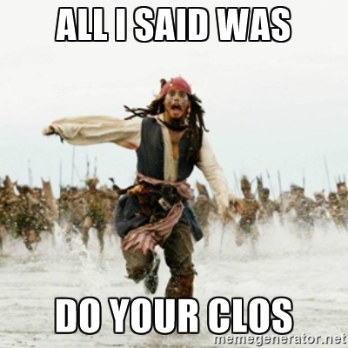

Slide 3
Once upon a time….
While attempting to fulfill ACCJC Accreditation Standards…
East Los Angeles College discovered that….
Implementing something new and untried can transform a college campus.

Slide 4
Institutional Engagement – Spring 2013
Notes:
The growth in closing the loop was incremental over 3 years
Conversely, attendance at the SLO Committee dropped sharply, from 75% of constituents attending in Spring 2011 to only 20% of constituents attending in Spring 2013
When surveyed, 90% of chairs said their departments were closing the loop; when questioned, only 8% could tell us what that meant and provide an example

Slide 5
How do “They” get the cooperation of faculty?
We started to ask…
Notes:
How does everyone else do it? We looked at Santa Monica, Cabrillo, Skyline – other schools that seemed to be doing this well and in a sustainable fashion.
What we realized: those schools engaged long before it became a mandate. We couldn’t re-write history, so we needed to do something else.
The biggest problem: no consistency in training and approach.
3 SLO Coordinators within 5 years; a president leave, 2 interim presidents, and a new president come on board in that time.

Slide 6
The First Step:
Hire a permanent Learning Assessment Coordinator
The Second Step:
Identify, train, and pay faculty members to be Department SLO Facilitators

Slide 7
Neither step would have been possible without the support of…
President Marvin Martinez
Senate President Alex Immerblum
Chair of Chairs Sherrie Davey
AFT1521 Chapter President Armida Ornelas

Slide 8
Being an SLO Facilitator
55 Faculty, including 2 Department Chairs, signed-up to be Department SLO Facilitators starting in Spring 2014
30 hours training ($500)
20 hours face-to-face instruction
10 hours work to demonstrate proficiency
Work throughout the semester ($750)
Complete ACCJC Basic Training
Attend Learning Assessment Committee meetings
Develop SLO plan and timeline for meeting proficiency
Provide data to department chair on participation
Ensure data and reports are entered into TracDat
Document meetings held for discussion of SLO results

Slide 9
Before Training
Notes:
Department Proficiency: only 28% could tell us where their department was before starting training;
Work to be done: 60% said there was “lots to be done” before training;
Time on task: 70% predicted it would take <20 hours to get the department up-to-speed before training;

Slide 10
What Did the Training Cover?
Notes:
What does training cover at your campus?

Slide 11
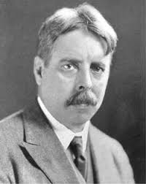
Who is the grandfather of the SLO process?
John Dewey
Edward Thorndike
“Give the pupils something to do, not something to learn; and the doing is of such a nature as to demand thinking; learning naturally results.” ~John Dewey

Slide 12
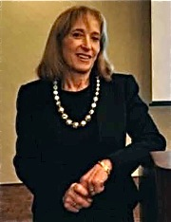
What is the connection between SLOs and neuro-education?
Willis argues that “starting the year with clear communication to students about the goals of their studies and expectations for their assessments sets a pattern that gives them the security that accompanies predictability.”
Research-Based Strategies to Ignite Student Learning: Insights from a Neurologist and Classroom Teacher. 2006
Brain-Friendly Strategies for the Inclusion Classroom. 2007.

Slide 13
What does Bloom’s Taxonomy really tell us?
Evaluating
Application
Comprehension
Synthesis
Analysis
Knowledge
Creating or Evaluating
Analyzing
Understanding
Applying
Remembering

Slide 14
Other Topics Addressed:
How can Understanding by Design help us build better CLOs?
I’ve got a CLO; what’s the best way to assess? Matching assessment types to Bloom’s taxonomy levels.
Engaging in “authentic assessment.” What are the possibilities and why should we use this approach?
Basic analysis of data

Slide 15
After Training
Notes:
Department Proficiency: only 28% could tell us where their department was before starting training; almost 93% knew at the end of training
Work to be done: 60% said there was “lots to be done” before training; 90% said “lots to be done” after training
Time on task: 70% predicted it would take <20 hours to get the department up-to-speed before training; 68% said it took 50+ hours to get the department up-to-speed

Slide 16
In addition, there were up to 3 campus SLO Facilitators, each with a .4 release

Slide 17
The worst aspect of the SLO Facilitator program
was...
The best aspect of the SLO Facilitator program was...
"Learning what SLOs really are and what is expected of our school in terms of SLOs. Before I became a facilitator, I had no idea what SLO meant and thus, didn't want to have anything to do with them. I feel like we helped with our school's accreditation on the SLO front. I enjoy working with the other SLO facilitator in my department as well as the department chair. I am glad to help the other faculty with their SLOs."
"When faculty complain about SLOs and yell at us because of the changes we announce. It's discouraging when someone says they "hate" SLOs and respond with hostility to our requests."

Slide 18
The SLO Facilitator program worked because...
"Most of the facilitators volunteered to do it, so that means we care about what we are doing. We are on board with SLOs and are ready to help with whatever is required of our department and our faculty. I know we are paid, so it is not entirely a volunteer position, but we aren't paid a huge amount, so it's not like money is the prime motivation. I also think that it's helpful to work with our fellow faculty on the same level, instead of having the chair or the dean order us to do our SLO homework.“
"The fact that we all came together to receive information. Our responsibilities were well outlined."

Slide 19
Facilitator Work: Where did most of the time go?
Reviewing SLOs and improving their quality
Identifying gaps in the department’s process
Helping other faculty understand the SLO process

Slide 20
Spring 2015 Results

Slide 21
There was more work to be done!

Slide 22
2014-2015
The Learning Assessment Committee:
Created CLO Technical Guidelines to improve CLO quality
Worked with Senate to embed the CLO Technical Guidelines review process into the Curriculum review process
Approved an SLO Fundamentals for Faculty
Revised the Institutional Learning Outcomes and General Education Learning Outcomes
Mapped CLOs to ILOs and GELOs
Developed a timeline for tasks to complete within the semester
Developed Excel “dashboards” for data collection
All Department Chairs received a shortened-form of training

Slide 23
Sample of the Timeline Guide we developed

Slide 24
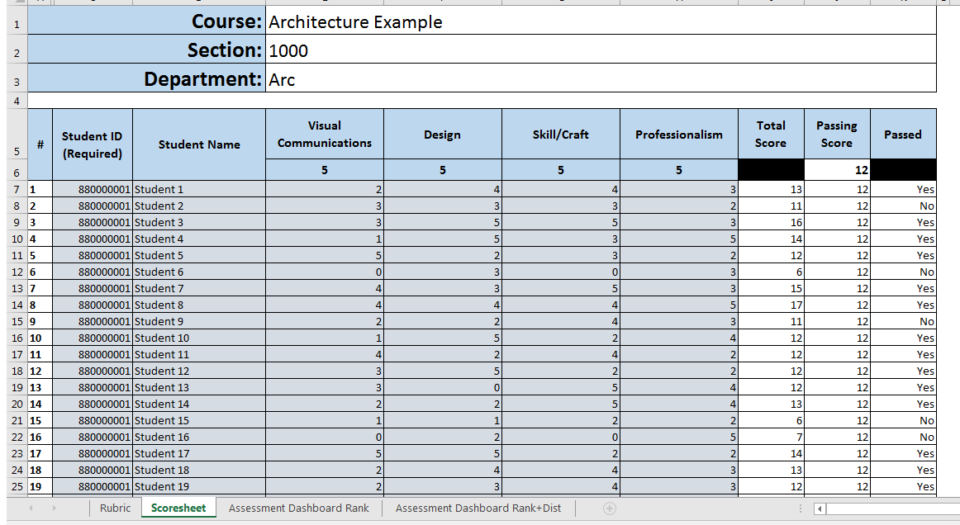

Slide 25
Spring 2015 Results

Slide 26
Still More Changes…

Slide 27
2015-2016
The Learning Assessment Committee and Academic Senate worked together to create the following:
Policy on length of the CLO assessment cycle, including guidelines for required number of CLOs
Required each department to submit a formal cycle for assessment
By course
By CLO
We also
Approved a move from TracDat to eLumen
Froze all revisions starting January 2016 in preparation for the transfer to eLumen
Notes:
Prior to first policy, 67% of courses has only 1 CLO

Slide 28
Spring 2016 Results

Slide 29
Accreditation Visit – March 2016
How did we fare?
2 SLO Recommendations:
Disaggregate SLO data for use in identifying and addressing gaps (IB6) - compliance
Formalize cycles for SSOs, PLOs, ILOs, GELOs - improvement

Slide 30
What’s happened since?
A new cohort of facilitators came on-board in fall 2016. Training for this cohort included linking SLO assessments to equity and introducing the Tuning/DQP ideas
eLumen got off the ground and became functional in Fall 2016
94% of courses that were planned to assess completed the assessment
In 3 departments, 100% of faculty participated
In 5 additional departments, 90% or more faculty participated
The Learning Assessment Coordinator moved on to become the Learning Center Director (and is now experiencing the wonderful world of SAOs)
One of the Campus SLO Facilitators assumed the Coordinator’s position for a smooth transition
Notes:
Training = $250
Semester work = $550

Slide 31
Does this mean we have a sustainable process?

Slide 32
Thank you!
Amanda Ryan-Romo
ryanroaj@elac.edu
323-415-5025

