Slide 1
Exploring Articulation and Transfer
Eric Wada, Biology, Folsom Lake College
Elizabeth Ramirez, ASCCC Curriculum Committee
Notes:
Eric, then Elizabeth

Slide 2
Breakout Description
Articulation and transfer are often considered one and the same, but there are differences. Learn more about the complex role of articulation officers, how they support faculty in curriculum, and the relationship between articulation and transfer. Additional topics include criteria for transfer general education approval (IGETC and CSU GE-Breadth), C-ID, and development of Associate Degrees for Transfer (ADTs), including transfer model curricula (TMC), articulation agreement by major (AAM), GECC, and BCT.
Notes:
Elizabeth

Slide 3
Poll #1
What roles are represented in this session’s audience?
Notes:
Eric

Slide 4
Poll #2
How many years of experience do you have in this role?
Notes:
Elizabeth

Slide 5
Does my course transfer? Is it articulated?
Defining terms:
Articulation
Courses Accepted for Baccalaureate Credit
Courses transferable to the CSU system
Courses transferable to the UC system
General Education Agreements
CSU GE – Breadth
IGETC
Lower Division Major Preparation Agreements
Course-to-course Agreements
Notes:
Elizabeth

Slide 6
The COR as the Basis of Articulation
COR vs. syllabus
ICAS Memo (May, 2019)
Discipline-specific considerations for COR’s for articulation
Academic freedom and specificity
Articulation considerations for multi-college districts
Notes:
Eric

Slide 7
Poll #3
Deadlines for submitting courses for UC transferability, CSU GE, and IGETC
Notes:
Elizabeth

Slide 8
How are articulation decisions made?
Timelines and resources for IGETC and CSU GE – Breadth (IGETC Standards, Guiding Notes)
CSU Transferability (CSU EO 167)
UC TCA
Articulation in the major and course-to-course
C-ID
TMCs
Notes:
Elizabeth, then Eric

Slide 9
Development of ADTs and TMCs
Acronym Definitions
AAM
BCT
GECC
FDRG (roles and responsibilities)
Considerations for structuring your ADT
CSU designation of “similar”
Notes:
Eric

Slide 10
English TMC Polls 4-9
Refer to the following English TMC template to answer the poll questions in Pathable.
Switch tabs in Pathable to add questions or comments.
Notes:
Eric & Elizabeth

Slide 11
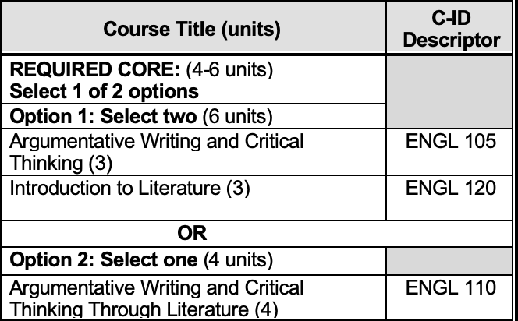
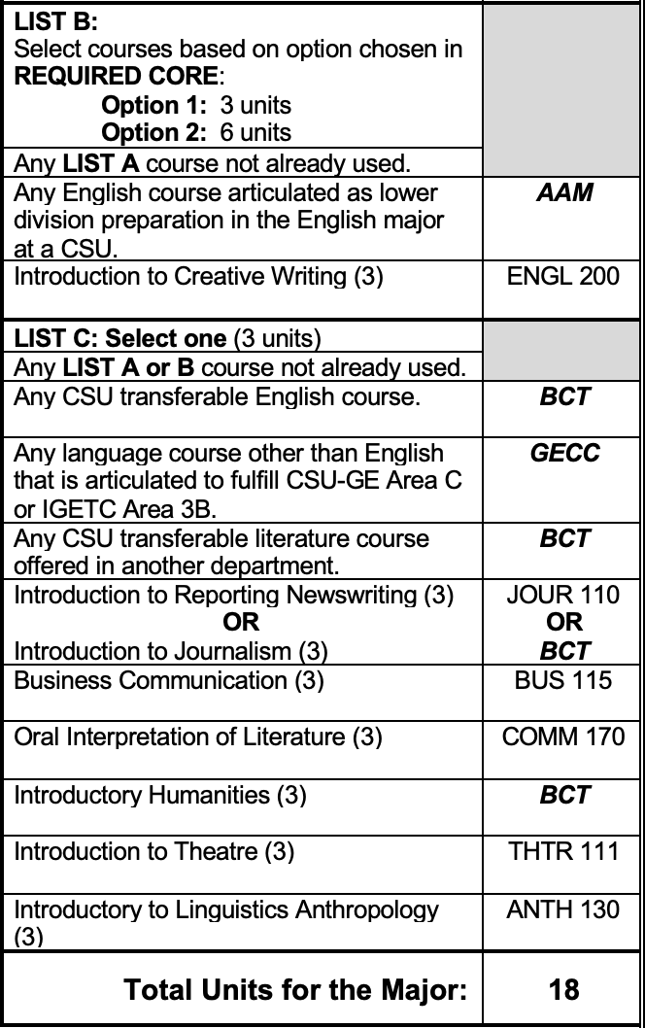
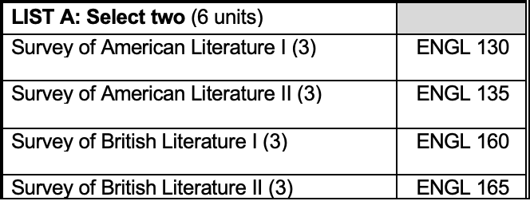
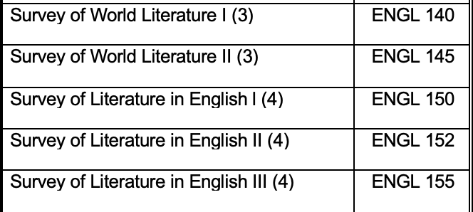

Slide 12
Resources
ICAS Memo: https://icas-ca.org/wp-content/uploads/2020/06/2019-UPDATE_ICAS_Memo_to_Articulation.pdf
CSU-GEB Guiding Notes: https://www2.calstate.edu/csu-system/administration/academic-and-student-affairs/academic-programs-innovations-and-faculty-development/geac/documents/GE-Reviewers-Guiding-Notes.pdf
IGETC Standards: https://icas-ca.org/wp-content/uploads/2020/06/IGETC-STANDARDS-FINAL-Approved-June-3-2020.pdf
C-ID Policies and Guidelines: https://c-id.net/page/1

