Slide 1
Building a Diverse Faculty Leadership: Intentionally Including, Growing, and Mentoring BIPOC Faculty for Academic Senate Leadership Roles

Slide 2
Breakout Presenters
Christopher Howerton – ASCCC North Representative
Robert L Stewart Jr. – ASCCC South Representative
Manuel Velez – ASCCC Area D Representative

Slide 3
Topics to Discuss
Why Have An Inclusive Workplace?
Effects of Colonization on Decision-Making
Traditional Domination of Meetings
Academic Senate Roles In College Decision-Making
College Committees
10 + 1: Academic and Professional Matters
Why is 10+1 important to this discussion?
Inclusion, Diversity, Equity, Anti-racism and Access in Faculty Leadership Empowerment

Slide 4
Why Have An Inclusive Workplace?
There have been many events through the years that have highlighted the need for creating a diverse and inclusive workplace. From a morale and business perspective, making sure that inclusion, diversity, equity, anti-racism and access are valued throughout the inner workings of the college is imperative. Why?
Increased innovation and creativity
Provides insight into the needs of diverse stakeholders
Improves decision-making
Insures that all employees are able to thrive
Makes sure that colleges and services are representative of the communities they serve

Slide 5
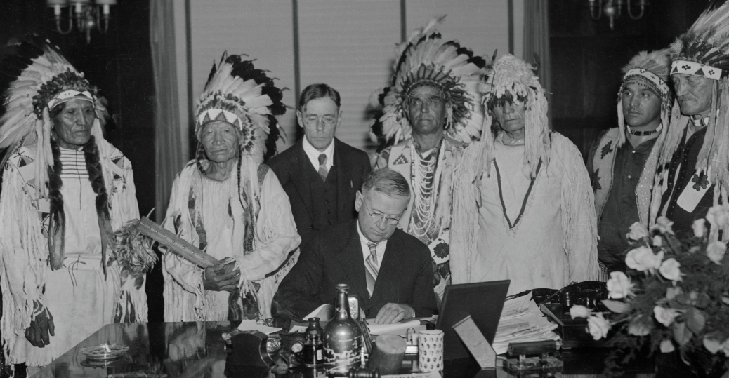
Effects of Colonization on Decision-Making
Traditionally, who sat at the decision-making table?
Once areas around the globe were colonized by Europeans, how did the decision-making model change? How did this inform how decision-making bodies are seen today?

Slide 6
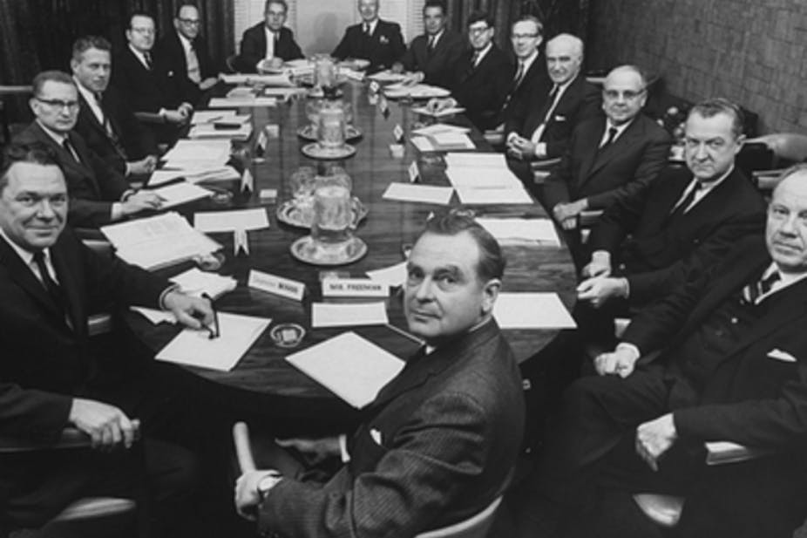
Domination of Meetings Post-Colonization
What happened?
What are some benefits of having a more diverse make-up of decision-makers at the table? Race considerations certainly affect diversity, but what are some other diversity issues recognized throughout the photo history in this presentation?

Slide 7
Academic Senate Roles In College Decision-Making
Academic senates serve a unique role on our California Community College campuses. Academic senates are the primary way by which the faculty engage in local, district and state participatory governance , and work closely with administrations on academic and professional matters.
Academic senates achieve this by offering the administration recommendations, guidance, perspective, and feedback as the college makes important decisions on how the college does its business.

Slide 8
College Committees
Decisions made at our colleges are driven through processes implemented via college decision-making committees. Some of the most common decisions a college makes are around areas such as: Curriculum, Degree and certificate requirements, Grading policies, Educational program development, Standards or policies regarding student preparation and success, District and college governance structures, Roles and involvement in accreditation processes, including self-study and annual reports, Policies for professional development activities, Processes for program review, Processes for institutional planning and budget development, among other academic and professional matters.
Sounds Familiar? If not, it certainly needs to sound familiar.

Slide 9
10 + 1: Academic and Professional Matters
The California Code of Regulations (Title 5) Section 53200 bestows the functional primacy of Academic Senates to make recommendations with respect to academic and professional matters. And in part (C) of Section 53200, it defines the areas in which the Academic Senate has this primacy.

Slide 10
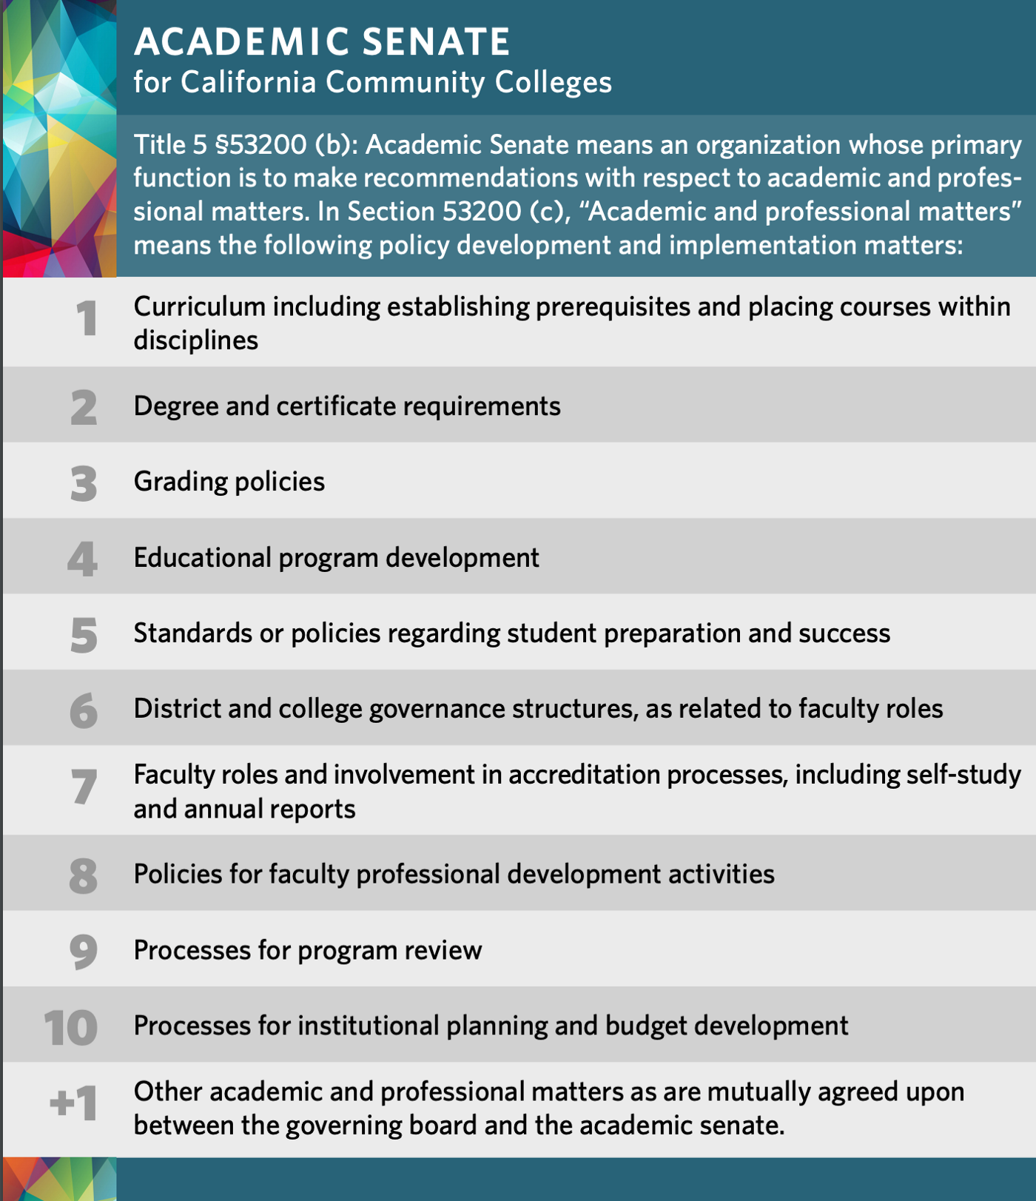
10 + 1: Academic and Professional Matters

Slide 11
Why Is This Important?
The types of decision-making committees that you typically find on college campuses align with the 10+1 topics of Academic Senate purview. Therefore:
Academic Senates get to play a significant role in the participation, faculty leadership, and faculty appointments of all college committees within the purview of the Academic Senate.

Slide 12
Why Is This Important?
It is well established in educational leadership research that decision-making is at its best when diverse voices are amplified and when alternative perspectives are considered.
Decisions are often influenced by who sits at the head of the table, and underrepresented groups are not being equitably elevated to positions of leadership in our academic senates and decision-making committees
This means that as it relates to Academic and Professional Matters at a college, the Academic Senate has the influence to make sure that Black, Indigenous and People of Color (BIPOC) voices are not only represented at the table, but also are able to realize positions of leadership at those decision-making tables.

Slide 13
Inclusion, Diversity, Equity, Anti-racism and Access in Faculty Leadership
Does it matter who runs the committee meeting?
Would who chairs a committee have an effect on the work and ideas that are considered by the committee?
Who typically holds the committee leadership on the college committees and academic senate committees at your college?
What does your Academic Senate President typically look like?

Slide 14
Academic Senate Leadership Power
As an Academic Senate leader, you may have been empowered by your local academic senate to make faculty appointments to committees, or your local academic senate may have a process in place to place faculty onto committees and into leadership roles on committees.
This means that if we are faculty leaders, with appointment powers to faculty leadership roles on campus, we must be in tune with our own level of comfort with inclusion and our own biases.

Slide 15
Why is it important to have diversity in these leadership roles?
Representation that differs in race, gender, language, abilities, religion and other identities at decision-making tables, and more importantly, diverse representation at the table as a committee “leader”, provides amplification of marginalized voices, and allows for various perspectives (even if they are not your own) to emerge that allows one to challenge the status quo, to question ideas that may not be IDEAA, to uplift novel ideas, and to advocate for all.
Ensuring inclusion, diversity, equity, anti-racism and access in academic senate leadership allows exploration of the huge range of ideas and issues present on campus and in the surrounding community.

Slide 16
Questions to Ask Yourself
Are you interested in changing the culture of exclusion at your college?
Are you confident in your understanding of specific behaviors that impact a person’s feeling of inclusion?
Are you aware of any implicit or explicit biases or racism that you may harbor in favor of others who are like you?
According to Zenger and Folkman, “Inclusivity is in the eye of the beholder. You might intend to be inclusive, and even think you are inclusive, but your impact on others might be very different."

Slide 17
Building Inclusive, Diverse, Equitable, Anti-racist Academic Senate Leadership Capacity
Wholistic & Targeted Professional Development to address any biases and racism among the faculty (and also the institution itself)
Intentional Leadership Mentorship opportunities that are inclusive of BIPOC faculty, in which sufficient engagement and dialogue occurs on the benefits, challenges, and responsibilities of specific faculty leadership roles
Empower BIPOC faculty to speak their truth to power in order to expose any implicit or explicit bias that may be holding them back from faculty leadership roles

Slide 18
Quotes To Marinate On
"First, people feel included when they are treated “equitably and with respect.” Participation without favoritism is the starting point for inclusion, and this requires attention to non-discrimination and basic courtesy

Slide 19
Quotes To Marinate On
“Inclusion is experienced when people believe that their unique and authentic self is valued by others, while at the same time have a sense of connectedness or belonging to a group”

Slide 20
Quotes To Marinate On
At its highest point, inclusion is expressed as "feeling safe to speak up" without fear of embarrassment or retaliation, and when people "feel empowered to grow"... Clearly, these elements are critical for diversity of thinking to emerge."

Slide 21
Quotes To Marinate On
Inclusion means... "A sense of belonging: feeling respected, valued, and seen for who we are as individuals; and a level of supportive energy and commitment from leaders, colleagues, and others so that we— individually and collectively—can do our best work."

Slide 22
Quotes To Marinate On
"Employees feel included when, simultaneously, they perceive they are both similar to and distinct from their coworkers. Perceiving similarities with coworkers engenders a feeling of belongingness while perceiving differences leads to feelings of uniqueness."

Slide 23
Resources
https://www.asccc.org/10_1
California Code of Regulations (Title 5) Section 53200
Miller, F. & Katz, J (2002) Inclusion Breakthrough: Unleashing the Real Power of Diversity
Bourke, J. & B. Dillon, (2018), The diversity and inclusion revolution: Eight powerful truths, Deloitte Review, Issue 12.
Catalyst (2014)
Ferdman, Prime & Riggio, (2021) Inclusive Leadership - Transforming Diverse Lives, Workplaces, and Societies
Navigating Inclusion As a Leader - Intoducing the Inclusive Leadership Compass (2021)
https://rossier.usc.edu/magazine/fall-winter-2021/having-a-place-at-the-table-is-not-enough/

Slide 24
What about Leadership Resources?
Bookmark ASCCC.org
Local Senates Handbook (2020) - Local Senates Handbook contains important resources all Local Academic Senate leaders should become familiar with.
https://www.asccc.org/communities/local-senates/leadership-resources
Please consider signing up for service on a statewide committee, ASCCC is looking to amplify diverse voices and ideas.
Notes:
Communities under the RESOURCES tab
Handbook under the COMMUNITIES tab
Technical Visits under SERVICES tab
Listservs under RESOURCES

