Slide 1


ASCCC
Part-Time Faculty Institute
Finding Your “WHY”
Jessica Cristo
Rebecca Moon-Stone
Crystal Kiekel
Vanson Nguyen
Presented by
Notes:
Joanna – point out other coordinators
10 mins 9:10-9:22 for first five slides (through norms)

Slide 2
Mission
Develop leaders in California community colleges who have the capacity to facilitate networks of faculty, staff, and students for curricular and institutional redesigns in support of increased student access, success, equity, and completion.

Slide 3

Theory of Change
If we provide training on networking and we use action research methodologies, community college professionals will transform their environments and identities to create communities of practice that will produce powerful learning and working across campuses. This will lead to greater student success

Slide 4


Moving the Needle by Moving Towards Greater Coherence: Vision 2022
Increase completion by 20% annually
Increase transfer to UC/CSU by 35% annually
Decrease average # of units earned for AA from 87 to 79
Increase # of exiting CTE students employed in their field from 60% to 69%
Fully close all equity/achievement gaps within 10 years

Slide 5
Building Networks Around Inquiry
What do we know about how learning works, and how can we redesign our institutions to best support learning?
How can all stakeholders, especially students, better understand how our systems work and participate equitably in our transformation work?
As we transform, how do we design for inclusive collaboration?

Slide 6
Norms
Raise hand
Be open to new ideas
Be present
Assume good intentions
Respect

Slide 7
Finding Your Why: Artifact Analysis
Take out and/or find an artifact on your person (a picture, an item in your bag, etc.) that represents you as an educator.
Share your artifact with your partner (each person gets 2 minutes)
    Why you chose it, what it represents, how is it connected to your educational journey?
Notes:
Crystal
2 minutes to think
6 minutes to share

Slide 8
Finding Your Why: Artifact Analysis
After you both have shared, please have a brief discussion as a table – what were some windows and mirrors?
Whole group share out
    What commonalities surfaced?
    What resonated?
Notes:
Crystal
2 minutes to think
6 minutes to share

Slide 9
Take a moment to think about who you are as an educator
In three minutes or less, write a 6 word introduction for yourself.
EXAMPLE:
Shared learning and collaboration creates transformation.
Why are you passionate about this work?
Notes:
Crystal - 3 minuts

Slide 10
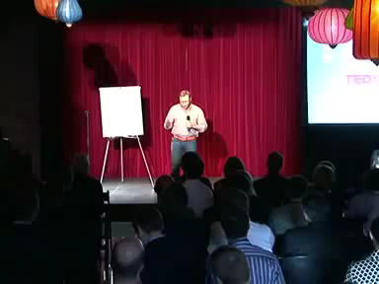
Golden Circle by Simon Sinek
Notes:
Crystal – 10 minutes to read
8 minutes to share

Slide 11
Revise your 6 words
Think about your practice and identity as an educator
How to you communicate your why to others?
  Syllabus, Job Interview
What do you want students to know about your why?
Notes:
Rebecca – think to yourself to 5 minutes to revise and think about communicating the why

Slide 12
Final Thoughts
Write down one thing that you want to learn before you leave
Look into the program and pick sessions that will speak to your why
If willing, write down your 6 word why on an index card for us to collect – no need to put name
Notes:
Rebecca

Slide 13
Thank you for learning with us today!
Notes:
Rebecca – mention visit

