Slide 1
Bringing It To Resolution Writing: A Fun Follow-up and Practice for Mock Plenary Friday, June 17 at 10:30 a.m. - 11:45 a.m. Juan Arzola, At-large Representative Michelle Velasquez Bean, Treasurer

Slide 2
Session Description
Whereas, At local and statewide levels, academic senates rely on clear, actionable resolutions to set their direction and take positions; and Whereas, The ASCCC resolutions process allows for all California community college faculty to participate in making policy recommendations that guide and impact our system. Resolved, That attendees come to this session to learn how to develop statewide resolutions that are more likely to be approved; and Resolved, The presenters will delve deeper into the details of the Resolutions Handbook and help participants fine-tune resolutions for the Mock Plenary session on Saturday.

Slide 3
Today, we will . . .
Consider and discuss
Consider and discuss how local resolutions processes vary
Brainstorm
Brainstorm ways to foster greater faculty engagement in resolutions processes
Use
Use Resolutions page on ASCCC Website to check already adopted resolutions
Review
Review specific passages of Resolutions Handbook
Develop and fine-tune
Develop and fine-tune resolutions and amendments for Saturday’s Mock Plenary

Slide 4
Introductions
In Pathable chat or in-person
Your name
Your college
Your resolution topic idea or what you would like to learn today

Slide 5
By 1:00 p.m. TODAY
Submit
Submit your mock resolutions and mock amendments to https://tinyurl.com/ASCCCResolutions
Secure
Secure the email addresses of four institute attendees as seconders on the resolution online form
Ready
Be ready to debate your mock resolution at Saturday’s Mock Plenary

Slide 6
The ASCCC Local Senates Handbook Recommends
“The Academic Senate for California Community Colleges conducts its business using the resolutions process (see the ASCCC Resolutions Handbook) and recommends that local senates do likewise; many senates, however, reserve resolutions only for the most urgent of their statements and recommendations.” (ASCCC Local Senates Handbook)
How are the processes different?

Slide 7
How have you engaged your senators?
Writing statewide resolutions
Share promising practices
Writing local senate resolutions
Share promising practices
Connecting the two processes
Share promising practices

Slide 8
Writing Resolutions: Help and Resources

Slide 9
From ASCCC Resolutions Handbook
“Homework: The Academic Senate has hundreds of resolutions, and they are accessible for review on its website, asccc.org. It is possible that a resolution already exists for the position you wish to take. Please review the existing resolutions first so that duplication can be avoided.”
“It is strongly advised not to introduce resolutions to reaffirm existing positions because of the confusion that may ensure if such resolutions fail.”

Slide 10
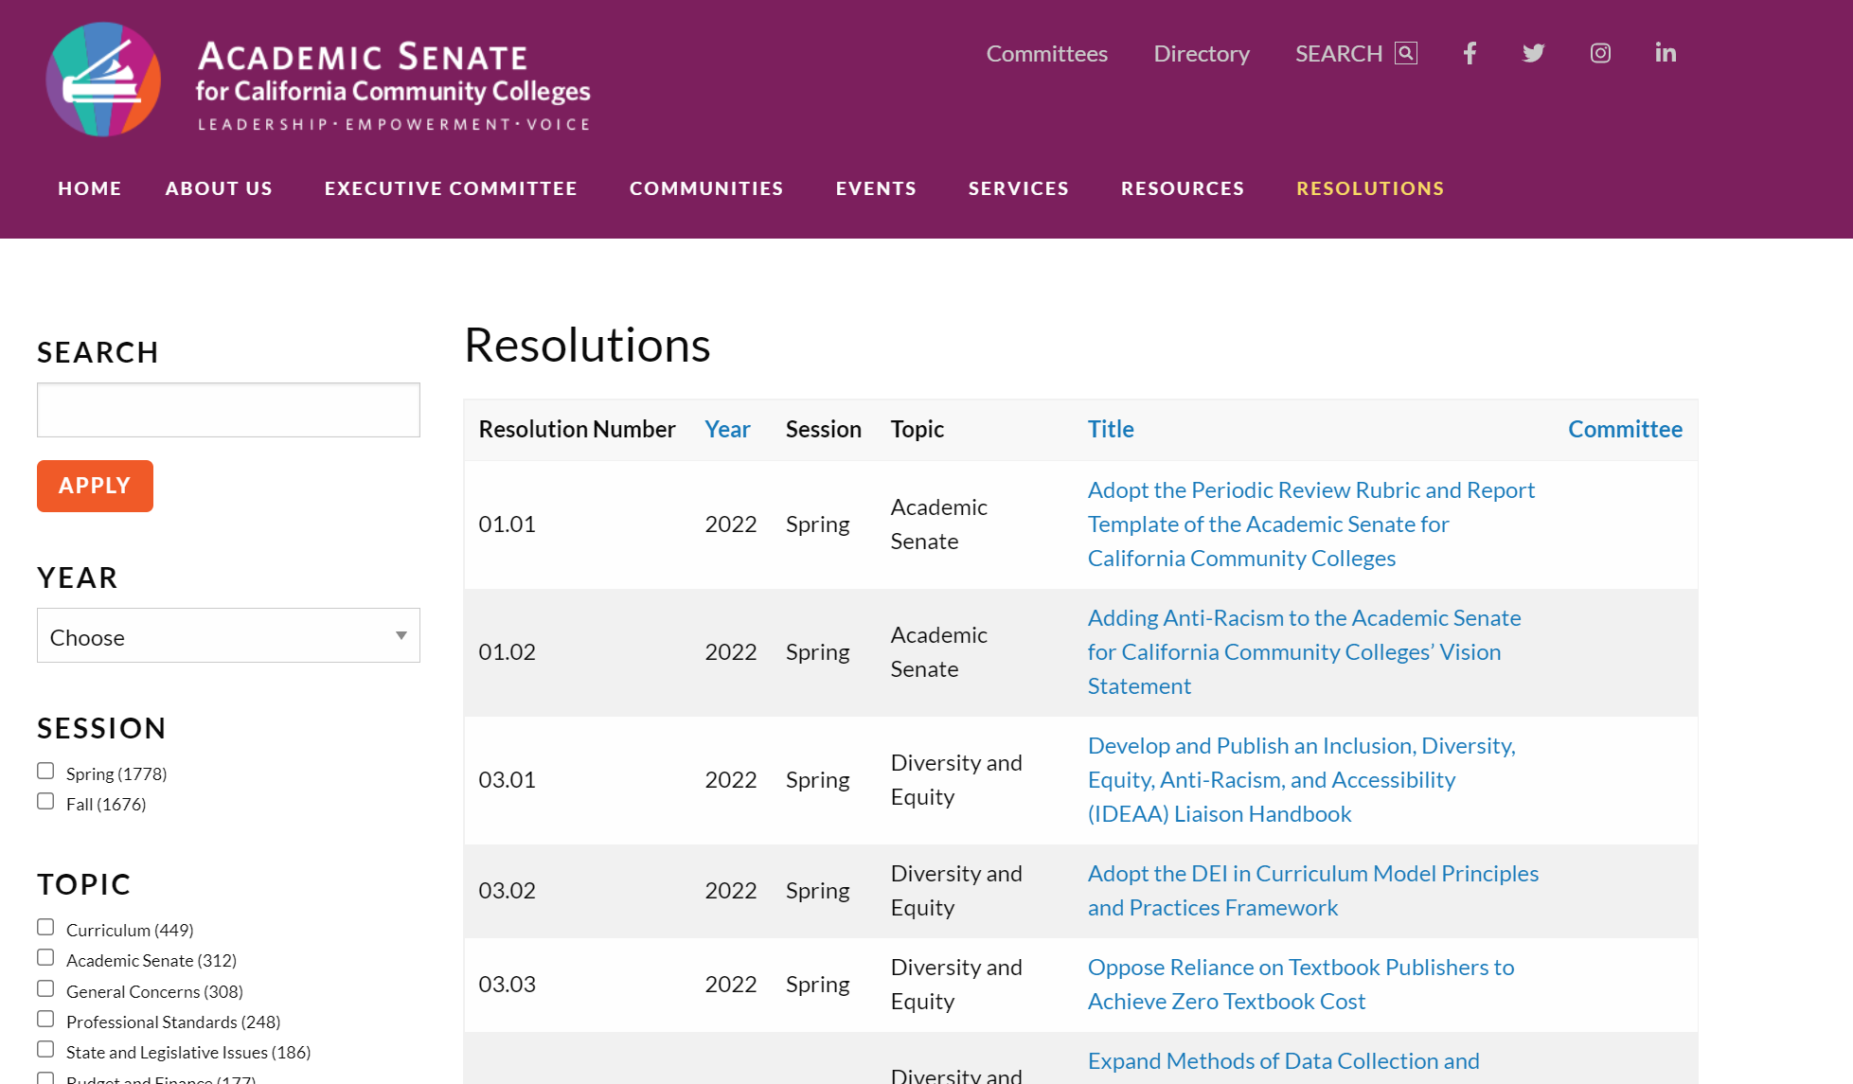

Slide 11
ASCCC Resolutions Should Not . . .
Reaffirm existing positions (because of the conflict that can ensue if they fail)
Recommend action outside the 10 + 1
Deal with strictly local concerns
Contain more than four Whereas or Resolved statements
Use inflammatory tone or contain personal insults or language that may be perceived as such

Slide 12
ASCCC Resolutions Should . . .
Be direct and clear
Contain factual Whereas statements
Include references
Include a clear and relevant title
Write out full names of groups/organizations in first use
Avoid lumping ideas (one reason per Whereas)
Only direct the academic senate to act (we cannot demand other entities or organizations to act)
instead say “work with [other body] to ensure” vs. “ensure,” “oppose,” “prevent”

Slide 13
First Whereas
“Consider using the first ‘whereas’ as an introduction, outlining the situation in general or providing background and indicating the people or groups involved before justifying your resolutions in the other ‘whereas’ statements.”

Slide 14
Citing Legislation
Cite the last name of author and year passed or date of most recent proposed legislation or regulations included in legislation.
For example, AB 1725 (Vasconcellos, 1988), AB 705 (Irwin, 2017), AB 130 (Low, as of June 3, 2019)
Include hyperlink in footnote¹
¹https://www.asccc.org/papers/resolution-handbook

Slide 15
Full Names of Organizations and Acronyms
Write out the names of groups or organizations in your first reference to the within your resolution.
The name may be followed by a parenthetical abbreviation, which may then be used for future references.
It is unnecessary to note an acronym if the group or organization is not referenced again in the resolution.
Ex: California Community Colleges Chancellor’s Office (instead of “Chancellor’s Office”)

Slide 16
Actionable Language
Urge
Research
Develop (a position, materials, a paper, etc.)
Distribute
Oppose
Publish
Survey
Encourage
Conclude
Adopt
Request
Express
Form
Collect
Communicate
Recognize

Slide 17
Advice on Wording to Consider
Recommend
Directed to a body with specific authority over issue in question? Within ASCCC purview to recommend?
Ensure
Does ASCCC have power to fulfill this goal? If not, consider “work with.”
Work with
Often followed by another direction to accomplish something.
Assert or Affirm
Has the ASCCC already researched and developed position on issue?
No? Consider using “explore” so the field can discuss and build a foundation for the issue at hand.

Slide 18
The Resolved Statements
Must begin with “Resolved, That the Academic Senate for California Community Colleges . . .”
Each must be able to stand alone
Must be actionable
Must be supported by the Whereas statements

Slide 19
Mock Resolution Pre-packet
Let’s check it against some of the guidelines in the Resolutions Handbook!

Slide 20
Contact and Seconders
If you submit a resolution or amendment
List your full name, your college, and email address
Pre-session resolutions from committees are identified as such
Four seconders are required
Must be voting delegates
Need full name and college
Include email addresses

Slide 21
How do I submit a resolution?

Slide 22
Online Resolution and Signature Page
https://tinyurl.com/ASCCCResolutions

Slide 23
What about amendments?
Write amendments to help clarify intent and/or expand the scope of a resolution
Use MS Word file or other document as an attachment to the online submission form at tinyurl.com/ascccresolutions
Submit amendments using typographical features such as underlining and strikethroughs—not track changes
Review the title after adding an amendment—amend the title if necessary
Make sure amendments don’t result in inconsistencies within a resolution or reverse the intent of the resolution (better to vote the resolution down)
Include four email addresses for seconders for each amendment

Slide 24
Breakout Activity
Small breakout groups work on short resolution for the Mock Plenary
4 people
15 minutes
Select a CONTACT to submit resolution or amendment

Slide 25
Group Share

Slide 26
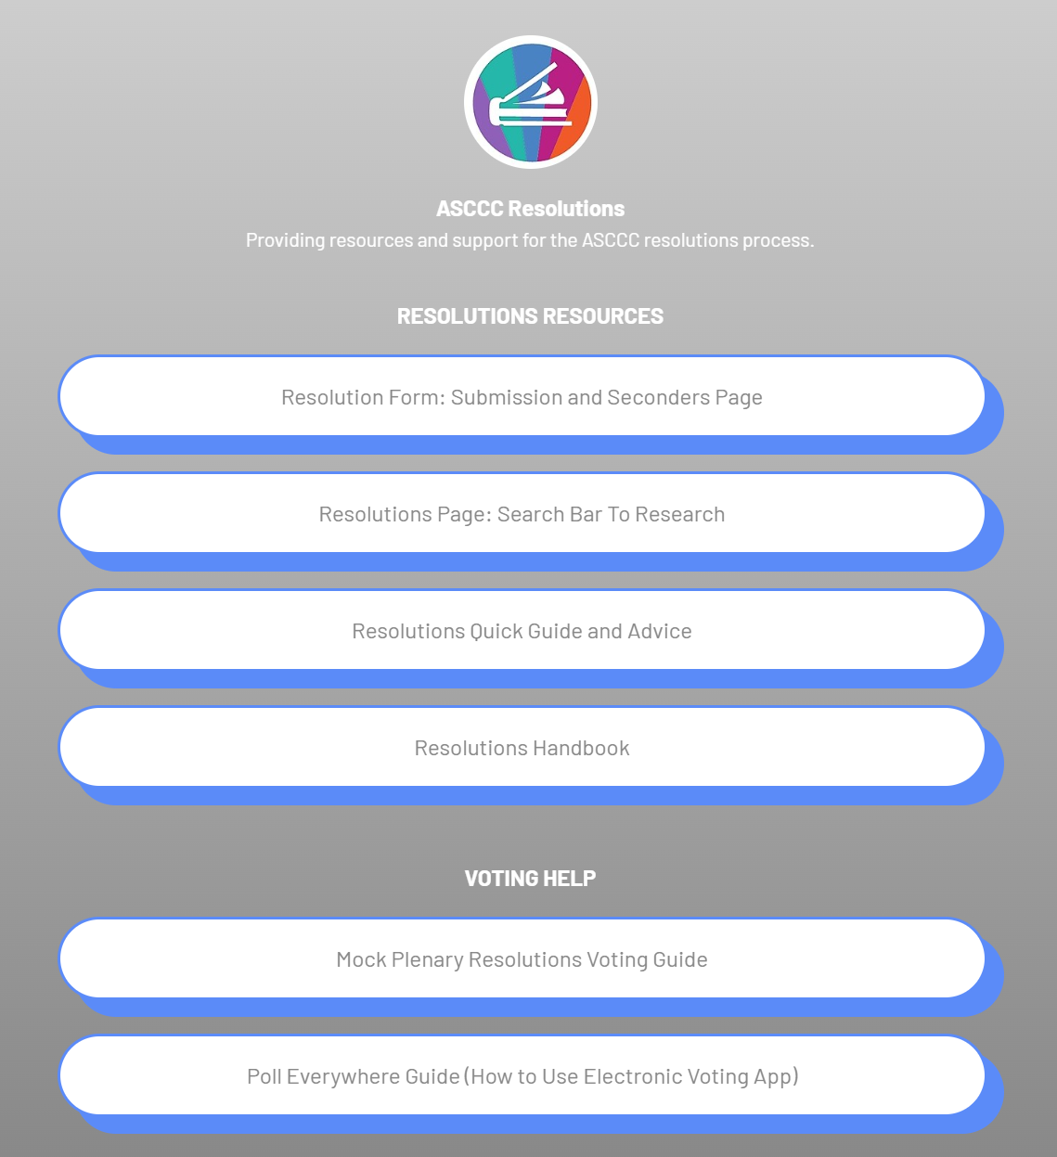
LinkTree with Helpful Resolutions Pages
Resolutions Seconders Page online form
Link to ASCCC Resolutions page
Resolutions Quick Guide
Resolutions Handbook
Mock Plenary Voting Guide
https://linktr.ee/ascccresolutions

Slide 27
Use the Mock Plenary Voting Guide

Slide 28
How Can We Help?
Thank you!
See you at our Mock Plenary Session on Saturday morning!
Email resolutions@asccc.org
davisondolores@foothill.edu Donahue_Nathaniel@smc.edu
gdyer@taftcollege.edu
sfoster@fullcoll.edu

