Slide 1
Got a faculty hiring criteria?
Michelle Bean, At-Large Presentative ASCCC
Mayra Cruz, Area B Representative ASCCC
Fermin Villegas, Deputy Counsel Office of the
General Counsel CCCCO
Notes:
The Academic Senate for California Community Colleges, Faculty Development Committee, recently conducted a survey on local colleges criteria for setting hiring priorities. Join us to discuss the survey results and compliance under the Education Code. Participants will be engaged in a conversation on how to improve processes for establishing hiring priorities.
Opening & closing (5 min)
Data review (5min)
Legal (20 min)
Survey results (25min)
Activity (10min)
Takeaways (10min)

Slide 2
Session Outcomes
Participants will…
Gain an understanding of criteria for establishing hiring priorities used statewide.
Describe compliance issues associated with establishing hiring priorities under the Education Code.
Take back to your campus processes to improve the establishment of hiring priorities.

Slide 3
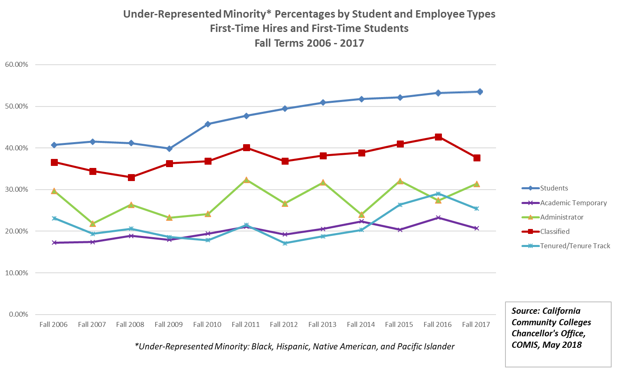
Faculty Hiring for Diversity and Excellence

Slide 4
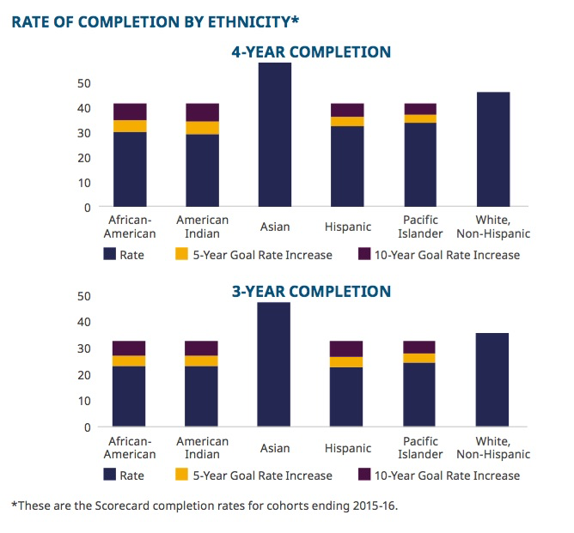
Student Equity Gaps

Slide 5
Education Code and Our Role
Assignment of authority to faculty in the realm of hiring
“Section 87360 (b) “hiring criteria, policies, and procedures for new faculty members shall be developed and agreed upon jointly by representatives of the governing board, and the academic senate, and approved by the governing board.”
Education code §87360(a) “districts are required to develop hiring criteria that include “a sensitivity to and understanding of the diverse academic, socioeconomic, cultural, disability, and ethnic backgrounds of community college students.”

Slide 6
Hiring Processes and Prioritization
“The decision to hire faculty for contract positions, including tenure-track, should be determined cooperatively through a well-defined process that involves college administration including human resources, the local academic senate, and subject-area faculty. “
“This process should include a thoughtful review of the capacity and needs of the college or district and an assessment of subject area strengths and weaknesses, as well as any need for special skills or foci within a discipline.
Notes:
Resource: A Re-Examination of Hiring Policies and Procedures. Spring 2018: ASCCC
Quantitative factors to consider may include the following:
current full-time equivalent faculty (FTEF) within the discipline.
The percentage of FTEF who are full-time faculty.
The percentage of FTEF who are part-time faculty or full-time faculty teaching overload sections.
The total number of sections offered in each discipline.
The total number of full-time equivalent students.
The percentage of instructional hours delivered by full-time faculty versus part-time faculty.
The average percentage fill rate of course sections.
Total weekly student contact hours.
Education Code §87482.6 specifies a legislative goal of 75% of instructional hours to be taught by full- time faculty .
Consider their district-wide faculty obligation number, or FON
Qualitative factors to consider:
The proposed job description
How the position would serve the needs of the discipline for which it is requested
Potential teaching load
The availability of qualified part-time faculty in the discipline
Representation of the staff with regard to gender, underrepresented group status, and other diversity metrics
Subjects and areas of the greatest strengths of the current staff and areas where additional expertise is required
Specific needs related to departments staffed by a single full-time faculty member or only part-time faculty members
Any legal mandates for a program, including state or federal mandates or requirements by external accreditation bodies (e.g. allied health programs).
new programs that may require discipline faculty expertise.

Slide 7
The Hiring Process
Determining hiring needs
Criteria for hiring faculty
Recruitment
Selection Committee
EO training /Implicit Bias training
Min Quals/Preferred Quals & Equivalency
Application review
The Job announcement
Screening candidates
Interview - questions
Recommendations/s to President
Final interview with President
Selection
Onboarding of new faculty
Supporting new faculty
Notes:
Pre-hiring: The college district must demonstrate that it has adopted board policies and resolutions that evidence a commitment to diversifying hiring processes and procedures.
In hiring: The district has established processes and procedures for addressing diversity throughout all steps and levels of the hiring processes. This measure includes such matters as the creation of the screening committee, the steps for job announcements, and interview processes, among others.
Post hiring: The college district provides professional development focused on diversity.
The college district ensures that diversity is incorporated into the employee evaluation and tenure processes.
The college district actively pursues the creation of “grow your own” programs seeking to hire students who attended California community colleges.
Resource: A Re-Examination of Hiring Policies and Procedures. Spring 2018: ASCCC

Slide 8
Legal Compliance
Sensitivity to and Understanding of Diversity is the “Prime Directive”
While Education Code section 87360, leaves faculty hiring criteria, policies, and procedures to be developed jointly by the governing board and the academic senate, it does mandate one criterion that is non-negotiable:
Education Code section 87360(a) provides:
“In establishing hiring criteria for faculty and administrators, district governing boards shall … develop criteria that include a sensitivity to and understanding of diverse academic, socioeconomic, cultural, disability, and ethnic backgrounds of community college students.”
In effect, Section 87360 requires that sensitivity to and understanding of diversity be included in the district’s final hiring criteria.
Notes:
Fermin

Slide 9
Legal Compliance
The Legislature believes the above can be achieved by hiring a work force that is itself diverse:
Education Code section 87100(a)(3) provides:
“a work force that is continually responsive to the needs of a diverse student population may be achieved by ensuring that all persons receive an equal opportunity to compete for employment and promotion within the community college districts and by eliminating barriers to equal employment opportunity.”

Slide 10
Legal Compliance
Why? Well, because…
“Academic excellence can best be sustained in a climate of acceptance and with the inclusion of persons from a wide variety of backgrounds and preparations to provide service to an increasingly diverse student population.” –Education Code section 87100(a)(2)
This is borne out in studies that prove the educational benefits of a diverse faculty, which can close achievement gaps by 20-50%!
Fairlie, R. W., Hoffman, F., Oreopoulos, P. (2014). A Community College Instructor Like Me: Race and Ethnicity Interactions in the Classroom. American Economic Review, 104(8): 2567-2591.

Slide 11
Legal Compliance
Equal Employment Opportunity
Defined in Title 5, California Code of Regulations ( 5 C.C.R.) § 53001(c):
“Equal employment opportunity” means that all qualified individuals have a full and fair opportunity to compete for hiring and promotion and to enjoy the benefits of employment with the district. Equal employment opportunity should exist at all levels in the seven job categories…. Equal employment opportunity also involves:
(1) identifying and eliminating barriers to employment that are not job related; and
(2) creating an environment which fosters cooperation, acceptance, democracy, and free expression of ideas and is welcoming to men and women, persons with disabilities, and individuals from all ethnic and other groups protected from discrimination pursuant to Government Code section 12940.

Slide 12
Legal Compliance
Permissible Hiring Criteria:
5 C.C.R. § 53006 requires districts to review information gathered to determine if significant underrepresentation of monitored groups may be the result of non-job-related factors in the employment process.
Review each locally established, “required,” “desired,” or “preferred” qualification being used to screen applicants for positions in the job category to determine if it is job-related and consistent with requirements of federal law and qualifications which the Board of Governors has found to be job-related throughout the community college system (5 C.C.R. § 53006(b)(4))
Discontinue use of any locally established qualification that has not been found to satisfy the above requirements (5 C.C.R. § 53006(b)(5))
Continue using such qualification standards only if no reasonable alternative exists (5 C.C.R. § 53006(b)(6))
Implement additional measures designed to promote diversity that are reasonably calculated to address area of need (5 C.C.R. § 53006(b)(7))

Slide 13
Legal Compliance
Permissible Hiring Criteria:
5 C.C.R. § 53024 – Selection and Screening Procedures
(a) All screening and selection techniques, including the procedure for developing interview questions, and the selection process as a whole, shall be:
(1) provided to the Chancellor upon request;
(2) designed to ensure that for faculty and administrative positions, meaningful consideration is given to the extent to which applicants demonstrate a sensitivity to and understanding of the diverse academic, socioeconomic, cultural, disability, gender identity, sexual orientation, and ethnic backgrounds of community college students. “Meaningful consideration” means that candidates shall be required to demonstrate sensitivity to diversity in ways relevant to the specific position;
(3) based solely on job-related criteria; and
(4) designed to avoid an adverse impact, as defined in section 53001(a), and monitored by means consistent with this section to detect and address any adverse impact which does occur for any monitored group.

Slide 14
Legal Compliance
Permissible Hiring Criteria:
5 C.C.R. § 53024 – Selection and Screening Procedures
(b) A district may not designate or set aside particular positions to be filled by members of any group … or engage in any other practice which would result in discriminatory or preferential treatment prohibited by state or federal law….
(c) Seniority or length of service may be taken into consideration only to the extent it is job related, is not the sole criterion, and is included in the job announcement consistent with the requirements of section 53022.
(d) Selection testing for employees shall follow procedures as outlined in the Equal Employment Opportunity Commission's “Uniform Guidelines on Employee Selection Procedures.”
(e) Whenever possible, screening committees shall include a diverse membership which will bring a variety of perspectives to the assessment of applicant qualifications.

Slide 15
Legal Compliance
Permissible Hiring Criteria:
5 C.C.R. § 53024 – Selection and Screening Procedures
(f) Notwithstanding any other provision of this division, the governing board or its designee shall have the authority to make all final hiring decisions based upon careful review of the candidate or candidates recommended by a screening committee. This includes the right to reject all candidates and to order further review by the screening committee or to reopen the position where necessary to further achievement of the objectives of the equal employment opportunity plan or to ensure equal employment opportunity. However, a consistent pattern of not hiring qualified candidates from a monitored group who are recommended by screening committees may give rise to an inference that the selections are not consistent with the objectives of equal employment opportunity that are required by this subchapter.

Slide 16
Survey Results
https://www.surveymonkey.com/results/SM-ZY2KQ89WV/

Slide 17
Survey Results
130 responses; 129 colleges participated
63.38% of responses from multi-college district
76.76% written procedures exist; 20% don’t know
61.60% have a set criteria (highlighting the Program Review and the Continuous Quality Improvement process); don’t know approx. 25% do not know

Slide 18
Top 5 criteria for establishing hiring priorities
Enrollment trends
FT/PT
Program Review
CTE employment trends
Projected growth in transfer level courses
Lowest scored:
Student achievement disparity;
student success rate/transfer rate
69.39% no measure of relationship between hiring and student success & equity
Technology needs
Other interesting results:
Criteria updated and align to program review
15.69% Administrators are responsible for updating

Slide 19
Making meaning: Taking action
How do we improve these criteria for setting hiring priorities locally?
the faculty role in updating criteria
student achievement disparity
relationship between hiring and student success & equity

Slide 20
Takeaways Questions

Slide 21
For more information contact:
Michelle Bean, At-Large Presentative ASCCC
MBean@riohondo.edu
Mayra Cruz, Area B Representative ASCCC
cruzmayra@deanza.edu
Fermin Villegas, Deputy Counsel, Office of the
General Counsel CCCCO fvillegas@cccco.edu

Slide 22
Resources
A Re-Examination of Hiring Policies and Procedures. Spring 2018: ASCCC. Retrieved from https://www.asccc.org/sites/default/files/Hiring%20Paper%20Final%203.12.18.pdf
Stewart, Abigail & Valian Virginia. Recruit Diverse and Excellent New Faculty. Inside Higher Ed.: July 2018.
https://www.insidehighered.com/advice/2018/07/19/advice-deans-department-heads-and-search-committees-recruiting-diverse-faculty
Center for Urban Education. (2017) Institute on Equity in Faculty Hiring at Community Colleges Toolkit. Los Angeles, CA: Rossier School of Education, University of Southern California.

Slide 23
Resources
Looking at Equivalency Differently: Rethinking Equivalency to General Education. Retrieved from https://asccc.org/content/looking-equivalency-differently-rethinking-equivalency-general-education
ACCJC Accreditation Standards III.A.1 and III.A.2 for hiring qualified faculty. Retrieved from https://accjc.org/wp-content/uploads/Accreditation-Standards_-Adopted-June-2014.pdf
EEO sections of the Title 5 regulations. Retrieved from https://govt.westlaw.com/calregs/Browse/Home/California/CaliforniaCodeofRegulations?guid=I54116010D48411DEBC02831C6D6C108E&originationContext=documenttoc&transitionType=Default&contextData=(sc.Default)

Slide 24
Thank You!

