Slide 1
How do we measure diversity to better represent actual faculty diversification?
ASCCC Part-Time Faculty Institute
“Affirming Our Voice”
January 23rd-25th
Presenters:
Jay Parnell, ASCCC Part Time Committee, San Bernardino College (Lead)
LaTonya Parker, ASCCC Area D Representative, Moreno Valley College (Co-Lead)
Jennifer Taylor – Mendoza, Vice President of Instruction, Skyline College

Slide 2
WHY Does Diversification matter?
Why faculty diversification measures matter? The diversification of California community colleges faculty has been a long-standing subject of priority and debate. Despite diversity being on the equity agenda in higher education for numerous years the needle for advancing faculty diversification has not moved much. This session will introduce new ways to measure faculty diversification. Discussion will include determining if diversification is an effective practice to bring about effective programs and services.

Slide 3
TODAY’S AGENDA: *Welcome and Introductions *Workforce Diversity Defined *Define Diversity *Faculty Diversity (FD) Discussion *FD Moving From an Organization Value to Practice Through Institutional Strategies *Group activity
Equitable (Ethnic and Racial Diversity) Approaches to Increase Student Success!!!

Slide 4
What is Workforce Diversity ?
“Workforce diversity means a workforce made up of people with different human qualities or who belong.”
Golembiewski, R. T. (1995). Managing diversity in organizations. Tuscaloosa, Ala: University of Alabama Press.
http://www.worldcat.org/oclc/44956061

Slide 5
DEFINE DIVERSITY?
WHAT DOES DIVERSITY MEAN TO YOU?
The concept of diversity encompasses acceptance and respect. It means understanding that each individual is unique, and recognizing our individual differences. These can be along the dimensions of race, ethnicity, gender, sexual orientation, socio-economic status, age, physical abilities, religious beliefs, political beliefs, or other ideologies. It is the exploration of these differences in a safe, positive, and nurturing environment. It is about understanding each other and moving beyond simple tolerance to embracing and celebrating the rich dimensions of diversity contained within each individual.
https://gladstone.uoregon.edu/~asuomca/diversityinit/definition.html

Slide 6
Why is it Important for Faculty and Administrators to Dialogue and Align Goals to Hire for Diversity?
Pair & Share Activity

Slide 7
Educational Benefits of Faculty Diversity
According to the California Community Colleges Chancellor’s Office 2016 Equal Opportunity Employment & Diversity Best Practices Handbook there has been an increase in underrepresented students in California community colleges in recent years.
Data shows that the student population in the community colleges has become increasingly more diverse, whereas all ranks of the workforce have not reflected this increase in diversity. According to data submitted by the districts, for the past 10 years, approximately 20 percent of full-time faculty members are from underrepresented communities.
See chart in next slide:

Slide 8
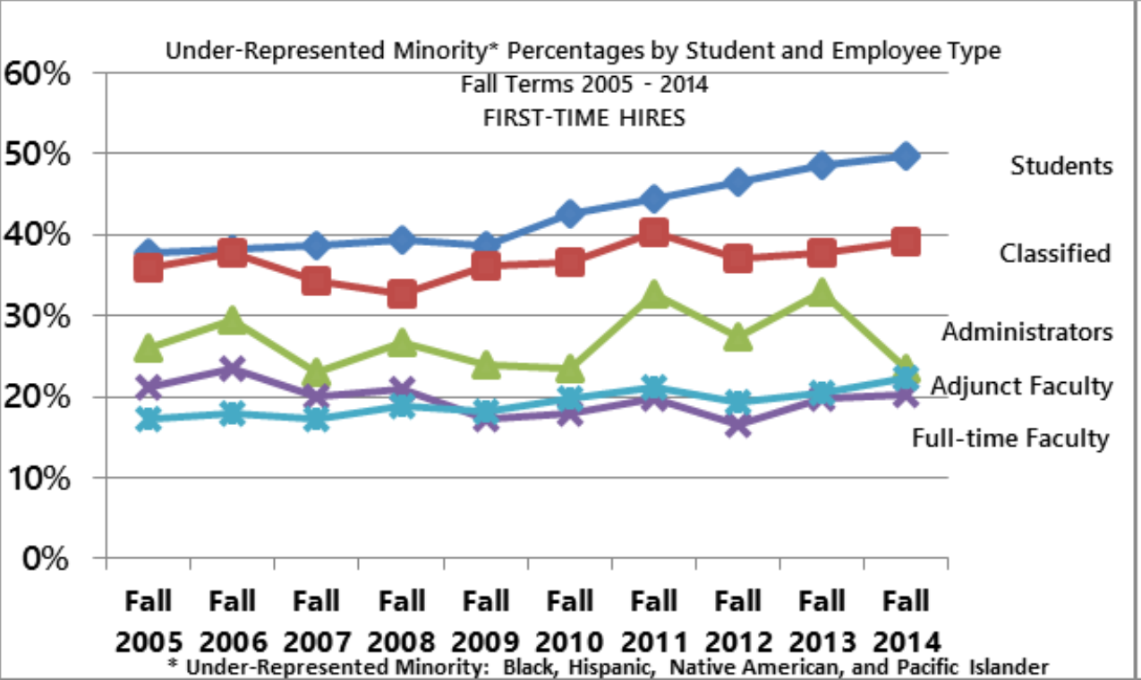
Under-Represented Minority Percentages by Student and Employee Type

Slide 9
Racial diversity among students at California’s public colleges 2016-17 https://edsource.org/2018/whites-dominate-california-college-faculties-while-students-are-more-diverse-study-shows/594268

Slide 10
Vision for Success Diversity Taskforce
In November 2018, the Board of Governors (Board) requested that the Chancellor’s Office establish a Faculty Diversity Taskforce (renamed the Vision for Success Diversity, Equity and Inclusion Taskforce
Faculty and Senior Leadership is not representative of the racial and ethnic diversity of the students they serve.
Specifically, in 2016-17, while 73 percent of students were non-white students
72 percent of Academic Senate’s Leaders were White
61 percent of tenured faculty were White
60 percent of non-tenured faculty were White
59 percent of College Senior Leadership were White
https://www.cccco.edu/-/media/CCCCO-Website/Files/Consultation-Council/consultation-council-agenda-20190815-ada.ashx?la=en&hash=663B23A8EE19BA67ED992D38814468B3F04C6550 California Community College Consultation Council Digest item #4

Slide 11
Resolution to solve systemic practices
Recognizing that California Community College districts have made significant improvements to implement and submit equal employment opportunity (EEO) reports, the Board requested that the Chancellor’s Office create a taskforce (separate from the Statewide EEO and Diversity Advisory), focused on addressing faculty diversity and present a set of recommendations on:
The utility of adding an additional statewide goal related to faculty, staff, administrator diversity; and
A set of statewide structural changes, including policies, practices, and tools that the system will need to improve EEO implementation and the recruitment, retention, support of faculty, staff, and student diversity

Slide 12
Additional Benefits of Faculty Diversity
Improving Faculty Diversity will Protect Districts Against Liability
Both the Civil Rights Act of 1964 and the California Fair Employment and Housing Act prohibit employers from discriminating against employees based on a number of protected characteristics, including race, gender, religion, sexual orientation and national origin.
Improving Faculty Diversity Improves the Quality of Instruction
Diversity in the workplace adds to the diversity of ideas and attitudes within an organization.
“what is possible when educators and administrators take seriously the responsibility of engaging diverse student populations in educationally purposeful ways.” ~Dr. Shaun Harper
consider this notion of “race-consciousness,” rather than “colorblindness,” which is “an overused and offensive way of denying the unique experiential realities of racial minority students in predominantly white situations.” ~Dr. Shaun Harper

Slide 13
What are Best Collaborative Practices for Faculty and Administrators to Hire for Diversity?

Slide 14
Achieving Common Ground Through Developing and Maintaining Institutional Commitment to Faculty Diversity
Data Informed Decisions
Has your organization reviewed the current hiring processes?
Does your organization make available under-represented students and employees data?
(ADD A QUOTE FROM DR. Shawn Harper? )
Bring Awareness
Identify Potential Barriers
Communicate Challenges
Data Driven Decisions
Create an Achieving Common Ground Plan
Develop a Metric
Include the Faculty, Staff and Administrators in the Communication Plan
Sustain Momentum

Slide 15
THANK FOR YOUR TIME!
ASCCC Part-Time Faculty Institute
“Affirming Our Voice”
January 23rd-25th
Presenters:
Jay Parnell, ASCCC Part Time Committee, San Bernardino College (Lead)
LaTonya Parker, ASCCC Area D Representative, Moreno Valley College (Co-Lead)
Jennifer Taylor – Mendoza, Vice President of Instruction, Skyline College

Slide 16
Resources:
https://asccc.org/sites/default/files/publications/FacultyHiring_0.pdf
https://californiacommunitycolleges.cccco.edu/Portals/0/Reports/2016-EEO-and-Diversity-Handbook-ADA.pdf
https://extranet.cccco.edu/Portals/1/Legal/EEO/2018-Longitudinal-Data-Guide.WEB.pdf
https://www.cccco.edu/-/media/CCCCO-Website/Files/Consultation-Council/consultation-council-agenda-20190815-ada.ashx?la=en&hash=663B23A8EE19BA67ED992D38814468B3F04C6550
https://gladstone.uoregon.edu/~asuomca/diversityinit/definition.html
https://edsource.org/2018/whites-dominate-california-college-faculties-while-students-are-more-diverse-study-shows/594268

