Slide 1
Promoting Online Course Quality: Adopting and Employing a Standard to Improve Student Outcomes
Dolores Davison, ASCCC Facilitator Pat James, Online Education Initiative Michelle Pilati, Online Education Initiative

Slide 2
Overview
Why adopt a standard?
Sample Standards
The OEI Course Design Rubric
Integrating a Course Design Standard

Slide 3
Why should your college consider adopting standards for DE course design?

Slide 4
Why adopt a standard?

Slide 5
ASCCC Resolution Fall 2015
Whereas, Faculty across California are considering migration to a new Course Management System (CMS) in conjunction with the adoption of the Canvas course management system by the Online Education Initiative (OEI);

Slide 6
ASCCC Resolution Fall 2015
Whereas, Migration to a new CMS provides an opportunity for faculty to evaluate and update their online and hybrid courses, and colleges may wish to include their courses in the OEI Exchange, which will require compliance with certain standards as set forth by the OEI in its adopted rubric; and

Slide 7
ASCCC Resolution Fall 2015
Whereas, Faculty are primarily responsible for all course content, academic rigor, and other standards, including regular and effective contact, regardless of instructional modality;

Slide 8
ASCCC Resolution Fall 2015
Resolved, That the Academic Senate for California Community Colleges encourage local senates to establish rubrics for online course standards.

Slide 9
Sample Standards
Quality Matters
Blackboard Exemplary Course Rubric
iNACOL National Standards for Quality Online Courses
CSU Chico’s Quality Online Learning and Teaching (QOLT, pronounced "colt")

Slide 10
Quality Matters
“Originating from a Fund for the Improvement of Postsecondary Education (FIPSE) grant project, QM is now a self-supporting organization offering institutional subscriptions and a range of fee-based services including QM-managed course reviews and an array of professional development opportunities.”
https://www.qualitymatters.org/higher-education-program
Notes:
https://www.qualitymatters.org/higher-education-program

Slide 11
Quality Matters Rubric Standards 2011-2013
Course Overview and Intro
Learning Objectives
Assessment and Measurement
Instructional Materials
Learner Interaction and Engagement
Learner Support
Accessibility
Notes:
Early versions of the trade-marked rubric are in the public domain. http://www.elo.iastate.edu/files/2014/03/Quality_Matters_Rubric.pdf

Slide 12
Blackboard Exemplary Course Program Rubric
Course Design (Goals & Objectives, Content Presentation, Learner Engagement, Tech. Use)
Interaction & Collaboration (Communication Strategies, Dev. of a Learning Comm., Interaction Logistics)
Assessment (Expectations, Assessment Design, Self-assessment)
Learner Support
Notes:
http://www.blackboard.com/getdoc/7deaf501-4674-41b9-b2f2-554441ba099b/2012-blackboard-exemplary-course-rubric.aspx

Slide 13
iNACOL National Standards for Quality Online Courses
International Association for K-12 Online Learning
Quality guidelines for:
Online course content
Instructional design
Technology
Student assessment
Course management
Notes:
http://www.inacol.org/wp-content/uploads/2015/02/national-standards-for-quality-online-courses-v2.pdf

Slide 14
Online Education Initiative Course Design Rubric
Actual OEI course review process consists of:
Responses on an application that assesses teaching practice
Review of course design
The OEI Course Design Rubric consists of:
Course Design
Interaction and Collaboration
Assessment
Learner Support
Notes:
https://sites.google.com/site/coursedesignrubricoeifinal/

Slide 16
OEI Numeric Scores
Distinguished to Exemplary (5-6)
Satisfactory to Accomplished (3-4)
Promising (2)
Incomplete (1)
Not Evident (0)

Slide 17
OEI Approval Process
For a course to be approved for delivery as part of the OEI process the following criteria must be met:
A minimum score of 3 in each sub-category, requiring at least some sub-categories to score in the accomplished to distinguished ranges
A minimum cumulative score of 51 (70%)
Inclusion of a component with content related to the OEI
Notes:
The minimum score required can’t be achieved without at lease some scores being in the “distinguished” range.

Slide 18
Course Design Rubric for the OEI
Modified after 1st use
Integrated into @ONE’s modified series of courses for “certification”
Course modules to be linked to elements of Rubric
Specific sub-area resources coming soon
Notes:
The minimum score required can’t be achieved without at lease some scores being in the “distinguished” range.

Slide 19
How might such a rubric be used locally?
Identify connections to accreditation
Identify connections to Title 5 requirements
Identify connections to legal requirements

Slide 20
A. Course Design
Course Design addresses elements of instructional design.
For the purpose of this program, course design includes such elements as:
structure of the course,
learning objectives,
organization of content, and
instructional strategies.
What does it take to be “Distinguished to Exemplary”?

Slide 21
A. Course Design
Objectives are made available in a variety of areas in the course (within the syllabus and each individual learning unit or module).
Content is made available or “chunked” in manageable segments (i.e., presented in distinct learning units or modules).
It is clear how the instructional strategies will enable students to reach course objectives.
Learners have the opportunity to give anonymous feedback to the instructor regarding course design and course content both during course delivery and after course completion

Slide 22
B. Interaction and Collaboration
“Interaction” denotes communication between and among learners and instructors, synchronously or asynchronously.
“Collaboration” is a subset of interaction and refers specifically to those activities in which groups are working interdependently toward a shared result.
A learning community is defined here as the sense of belonging to a group, rather than each student perceiving himself/herself studying independently.

Slide 23
B. Interaction and Collaboration
Communication Strategies
Development of Learning Community
Interaction Logistics

Slide 24
B.1 Communication Strategies
Contact information for the instructor is easy to find and includes multiple forms of communication.
Expected response time for replies is included.
The instructor’s role within the course is explained.
There are plentiful opportunities for interaction, as appropriate.
Communication strategies promote critical thinking or other higher order thinking aligned with learning objectives.
Communication activities benefit from timely interactions and facilitate “rapid response” communication (i.e., students gain practice discussing course content extemporaneously without looking up basic, declarative information).

Slide 25
B.2 Development of Learning Community
Instructors have a plan for initiating contact prior to or at the beginning of class and at regular intervals during the course.
Communication activities are designed to help build a sense of community among learners.
Student-to-student interactions are required as part of the course.
Students are encouraged to initiate communication with the instructor.
Collaboration activities (if included) reinforce course content and learning outcomes, while building workplace-useful skills such as teamwork, cooperation, negotiation, and consensus-building.

Slide 26
B.3 Interaction Logistics
Guidelines explaining required levels of participation are provided.
Expectations regarding the quality of communications are clearly defined.
A rubric or equivalent grading document is included to explain how participation will be evaluated.
The instructor plans to participate actively in communication activities, including providing feedback to students.
The instructor plans to use communication tools effectively to provide course updates, reminders, special announcements, etc.

Slide 27
Basic Principles
Clear and complete communication – about expectations and how the course works.
Purposeful activities and interaction.
Promoting connection – to course content, to other students.

Slide 28
C. Assessment
Tied to outcomes
Match the ability of the online platforms
Multiple Measures of Assessment (authentication)
Use samples and rubrics

Slide 29
D. Learner Support
Supplemental Software and Resources
Course and institutional policies and support
Technical Accessibility
Accommodations
Notes:
D.1 trips up many faculty and is very easy to address – if you require students to use any sort of software, you need to ensure that they have that software when they need it.

Slide 30
Supplemental Software and Resources
Online Student Readiness Tutorials
http://apps.3cmediasolutions.org/oei/
02-Getting Tech Ready

Slide 31
List of Resources
Java - http://www.java.com/en/download/index.jsp
Adobe Reader - http://get.adobe.com/reader/
Adobe Flash Player - http://get.adobe.com/flashplayer/
Windows Media Player - http://windows.microsoft.com/en-us/windows/windows-media-player
Quicktime - http://www.apple.com/quicktime/download/
Microsoft Silverlight: http://www.microsoft.com/silverlight/
Notes:
Resources to include in your course when appropriate.

Slide 32
How do you make course design standards a part of your DE program?

Slide 33
Consumnes River College
http://bit.ly/OEI-D2L
Developed a CMS-specific guide for getting to exemplary – with critical accreditation reminders embedded
A.1. Objectives - Do the following in D2L…
A content item called Syllabus in an eponymous root-level module (or a root-level module with a title like Course Information) includes the student learning outcomes for the course
Accreditation note: The outcomes should be the same as on the official course outline of record
The assignments section of the syllabus says how success on each assignment helps achieve outcomes
Overview for each unit/module say how its material and activities help achieve outcomes

Slide 34
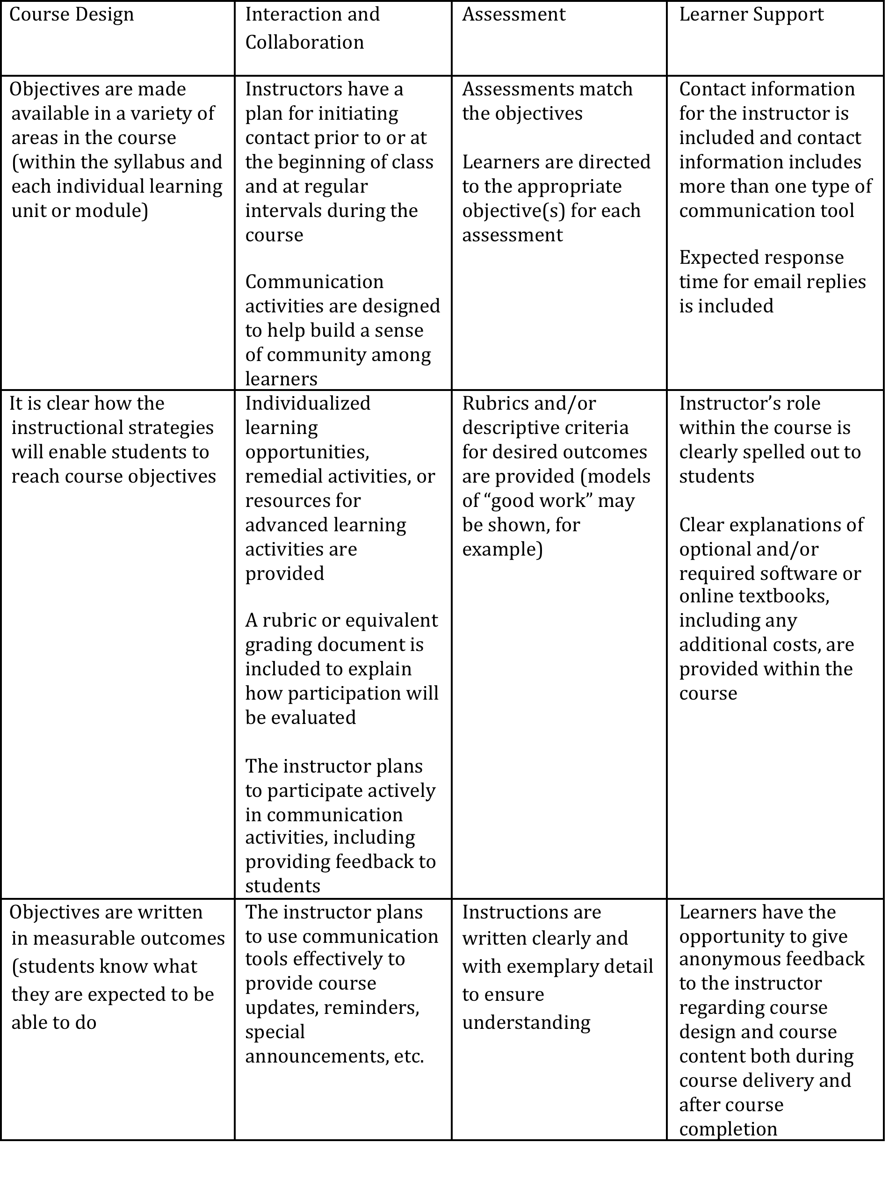
Merritt College
Notes:
Best Practices for Online Courses

Slide 35
American River College DE Course Checklist
Adapted from Portland Community College’s “Query Guide for Online Course Design at PCC” and the CCC Online Education Initiative’s “Course Design Rubric for the Online Education Initiative.”
This self-assessment is designed to give you an idea of how well your hybrid and/or DE courses are meeting the requirements of our state regulations (Title 5),
ACCJC, and the U.S. Department of Education. This checklist focuses on two categories only — Regular Effective Contact (REC) and Accessibility. For a comprehensive assessment tool, check out the Online Education Initiative – Course Design Rubric.

Slide 36
For more information:
Michelle Pilati
Interim Chief Professional Development Officer
mpilati@ccconlineed.org
OEI Course Design Rubric http://ccconlineed.org/faculty-resources
🌐 http://CCCOnlineEd.org
Additional Info and Blog http://CCCTechEdge.org

