Slide 1
Baccalaureate Degrees in the California Community College System
Jolena Grande, Cypress College
James Todd, Modesto Junior College
John Stanskas, ASCCC

Slide 2
Overview
Background to CCC Baccalaureate Degrees
Degree Requirement Considerations
Local Implementation
in Parallel

Slide 3
Background
There are 21 states with more than 50 community colleges offering baccalaureate degrees
SB 850 (Block, 2014)
was signed by Governor
Brown on September 28,
2014

Slide 4
Background
The Chancellor’s Office released the Application to Participate on November 21, 2014 with a deadline of December 19, 2014
34 applications were received
Steps of the Application Review included: Applicant webinar, FAQs, recruitment of readers, Readers’ webinar, distribution of applications to readers, collection of scores, ranking scores, and making recommendations

Slide 5
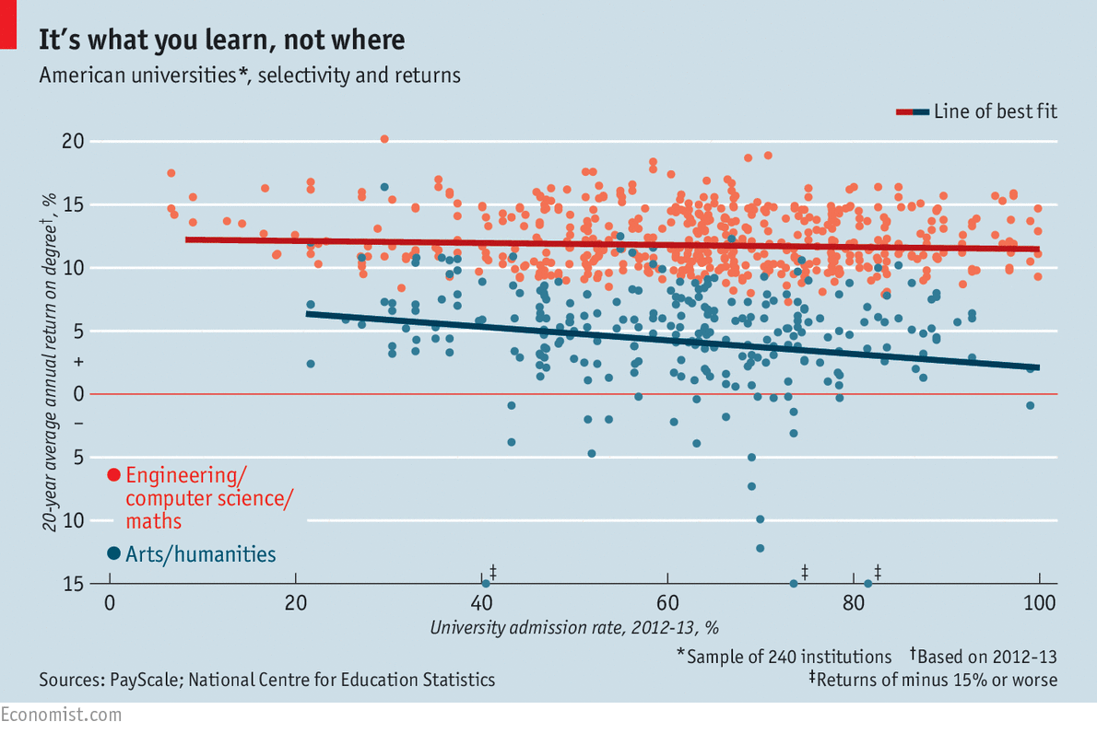
Why the Legislature and Public Want CCC-Baccalaureates

Slide 6
Background
BOG gave provisional approval to 15 applications for the pilot in January 2015
BOG gave 12 programs final approval in March 2015
The Chancellor’s Office
released the second Application
to Participate on March 19, 2015
with a deadline of April 16, 2015

Slide 7
Background
14 applications were received in the second round
The steps of the Application Review were the same as the ones in the first round
BOG provided approval on the final 3 colleges in May 2015

Slide 8
College | Degree
Antelope Valley | Airframe Manufacturing Technology
Bakersfield | Industrial Automation
Cypress | Mortuary Science
Feather River | Equine and Ranch Management
Foothill | Dental Hygiene
Mira Costa | Biomanufacturing
Modesto | Respiratory Care
Rio Hondo | Automotive Technology
San Diego Mesa | Health Information Management
Santa Ana | Occupational Studies
Santa Monica | Interaction Design
Shasta | Health Information Management
Skyline | Respiratory Therapy
Solano | Biomanufacturing
West Los Angeles | Dental Hygiene

Slide 9
Background
For 10 months after notification to the colleges, the framework for baccalaureate degrees was still being determined by the academic senate given
Short timeline
Public and political
pressure
Intersystem strife

Slide 10
Degree Requirements

Slide 11
Background
Degree Requirements – Upper Division
Degree Requirements – General Education
Lower Division
Upper Division
Minimum Qualifications

Slide 12
Background
Accreditation
Substantive Change
Support Services Needed
Financial Aid
Counseling
Library and Learning Resources
Admission Requirements

Slide 13
Disruptive Innovation
More than 10 years in contemplation and unsuccessful legislation
21 states already innovating
Industry and faculty
support sometimes
contradictory
Passage of SB 850
California Community
Colleges Baccalaureate
Degree Pilot Program

Slide 14
Grace Under Pressure
Between September 28 and November 12, 2014, the local Academic Senates had to:
Call for interested faculty/programs
Entertain presentations of potential proposals
Determine which proposal to support and forward for district consultation
Present campus proposal to district curriculum coordinating committee
Select a single program to forward for Board of Trustees’ consideration
Rally support from all district faculty for the selected program and garner BOT support
Submit the Chancellor’s Office Intent to Participate
Complete the formal proposal for submission to the Chancellor’s Office by December 19, 2014

Slide 15
Board of Governors Selection
In January 2015, the California Community Colleges Board of Governors initially approved 15 pilot colleges
In March, final approval was granted to 13
An additional 2 programs were selected in May, 2015
Cypress and Modesto Junior College have respectively been working toward:
Fall 2017 initial enrollment in the Bachelor of Science in Funeral Service
Fall 2016 initial enrollment in Bachelor of Science in Respiratory Care

Slide 16
Cypress College convened a campus advisory committee consisting of representatives from:
Academic Senate
Admissions and Records Office (Registrar and Evaluators)
Counseling Division (Articulation Officer and SSSP & Student Equity Directors)
Curriculum Committee
Discipline and General Education Faculty
Financial Aid Office
Library & Learning Resources Staff (Student Support Services)
Administration (Vice Presidents of Finance
and Instruction; Instructional Dean and
CTE Dean; Institutional Research)
Campus and District Technology Staff

Slide 17
Modesto Junior College convened a Respiratory Care Task Force consisting of representatives from:
Academic Senate
Allied Health
Curriculum Committee
Executive Administration
Grants Office
General Education Faculty
Library
Marketing
Research
Student Services
Student Financial Services
Counseling
Enrollment Services
Admissions and Records
SSSP

Slide 18
Implementation Challenges and Hurdles at the Local Level
Academic Senate
Determine what a generic bachelor degree will include
Determine what upper division courses will include
Establish the timeline for curriculum submission
Draft substantive change documents for ACCJC

Slide 19
Admissions and Records
Determine what application materials need to be developed
Establish the procedure for applying to the program
Determine the evaluation criteria for applications
Assess the ability to implement with the current records system
Query the ability of district IT to make changes to system
Implementation Challenges and Hurdles at the Local Level

Slide 20
Counseling,
Articulation Officer,
SSSP & Student Equity
Designate a counselor for baccalaureate students
Design an educational plan for different scenarios of applicants
Discuss the transferability of CSU coursework
Determine what changes need to be made to the college catalog
Discuss the DegreeWorks challenges
Implementation Challenges and Hurdles at the Local Level

Slide 21
Curriculum Committee
In tandem with the Academic Senate, determine the upper division requirements and degree completion
Establish process for submitting the courses to the local committee
Determine what changes need to be made to accommodate the state submission deadlines
Draft the program curriculum for inclusion in ACCJC substantive change documents
Implementation Challenges and Hurdles at the Local Level

Slide 22
Discipline and General Education Faculty
Determine what graduation requirements will be expected
Enlist GE faculty to write upper division curriculum
Support discipline faculty in developing courses
Determine level of professional development necessary
Implementation Challenges and Hurdles at the Local Level

Slide 23
Financial Aid Office
Discuss applying for USDOE approval to offer financial aid to bachelor degree students
Determine staff availability to work specifically with BDPP students
Determine financial aid available for students
Implementation Challenges and Hurdles at the Local Level

Slide 24
Library & Learning Resources Staff (Student Support Services)
Determine impact on database subscriptions and resource allocations
Discuss need for additional library research support
Implementation Challenges and Hurdles at the Local Level

Slide 25
Administration
Vice Presidents
Instructional Deans
CTE Deans
Institutional Research
Determine level of support for faculty and program needs
Budget allocation of one-time funds
Discuss data elements
that need to be collected
Draft funding request for first three years
Implementation Challenges and Hurdles at the Local Level

Slide 26
Campus and District Technology Staff
Determine changes needed in college application, student records, and DegreeWorks
Discuss needed upgrades to Banner system
Create separate online application
Implementation Challenges and Hurdles at the Local Level

Slide 27
Start planning now – what innovative programs are already on your campus/needed in your region
Learn from the 15 pilot programs—those that have gratuitously led the way for us to follow
Provide input and feedback
Implementation Challenges and Hurdles at the Local Level

Slide 28
Questions?
Jolena Grande: jgrande@cypresscollege.edu
James Todd: toddj@yosemite.edu
John Stanskas: jstanskas@valleycollege.edu
Thank You For Coming!

