Slide 1
Innovative Strategies for Hiring Faculty of Color
Professor Silvester Henderson, At-Large Representative, ASCCC Dr. LaTonya Parker, South Representative, ASCCC Professor Robin Allyn, Mira Costa College Dr. Khalid White, San Jose City College
ASCCC Faculty Diversity Meeting/Regional Norco College 2001 Third St, Norco, Ca 92860 February 28, 2019
[Date]

Slide 2
Presentation Highlights
What is the definition Ethnicity?
Key Racial and Ethnic Diversity Definitions
Who are Faculty/Persons of Color? – Faculty/Student Ratios.
What tools can be engaged to improve the hiring of Diverse Faculty?
Once hired should Faculty of Color support “Cultural Taxation” and serve on campus committees and campus governance structures, for the good of the institution and the students?
How can colleges develop equity in hiring and promoting “Faculty Diversity”
Group Discussion - Discuss current College Hiring Guidelines? - Sharing (Ten Minutes)
Questions & Comments
Marketing Tools for building a diverse team of Senate Leaders.
Questions and Comments?

Slide 3
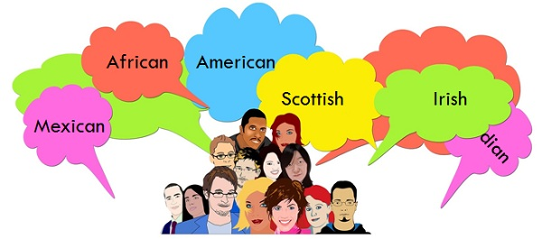
What is the definition of Ethnicity?
Ethnicity: ethnic quality or affiliation A: Of or relating to large groups of people classed according to common racial, national, tribal, religious, linguistic, or cultural origin or background;
B:Being a member of a specified ethnic group.
https://www.merriam-webster.com/dictionary/ethnic

Slide 4
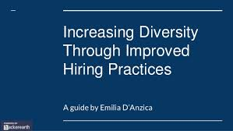
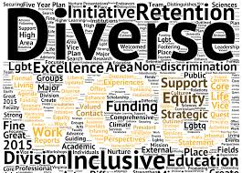
Key Racial and Ethnic Diversity Definitions
To effectively improve racial and ethnic diversity in the workplace, organizations need to understand some of the key terms and definitions including:
Racial Discrimination: Racial discrimination in the workplace can be defined as any exclusion, restriction or preference based on race, color, descent or national or ethnic origin which has the purpose of impairing an employee’s ability to exercise their rights to equal standing in the workplace.
Ethnic Group: The term “ethnic group” refers to a group of persons whose members identify with each other through such factors as common heritage, culture, ancestry, language, dialect, history, identity and geographic origin.
Implicit Bias: Also known as unconscious or hidden bias, implicit biases are negative associations that people unknowingly hold. They are expressed automatically, without conscious awareness.
Inclusion: Authentically incorporating traditionally excluded individuals and/or groups into processes, activities and decision/policy making in a way that shares power.
https://www.peoplescout.com/racial-and-ethnic-diversity-in-the-workplace/ (2019)

Slide 5
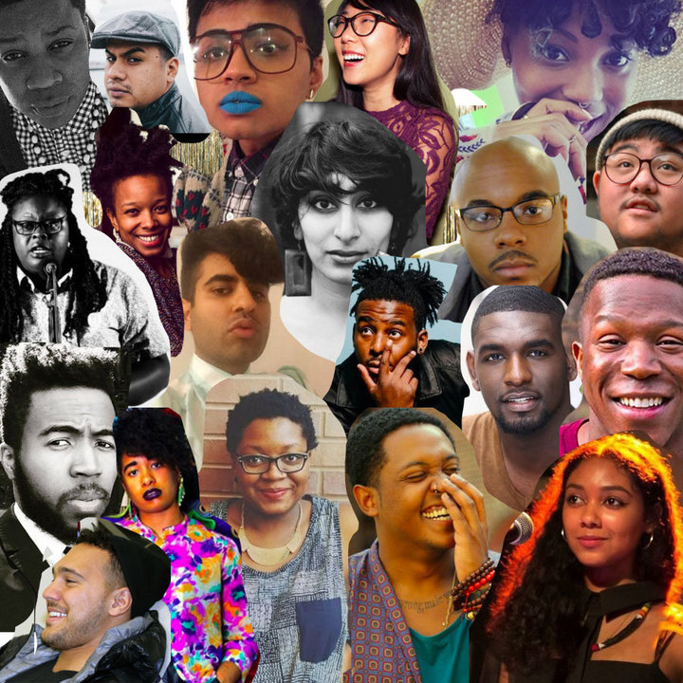
What is “Representative Diversity” Who are Faculty/Persons of Color? – Faculty/Student Ratios
Oxford University Press Dictionary –People of Color – “a person who is not white or of European parentage.” https://theithacan.org/columns/the-term-people-of-color-includes-asian-americans/
California Higher Education Faculty/Student - Ratios
In the CSU system, 75% of Cal State students are students of color and 62% of tenured faculty are white;
In the UC system, 74% of students are students of color and 70% of tenured faculty are white; and
In the CCC system, 73% of student are students of color and 61% of tenured faculty are white.
https://medium.com/national-center-for-institutional-diversity/want-to-retain-faculty-of-color-support-them-as-faculty-of-color-9e7154ed618f

Slide 6
What tools can be engaged to improve the hiring of Diverse Faculty?
L
Reevaluate your Hiring Guidelines & Committee Formations.
Expand “Recruitment Efforts” to non conventional advertisement sources.
Campus Teams arrange visits at Historically Black Colleges & Universities – Speak with the potential Graduate Students.
Adopt an Graduate Department – Guest Lecture
Positively speak about the Professoriate.
Mentor and Adopt a Diverse Graduate Student.
Write equity minded questions into the Job Announcement.
Make sure your search committees are trained regarding EEO Laws and procedures.
Establish “Grow Your Own” Programs
Create a Faculty Diversity Mentorship & Recruitment Program.
Look Beyond Culture Fit – Practice Equity Mindedness!
Be Intentional
Marketing to areas such urban marketing
Look Beyond College Culture Fit
Most employers seek to hire employees based on culture fit. However, the intent to hire only those who share the company’s vision, mission and values can lead to a homogeneous workforce that prioritizes like-minded thinking over diversity. Instead, employers should hire for culture add, targeting candidates who bring something unique to the company culture that didn’t exist previously. - John Feldmann, Insperity

Slide 7
Once hired should Faculty of Color support “Cultural Taxation” and serve on campus committees and campus governance structures, for the good of the institution and the students?
“Cultural Taxation” is a term coined by Amado Padilla as a way of describing the unique burden placed on ethnic minority faculty in carrying out their responsibility to service the university.
Amado Padilla - “Cultural Taxation” is the obligation to show good citizenship towards the institution by serving its needs for ethnic representation on committees, or to demonstrate knowledge and commitment to a cultural group, which, though it may bring accolades to the institution, is not usually rewarded by the institution on whose behalf the service was performed.
Discussion
https://www.calfac.org/magazine-article/cultural-taxation-faculty-color-academy

Slide 8
How can colleges develop institutional skills for promoting “Cultural Inclusivity”?
Respect all forms of “Culturally Diverse” respectful communication
Develop a clear understanding of “Intercultural Communication Styles,” both verbal and written
Include questions in all of your Job Applications on “Social Justice”
View all Job Applicants as a “Benefit” and not a form of offense
Challenge your level of professional and personal space, and employment comfort
Cultural Inclusion
The calls for more inclusive educational environments are not only concerned about widening participation but the calls are equally concerned about reorienting the mission, vision and values of educational institutions to better align them with core democratic principles. In this relationship, educational institutions have a valuable role to play in helping strengthen democracy.
https://www.universityworldnews.com/post.php?story=20161102112722844

Slide 9
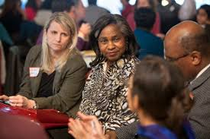
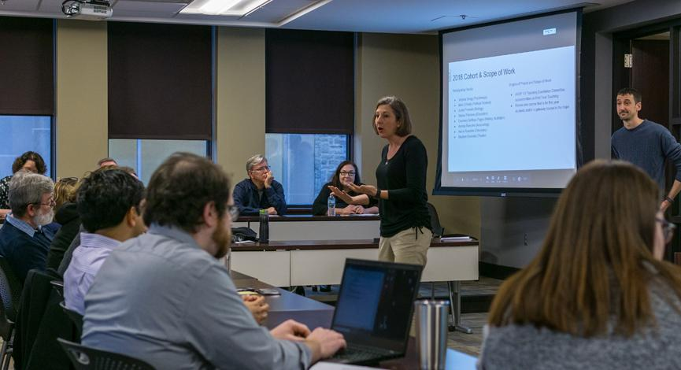
Group Discussion - Discuss current College Hiring Guidelines? – Sharing (Ten Minutes)
From: Three Research Studies on Diversity in College Classrooms (American Council on Education/American Association of University Professors)
“Today, hundreds of colleges and universities recognize the educational value of diversity and view student and faculty diversity as an essential resource for optimizing teaching and learning”.
https://www.aaup.org/NR/rdonlyres/F1A2B22A-EAE2-4D31-9F68-6F235129917E/0/2000_diversity_report.pdf

Slide 10
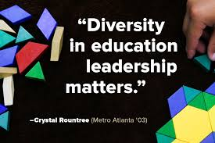
Questions & Comments
Please feel free to contact each of us for more information.
Professor Silvester Henderson Shenderson@losmedanos.edu
Dr. LaTonya Parker LaTonya.Parker@mvc.edu
Professor Sandy Somo ssomo@glendale.edu
Dr. Khalid White Khalid.White@sjcc.edu

