Slide 1
Leadership with Empathy: “Inviting More Voices and Authentic Stories” Silvester Henderson ASCCC, At Large Senate Representative Rochelle Olive Department Chair Business, Economics, HLTOC College of Alameda Natalie Rodriguez, Interim Director of Student Activities and Campus Life College of Alameda April 16, 2021
Notes:
Silvester Henderson

Slide 2
As our nation grapples with effective ways to deal with "Racial and National Discourse", developing skills around listening and inclusive caring becomes essential for both institutional advancement and campus empowerment.
Empathetic Leaders are passionately invested in people.
Session Description
Come share your thoughts, your professional challenges, and commitments, to learning how to grow and develop trust amongst your faculty professionals, your classified professionals, administrators, and most importantly your students.
Notes:
Silvester Henderson

Slide 3
Presentation Highlights
Cultural Survival: Biodiversity and Empathy Highlights
Why should we care?
Six-Steps for Developing Empathy
How does Empathy support the work of Diversity, Equity and Inclusion? – Three Ways!
5. Stories, Conversations, Examples (Breakout Rooms) – 10 Minutes!
Leadership and Empathy – “The Benefit”
7. Questions & Dialogue
8. Closing Comments
Notes:
Silvester Henderson

Slide 4
Bio Diversity & Empathy
Protection of Biodiversity, Language and Cultural Traditions
“But in recent years it has been increasingly apparent that the extinction crisis affecting the world's biodiversity is closely related, in its causes and consequences, to the crisis threatening the world's indigenous and traditional peoples, their languages, and their cultural traditions.”
https://www.culturalsurvival.org/publications/cultural-survival-quarterly/toward-integrated-protection-language-and-knowledge-part
Notes:
Natalie Rodriquez

Slide 5
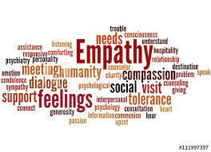
Define “Bio Diversity & Empathy”
Empathy “The ability to share in the feelings of someone else.” Lauren White
Notes:
Rochelle Olive

Slide 6
Leadership with Empathy Inviting More Voices and Authentic Stories
Decolonizing Institutions by brining our authentic selves to institutions that have traditionally told us that we don’t belong.
Example:
Poor
Woman of Color
First Generation College Student
Daughter of Immigrants
Having empathy for ourselves as well as for our students allows us to relate and assist our community of students in bridging equity gaps.
Notes:
Natalie Rodriquez

Slide 7
They Don’t Care About Us
Notes:
Natalie Rodriquez

Slide 8
Leadership with Empathy Inviting More Voices and Authentic Stories
When we bring our authentic selves and our authentic stories with empathy for our students as well as for ourselves are able to better relate and assist our students in bridging equity gaps.
Students are more comfortable in accessing services that have been created as equity tools when they see you as approachable and relatable.
Notes:
Natalie Rodriguez

Slide 9
Why Should we Care?
“Once we start thinking about others the world starts to change “ Junior Smart (2013)
SOS Gang Project
https://www.youtube.com/watch?v=TX3cYe87Zqk&list=TLPQMzEwMzIwMjFckLJEUillnw&index=1
Support Inclusive - Diversity
Notes:
Silvester Henderson

Slide 10
Why Should we Care? (Continue)
“Black Lives Matter”
as well as
“All Lives Matter”
1.Lets Stop “Police Violence! 2. Lets Start Promoting Equity, Diversity & Equality in all we do!
Notes:
Silvester Henderson

Slide 11
How does “Empathy” support the work of Diversity, Equity and Inclusion?
“Empathy is clearly a great way to build connection and supportive collaboration around DEI efforts. It is important to note that the goal is here is to build engagement, not to give in to resistance. Instead, empathy should inform a sense of radical accountability, that is centered (center) on the goals and values of an organization for diversity, equity, and inclusion.”
https://charityvillage.com/empathy-a-key-ingredient-in-effective-diversity-equity-and-inclusion
Three Ways to achieve Diversity, Equity & Inclusion (DEI):
DEI-related change management
DEI Capacity-Building
Partnership Development and Collaboration
“/
Notes:
Natalie Rodriquez

Slide 12
How does “Empathy” support the work of Diversity, Equity and Inclusion?
Three Ways to achieve Diversity, Equity & Inclusion:
DEI-related change management:
Embracing empathy can allow us to put ourselves in our colleagues’ shoes, and plan for change management in a way that considers their needs, expectations, and perspectives. It’s important to take the time to listen to our internal stakeholders, as the insights they share can often illustrate opportunities for deeper connection and understanding, both internally and with our clients and members.
“Empathy is clearly a great way to build connection and supportive collaboration around DEI efforts. It is important to note that the goal is here is to build engagement, not to give in to resistance. Instead, empathy should inform a sense of radical accountability, that is centered (center) on the goals and values of an organization for diversity, equity, and inclusion.”
https://charityvillage.com/empathy-a-key-ingredient-in-effective-diversity-equity-and-inclusion/
Notes:
Natalie Rodriquez

Slide 13
How does “Empathy” support the work of Diversity, Equity and Inclusion?
Three Ways to achieve Diversity, Equity & Inclusion:
DEI Capacity-Building:
An empathetic approach to capacity building helps us understand where our colleagues are at and why they are where they are at. It allows us to lead with curiosity to learn more about their learning and development needs.
“Empathy is clearly a great way to build connection and supportive collaboration around DEI efforts. It is important to note that the goal is here is to build engagement, not to give in to resistance. Instead, empathy should inform a sense of radical accountability, that is centered (center) on the goals and values of an organization for diversity, equity, and inclusion.”
https://charityvillage.com/empathy-a-key-ingredient-in-effective-diversity-equity-and-inclusion/
Notes:
Natalie Rodriquez

Slide 14
How does “Empathy” support the work of Diversity, Equity and Inclusion?
Three Ways to achieve Diversity, Equity & Inclusion:
Partnership Development and Collaboration:
Like our staff and volunteers, our organizations may vary in their understanding of DEI, and move forward at very different paces. This could be due to a variety of factors, such as an organization’s history or location. Empathy can support healthy and meaningful dialogues about DEI, helps us decentre our perspectives to hear others’, and allows us to continue moving the dial forward by bringing others along.
“Empathy is clearly a great way to build connection and supportive collaboration around DEI efforts. It is important to note that the goal is here is to build engagement, not to give in to resistance. Instead, empathy should inform a sense of radical accountability, that is centered (center) on the goals and values of an organization for diversity, equity, and inclusion.”
https://charityvillage.com/empathy-a-key-ingredient-in-effective-diversity-equity-and-inclusion/
Notes:
Natalie Rodriquez

Slide 15
How can we induce “Empathic Conversations? – Six Steps
Six-Steps for Developing Empathy
Imagine Yourself in the Other Person's Shoes.
2.Investigate Underlying Feelings.
3. Identify with the Person's Experience.
4. Verify the Accuracy of What You're Hearing.
5. Offer Your Support.
6. Practice Emotional Detachment.
https://blog.iqmatrix.com/developing-empathy
Notes:
Silvester Henderson

Slide 16
Stories, Conversations, Examples
Breakout Rooms (10 Minutes)
Please share your findings!
Notes:
Rochelle Olive

Slide 17
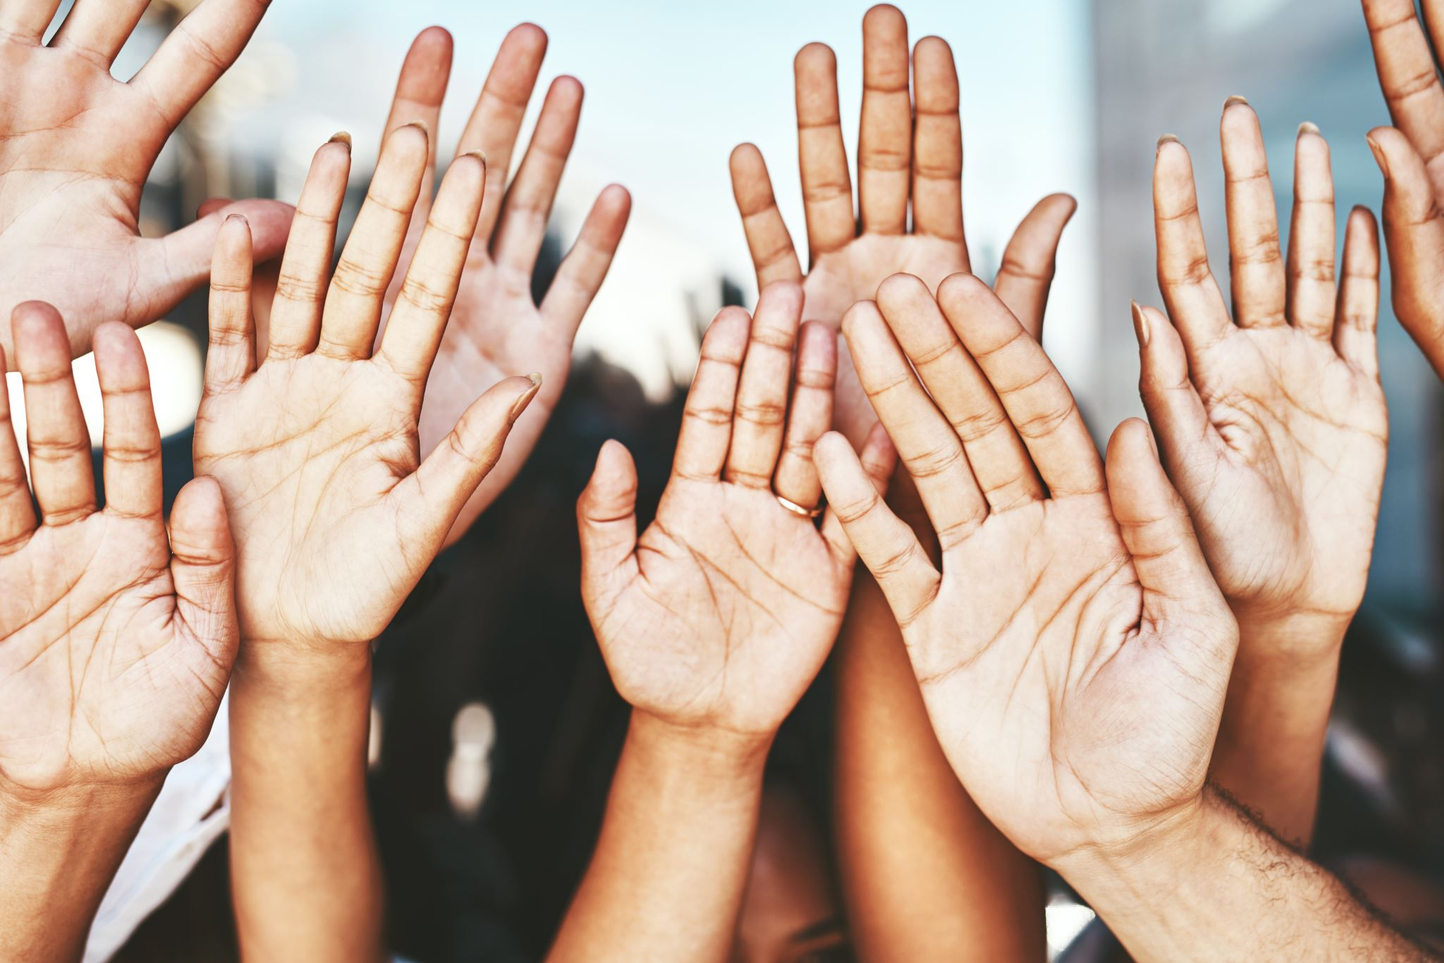
Stories, Conversations, Examples
Breakout Rooms Please share your findings!
Notes:
Rochelle Olive

Slide 18
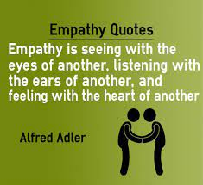
Leadership & Empathy “The Benefit”
“Empathy enables you to know if the people you’re trying to reach are actually reached. It allows you to predict the effect your decisions and actions will have on core audiences and strategize accordingly. Without empathy, you can’t build a team or nurture a new generation of leaders. You will not inspire followers or elicit loyalty.”
https://www.forbes.com/sites/prudygourguechon/2017/12/26/empathy-is-an-essential-leadership-skill-and-theres-nothing-soft-about-it/?sh=3c57bf002b9d
Notes:
Rochelle Olive

Slide 19
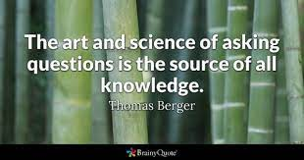
QUESTIONS & COMMENTS
Notes:
Rochelle Olive

Slide 20
Closing Comments
“Thank You for Coming!
We Are “Crazy” About you!
Notes:
Silvester Henderson

Slide 21
Thank You for coming! Silvester Henderson ASCCC, At Large Senate Representative Rochelle Olive Department Chair Business, Economics, HLTOC College of Alameda Natalie Rodriguez, Interim Director of Student Activities and Campus Life College of Alameda For more information, please contact info @asccc.org
Notes:
Silvester Henderson, Rochelle Olive, Natalie Rodriguez

