Slide 1
Legislation and the Budget Cycle 2020: What Has Happened and What Is Coming
Dolores Davison, ASCCC Vice President
John Govsky, Cabrillo College

Slide 2
Breakout Description
Last year saw a flurry of legislation around community colleges, much of which may impact adjunct faculty. In addition, new bills have been introduced that also may change the roles of adjunct faculty. From the potential of maternity leave, to discussions of an increase in the amount of load an adjunct can teach, to how reemployment is dealt with at institutions, it is vitally important that adjunct faculty are aware of what is coming through the legislature and how it may impact their lives. Join us for this interactive session on legislation past, present, and future.

Slide 3
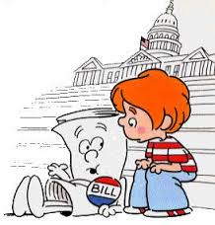
Overview
Role of the ASCCC in legislation and the budget
Current legislative and budget cycles
Local advocacy and getting involved at the state level

Slide 4
What is the ASCCC Role?
Legislation and Advocacy Committee
Letters in Opposition or Support
Resolutions
Legislative Visits
Legislative Advocacy Day
ICAS Advocacy Day
Info to Local Legislation Liaisons

Slide 5
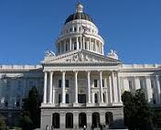
The Legislative Cycle – Part 1
January – February
A bill is introduced by member of Senate (numbered as SB) or Assembly (numbered as AB).
March – May
Amendments – revisions, improvements
Committees hearings
Education, Appropriations (fiscal)
Last week of May
Bills that make it through go to the floor of the house for vote

Slide 6
The Legislative Cycle – Part 2
June – August
Same process is repeated in other house
September
Concurrence
If both houses pass the bill then it moves onto the Governor’s desk
October ☛ Governor’s Desk
Veto – reject the bill
Sign – make the bill into law
Ignore – bill becomes law**
House override – 2/3 vote of both houses
Bills go into effect 1 January unless otherwise noted

Slide 7
Key Committees to Watch
Assembly and Senate have similar structures
Committee on Higher Education
Multiple subcommittees on budget and other aspects of Higher Ed
Committee on Higher Ed and the Judiciary
Committee on the Budget
Appropriations
The Suspense File

Slide 8
Bills That We Watched in 2019
AB 2 (Santiago) College Promise – Chaptered
AB 30 (Holden) Dual Enrollment – Chaptered
AB 130 (Low) CPEC Reboot – Vetoed
AB 302 (Berman) Homeless Student Parking – 2 Year Bill
AB 1460 (Weber) Ethnic Studies – Held in committee
AB 1658 (Carrillo) Teacher Credentialing – Vetoed
AB 1727 (Weber) CDCP Courses – Vetoed
SB 3 (Allen) CPEC Reboot – Dead in committee
SB 291 (Leyva) Financial Aid – 2 Year Bill
SB 462 (Stern) Forestland Restoration Program – Held in committee

Slide 9
Bills Last Year with Direct Impact on Working Conditions
AB 897 (Medina) would increase the percentage of hours part-time faculty may teach from 67% to up to 85% of the hours per week a full-time employee having comparable duties – moved to a second committee reading yesterday (23 January 2020)
SB 777 (Rubio) would require a community college district that has less than 75% of its hours of credit instruction taught by full-time instructors to make, at a minimum, an annual 10% reduction in the district’s deficit, defined as the gap between 75% of the total district credit hours taught and the total of those taught by full-time faculty.

Slide 10
Budget Process (July – July)
Release of Governor’s Budget
Legislative Analyst’s Analysis
Budget Subcommittee Hearings
Governor’s Revisions
Budget Subcommittee Final Actions
Conference Committee
Legislative Actions
Governor’s Consideration
Implementation
Agency Submittals of Requests to Department of Finance
Board of Governors Adoption of Budget and Legislative Request
Submission of Priorities from Stakeholders to Chancellor’s Office

Slide 11
The Budget Cycle
Dept. of Finance
Prop 98 Money
Governor’s January Budget (drops by 10 January)
Trailer Bill Language
Governor’s May Revisions (the May Revise)
June 15 Deadline for Legislature -- Must be printed 72 hours ahead of deadline

Slide 12
What Can Local Faculty Do?
Be familiar with processes
Meet with local legislators and others involved with budget
Discuss legislative priorities with your Board of Trustees
Sign up for the ASCCC legislative liaison listserv (HOW?)
Make sure your academic senate has a Legislative and Advocacy Liaison
Work with your student government/student senate on local priorities

Slide 13
Some Helpful Websites
ASCCC Legislation Information:
https://www.asccc.org/directory/legislative-and-advocacy-committee
Under the “Resolutions” tab on this page, all ASCCC resolutions about legislation are listed.
FACCC information:
http://www.faccc.org/current-legislation/
http://www.faccc.org/2020-legislative-and-budgetary-priorities/

Slide 14
Some Helpful Websites (continued)
The Assembly Committee on Higher Education:
http://ahed.assembly.ca.gov
The Legislative Analyst Office (LAO):
http://www.lao.ca.gov
The Department of Finance Budget Page:
http://www.ebudget.ca.gov
Legislation Information, including bill status:
https://leginfo.legislature.ca.gov

Slide 15
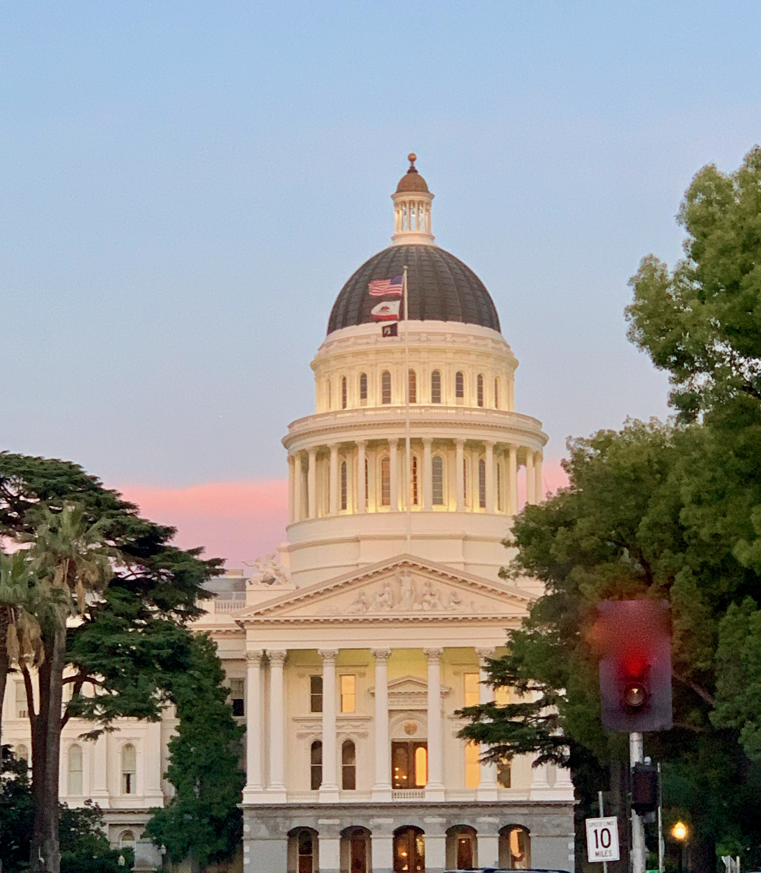
Questions and Thank You
Information: info@asccc.org

