Slide 1
We’re Here to Help! Leveraging ASCCC Resources to Help Empower and Inform Karen Chow, Area B Representative Krystinne Mica, Executive Director

Slide 2
Breakout Description
The ASCCC offers a myriad of resources and services for faculty! This breakout is designed as an interactive session where attendees will have an opportunity to explore the new ASCCC website, review briefly the Local Senates Handbook, examine resources for campuses, and determine when or if there is a need to call for help. Bring your laptops and come prepared with questions!

Slide 3
ASCCC Mission and Vision
Mission
As the official voice of California community college faculty in academic and professional matters, the Academic Senate for California Community Colleges (ASCCC) is committed to equity, student learning and student success. The Academic Senate for California Community Colleges acts to:
Empower faculty to engage in local and statewide dialog and take action for continued improvement of teaching, learning, and faculty participation in governance
Lead and advocate proactively for the development of policies, processes, and practices
Include diverse faculty, perspectives, and experiences that represent our student populations
Develop faculty as local and statewide leaders through personal and professional development
Engage faculty and system partners through collegial consultation
Vision
Faculty leading change, serving students, and embracing inclusion

Slide 4
ASCCC Website asccc.org

Slide 5
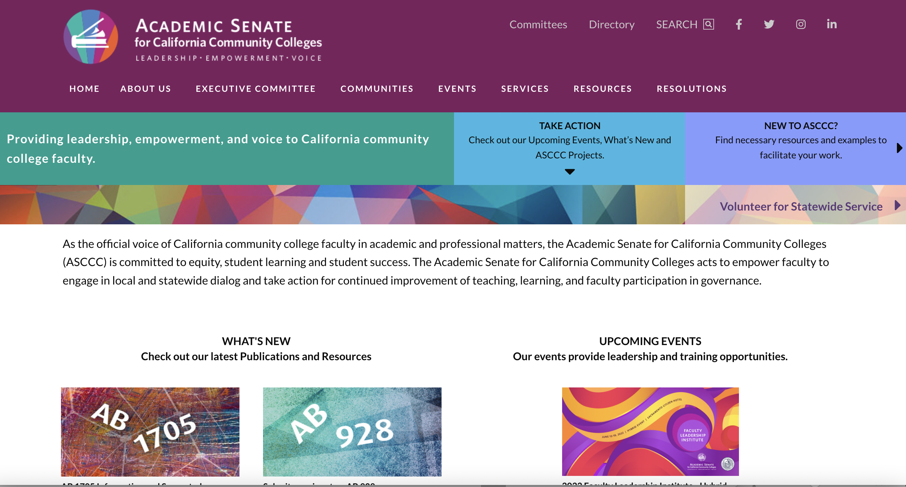
New to ASCCC? https://asccc.org/local-senates
Click this tab to access frequently used ASCCC resources

Slide 6
ASCCC Website – Useful Links
ASCCC: Subscribe to Newsletter: https://asccc.org/signup-newsletters
Official vs Unofficial Senate President Listservs
ASCCC Request for Services: https://asccc.org/content/request-services
ASCCC Resolutions: https://asccc.org/resources/resolutions
ASCCC Legislative Positions: https://asccc.org/legislative-positions
ASCCC Volunteer for Service: https://asccc.org/volunteer-serve-committee
ASCCC Events: https://asccc.org/calendar/list/events
ASCCC Awards: https://asccc.org/awards

Slide 7
Local Senates Handbook https://indd.adobe.com/view/7f4e2df0-a2c8-42cd-8a88-bb92cfc68ed3
Part I: The Academic Senate for California Community Colleges: A Brief History
Part II: Roles and Responsibilities of an Academic Senate
Part III: Duties as a Local Academic Senate President
Part IV: Ensuring the Effectiveness of the Local Academic Senate
Part V: Linking Local Academic Senates to the ASCCC

Slide 8
Local Senate Visits
As part of its commitment to supporting local senates, the Academic Senate for California Community Colleges provides the opportunity for local senates to have visits from members of the Executive Committee and the Relations with Local Senates Committee. The purpose of such a visit is for the committee member to serve as a liaison between the Senate and your local senate. Our role is to listen to your discussions, share Senate resources to support you, and to gather questions and concerns to forward to the Academic Senate President for consideration and response. The visit can be with the local senate president, the local executive committee, the entire senate: whatever you would like. We are here to serve you!
Request a visit: https://asccc.org/content/request-services
There is no cost for local Senate Visits. These are different from the formal Collegiality in Action visits done in collaboration with the CCLC (there is a fee for these visits).

Slide 9
Need Some Help? Send it to Info!
Need to ask a questions related to the 10+1? Submit it through info@asccc.org.
As soon as possible, but usually within a few days, you will receive a detailed response from an ASCCC Executive Member.
Some helpful tips while you’re waiting for a response:
Review the Local Senates Handbook for information
Check the ASCCC website for resolutions or adopted papers on the topic you have a question on
Consider reviewing Rostrum articles, but remember, these are not official positions of the ASCCC!
Review previous breakout session materials to find out more information. The ASCCC has a great look-up too to find all past ASCCC breakout materials: https://asccc.org/resources/presentation-materials
If you haven’t heard back within one week, send a follow up message to info! Chances are, someone is working on a response but it’s just taking a little longer to get the message back to you.

Slide 10
Resolutions, Legislative Positions, and Governance Resources
Resolutions Handbook: https://www.asccc.org/sites/default/files/ResolutionHandbookFinalFA17_1.pdf
Resolutions Webpage: https://asccc.org/resources/resolutions
Legislative Positions: https://asccc.org/legislative-positions
Governance: https://asccc.org/communities/local-senates/leadership-resources
Scenarios: https://asccc.org/sites/default/files/Participating_Effectively_200503.pdf
The purpose of the guidelines is to provide assistance to trustees, CEOs, academic senate leaders, bargaining units, administrators, classified staff, and students that will enable them to fulfill the intent of effective participation in local decision making as delineated in state law under California Education Code and in Title 5 regulations.

Slide 11
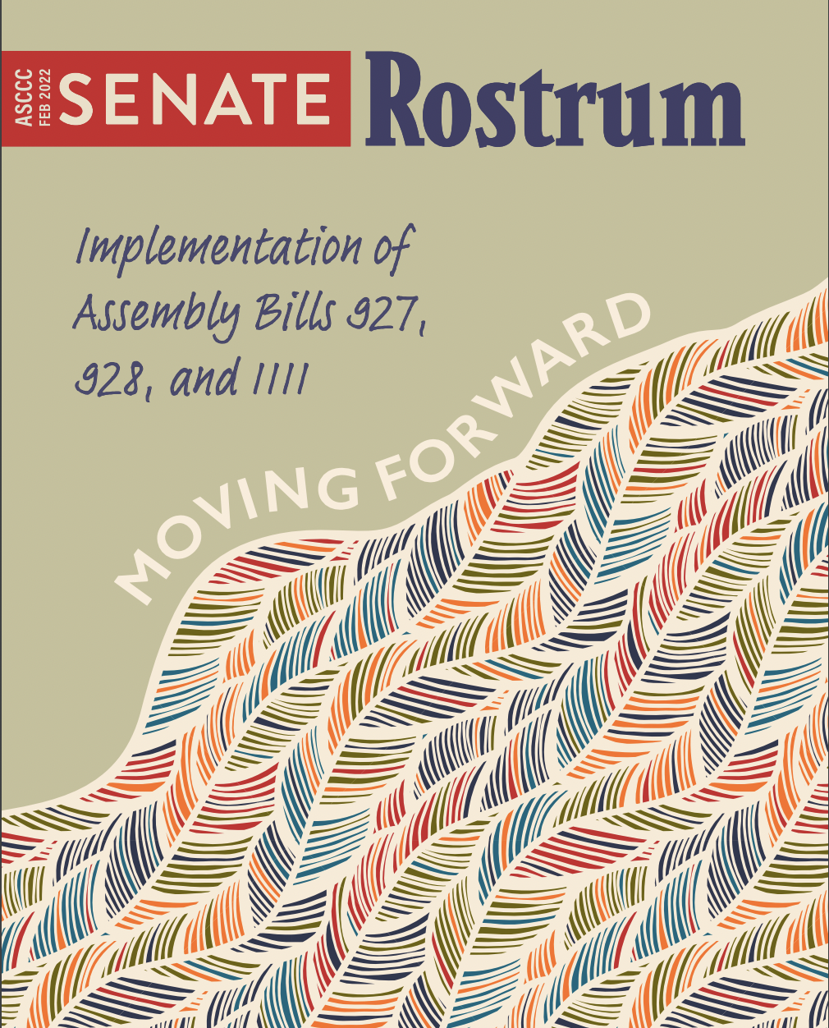
Publications and Rostrums
Academic Senate Papers:
https://asccc.org/publications/academic-senate-papers
Senate Rostrums:
https://asccc.org/resources/rostrums

Slide 12
Volunteer to Serve! https://asccc.org/volunteer-serve-committee
The ASCCC appoints many faculty to work on statewide committees, workgroups, and task forces. Submitting an application to serve provides you the opportunity to:
Create change within the California Community Colleges system
Network with other faculty from all over California
Gain experience serving on a committee
Access professional development
Increase your knowledge on issues within the California Community Colleges system

Slide 13
Additional Resources (more links!)
Model Hiring Principles and Practices: https://ccconlineed.instructure.com/courses/5733
DEI Curriculum Model Principles and Practices: https://asccc.org/sites/default/files/CCC_DEI-in-Curriculum_Model_Principles_and_Practices_June_2022.pdf
Professional Development College:
https://asccc-oeri.org/professional-development-college-pdc/
ASCCC Open Educational Resources Initiative: https://asccc-oeri.org/
C-ID: www.c-id.net
California Community Colleges Chancellor’s Office (CCCCO or CO): http://www.cccco.edu
California Legislative Information: http://leginfo.legislature.ca.gov
Find your legislators: http://www.legislature.ca.gov/legislators_and_districts/legislators/your_legislator.html
Community College League of California (CCLC): https://www.ccleague.org
Accrediting Commission of Community and Junior Colleges (ACCJC): https://accjc.org

Slide 14
Questions? Contact us at info@asccc.org Thank you!

