Slide 1
Low-Unit Certificates: making them “count”
Fall Plenary, Thursday, November 2nd, 10:00-11:15a.m.
Conan Mc Kay, ASCCC Executive Committee, Facilitator
Marie Boyd, Chaffey College, CTE Leadership Committee Member
Lorraine Slattery-Farrell, ASCCC Executive Committee, CTE Leadership Committee Chair
Notes:
Introductions, Temperature of the Room (Michael), Pass our Stickie Notes for Questions (Donna)

Slide 2
What are “low-unit” certificates?
The basics - Types of certificates:
CREDIT
Achievement:
12 – 17.99 units with Consortium recommendation and Chancellor’s Office approval
18 units and over – Required Consortium recommendation and Chancellor’s Office approval
May be transcripted
“Low unit Certificates” = Other local name/s: proficiency, accomplishment, recognition, etc. up to 17.99 units, not CO approved
May not be transcripted

Slide 3
What are “low-unit” certificates?
NONCREDIT:
Competency: a certificate in a recognized career field articulated with degree-applicable coursework, completion of an associate degree, or transfer to a baccalaureate institution
Completion: a certificate leading to improved employability or job opportunities

Slide 4
What are “low-unit” certificates?
“Skills Builders” – Students who enroll at a community college not to earn a credential or to transfer to a four-year school, but to get a promotion at work, or earn a higher salary.
According to the California Community Colleges Chancellor’s Office, there were 86,328 skills-builders in the system in 2011-12.
Wage gains data will come from matching the state’s unemployment insurance wage records with individual student records.
Notes:
On March 30th, California Community Colleges will begin tracking wage outcomes for “skills-builders.” These students enroll in courses at a community college not to earn a credential or to transfer to a four-year school, but to get a promotion at work or earn a higher salary. According to the California Community Colleges Chancellor’s Office, there were 86,328 skills-builders in the system in 2011-12.
The California Community Colleges Board of Governors established the scorecard to measure student success at the system’s 112 community colleges. Currently, the scorecard provides the percentage of students who complete a degree, certificate, apprenticeship, or who transfer to a four year college. However, the new scorecard will include the skills-builders metric, which will show salary increases for students who take one or two courses, but don’t earn a credential or transfer.
Wage gains data will come from matching the state’s unemployment insurance wage records with individual student records.
http://www.workforcedqc.org/news/blog/california-community-colleges-use-new-skills-builder-metric

Slide 5
The “case” for low-unit certificates
Program completion is considered evidence of student success. CCCAOE and the RP group have discussed the merits of tracking “low unit” certificates. There is a growing emphasis on “stackable” credentials, based on the notion that students, once engaged in a pathway or discipline, can be encouraged to persist by recognition “along the way” as long as each award is recognized as having value in the worksite.
Notes:
Donna

Slide 6
The “case” for low-unit certificates
Current research on the award and value of low-unit certificates is sparse. A study at Georgetown University suggests a complex picture, and explores important differences by field of study/sector as well as differential payoffs by gender and race for certificates in general.
http://www9.georgetown.edu/grad/gppi/hpi/cew/pdfs/Certificates.ExecutiveSummary.071712.pdf
The study emphasizes the importance of understanding best design and practice -- to ensure that lower unit certificates DO “stack” toward higher unit ones to the extent possible and appropriate, so that students are set up for continuing opportunities for both educational AND career advancement . . . and associated wage gains.

Slide 7
The “case” for low-unit certificates
Up to 30% of community college students are "skills builders“, students who take a small number of courses, do very well in them, and then move on . . . these may be among our most successful students, but they may not be counted as successes in our completion metrics. It may be that some number of these skills building students are earning lower unit certificates, but system data is not reporting or tracking these awards as detailed in the recent report LearningWorks released with the RP Group, "What's Completion Got to Do With it. . . . " http://www.learningworksca.org/whats-completion-got-to-do-with-it-using-course-taking-behavior-to-understand-community-college-success/

Slide 8
Why the interest in low-unit certificates?
Strong Workforce Program funding model includes metrics for completions in both the local, regional and incentive funds
Credit and noncredit certificates “count”
Both Chancellor’s Office-approved and non-Chancellor’s Office-approved credit certificates “count”
Notes:
Donna

Slide 9
How are low-unit certificates reported?
Colleges have always had the ability to report low-unit certificate outcomes to the Chancellor’s Office
Data Element Dictionary http://extranet.cccco.edu/Divisions/TechResearchInfoSys/MIS/DED.aspx
Relevant data elements
SP02 – Student Program Award
SP04 – Student Program Control Number

Slide 10
Strong Workforce & 17% Committee
Incentivized Funding
First of its kind!
17% of the SWF funding based on metrics
Multiple stakeholders
Used research from other states
Developed incentivized, point-based, funding model

Slide 11
Incentivized Funding
Measures Results for All CTE Programs
Outcomes are counted for all CTE students, both at the college and regional level, to incentivize strong overall CTE portfolios and collaboration across institutions.
Transparency and Accountability
Annual progress is made visible on the LaunchBoard Strong Workforce Program tab and effective programs are recognized through an awards program each year.
Continuous Improvement
Colleges and regions update their plans each year, using labor market data and nonbinding projections at the program level, to ensure that investments expand and improve CTE programs.

Slide 13
17% of funding now based on points system
Points based on CTE student
Progress toward completion
Earning a certificate or degree
Transfer to 4-year college
Secures employment
Increase in wage

Slide 14
17% “in the weeds!”
Notes:
Source: http://doingwhatmatters.cccco.edu/portals/6/docs/sw/SWP%20Metrics%20Fundamentals.pdf

Slide 19
SWP Incentive Funding Calculations

Slide 25
Data Sources and Reporting Responsibilities

Slide 26
Launch Board Data Map for SWP Metrics

Slide 27
Grantee Data Responsibilities

Slide 28
Resources

Slide 30
Curriculum Innovation
Collaboration with neighboring colleges
Providing options for emerging industry
Pathways
Meaningful, stackable certificates
Low Unit Certificates
Alignment with 3rd party credentials
Notes:
SOURCE: http://doingwhatmatters.cccco.edu/portals/6/docs/sw/SWP%20Metrics%20Fundamentals.pdf

Slide 31
Curriculum Practice Recommendations
Encourage all programs to submit all certificates through the same local approval process, regardless of unit value, credit or noncredit status
Ex. Department>Division>Curriculum Committee>Governing Board
May be other groups [CTE committee, College Council (resources), Academic Senate]
All certificates should appear in the catalog, advisement materials, educational planning tools etc.
Often “low-unit” certificates are “scaffolded”, i.e. parts of higher unit programs. Ensuring their visibility is helpful to students, parents, counselors, etc.
Build all programs in college/district MIS

Slide 32
CO Review New/Substantial Revision to CTE Proposals
Supporting Documentation=Narrative + 3 additional:
Labor Market Information (LMI) & Analysis
Regional Consortia Recommendation
Advisory Committee Recommendation
Program Review Date on the proposal must be:
Every 2 years, per Education Code 78016

Slide 33
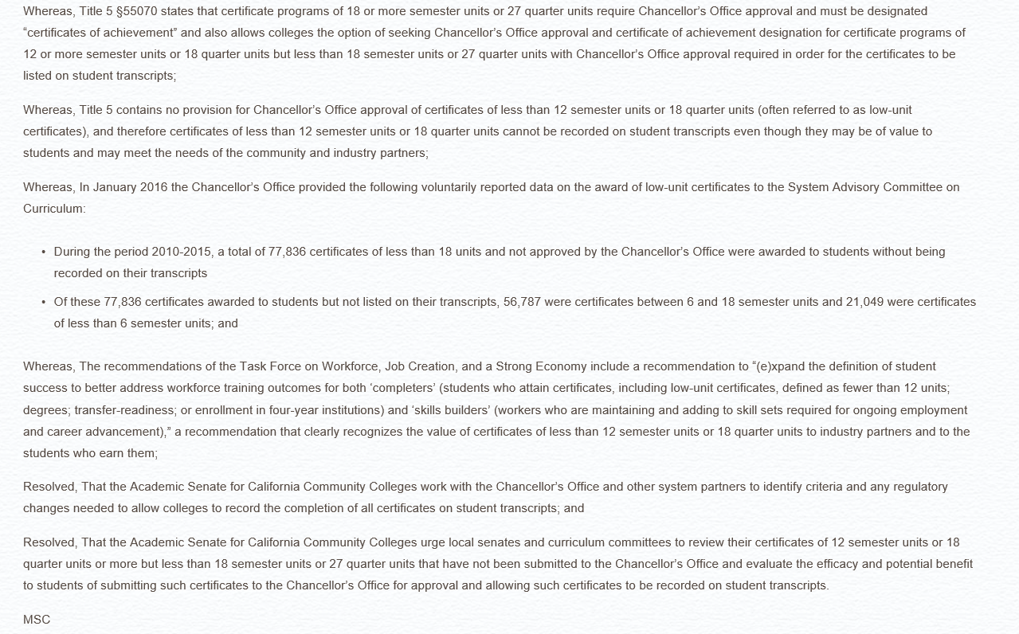
ASCCC
“Low-unit” resolution 09.03 SP16 – assigned to SACC

Slide 34
California Community Colleges Curriculum Committee (5C)
Proposed changes to Title 5 CCR §55070
Draft changes currently under discussion
Recommending low unit certificates have floor of 8 units
Recommendation goes to Board of Governors
Once approved by BOG will be added to the Curriculum Inventory

Slide 35
Questions?

Slide 36
Thank you!
For more information feel free to contact:
Lorraine Slattery-Farrell: lfarrell@msjc.edu

