Slide 1
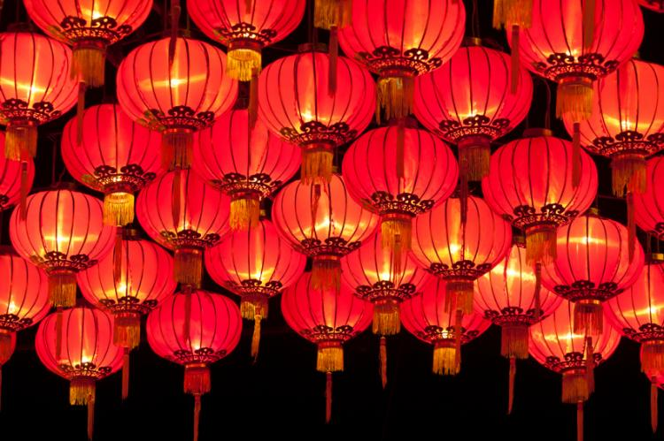
Saturday, January 25, 2020
Happy Lunar New Year!
Year of the Rat

Slide 2
Lunar vs. Western Gregorian calendars
Chinese, Korean, Mongolian, Tibetan, and Vietnamese people all around the world celebrate Lunar New Year as the most important holiday of the year.
The date changes every year because the Lunar and western Gregorian calendars intersect at different times.
In the spirit of diversity and inclusivity, your students would appreciate it if you shared a few words.

Slide 3
Year of the Rat
The rat is the first animal in the 12-year lunar zodiac cycle, which restarts in 2020.

Slide 4
House Cleaning 10 Days Before Lunar NY
to Sweep Away Bad Luck!
Before, but not after, as many believe cleaning on or after the New Year would sweep away any good luck.

Slide 5
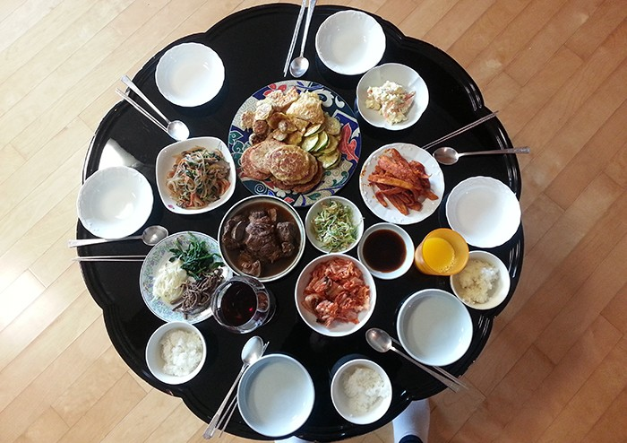
Lunar New Year Feasts: include rice cakes, dumplings, noodles, among others
Food is a particularly important part of the celebration, and meals often feature dumplings, rice cakes, and other items that symbolize wealth, bounty, prosperity, and peace.

Slide 6
Red Envelopes as Gifts
with money are commonly given to family, especially children.
Red symbolizes good fortune and prosperity.

Slide 7
President Obama’s Lunar New Year message Video:
https://www.youtube.com/watch?v=Yy3x8jUcH-w
Michelle and I send our warmest wishes to everyone celebrating the Lunar New Year here in America and all around the world. I’ll always remember the parades, fireworks, and gatherings that surrounded the Lunar New Year when I was growing up in Hawaii. And now as President, this celebration is a perfect reminder of the many cultures and faiths that make us who we are as Americans.
We are a nation of immigrants. Our vast array of traditions and perspectives and backgrounds – our melting pot – is what makes America unique. It’s what keeps us fresh and dynamic and entrepreneurial. That’s why last year, I took action to help fix our broken immigration system. But our work isn’t finished. We’ve still got to come together to pass a comprehensive immigration bill so that we can expand opportunities for more people to study, and serve, and contribute to our nation. Those are the aspirations that have attracted families to our shores for generations. And that story continues today. So whether you’re celebrating the Year of the Ram, the Year of the Goat, or the Year of the Sheep, may we all do our part to carry forward the work of perfecting this country that we love.
Happy New Year, everybody.
2015

