Slide 1
Breakout B: The Science of Program Mapping and DNA of Meta-Majors
Rebecca Eikey, Guided Pathways Task Force, Chemistry, College of the Canyons
Janet Fulks, Guided Pathways Faculty Lead, ASCCC Capacity Building
Biology, Bakersfield College

Slide 2
Program Mapping & Meta Majors
How do you get started with mapping programs and creating meta-major organization?
What are the guiding principles to help colleges build relevant groupings for meta-majors?
How can this organization serve the students and the college?
How can this process clarify pathways for the college and student support efforts?
What are some of your main questions?

Slide 3
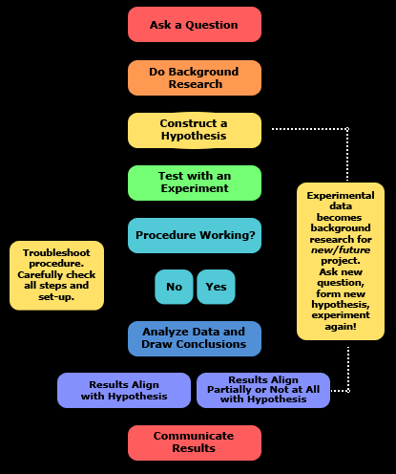
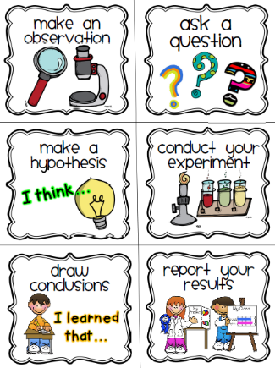
The Scientific Method
Begin with Observations

Slide 4
observations

Slide 5
Observation: First Screen of Majors

Slide 6
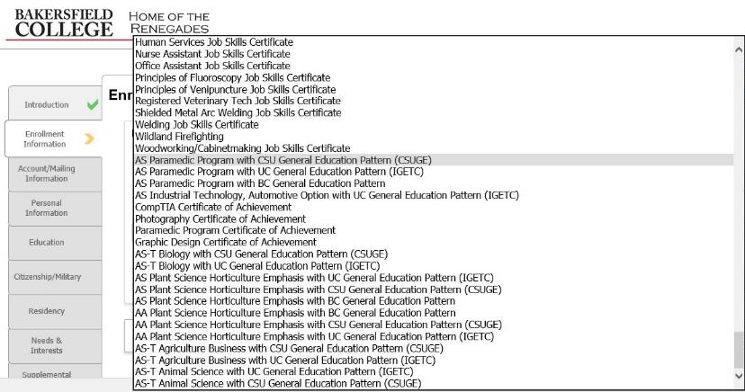
Observation: Ninth Screen of Majors

Slide 7
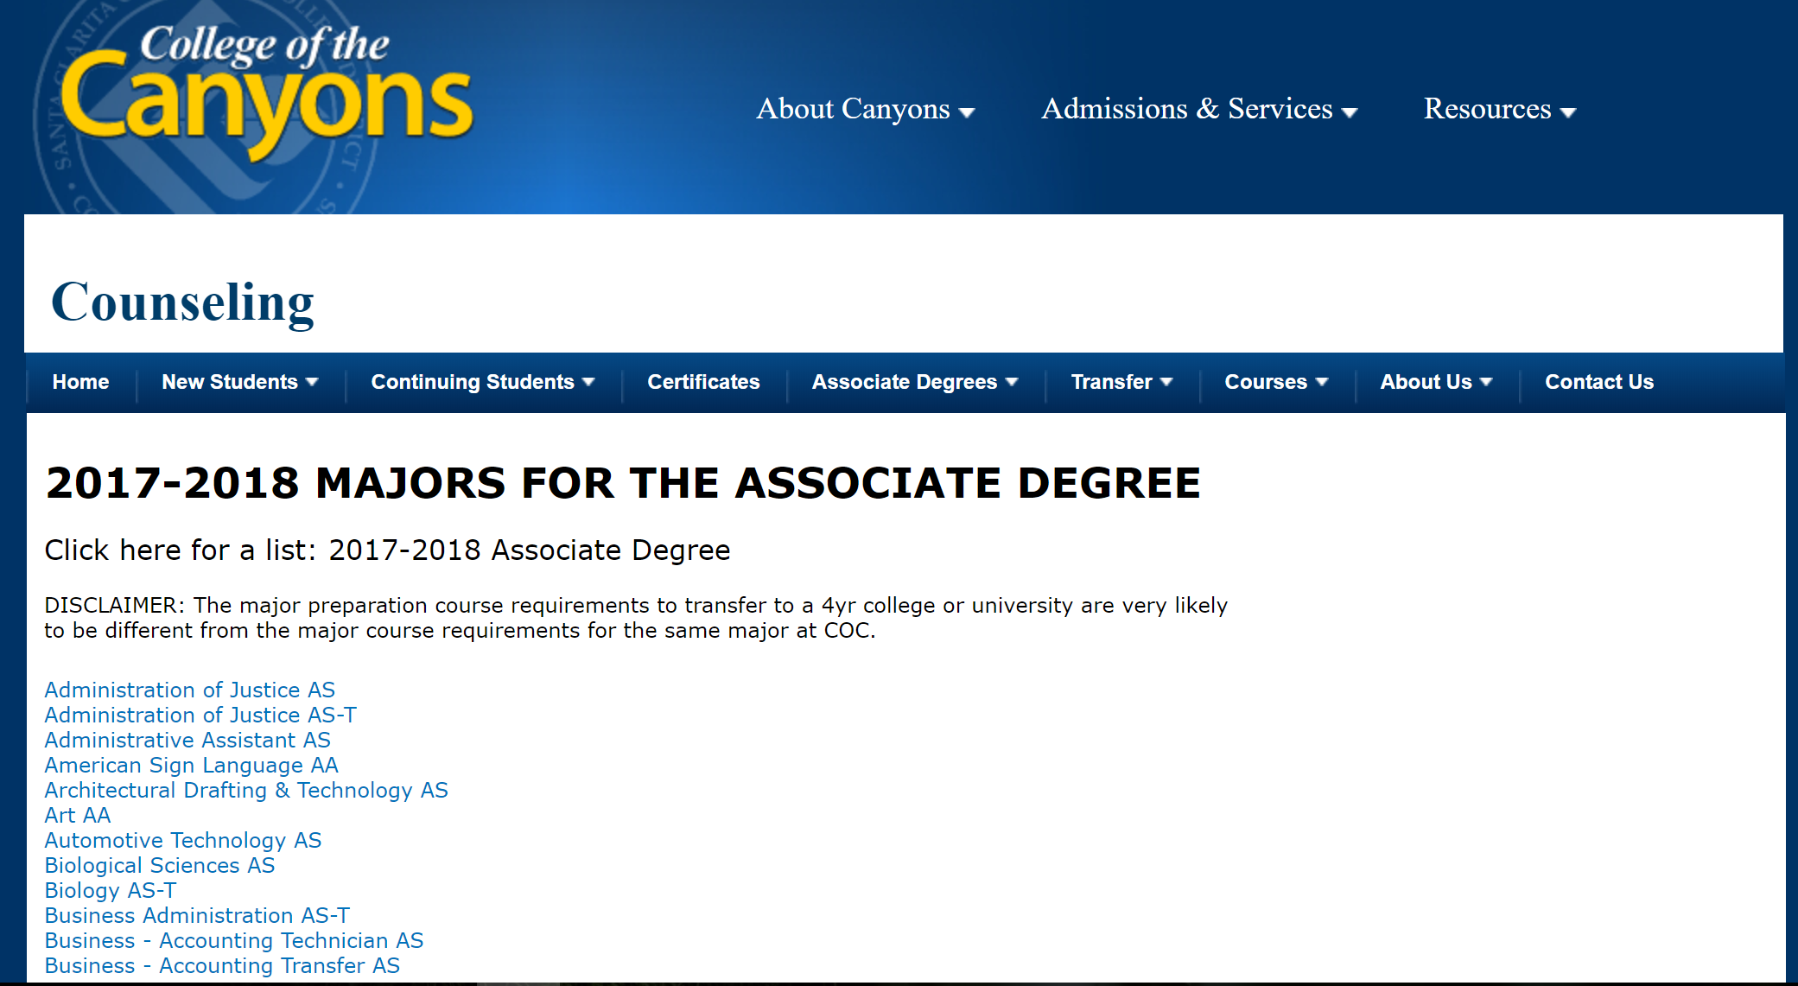
Observation: List of Majors with a Disclaimer

Slide 8
Question
What can be done to help students decide?

Slide 9
Would Meta-Majors Be Beneficial for Students in Selecting a Major?
Agriculture, Nutrition and Culinary Arts
Business
Arts, Humanities, and Design
Education
Health Sciences
Industrial and Transportation Tech
Public Safety
Social, Behavioral and Human Services
STEM
Personal and Career Exploration

Slide 10
Would Program Mapping Help Clarify Requirements?
Notes:
Middlesex Community College in MA

Slide 11
Do Background Research
What is a meta-major?
What is program mapping?
How are they related?
What are other colleges around the nation doing?

Slide 12
What are Meta-Majors?
Groupings of Related Majors
“Areas of Interest” or “Areas of Overlap” or “Major Pathways”

Slide 13
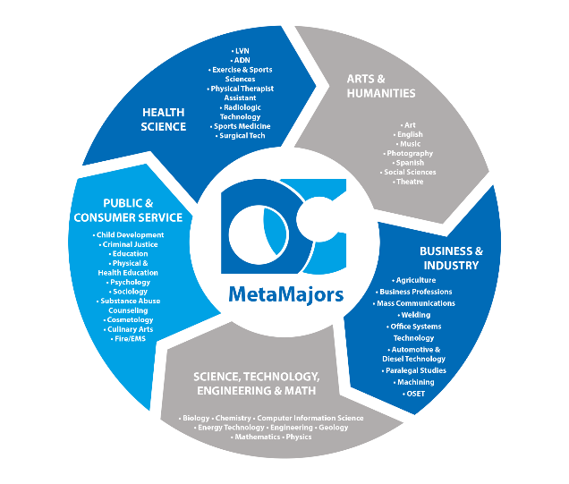

Slide 14
Meta-Majors or Career Pathways

Slide 16
City Colleges of Chicago

Slide 17
What is Program Mapping?
Academic or Program Mapping
Maps sequence of courses required to complete the degree
Term-by-term or
Unit-based
Helps students understand degree requirements and plan accordingly

Slide 18
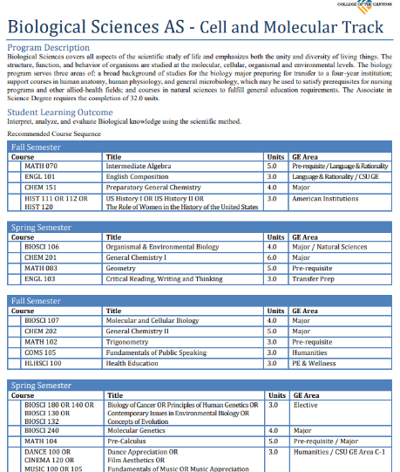

Slide 20
Why Have Meta-Majors?
Intentional Alignment with:
High School Pathways
Example: San Diego County’s California Career Pathways Trust Grant in Advanced Manufacturing
Transfer & Professional School Requirements
Example: Santa Monica College’s Law Pathway
Job Market & Careers
Core requirements – e.g. STEM math and science
Informed Choices

Slide 21
Santa Monica Colleges’ Law Pathway

Slide 22
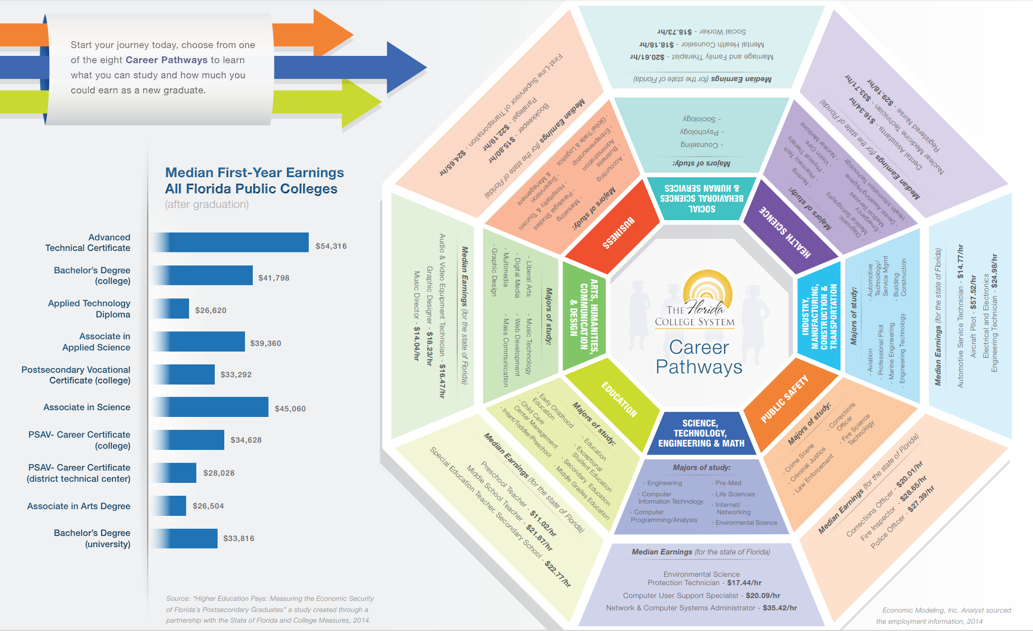
Florida College System

Slide 23
Meta-Majors with Program Mapping
Notes:
Better Guidance at All Levels
Helps to Find Majors
Exploration
Demonstrates the Starting and Ending Points
Informs Choices
Reduce Excess Units
Related Careers and Salaries
Register for the Correct Math and General Education
Math Pathways – Depends on Major

Slide 24
Graduating in Math at Bakersfield College an unguided pathway research project
Sample Pathways with Program Mapping

Slide 25
Common Elements of Meta-Majors & Program Mapping:
Each meta-major is clearly mapped to programs and careers.
General Education (GE) core courses are mapped with meta-majors.
Connections with GE courses and meta-majors and majors are made clear.
Sometimes electives are aligned with meta-majors.
Advising and student services are aligned with the student’s meta-major.
Math quantitative reasoning course is aligned with programs within the meta-majors.
Meta-majors may be aligned with local labor market demand.

Slide 26
Hypothesis:
Creating meta-majors with program mapping will benefit students.

Slide 27
Design the experiment
Which comes first, meta-majors or program mapping?

Slide 28
Design Principles in Creating Meta-Majors & Program Mapping
Who will lead the creation & implementation?
Committee? Taskforce?
Who should be involved?
How do you bring in student voice?
Which other stakeholders need to know about this?
How does the college’s broader environment (e.g., state or college policy) support or inhibit meta-majors?
How will the meta-majors and program mapping be communicated to students?
Notes:
Questions From Jobs for the Future

Slide 29
Skyline College

Slide 30
Analysis to Support Creating Meta-Majors & Program Mapping
What is the full scope of programmatic offerings at the college?
Do the college’s programs align to the local labor market and/or university transfer partner?
Which general education courses align best to each meta-major?
What are the common courses across all programs?
What is the required core within this meta-major that allows students to branch off into various majors without losing any credits?
Which courses will introduce students to relevant faculty and career information early in their academic careers?
Which courses might not be included, and who needs to be involved in that decision?
Notes:
Questions From Jobs for the Future

Slide 31
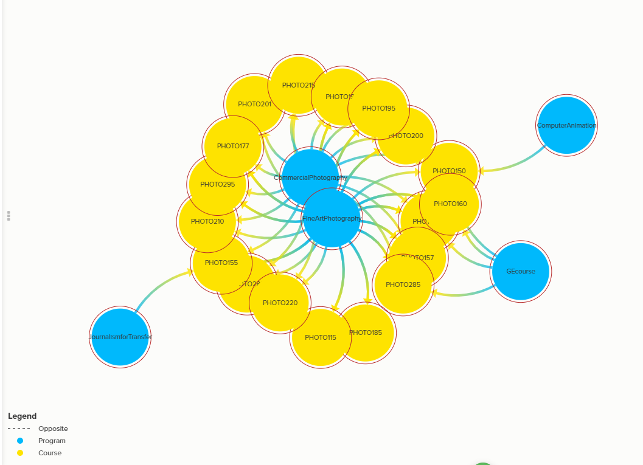
Programs that Require Photography Courses for Degree, Certificate, and/or Transfer
Kumu Map of Programs & Courses Vizualization

Slide 32
Student Course Taking Behavior
Programs with the Greatest Percentage of its Students Successfully Completing Photography Courses who are not Fine Art Photography program completers

Slide 33
Additional Considerations
How does the college communicate meta-majors to prospective students?
Will mapped pathways be presented to students as their default registration?
How will the college present mapped pathway requirements to students?
How does the college help students make informed choices about meta-majors?
How does meta-majors placement align with English, math & ESL placement?
Do orientations, first-year experience courses, and student success courses align to the meta-major?
Notes:
Photo data – example from COC

Slide 34
Other Thoughts on Designing Meta-Majors & Program Mapping
Many variations and possibilities
Bringing in the student voice
Student Focus groups
Classwork
Surveys
Iterative process
Refinement over time

Slide 35
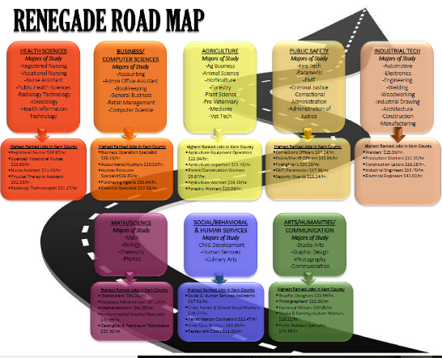
First Attempt at Bakersfield College
Focused on Outcomes and Jobs

Slide 36
Refinement of the Renegade Road Map

Slide 37
exploration?
Can students explore?

Slide 38
Arizona State University
Notes:
https://www.aacc.edu/programs-and-courses/credit-and-degree-seekers/explore/ - starting fall 2018

Slide 39
Results
How can this organization serve the students and the college?

Slide 40
What are the Outcomes?
Program clarity
Sequencing clarity
Specific data for nudges
Targeted messaging
Clear contacts for student questions
A village to lead the student to the outcome

Slide 42
Meta-Majors
Select a meta-major or Major
Program Offerings

Slide 43
CCCApply for Pathways

Slide 44
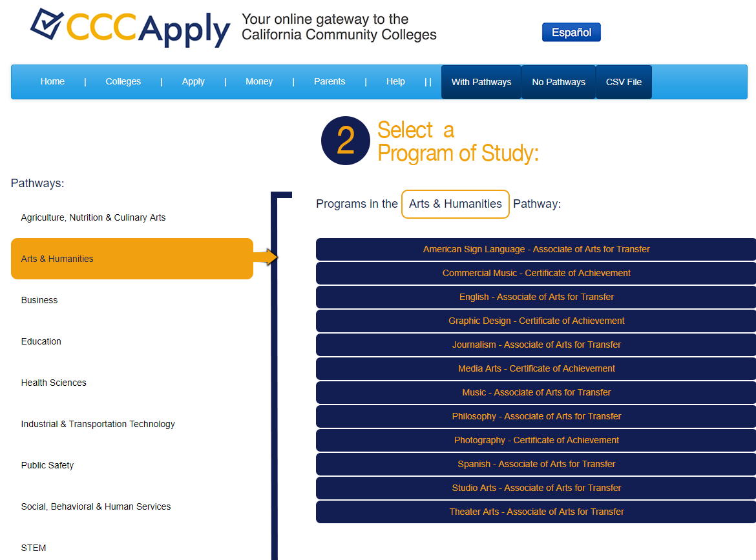
CCCApply for Pathways
Notes:
Should STEM be spelled out in CCCApply

Slide 45
Questions?
Thank you!

Slide 46
Additional Resources
Meta-Majors: An Essential First Step on the Path to College Completion (JFF)
http://www.jff.org/publications/meta-majors-essential-first-step-path-college-completion
How meta-majors guide students toward on-time graduation (EAB)
https://www.eab.com/daily-briefing/2016/07/26/how-meta-majors-guide-students-toward-on-time-graduation

