Slide 1
With Great Power comes great responsibility: New Ideas in Curriculum
Dolores Davison, Secretary, ASCCC
Ginni May, Executive Committee Member, ASCCC
Jackie Escajeda, Dean in Academic Affairs, CCCCO

Slide 2
Overview
SACC Update
Credit Courses
Program & Course Approval Handbook (PCAH)
Chancellor’s Office Curriculum Inventory (COCI)
Curriculum Workgroup

Slide 3
California Community Colleges Curriculum Committee
Name Change from SACC to 5C
Overseeing Work of the Curriculum Work Group
Current Projects:
Definitions of Basic Skills
TOP Codes and Alignment with WestEd
Credit Hour Regulations
Catalog Rights and Definitions
Program and Course Approval Handbook and Submission Guidelines Rollout

Slide 4
Credit Courses
Annual Credit Courses Certification
Due December 16, 2016
CIO and Curriculum Chair signature
This certification applies to the following credit courses:
1. New proposals to existing approved credit programs
2. Substantial change proposals
3. Stand-alone proposals
4. Nonsubstantial change proposals

Slide 5
Credit Courses

Slide 6
PCAH, 6th Edition
Standards and Guidelines
Implementation & Submission
Curriculum Inventory Manual

Slide 7
PCAH Timeline
Standards and Guidelines
Submitted to the BOG in July 2016
Corrections (inclusion of standalone approved by the BOG in July) continuing
Intended release - December 2016 (in conjunction with the COCI)

Slide 8
PCAH Timeline
Submission Guidelines
Plan is to release version with PCAH if possible
Curriculum Inventory Technical Manual
Will be developed after COCI is fully rolled out and issues/concerns have been identified

Slide 9
Important Reminders:
The new COCI application is being designed to replace the system currently in use because the original contract concluded. The application isn't being designed for use as the primary curriculum management system at the local level.
The CCCCO is not requiring colleges to correct data validation issues prior to using the new application.
Courses and Programs that have validation errors will not change in status during migration.
Notes:
jackie

Slide 10
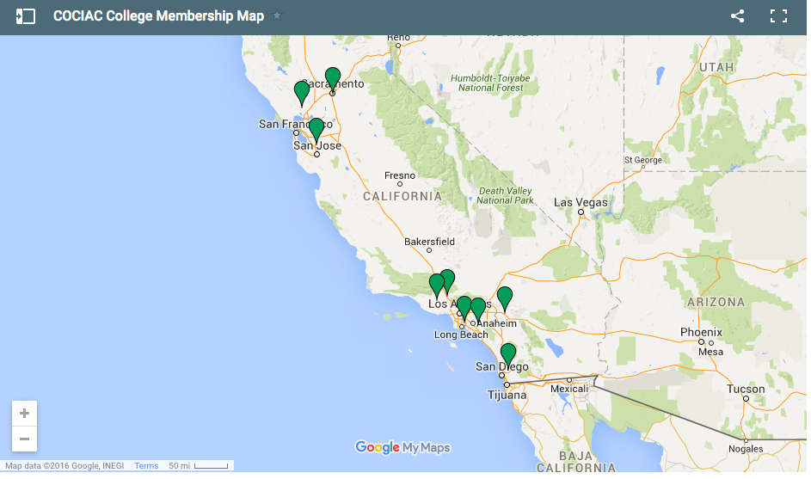
Pilot Colleges and COCIAC
Cerritos
Foothill College
Rio Hondo
Sacramento City College
Ohlone
Grossmont
Moorpark
College of the Canyons
Crafton Hills
Cypress
Barstow
Santiago Canyon
Los Rios
Mendocino
Berkeley College
College of Marin
Imperial Valley
Chaffey
Notes:
Craig/Joanna

Slide 11
Implementation Schedule
 | Sep | Oct | Nov | Dec | Jan | Feb | Mar
MVP Development
User Acceptance Testing
Pilot and Advisory Committee Testing and Conversion |  |  |  | 12/16-2/3
Limited Availability |  |  |  |  | 2/10-2/24
Final Conversion |  |  |  |  |  | 2/27-3/10
Notes:
Craig/Joanna

Slide 12
Curriculum Workgroup
Purpose
Members of the Work Group
Legislation and History of the Review of Curriculum
Curriculum Lifecycle
Curriculum Process – Effective Practices
Next Steps

Slide 13
Curriculum Workgroup Purpose
Delve into curriculum processes and determine means by which to streamline
Local Processes
ASCCC Regional Workshops
Plan to roll out in December through winter/early spring
CCCCO Processes
What are the legal obligations?
Changes on standalone and other approvals
Outside entities

Slide 14
Curriculum Workgroup Members
CEO Lori Bennet and Doug Houston
CIO Virginia Guleff and Terri Long
ASCCC Cheryl Aschenbach, Marie Boyd, Dolores Davison, and Craig Rutan
CO Pam Walker, Van Ton-Quilivan, Kirsten Corbin, Jackie Escajeda, and LeBaron Woodyard
5C Marilyn Perry

Slide 15
Curriculum Review: Legislation & History
Ed Code §70901
b) Subject to, and in furtherance of, subdivision (a), and in consultation with community college districts and other interested parties as specified in subdivision (e), the board of governors shall provide general supervision over community college districts, and shall, in furtherance of those purposes, perform the following functions
10) Review and approve all educational programs offered by community college districts and all courses that are not offered as part of an educational program approved by the board of governors

Slide 16
Curriculum Review: Legislation & History
Ed Code §70902
(a) (2) The governing board of each community college district shall establish rules and regulations not inconsistent with the regulations of the board of governors and the laws of this state for the government and operation of one or more community colleges in the district
(b) In furtherance of subdivision (a), the governing board of each community college district shall do all of the following:
(1) Establish policies for, and approve, current and long-range academic and facilities plans and programs and promote orderly growth and development of the community colleges within the district. In so doing, the governing board shall, as required by law, establish policies for, develop, and approve, comprehensive plans. The governing board shall submit the comprehensive plans to the board of governors for review and approval
(2) Establish policies for and approve courses of instruction and educational programs. The educational programs shall be submitted to the board of governors for approval. Courses of instruction that are not offered in approved educational programs shall be submitted to the board of governors for approval. The governing board shall establish policies for, and approve, individual courses that are offered in approved educational programs, without referral to the board of governors

Slide 17
Curriculum Review: Legislation & History
Six duties of CO:
Review and approve all educational programs (70901(b)(10))
Review and approve all courses that are not program-related (70902(b)(2))
Establish policies for courses of instruction and educational programs (70902(b)(2))
Review and approve courses of instruction and educational programs (70902(b)(2))
Review and approve non-program courses (70902(b)(2))
Review and approve program courses (70902(b)(2))

Slide 18
Curriculum Review: Legislation & History
Historical timeline:
1907 CA is the first state to legislate public junior colleges
1910 Fresno establishes the first JC
1921: Three types of JC districts legislatively created, two more in 1927
Modesto JC first college district, Riverside soon after
1930: Junior College Federation formed. Represented JC's as institutions
1931: Prior, UC had accredited JC's, after Dept. Ed took over

Slide 19
Curriculum Review: Legislation & History
Historical timeline:
1947: AB2273 provided for comprehensive survey of higher education in CA, the "Strayer Report". Stopped the growing trend for JC's to try to become 4-year institutions
1950: Western College Association took over accreditation. College of the Sequoias first to be accredited by them
1953: Legislature requests study on higher education in CA. Recommendations: JC's provide GE, occupational training, lower division college education, guidance, and community service training. Recommended a fuller study

Slide 20
Curriculum Review: Legislation & History
Historical timeline:
1953: JC's and State DOE to establish clear cut criteria for approving courses and curriculum. Tied this to state funding
1955: JC's allowed to hold summer school, admit students 16 years and older, and to admit non-HS graduates over A-18
1955: Legislature begins fuller study. The Master Plan for Higher Education in CA (MPHE) grew out of this
1959: Out of state tuition started

Slide 21
Curriculum Review: Legislation & History
Historical timeline:
1960: MPHE established:
Defined public education in higher ed as: UC, state college system, and JC's
JC's to be governed by local boards
State BOE to establish minimum standards.
JC's not to instruct past 14th year
Focus on: College transfer courses, vocational-technical training, GE and liberal arts

Slide 22
Curriculum Review: Legislation & History
Historical timeline:
1963: Grading standards for JC's established
1964: State BOE created Academic Senates
1988: AB1725 increases responsibility of BOG, CO, and CCD's

Slide 23
Curriculum Review: Legislation & History
Findings:
AB1725 implemented most recommendations from a 4-year study by the Master Plan Review Commission and Joint Legislative Committee for Review of the Master Plan for Higher Education
The bill is diffuse and at times inconsistent
Increases the authority of BOG and the CCD's
Reduces involvement of Legislature
Enhances notion of CC's operation as a system

Slide 24
Curriculum Review: Legislation & History
Findings:
No clear legislative intention found
No mention in committee notes
Both CO and CCD duties increased
There is a mention that the CO should work with the Academic Senate on matters of curriculum and course approval*
*Assembly Subcommittee on Higher Education, Hearing Report for May 04, 1987 (page 11 of "AB 1725 Assembly Subc Higher Ed.pdf"); see also: Letter from the Commission for the Review of the Master Plan for Higher Education to the Joint Legislative Committee for the Review of the Master Plan for Higher Education, (page 32 of "AB 1725 Senate Education Committee.pdf").

Slide 25
Curriculum Review: Legislation & History
Conclusion:
Ambiguous and incomplete law
Unclear legislative intention
History demonstrates a movement of authority and responsibility away from the legislature and to CO and CCD, similar to CSU and UC

Slide 26
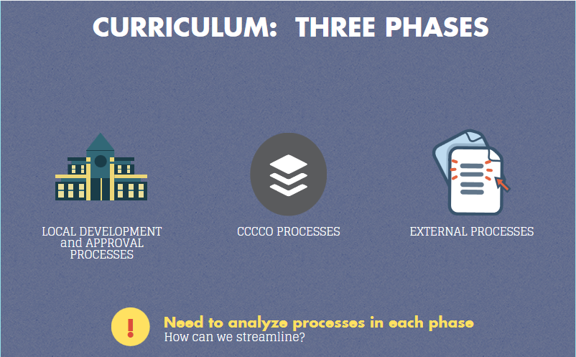

Slide 27
Curriculum Process
Effective practices in the last 2 years:
Established hours and units calculations
Auto approval of nonsubstantial credit courses
Title 5 changes to delegate local authority for stand-alone credit courses
Increase of curriculum training
Peer review workshops
Improved communications
PCAH, 6th Edition

Slide 28
Next Steps
Meeting Schedule:
November 15
December 14
California Community Colleges Curriculum Committee (5C) Schedule
Consultation with Colleagues
Implementation

Slide 29
Questions and Thank you!!
Dolores Davison (davisondolores@foothill.edu)
Ginni May (mayv@scc.losrios.edu)
Jackie Escajeda (jescajeda@CCCCO.edu)‎

