Slide 1
New, Newer, or Aspiring Curriculum Chairs
Randy Beach, Southwestern College Curriculum Chair
Sarah Harris, College of the Sequoias, ASCCC Curriculum Committee Member
Jeff Waller, Grossmont College, Former Curriculum Chair (6 years)

Slide 2
Description
This pre-session is designed for new, newer, and aspiring curriculum chairs or faculty on curriculum committees. Topics will include the role of the curriculum committee and its members as a part of a college’s academic senate, the legal framework for how the committee works with the local governing board, examples of common curriculum processes and practices, incorporating IDEAA in curriculum work, and ways for chairs to work effectively with others and get things done.

Slide 3
Agenda
In the Room and on the Zoom: Introductions
The Curriculum World: Contexts, Policies and Processes
Responsibilities of Curriculum Chairs
Working with Others
Managing Conflict and Workload
Resources
Closing Thoughts
Contact information

Slide 4
Introductions

Slide 5
In the Room and on the Zoom: Introductions
Panel and Attendee Introductions:
Are you a: Current Curriculum Chair, Future Chair, Aspiring Chair, Committee Member, Other Role
How long have you been in your role: Less than 1 year, 1 – 5 years, More than 5 years
How many Curriculum Institutes have you attended: First time attendee, 2 – 5, More than 5
On Zoom: Use the chat feature in Pathable. One of our presenters will monitor chat and address questions or raise them with the group.
On Zoom: Please make sure your mic is muted! If you wish to speak, use ”raise hand” and wait to be called on to unmute.
In Room: Please keep cross-talk to a minimum so online attendees can follow the conversation.
In Room: Raise your hand and be sure to speak up when called on! Panelists will repeat your question/comment or run a mic to you.
All: Please be patient and with us and your colleagues as we navigate this new, hybrid experience together.
Notes:
Poll Questions: Rolls – Current Chair, Future Chair, Aspiring Chair, Committee Member. Time Served: 1 year or less, 2 – 5, more than 5, How many institutes
Sarah – Presenting, Randy – Zoom, Jeff - Mic

Slide 6
Navigating the Curriculum Institute
Chats and PPT materials are archived on Pathable – all registered attendees have access
Attend “Curriculum Mingle and Networking” Sessions (Breakout 7, each session)
Have you signed-up for the ASCCC and
California Community College Curriculum Chair Listservs?
ASCCC Listservs:
https://www.asccc.org/signup-newsletters
California Community College Chairs Listserv:
https://groups.io/g/CCCCurriculumChairs/

Slide 7
Commonly Used Acronyms
Acronym | Definition
ASCCC | Academic Senate for California Community Colleges
ACCJC | Accrediting Commission for Community and Junior Colleges
CCC | California Community Colleges
CCCCO/CO | California Community Colleges Chancellor’s Office
CIO | Chief Instructional Officer (often the VPI)
COCI | Chancellor’s Office Curriculum Inventory
COR | Course Outline of Record
PCAH | Program and Course Approval Handbook
*VPI | Vice President of Instruction
 | *colleges may have different titles
Notes:
Note PCAH has more – link in references

Slide 8
The Curriculum World: Contexts, Policies and Processes

Slide 9
Addressing IDEAA (Inclusion, Diversity, Equity, Anti-Racism and Accessibility)
Our nation, system, and colleges are at critical point of self-reflection and change.
Equity is the mission of the CCC system. It’s baked into our purpose by design and law.
Curriculum Committee Chairs are key faculty leaders on local campuses. You have an important role in this dialogue and action.
Educate yourself! Systemic, institutional change is needed to meet the moment and you are in a key position to support your colleagues as they address these issues through evaluation and revisions of their curricula.
Changes to curriculum to address issues of equity are likely to be in front of your committee in the coming year. Lead and train your committee to support the work of faculty as they respond to these issues in their discipline.
Notes:
Links to IDEAA resources on last slide
Jeff (9 – 11) – Present, Randy – Zoom, Sarah - Mic

Slide 10
Layers of Guidance
CA Education Code
Statute, determined by legislation
Title 5 (California Code of Regulations)
Interprets Ed Code into regulations, determined by Board of Governors
Chancellor’s Office Program and Course Approval Handbook (PCAH)
Establishes specific guidelines for implementing Title 5
Developed by Chancellor’s Office with CCC Curriculum Committee (5C)
Chancellor’s Office guidelines
Further clarify implementation of title 5 and emerging issues (e.g. AB 705)
ASCCC papers and reference guides
Best practices available online: https://www.asccc.org/publications#

Slide 11
Searching Title 5
Easy to browse or search CA Code of Regulations at https://govt.westlaw.com/calregs/Browse/Home/California/CaliforniaCodeofRegulations
Title 5: Education
Division 6: California Community Colleges
Chapter 6: Curriculum and Instruction
Subchapter 1: Programs, Courses, and Classes
For a list of sections related to curriculum see PCAH, 7th ed.

Slide 12
CCCs, CSUs, and UCs
CCC’s can determine CSU transferability based on local policy with some basic content requirements (CSU Executive Order 167)
UC Courses must be submitted and reviewed to determine transferability
Transfer is distinct from an AAM (Articulation Agreement by Major)
These systems are complex – rely on your Articulation Officer as an expert resource!
Related Breakout Sessions:
Transfer Pathways and Updates (Breakout Session 1 – Online)
C-ID Update and AB 1111 Common Course Numbering (Breakout Session 2 – Online)
General Education and AB 928 (Breakout Session 4 – Hybrid/Interactive)
Collaboration between Curriculum and Articulation to support student transfer (Breakout Session 5 – Hybrid/Interactive)
Notes:
New Chairs focus – AO as resource, links to C-ID, pathways, assist, other breakouts
Sarah – presenter, Randy – Zoom, Jeff - Mic

Slide 13
Faculty Authority Over Curriculum
Authority over the curriculum is codified in California Education Code (§70902) and further refined in Title 5 Regulations (§53200).
Along with the authority, there is a responsibility: work with other faculty, administrators, and staff.
Administration has “right of assignment” over courses and programs.
ACCJC Standards focus on faculty purview in curricular matters:
II.A.2 Faculty ensure that the content/methods of instruction meet standards
II.A.3 Student learning outcomes
II.A.4 Pre-collegiate level curriculum
II.A.12 Faculty expertise the basis for courses approved for general education
IV.A.4 Faculty role in governance for curriculum and student learning programs and services
Notes:
(13-14) Randy – presenting, Jeff – Zoom, Sarah - Mic

Slide 14
Curriculum is a 10+1 Matter – Title 5, Section 53200
Curriculum, including establishing prerequisites
Degree and certificate requirements
Grading policy
Educational program development
Standards or policies regarding student preparation and success
College governance structures, as related to faculty roles
Faculty roles and involvement in accreditation processes
Policies for professional development activities
Processes for program review
Processes for institutional planning and budget development
+1 Other academic and professional matters as mutually agreed upon

Slide 15
Responsibilities of Curriculum Chairs

Slide 16
Types of Curriculum
CREDIT
Courses
Degree-applicable
Non degree-applicable
Programs
Associate Degrees (AA, AS)
Associate Degrees for Transfer (AA-T, AS-T)
Certificates of Achievement
16 + units must be submitted to CO
8-<16 units may be submitted to CO
Locally Approved Certificates
<8 units; or 8 -<16 units not CO approved
NONCREDIT
Courses
Noncredit: Courses must fit in one of 10 categories to be approved by CO/receive apportionment
vs. not-for-credit/community services: fee-supported class; apportionment is not claimed; locally approved
Programs
Cert. of Completion/Competency (CDCP)
Adult High School Diploma
Noncredit Apprenticeship Program
Locally Approved Certificates (not CO approved)
Notes:
(16 – 18) Jeff – Presenting, Randy – Zoom, Sarah Mic

Slide 17
Typical Approval Process
Discipline faculty develop and submit
Local curriculum committee reviews and approves
May include separate tech review, distance education review, requisite review, etc.
Local governing board approves
Submit to Chancellor’s Office
Auto approval/chaptering for credit courses, local credit programs
Review/approval for CDCP noncredit, non-C-ID CTE, ADTs
Once you have a Control Number, curriculum can be:
published in catalog, schedule, etc.
eligible for apportionment
sent for external articulation and transfer agreements
Notes:
Note: At some colleges Senate approves curriculum (bullet two).

Slide 18
What Typically Happens in Committee Review
Technical review: ensures complete data, compliance, and consistency
May be completed by CC members, subcommittee, co-chair, curriculum specialist, etc.
Can deal with looking at some of the things that tend to make CC meetings drag on: grammar, wording, codes, etc
Content review: looks at the appropriateness of the content, objectives, SLOs, assignments, etc. specific to the discipline.
Discipline faculty create and review content in terms of disciplinary expertise
CC members trained to looked for specific things in content:
Assignment of a discipline, minimum qualifications
Avoiding duplication of existing curriculum
Appropriateness to college mission
Integration of elements of COR (content, objectives, assignments, etc.)
Justification for advisories, requisites, GE petitions, DE modalities

Slide 19
Things to Keep on Your Radar
Federal and state laws and regulations, Breakout 1: “Curriculum and Legislation”
ACCJC accreditation standards, Breakout 6: “Catalog Requirements and other Curriculum Related Accreditation Requirements”
District policy and regulations
College mission
UC, CSU, and C-ID (See slide 12 for related sessions)
CTE consortia and advisory committees, Breakout 5: “Using Labor Market and Advisory Committee Data”
Noncredit policies and regulations, Breakout 1: “Noncredit Basics”
Community need
And more …
Notes:
(19 – 20) Sarah – Presenting, Randy – Zoom, Jeff - Mic

Slide 20
Advice for New/er Chairs
The most important thing that you always need to remember is slow down and take a deep breath.
Best statement to use when you don’t know the answer: “Let me get back to you on that…”
Train committee members and delegate; you can’t and are not expected to do it all yourself!

Slide 21
Break!
(15 Minutes)

Slide 22
Working With Others
Who needs to be involved with curriculum? Who else is affected?

Slide 23
Chief Instructional Officer (CIO)
CIOs are usually members of the curriculum committee.
The curriculum chair ideally should schedule regular meetings with the CIO.
Discuss important issues outside of the Curriculum Committee meetings.
It is not productive for the CIO and the Curriculum Chair to be disagreeing with each other during a committee meeting.
Disagreements will happen - remember faculty purview over 10+1 areas.
Notes:
(23 – 24) Randy – presenting, Jeff – Zoom, Sarah - Mic

Slide 24
Articulation Officer (AO)
Your AO is an incredible resource of information for you and the curriculum committee.
If they aren’t already a member of your committee, they probably should be.
Does your AO give reports at your meetings? How might you work with the AO to encourage faculty to make changes to their courses to improve your college articulation agreements?
Articulation Officer website: http://ciac.csusb.edu/

Slide 25
Curriculum Specialist/s
Strong support from the staff in your curriculum office is vital.
Curriculum staff have many responsibilities including:
submitting changes to CCCCO;
inputting changes into your student enrollment system;
preparing submissions for the governing board; and
assisting with the production of your college catalog.
Establish an effective working relationship with regular communication and consultation.
Notes:
(Sarah 25 – 28) – presenting, Randy – Zoom, Jeff - Mic

Slide 26
Local Academic Senate
Curriculum Committee acts under the authority granted to the Academic Senate.
Senate needs to stay in the loop even if they do not actively review curriculum
Curriculum chair may be a voting member of Senate OR,
Curriculum chair may make regular reports to Senate OR,
Senate may appoint a liaison to attend curriculum meetings.
Make sure as chair you have a place at Senate to discuss curricular issues/updates.
Consider other committees/groups where the curriculum chair should have a place to inform about/discuss issues/updates.

Slide 27
Working with Faculty
Faculty tend to only look at their CORs when they are in curriculum review or want to create a new class (or remove a class). How do curricular changes affect other disciplines?
Educate the faculty on effective and equitable curriculum practices.
Make yourself available to faculty to answer questions.
When regulatory changes happen (like AB 705/1705), you need to sit down with affected faculty and explain what is going on and why.

Slide 28
Local Board of Trustees (BOT)
Ideally they will adopt policies and procedures related to curriculum only if recommendations on those curriculum policies and procedures are made through collegial consultation with the local Academic Senate.
Final approval for all curriculum proposals.
Where BOT members get their training:
Community College League of California
https://www.ccleague.org/professional-development/trustee-development
Admin are required to receive annual curriculum training related to the Curriculum Certification process; consider also training Board Members.

Slide 29
Other People Chairs Might Work with:
Former chairs!
Counselors & Librarians
Deans
Deputy Sector Navigators (CTE)
Distance Ed coordinator
Equity Committee Chair/Rep
Financial Aid Office
IT support staff
SLO coordinator
College Researcher
Admissions/Records/ Degree Auditors
Scheduling
Assessment/Placement Coordinator
Other committees
High School Articulation and Dual Enrollment
Others??

Slide 30
Scenario #1
A faculty member wants to develop two new programs: a certificate that helps students get a job and a transfer degree. They want to know how to get started.
What is your college process for new program development?
Who needs to be involved in the discussion?
What resources do you need?
What other questions do you ask?
Discussion
Notes:
(29 – 30) Jeff – presenting, Randy – Zoom, Sarah - Mic

Slide 31
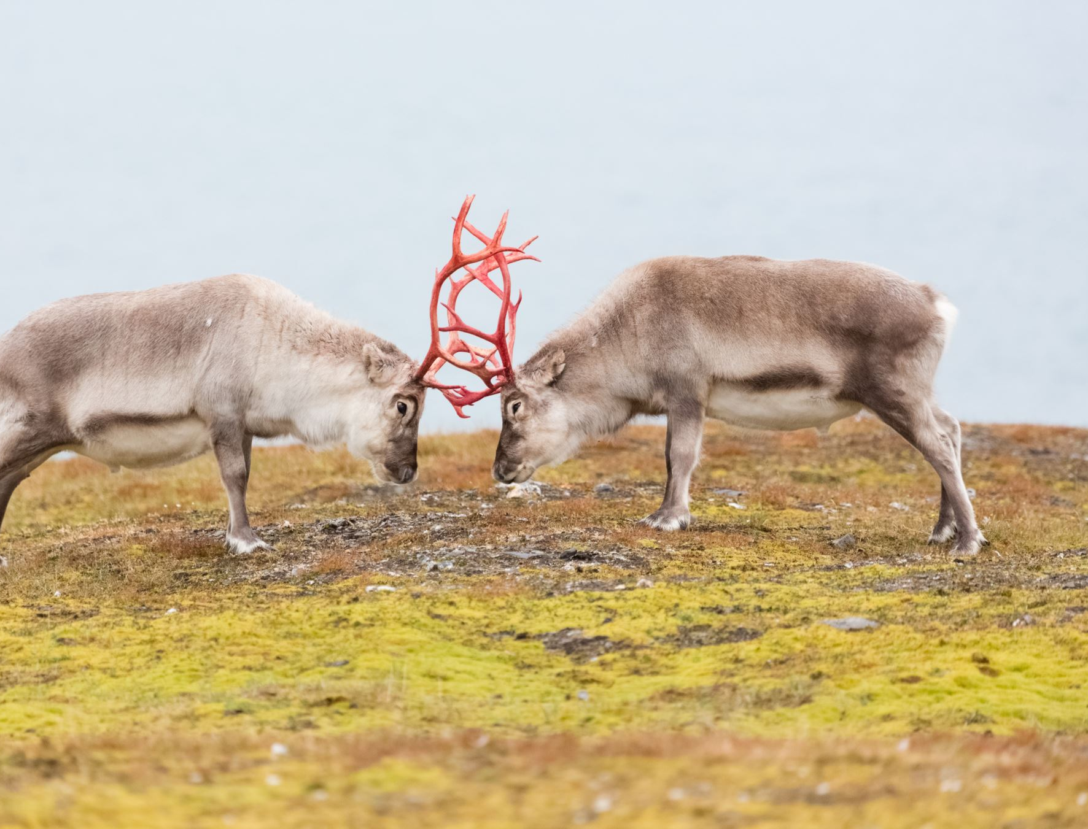
Managing Conflict and Workload

Slide 32
Managing Conflict
Get comfortable with conflict - it can be productive or destructive, depending on how it is handled.
Remain impartial and remember that you are representing the faculty of your college not just one area.
You can’t make everyone happy. Work with all parties to try and reach a solution that meets as many interests as possible.
Anticipate and preempt what conflicts could arise.
If conflicts happen during a meeting, take back the floor when the discussion gets off topic. Remember that you are in control of the meeting and you need to keep the discussion as civil as possible.
Notes:
Sarah – presenting, Randy – Zoom, Jeff - Mic

Slide 33
Managing the Meeting
Curriculum Committees follow Brown Act Public Meeting Act (72 hour agenda, public access, etc.)
Public Comment time opportunity for issues to be raised without debate
Actions must be agendized, so gives cooling off time
Robert’s Rules can be your friend
Chair must recognize a speaker
Speakers have an order, voting members then guests
Once someone has spoken, back of the line...encourages diverse views
Can place a limit on time for a speaker
Establish your protocols at the beginning...pays off later
Notes:
Randy (33 – 34) – Presenting, Jeff – Zoom, Sarah - MIc

Slide 34
Workload and Scope-Creep
New Initiatives:
What is your role in new initiatives?
What is your communication pipeline?
Can you propose change/ manage change?
What and where can you delegate?
What new initiatives are you aware of?
How can you balance the workload while also ensuring faculty voice?
How do you document which committee is responsible for each task?

Slide 35
Scenario #2
The department chair from Political Science has approached you about a pending new course submission for “Political Philosophy” from the Philosophy department, claiming that the new course is actually a Political Science course, not a Philosophy course, and should be removed from the committee’s agenda until the faculty from each department sort out who should ”own” the course.
What steps would you take in this situation?
What local or state resources can you consult?
What information would be most helpful for your committee and the faculty as you work through this process?
Who needs to be involved in the discussion?
What other questions do you ask?
Breakout Session
Notes:
Jeff – presenting, Randy – Zoom, Sarah – Mic
DEIA Curriculum Document – refer to “discipline ownership” as potential barrier to equity (alternate between room and zoom)

Slide 36
Closing Thoughts

Slide 37
Useful Resources
ASCCC curriculum webpage: https://www.ccccurriculum.net/
Listservs:
ASCCC Listservs: https://www.asccc.org/signup-newsletters
California Community College Chairs Listserv : https://groups.io/g/CCCCurriculumChairs/
IDEAA:
CCC Student Senate: Anti-Racism Plan of Action
DEIA Model Principles and Practices (Memo)
Transfer Resources:
ASSIST.org
C-ID: https://c-id.net/
UC Pathways: https://admission.universityofcalifornia.edu/admission-requirements/transfer-requirements/uc-transfer-programs/transfer-pathways/
UC Transfer guidelines
CSU GE and IGETC Guiding Notes
CTE and Other:
California Regional Consortia, https://www.regionalcte.org/
CA Cooperative Work Exp Education Handbook
Dual Enrollment Guide (RP Group)
Regulations:
US Federal Student Aid Financial Aid
Title 5 on Westlaw, https://govt.westlaw.com/
ASCCC Exec Committee Legislative Reports (see Events > Past Events for prior Exec Committee meetings)
ASCCC Resources/Publications:
https://www.asccc.org/resources
Equivalence to Minimum Qualifications
Noncredit at Glance
The Course Outline of Record: A Curriculum Reference Guide Revisited
CCCCO Resources:
https://www.cccco.edu/
Baccalaureate Degree Pilot Program
COCI (public view): https://coci2.ccctechcenter.org/
Minimum Qualifications Handbook
Prerequisites/Corequisites Guidelines
Program and Course Approval Handbook (PCAH)
Repetition Guidelines
TOP Code Manual
Notes:
Update links here – maybe add leg updates from ASCCC, link to ICAS, DEIA memo

Slide 38
Contact Information
Questions? Email the Academic Senate for California Community Colleges:
info@asccc.org
Join the CA Community College Curriculum Chairs Listserv:
https://groups.io/g/CCCCurriculumChairs/

