Slide 1
Noncredit & AB705 Panelist Tyrone Nagai - MiraCosta Janet Cagley - NOCE Maryanne Galindo – LA Mission Organizers Gevork Demirchyan - Glendale Mary Margarita Legner - Riverside City

Slide 2
Description
This session will cover some of the changes as a result of AB705 and how Noncredit can be used to support underprepared students in transfer-level courses

Slide 3
Introductions
Tyrone Nagai
Instructor, Pre-Transfer Letters Department
MiraCosta College
Janet Cagley
Professor, High School Diploma Program & Distance Education Faculty Coordinator
North Orange Continuing Education (NOCE)
Maryanne Galindo
Department Chair- Academic Readiness, Career & Community Institute
Los Angeles Mission College

Slide 4
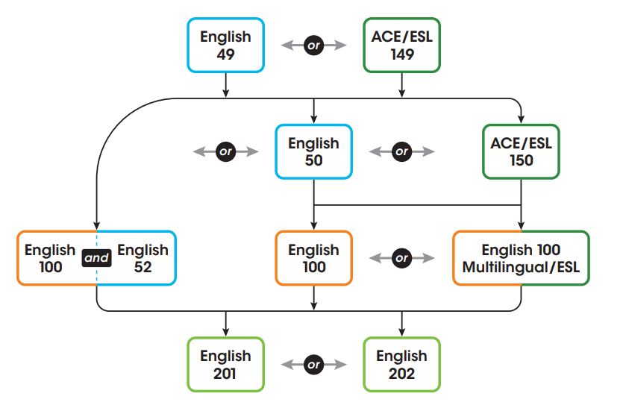
MiraCosta College’s Past English Sequence
(Before AB705)

Slide 5
MiraCosta College’s Present English Sequence
English 100 offered at non credit
campus
Co-req course mirrored as non credit at all campuses
(After AB705)

Slide 6
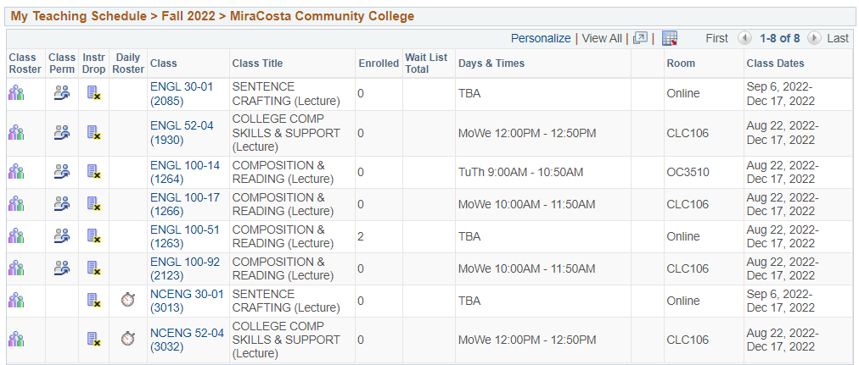
Mirrored Sentence Crafting Course Tyrone Nagai

Slide 7
Mirrored Co-req Course Tyrone Nagai

Slide 8
College Prep Math
NOCE inherited below transfer level courses from Cypress College as a result of AB 705.
Before COVID (BC), these courses were offered in a f2f format.
With the transition to online instruction as a result of the pandemic, we realized that instructors needed support to create accessible, engaging online math courses.
This resulted in a partnership with Ease Learning.
@ North Orange Continuing Education

Slide 9
NOCE & Ease Learning
Ease provided NOCE’s subject matter experts (SMEs) with a framework and systematic approach to online course development.
Courses are created in alignment with the CVC-OEI Rubric and with an eye for digital equity.
In addition to support designing the courses, NOCE opted to migrate content to Ease Learning’s Skillways platform.
Collaboration

Slide 10
Supporting Students
Ease Learning is supporting NOCE in developing data-driven continuous improvement processes through their analytics and insights.
Skillways provides instructors with real-time data, empowering them to intervene quickly if students need support or enrichment.
Analytics and insights will be used to guide future course revisions, programming, and reporting on outcomes.
Through Targeted Data

Slide 11
Skillways Heat Map
Figure shows Mastery Achievement and Completion. Results are updated in real time.

Slide 12
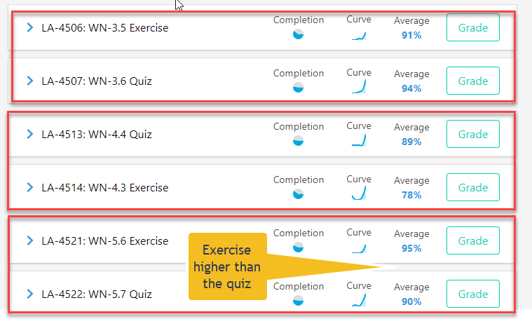
Analytics & Insights
In theory, the scores on Quiz formative assessments (second practice) should be higher than the Exercise formative assessment (first practice).
Does the course require too much practice without scaffolding to higher level skills?

Slide 13
Los Angeles Mission College
Past, Present & Future
Leadership & infrastructure gaps prompted a decentralized model in which noncredit was embedded in various credit departments.
Pros – Strong relationships with credit programs; collaborative pathway building
Cons – Requires even stronger centralized operations
COVID Impact
Pivot all curriculum
3 Strategies for New Program Design
Rebranding
Professional Development
AB705 Town Hall – “Withdrawals”
Academic Readiness, Career & Community Institute
(ARCC Institute)
…formerly the Adult Basic Education Dept.

Slide 14
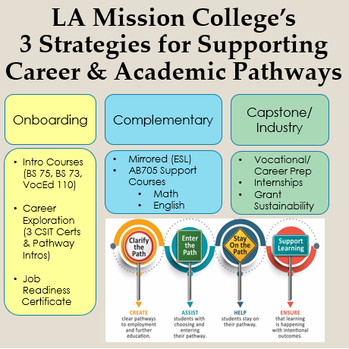
Los Angeles Mission College
Academic Readiness, Career & Community Institute
(ARCC Institute)
…formerly the Adult Basic Education Dept.

Slide 15
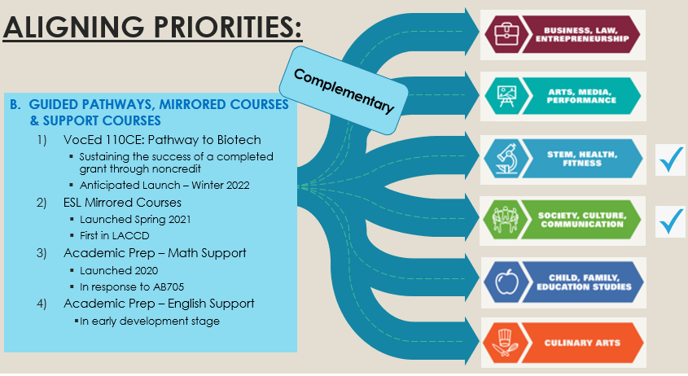

Slide 17
Past, Present & Future

Slide 18
Past, Present & Developing the Future
English Department
ARCC Institute
Survey
Design
Critical Thinking in Reading: 6
Critical Thinking in Writing: 6
Essays: 4
Research Writing: 7
Integration
Syllabi
“Just in time” remediation for preventing Withdrawals
“Extra credit” & Attendance Tracking
Open Entry/Open Exit

Slide 19
Program Overview
How big is noncredit at your school and how do you encourage students to enroll in your noncredit courses?
Describe the past, present and future of noncredit at your college.
What has worked for your college and what hasn’t?
What advice would you give to a college who is just starting to create noncredit courses and certificates for math and English?

Slide 20
Contact Information
Tyrone Nagai
MiraCosta College tnagai@miracosta.edu
Janet Cagley
North Orange Continuing Education jcagley@noce.edu
Maryanne Galindo
Los Angeles Mission College galindm@lamission.edu

Slide 21
Questions?

