Slide 1
OUTCOMES: DRIVING EQUITY, IMPROVEMENT AND INNOVATION
Randy Beach, Southwestern College and ACCJC Commissioner
Stephanie Curry, ASCCC North Representative
Colin Williams, Long Beach City College
Notes:
Stephanie

Slide 2
Breakout Description
Outcomes, once synonymous with compliance, have evolved to be an essential element of Guided Pathways and Equity work. The assessment of outcomes has driven discussions of improving classes, programs, systems and structures. Learn how your colleges can use outcome data (qualitative and quantitative) to show improvement, innovation and evidence of meeting the standard.
ASCCC Accreditation Institute February 21-22, 2020 San Diego Marriott, La Jolla
Notes:
Stephanie

Slide 3
Outcomes: A History
ACCJC Introduced outcomes
standards in 2002
Behind the rest of the country in understanding/application
2012 expectation to be in compliance
Colleges and faculty saw it as a compliance issue...not an issue of CQI or innovation
Technology challenges only worsened attitudes towards SLOs
Standard IIIA6 required participation in outcome assessment to be part of employee evaluations
Standard has since been rescinded by ACCJC
ASCCC Accreditation Institute February 21-22, 2020 San Diego Marriott, La Jolla
Notes:
Randy

Slide 4
Outcomes: The Future
Organic Student Centered Assessment
Outcomes are better understood as concrete evidence of learning
Faculty possess better understanding of the difference between objectives (what we will learn) and outcomes (mechanisms to demonstrate learning)
Better consideration of student goals (degree, certificate, transfer, or specific skill set) when developing programs and required courses
Beginning with the end in mind, working backwards
Pathways created leading to specific outcomes to make programs more than just a collection of courses
ASCCC Accreditation Institute February 21-22, 2020 San Diego Marriott, La Jolla
Notes:
Randy

Slide 5
Opportunities for Innovation
Using Appreciative Inquiry...
What does your outcomes data tell you is working well?
What are the factors that make the practice successful?
Is the practice scalable?
What would be needed to expand/improve the practice?
What planning mechanisms are available to give momentum to scaling?
Quality Focus Essay
Guided Pathways
Student Equity and Achievement Program
ASCCC Accreditation Institute February 21-22, 2020 San Diego Marriott, La Jolla
Notes:
Randy

Slide 6
Equity at the Core
●Compositional changes impact the college experience
●Set of “highly diverse experiences” leading to different outcomes
●Increase in opportunities to uncover insights for disproportionately impacted student groups.
(Goldrick-Rab & Cook, 2011, p. 257)
ASCCC Accreditation Institute February 21-22, 2020 San Diego Marriott, La Jolla
Notes:
Colin

Slide 7
Standards I B.5 & I B.6
“I B.5: The institution assesses accomplishment of its mission through program review and evaluation of goals and objectives, student learning outcomes, and student achievement. Quantitative and qualitative data are disaggregated for analysis by program type and mode of delivery.
I B.6 The institution disaggregates and analyzes learning outcomes and achievement for subpopulations of students. When the institution identifies performance gaps, it implements strategies, which may include allocation or reallocation of human, fiscal and other resources, to mitigate those gaps and evaluates the efficacy of those strategies.”
ACCJC (2014) Revised Standards
Notes:
Colin In terms of assessing student learning, the field has been largely quiet when it comes to issues of equity.
Assessment, if not done with equity in mind, privileges and validates certain types of learning and evidence of learning over others, can hinder the validation of multiple means of demonstration, and can reinforce within students the false notion that they do not belong in higher education.
For equity gaps to be addressed, an entire institution needs to explore the combination of solutions and supports needed for students to be successful (Jones, 2015; Methvin & Markham, 2015), of which assessment is one.

Slide 8
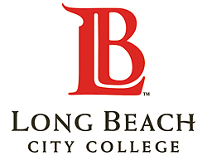
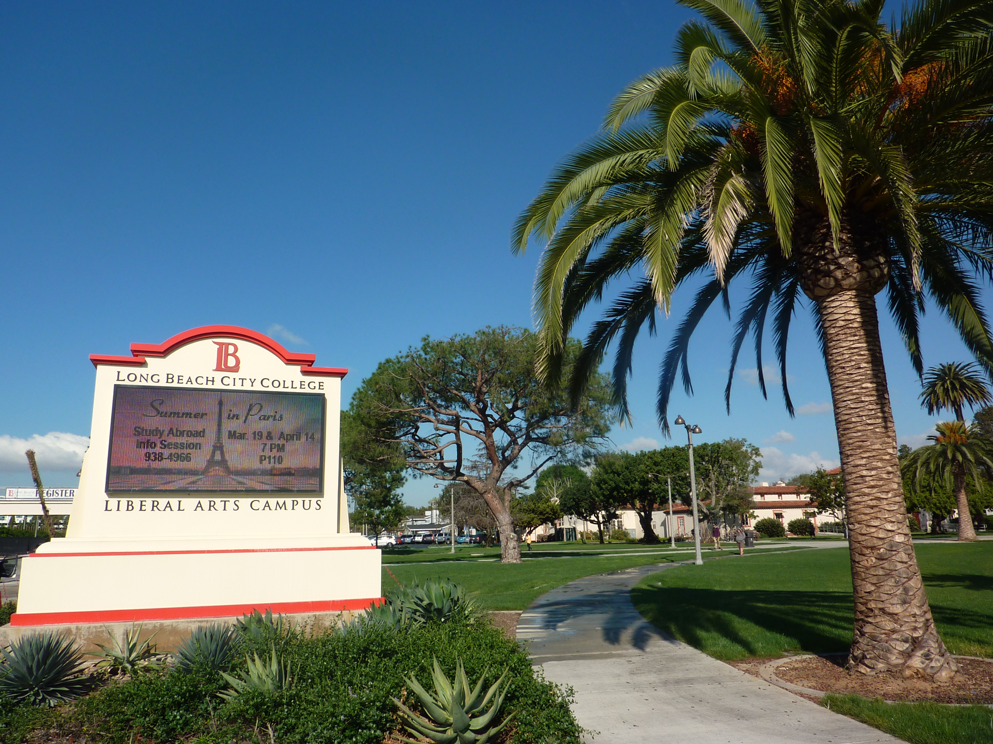
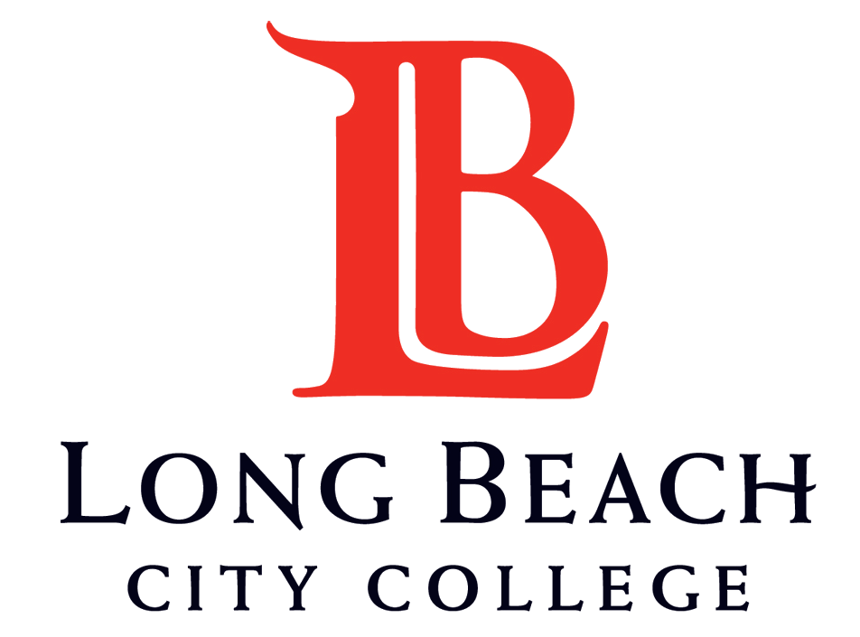
A Bit About LBCC in 2018…
~1,500 active courses
~3,700 Course SLOs
~490 Program SLOs
Student learning outcomes and assessments are established for all instructional programs, learning support services, and student support services.
Review Criteria for Standard B.2.
Notes:
Colin

Slide 9
Integrate Enterprise/Services Systems
Notes:
Colin
Assess multiple SLOs in an expedited manner,
Automatically calculate Results of Assessment for each SLO at the question-level,
Centralize the storage of SLO assessment data…
Ensure SLO assessment is minimally invasive,
Derive more meaningful data from assessment,
Better serve our students and strive for social justice.

Slide 10
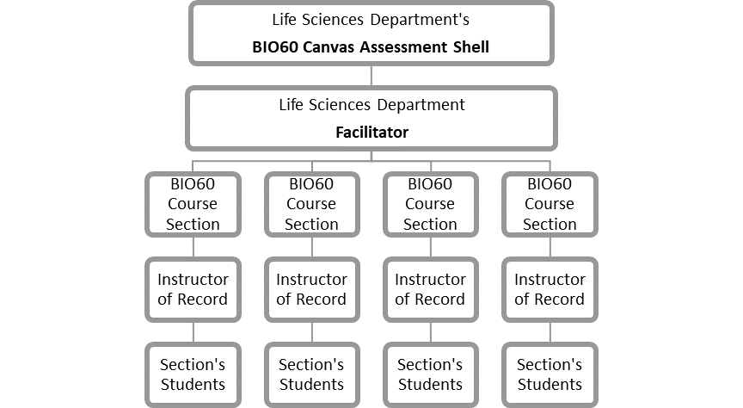
Notes:
Colin
Centralize the storage of SLO assessment data…
Optimize faculty workload,

Slide 11
A Bit About LBCC’s Progress
Fall 2016
2 pilot courses.
Spring 2017
30 courses with Results of Assessment via the LMS
Fall 2017
61 courses request to use the LMS in Fall
56 courses with results
Fall 2018
525 SLO Canvas shells created; 438 SLOs into those shells.
259 courses with results
Fall 2019
647 SLO Canvas shells created for courses marked to ASSESS
A total of 778 SLOs into those Canvas shells.
Notes:
Colin

Slide 12
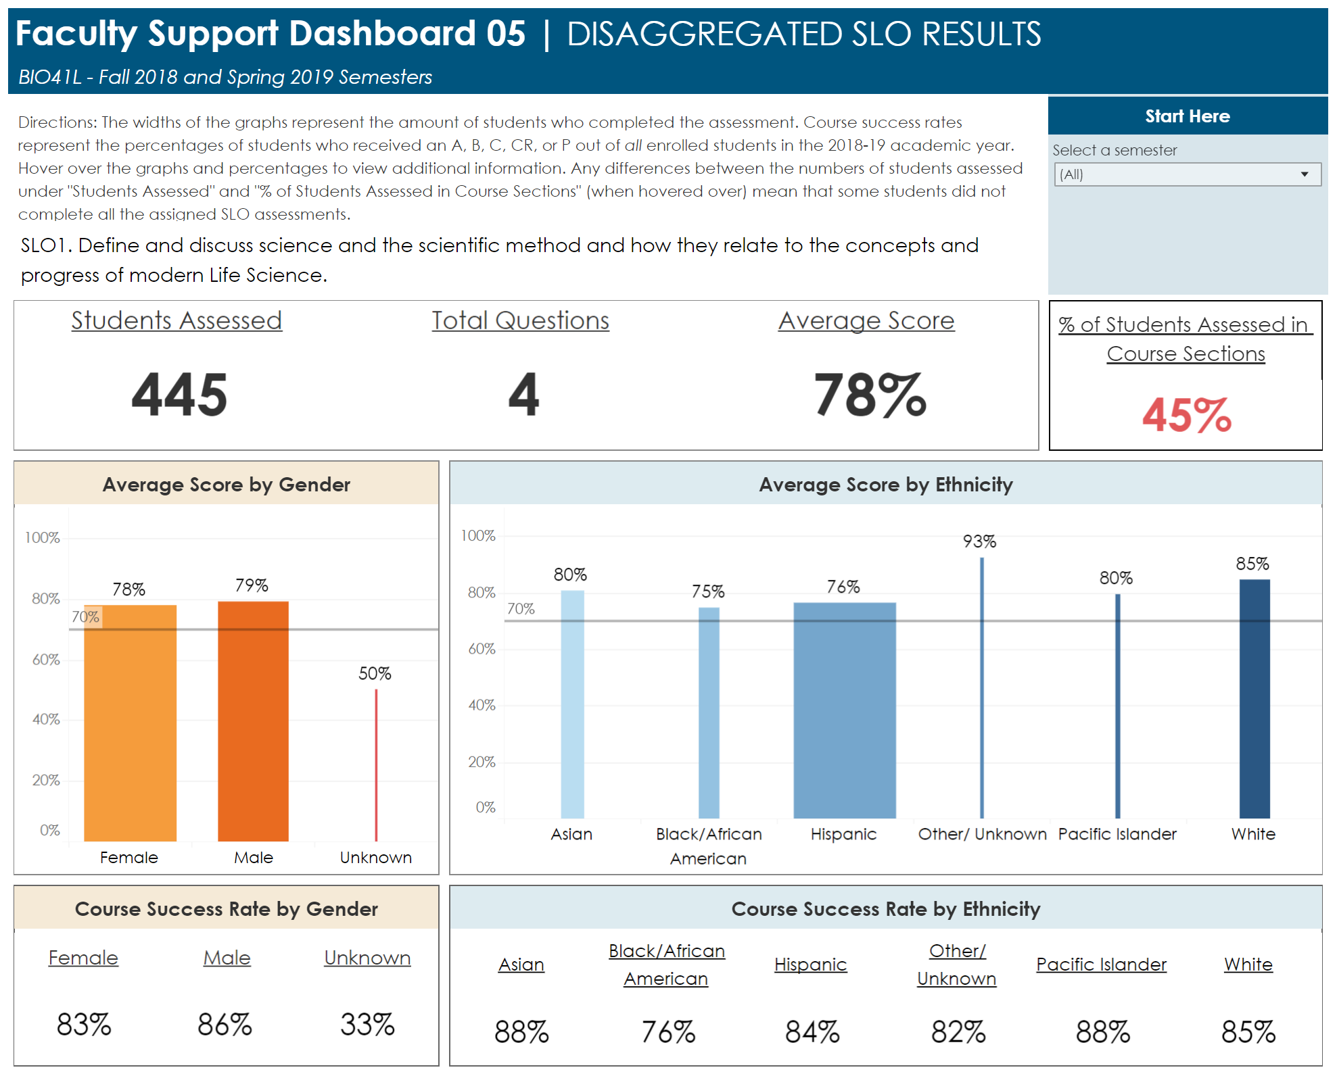
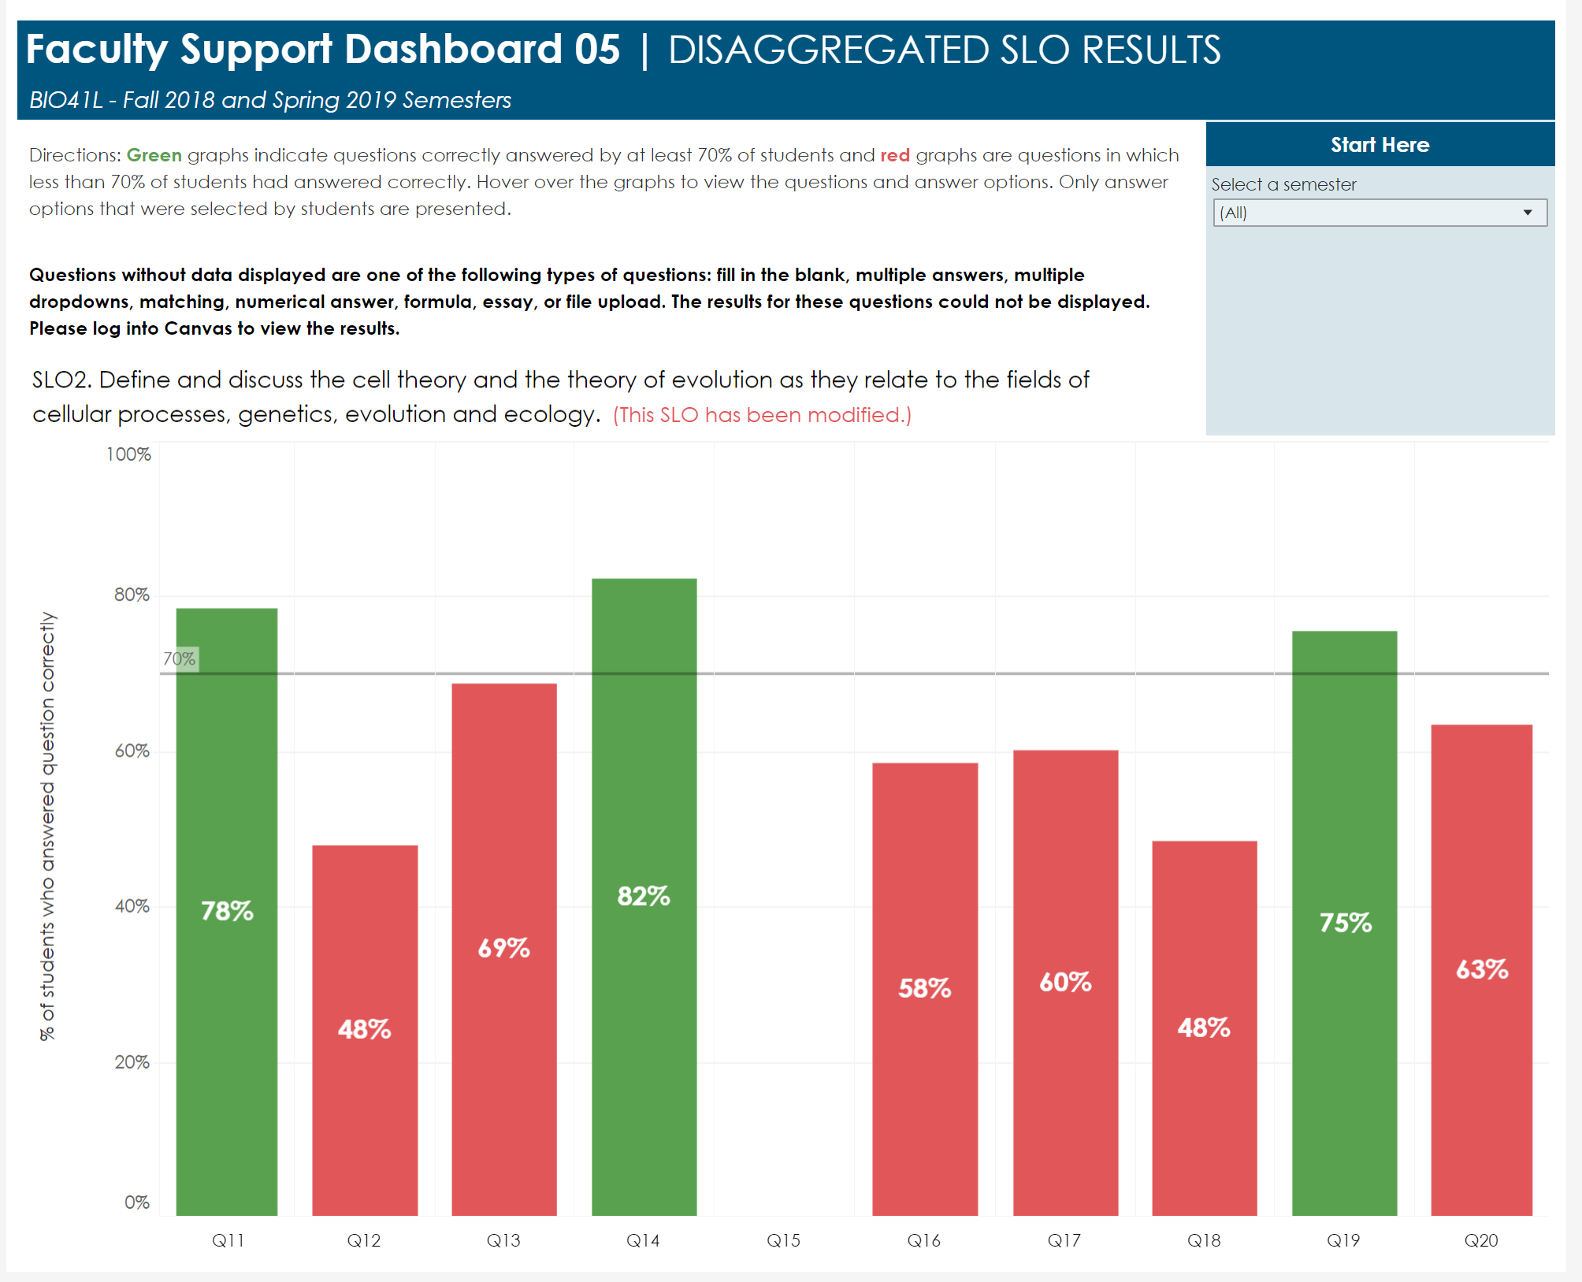
…Quantitative and qualitative data are disaggregated for analysis by program type and mode of delivery. Standard B.5
…The institution disaggregates and analyzes learning outcomes and achievement for subpopulations of students. Standard B.6
Notes:
Colin

Slide 13
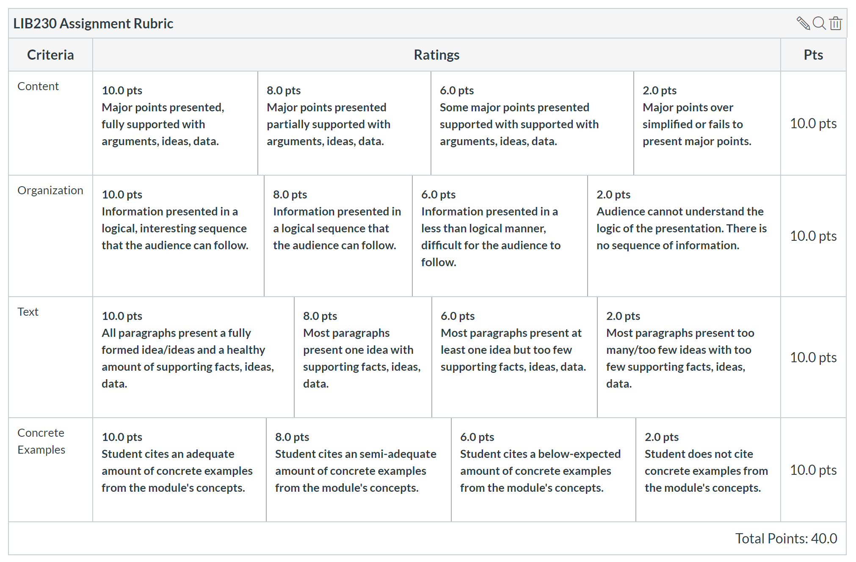
Taking Action as a Result of Outcomes
Common Assessments
Quizzes
Rubrics
External agency exams
Competencies
Every Course, Every Section, Every SLO
Institution Set Standard 70%
Standard B.3
Notes:
Colin

Slide 14
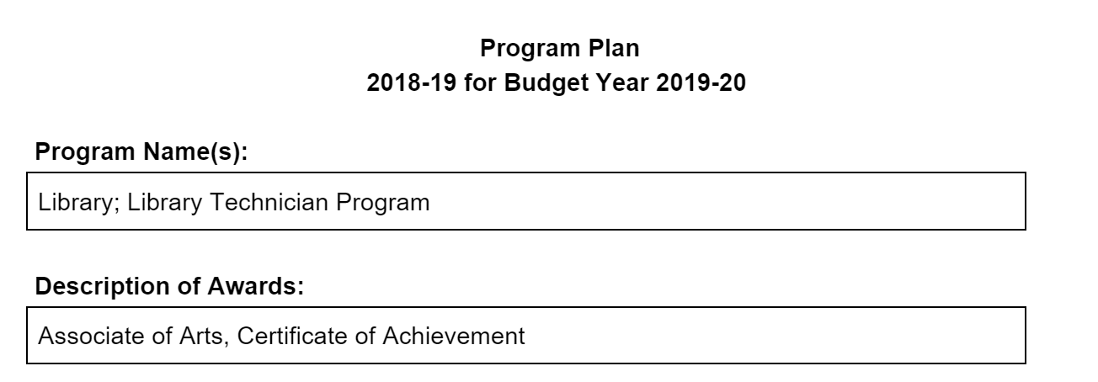
Taking Action as a Result of Outcomes
The institution provides for systematic and regular review of its instructional and student support services.
Review Criteria for Standard B.2.
Notes:
Colin

Slide 15
Taking Action as a Result of Outcomes
Tier 1
Tier 2
Tier 3
Taking Meaningful Action based on the Analysis of Results is the final step in the assessment of an SLO. This phase is also referred to as "closing the loop."
There are three different tiers of Actions that faculty can take that imply local or institutional changes:
Assessment data drives college planning to improve student learning and student achievement.
Standard B.4
Notes:
Colin
Change the trend over time.
Peer-led, peer-instigated and deeply reflective practices for both students and for faculty.
Blind grading.
Intrinsic motivations for learning.
Less grading, more evaluating, more formative assessment.
Focus Groups with Students
Be yourself - care about learning.
Don’t Breed “Excellent Sheep.”
Examine and include discipline-specific equity trends and career demographics.

Slide 16
Guided Pathways and Outcomes
Where do learning outcomes and guided pathways intersect?
Where can we use outcomes to inform our pathways design and implementation?
ASCCC Accreditation Institute February 21-22, 2020 San Diego Marriott, La Jolla
Notes:
Stephanie / Randy

Slide 17
THE 10+1 AND GUIDED PATHWAYS
Curriculum
Educational Programs
Degree and Certificate Requirements
Student Preparation and Success
Curriculum
Student Preparation and Success
Educational Programs
CLARIFY -Clear pathways and programs
ENTER-Guided Exploration and Progress
STAY-Teaching and Learning
ENSURE - Academic and Student Support
Curriculum
Grading Policies
Student Preparation and Success
Educational Programs
Curriculum
Student Preparation and Success
ASCCC Accreditation Institute February 21-22, 2020 San Diego Marriott, La Jolla
Notes:
Stephanie

Slide 18
Faculty Role in Outcomes and Assessment
Alignment with the 10+1
Curriculum (#1)
Degree and Certificate Requirements (#2)
Educational Program Development (#4)
Student Preparation and Success (#5)
Professional Development (#8)
Program Review (#9)
Planning and Budget (#10)
Local Senates should be involved in creating, processing, evaluating, and outcomes
ASCCC Accreditation Institute February 21-22, 2020 San Diego Marriott, La Jolla
Notes:
Stephanie

Slide 19
Guided Pathways and Outcomes
Both suport designing programs with the end in mind
Both are grounded in equity
Both provide data and opportunity to review/revise processes
Both encourage engagement of all constituent groups and across traditional silos
Both focus on the Student Journey and student voices
Both encourage a holistic assessment (360º) of practices
ASCCC Accreditation Institute February 21-22, 2020 San Diego Marriott, La Jolla
Notes:
Randy

Slide 20
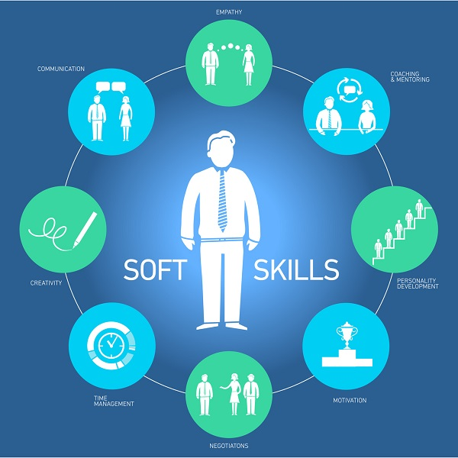
ISLO and The GP Framework
Begin with the ILOs and GELOs when designing programs
Be sure to consider the “soft skills” employers desire and support lifelong learning and adaptability
Skills that are supportive of students changing majors/industries and help carry students between fields
ASCCC Accreditation Institute February 21-22, 2020 San Diego Marriott, La Jolla
Notes:
Randy

Slide 21
Guided Pathways and Program Outcomes
Support comprehensive and systematic program review and improvement
Require authentic, relevant assessment
Use multiple evaluation types and sources
Include faculty and students, a collaborative journey of discovery
Help connect programs to the college mission and beyond
ASCCC Accreditation Institute February 21-22, 2020 San Diego Marriott, La Jolla
Notes:
Randy

Slide 22
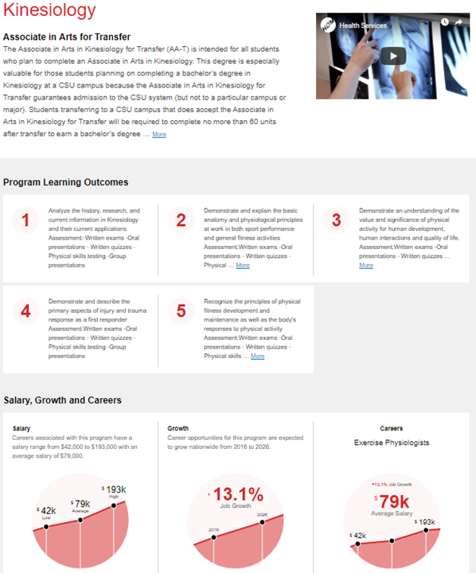
Notes:
Randy

Slide 23
Course and Program Outcomes
Sorting programs into metamajors
Evaluating courses sequencing in program mapping
Evaluating general education recommendations for program mapping
Evaluating pathways from HS to CC to CSU/UC and transfer using outcomes
Communicates to other faculty how their general education courses (and others) support your program outcomes
Better alignment of prerequisites and corequisites comes from better understanding of outcomes
ASCCC Accreditation Institute February 21-22, 2020 San Diego Marriott, La Jolla
Notes:
Randy

Slide 24
1. Review your outcomes
Program outcomes should include:
Career-related skills and abilities
Transfer related content and coursework
Relevant/affective qualities, e.g. ethics, empathy, organization, etc
Significant 21st century skills e.g. teamwork, communication, social awareness, safety, technical abilities, etc
High level facility within the content field
ASCCC Accreditation Institute February 21-22, 2020 San Diego Marriott, La Jolla
Notes:
Randy

Slide 25
2. Vet your outcomes
Discuss the program outcomes with everyone within the program pathway; both faculty teaching majors and faculty teaching general education
Creates consensus between faculty about the discipline/program values
Coordinate with the primary transfer institutions
Talk to the students near the end of the program
ASCCC Accreditation Institute February 21-22, 2020 San Diego Marriott, La Jolla
Notes:
Randy

Slide 26
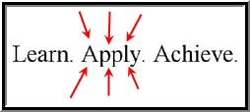
3. Determine assessments
Course-level outcomes measure something finite/discrete
Program outcomes demonstrate the synthesis of knowledge
Key opportunities in capstone courses and projects
Higher level assessments in core program courses
Emphasize students will understand core competencies in a discipline
ASCCC Accreditation Institute February 21-22, 2020 San Diego Marriott, La Jolla
Notes:
Randy

Slide 27
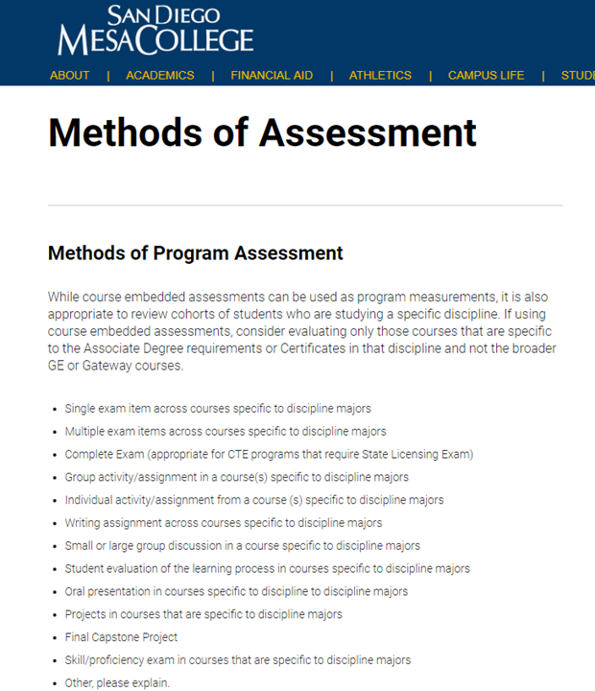
Notes:
Randy

Slide 28
Fundamental Questions
What would it look like if students were capable?
Are these outcomes demonstrable along the way in courses, at the end in capstones, after graduation?
How can you best assess the individual student’s ability?
How will you communicate outcomes and abilities to students, with a goal of helping them be confident and identify their skills related to the program?
ASCCC Accreditation Institute February 21-22, 2020 San Diego Marriott, La Jolla
Notes:
Randy

Slide 29
Continuous Quality Improvement
Case Studies
ASCCC Accreditation Institute February 21-22, 2020 San Diego Marriott, La Jolla
Notes:
Stephanie

Slide 30
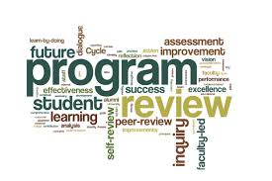
Reedley College
Outcomes and Program Review Process tied together
New Focus on Equity in Outcomes Assessment
Impact of Guided Pathways
Design with the End in Mind
Discussion with Academic Senate about complete revision of Program Review/SLO process
Decision to take a year to review, assess and redesign Evaluation and Assessment processes
Program Review, SLO, Student Success and GP design teams worked together
Goal: Change to Student Centered Program Review Process
ASCCC Accreditation Institute February 21-22, 2020 San Diego Marriott, La Jolla
Notes:
Stephanie

Slide 31
Outcomes Across the Standards
Outcomes and their Results are found all across the ACCJC Standards
Basis for assessment of programs and services (Standard I and II)
Should be foundation for resource allocation (Standard III)
Should promote innovation and improving student learning and achievement (Standard IV and QFE)
ASCCC Accreditation Institute February 21-22, 2020 San Diego Marriott, La Jolla
Notes:
Stephanie

Slide 32
Competency Based Education (CBE)
“An outcomes-based approach to earning a college degree or other credential. Competencies are statements of what students can do as a result of their learning at an
institution of higher education…The curriculum is structured around the specified competencies, and satisfactory academic progress is expressed as the attainment or mastery of the identified competencies. Because competencies are often anchored to external expectations, such as those of employers, to pass a competency, students must generally perform at a level considered to be very good or excellent.”*
*from ACCJC draft policy on CBE 1/15/2020
ASCCC Accreditation Institute February 21-22, 2020 San Diego Marriott, La Jolla
Notes:
Randy

Slide 33
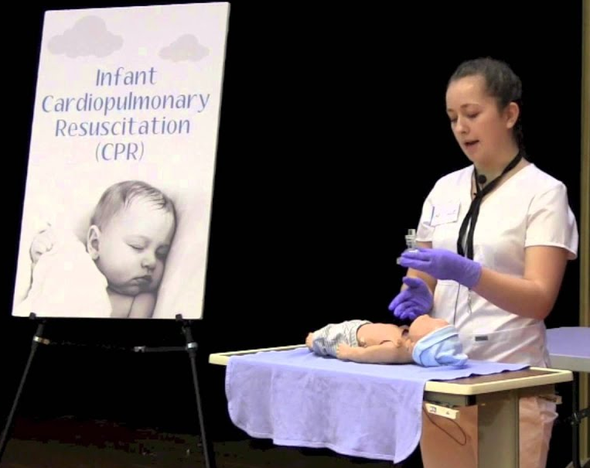
Federally Recognized Approaches to Competency Based Education*
1) Credit-based approach using credit hour or clock hour;
2) Direct assessment approach based on student’s demonstration of competencies,
in lieu of credit hours or clock hours, as a measure of student learning
3) Hybrid approach which uses a combination of credit hours or clock hours and direct
assessment of student learning
competencies.
*from ACCJC draft policy on CBE 1/15/2020
ASCCC Accreditation Institute February 21-22, 2020 San Diego Marriott, La Jolla
Notes:
Randy

Slide 34
Questions?
ASCCC Accreditation Institute February 21-22, 2020 San Diego Marriott, La Jolla

