Slide 1
Dr. Pamela Strangelove Or How I learned to stop Worrying and love Curriculum Streamlining
ASCCC Spring Plenary April 2017
Dolores Davison, ASCCC Secretary and 5C Co-chair
Virginia Guleff, CIO, Butte College and 5C Co-chair
Jackie Escajeda, Dean of Academic Affairs, CCCCO

Slide 2
Overview
Background
Progress to date
From SACC to 5C
Far North Project
Roles of CIOs and Curriculum Chairs
Curriculum Workgroup
Next Steps

Slide 3
background

Slide 4
History of Curriculum Review and Legislation
Pursuant to Education Code, §70901, the Board of Governors has the general authority to review and approve all educational programs offered by community college districts and all courses that are not offered as part of an educational program approved by the Board of Governors.
Additionally, the Board has the ability to transfer such approval authority to the governing board of each community college district.

Slide 5
History of Curriculum Review and Legislation
In accordance with California Education Code, §70902, the governing board of each community college district shall establish policies for and approve courses and educational programs.
The educational programs shall be submitted to the Board of Governors for approval.
The governing board shall establish policies for, and approve, individual courses that are offered in approved educational programs, without referral to the Board of Governors.

Slide 6
Legal Authority Involving Local Curriculum Approval
With the passage of AB 1725 (Vasconcellos, 1988), oversight of local curriculum rests with the local academic senate and, by extension, with faculty.
It is faculty’s responsibility to ensure that curriculum is timely, pedagogically sound, and responsive to the needs of students, the colleges, and the workforce.
At the local level, approval of curriculum is the responsibility of the Academic Senate or a subcommittee of the Academic Senate, which would include the curriculum committee or other group comprised primarily of faculty, which has been designated as the approving body.

Slide 7
Curriculum Review: Legislation & History
Chancellor’s Office Review:
Review and approve all educational programs (CEC §70901(b)(10))
Review and approve all courses that are not program-related (CEC §70902(b)(2))
Establish policies for courses of instruction and educational programs (CEC §70902(b)(2))
Review and approve courses of instruction and educational programs (CEC §70902(b)(2))
Review and approve program courses (CEC §70902(b)(2))

Slide 8
Progress to date

Slide 9
SACC Effective Practices and Accomplishments over the Previous 2 Years:
Established hours and units calculations
Auto approval of nonsubstantial credit courses
Modify Title 5 to delegate local authority for stand-alone credit courses
Increase availability of curriculum training
Peer review workshops
Improved communications

Slide 10
North Far North Project
Convened between June and October 2016
Brought together members of 10 curriculum committees from the North Far North Region
Looked at local approval processes (Board of Governors WFTF Recommendation 8)
Determined that many of the issues could be either resolved locally or through changes with the process at the Chancellor’s Office

Slide 11
This Year’s Changes for the California Community Colleges Curriculum Committee
Name Change from SACC to 5C to more accurate reflect the work of the group
Change of Charter and Membership:
Now a recommending body rather than advisory
Membership:
8 faculty appointed by the ASCCC, including a co-chair
4 CIOs appointed by the CCCCIO Board, including a co-chair
A curriculum specialist appointed by the CCCCO
Vice Chancellor of Academic Affairs
Dean of Academic Affairs
Liaison from ACCE and CTE deans

Slide 12
5C’s Work This Year (So Far)
Current Projects:
Definitions of Basic Skills and ESL Coding Issues
TOP Code Alignment (with WestEd)
Credit Hour Regulations
Catalog Rights and Definitions
Program and Course Approval Handbook, 6th edition
High School Articulation
Reworking of Title 5 to support streamlining project
COCI
Presentation to the BoG in January regarding streamlining project

Slide 13
Discoveries in 5C and NFN Projects
Concerns regarding local approval processes include:
Lack of training for curriculum chairs, as well as turnover of curriculum chairs and lack of release time
Turn over of CIOs, and lack of familiarity with local processes
Lack of training at the local level for curriculum specialists (and sometimes the lack of a curriculum specialist at the college)
Variations in in curriculum timelines (first readings, second readings, frequency of curriculum meetings)
Variations in submission of curriculum to the Board of Trustees
Overall length of approval process does not allow for necessary changes to curriculum due to industry demands

Slide 14
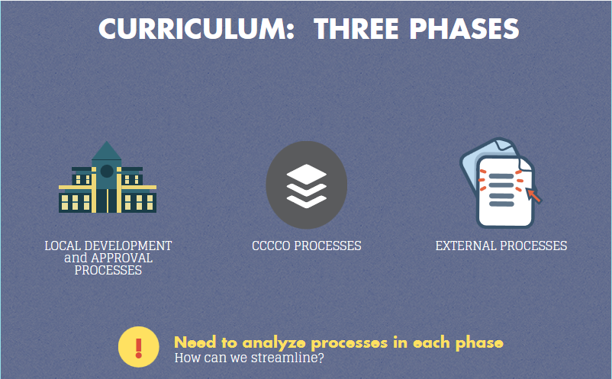

Slide 15
Curriculum workgroup

Slide 16
Purpose and Membership
Examine local and state curriculum processes and identify strategies for streamlining and making more efficient
Met in October, November, December, and will be convened next month
Membership:
CEO Lori Bennet and Doug Houston
CIO Virginia Guleff and Terri Long
ASCCC Cheryl Aschenbach, Marie Boyd,
Dolores Davison, and Craig Rutan
CO Pam Walker, Van Ton-Quilivan, Kirsten Corbin,
Jackie Escajeda, and LeBaron Woodyard
5C Marilyn Perry

Slide 17
Charge of the 5C Workgroup
Examine CCCCO Processes
What are the legal obligations?
What changes could be made in the approval of standalone courses and new and modified courses and programs?
Outside entities – what can be done regarding these?
What are the unintended consequences of returning control to the colleges?
What are the benefits/costs/concerns?

Slide 18
Discoveries from the 5C Workgroup
Concerns regarding Chancellor’s Office approval processes include:
Significant increases in the number of Associate Degree for Transfer (ADTs) submissions
Shift in staff priorities in response to several new initiatives that did not include additional staffing or other resources to support these new initiatives.
Lack of funding for additional Academic Affairs staffing, meaning fewer people to work on the queue, do training, etc
Lack of software bridging between the Chancellor’s Office curriculum Inventory and local curriculum management system

Slide 19
Recommendations from 5C Workgroup
The streamlining effort is a system wide collaboration that will take significant time, energy, and patience to appropriately facilitate the lifecycle of curriculum. Currently, the recommendations are the following:
Develop a process to allow for local approval beyond standalone courses
Work with the regional consortia regarding streamlining the recommendation process
Develop a new process for state chaptering at the CCCCO

Slide 21
First Actions: Credit Course Certification
Annual Credit Courses Certification
Initial document was due December 16, 2016
112 of 113 colleges have now signed the certification
CIO and Curriculum Chair signature
Will be due annually on 1 October beginning in 2017
This certification applies to the following:
1. New course proposals to existing approved credit programs
2. Substantial change proposals for credit courses
3. Stand-alone proposals
4. Nonsubstantial change proposals for credit courses

Slide 22
Credit Courses Need to Demonstrate that Both of the Documents Below Were Used

Slide 24
A Quick Reminder
All curriculum (courses and programs, credit and non credit, standalone, etc) must still be submitted to the Chancellor’s Office Curriculum Inventory for chaptering!!!
For colleges that have signed the certification, credit courses will be automatically approved; for those colleges that don’t sign, their courses will go into the queue.
All other curriculum pieces (for the moment) will go into the queue for approval by the Chancellor’s Office.

Slide 25
Chancellor's Office Curriculum Queue (as of 18 April 2017)
Programs | New | Non-substantial | Substantial | Oldest Date
ADTs | 1 | 5 | 1 | March-17
Traditional Degrees | 8 | 118 | 1 | February-17
Credit Certificates | 31 | 78 | 3 | February-17
Noncredit Programs | 73 | 29 | 1 | January-17
Total No. of Programs: | 113 | 230 | 6
Grand Total: | 349
Courses | New | Non-substantial | Substantial | Oldest Date
Credit-Program Applicable | 19 | 0 | 23 | February-17
Credit-Standalone | 7 | 0 | 1 | January-17
Noncredit-Program Applicable | 47 | 23 | 31 | February-17
Noncredit-Standalone | 48 | 28 | 5 | March-17
Total No. of Programs: | 121 | 51 | 60
Grand Total: | 232

Slide 26
Next steps

Slide 27
Next Steps at the Chancellor’s Office
Curriculum Streamlining White Paper
Title 5 changes to support streamlining
Chancellor’s Office Curriculum Inventory
Substantial and Nonsubstantial Changes to Credit Programs
Publish the 6th edition of the PCAH to reflect the changes being undertaken
Examine potential local approval of new credit programs
ADTs and Noncredit

Slide 28
Next Steps with the Regional Consortia
Reduce time on task to 30 days or less (electronic first readings, etc.)
Standardized forms and processes among the consortia
No “unpacking” curriculum
Consortia provide recommendations, NOT approval (per Title 5 §55130 (b)(8)(E), of programs only (not courses))

Slide 29
Regional Workshops
Create local workshops involving multiple colleges, led by the ASCCC, CIOs, and 5C membership
Bring together teams of curriculum chairs, CIOs, articulation officers, curriculum specialists, and interested faculty and staff/administrators whenever possible
Discuss local processes and look for ways to streamline those processes
Meetings taking place throughout the state during spring 2017

Slide 30
Regional Workshops for 2017
10 March at LACCD (involving all LACCD curriculum chairs)
17 March at Merritt College (Peralta District colleges, Contra Costa College, Solano College)
17 April at Marin College (College of Marin, CCSF, Mendocino, Santa Rosa, Napa Valley)
26 April at Long Beach (Long Beach, Cerritos, Coastline, Cypress, Fullerton, Golden West, Orange Coast and others)
28 April at Cabrillo (Allan Hancock, Cabrillo, Cuesta, Gavilan, Hartnell, Monterey Peninsula)
3 May at Clovis (State Center, Sequoias, Modesto)
12 May at Butte (All North Far North Colleges)
15 May at Irvine Valley College (SoCal colleges)
23 May at Las Positas (Chabot, Las Positas, Ohlone, San Joaquin Delta)

Slide 31
Questions
Dolores Davison (davisondolores@foothill.edu)
Virginia Guleff (guleffvi@butte.edu)
Jackie Escajeda (jescajeda@cccco.edu)

