Slide 1
Post-Secondary Education and disabilities
Briseida Ramirez, Mt. san Antonio college
Susan Stroebel, mt. san Antonio college
Carrie Roberson, ASCCC North Representative

Slide 2
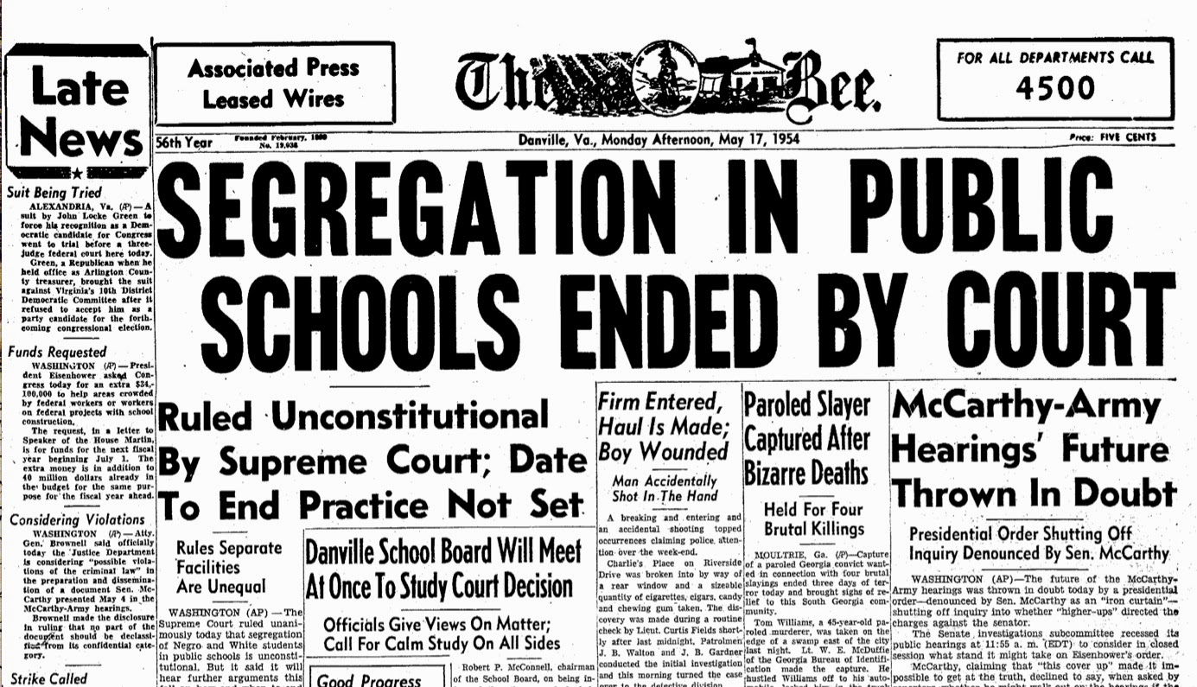
Separate is not equal
In Brown vs. the board of education, Brown claimed that schools for black children were not equal to the white schools, and that segregation violated the so-called “equal protection clause” of the 14th Amendment, which holds that no state can “deny to any person within its jurisdiction the equal protection of the laws.” The supreme court stated that segregation by it’s very nature made those segregated feel “less than” and had a negative impact on self worth.
This Photo by Unknown Author is licensed under CC BY

Slide 3
LAWS
The Americans with Disabilities Act (ADA) became law in 1990. The ADA is a civil rights law that prohibits discrimination against individuals with disabilities in all areas of public life, including jobs, schools, transportation, and all public and private places that are open to the general public. The federal government through HEOA now funds certificate programs from community colleges and universities specifically for students with DD/ID validating the importance of an inclusive college experience for students with DD/ID
This Photo by Unknown Author is licensed under CC BY-SA

Slide 4
Higher education is about developing an appreciation for lifelong learning as well as learning about yourself
. For many people, learning about self-determination (who you are) and self-advocacy (how do you think?) begins at college. However, the need for students with disabilities to learn about their disability and how to be their own advocate is critical towards their success within the college environment and their daily lives.
Research studies suggest that students with disabilities that are more aware of their strengths and weaknesses in the college environment and able to discuss them are more likely to finish college than those that are not as self-aware (Thoma and Wehmeyer, 2005)

Slide 5
Physical and intellectual disabilities
Visible disabilities
Less visible disabilities
Physical disabilities are easier to spot and accommodate. There are strong standards to accommodate physical disabilities. Some severe developmental disabilities are accompanied by physical challenges that are easily recognized.
The majority of disabilities are developmental including specific learning disabilities, Autism and Intellectual disabilities. Most of these students do not test well, so standardized tests tell us little about their abilities

Slide 6
Sneak Peak
https://youtu.be/7k2KLl0IL_k

Slide 7
Welcoming neuro-diverse students
As the laws change and inclusion becomes the norm, students with disabilities desire to meet the same goals as their peers.
Use universal design methods of instruction and access https://www.youtube.com/watch?v=AGQ_7K35ysA
Students with disabilities process information differently, so they need more explicit instruction to develop and use these skills than general education students do.
They may also need supports that are not academic in nature. We must rely on collaborative partners for some of these supports.

Slide 8
What we have learned from our journey so far…..
Mario:
Mike:
Eddie:
Becoming “home room”

Slide 9
Benefits for all students
Students gain skills
Skills are generalized
Same age peer role models
Advancing knowledge that leads to lifelong learning
Continue social and emotional growth

Slide 10
Resources to support diverse students and Instructors
Universal design: www.cast.org
National technical assistance center on transition: www.transitionta.org
Supporting college students with disabilities: www.Thinkcollege.org
More details about HEOA:
More info about inclusion of students with DD/ID: https://ici.umn.edu/

Slide 11
Thank you!
Briseida Ramirez, bramirezcatalan@mtsac.edu
Susan Stroebel, sstroebel@mtsac.edu
Carrie Roberson, robersonca@butte.edu

