Slide 1

Resolution Writing: 101
Sam Foster, Area D Representative
Conan McKay, Area B Representative
The ASCCC expresses its official position on issues, legislation, and ideas through the resolution process.

Slide 2

Overview
Introduction
Resolutions Handbook
Process
Nuts and Bolts

Slide 3
Introduction
Resolutions…
Identify and record the will of the academic senates of the California community colleges
Set direction for the ASCCC as a whole
Direct members of the Executive Committee and ASCCC Committees to take action in response
Are borne out of issues important to faculty and often identified by:
  the ASCCC Executive Committee
  ASCCC Committees/Taskforces
  Local Senates
  Individuals

Slide 4


Introduction
Resolutions…
Are debated by the body at the fall and spring plenary sessions
Are voted on by the delegates of the local senates
Are bottom up, grass roots democracy
Are used for:
  Adopting Papers
  Disciplines List
  Positions on Pending Legislation
  Affect Change
  Address Conflict

Slide 5

Resolutions Handbook
Adopted in Fall 2014
Updated Fall 2016/Spring 2017
Details Process and Procedures
Defines the roles of the Executive Committee and the Resolutions Committee

Slide 6
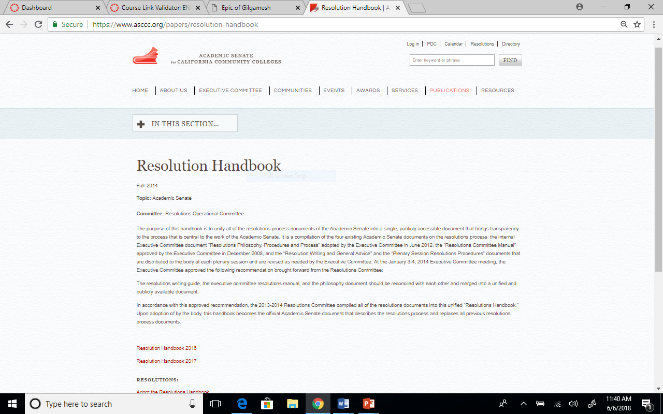
Resolutions Handbook
Publications→ Papers
→ Use most current!

Slide 7


RESOLUTIONS PROCESS
OVERVIEW
Notes:
Geoffrey/Oleg

Slide 8

Process
Resolution:
Pre-plenary review
Executive Committee
Resolutions Committee
Area Meetings
Plenary Breakouts and Office Hours
New resolutions and amendments require four signatures
Debate and Voting – Parliamentary Process

Slide 9
Resolutions & Amendments Timeline
Resolutions can be pulled from consent until 8:20 on Saturday of Plenary

Slide 10
Required
All resolutions and amendments are to be submitted electronically to resolutions@asccc.org
Signature pages are to be submitted during session to the Resolutions Committee Chair – with signatures from four (4) delegates
Contacts must attend afternoon sessions at plenary to address conflicts
All new resolutions and amendments are due by 4:30pm TODAY

Slide 11
Consent Calendar
Resolutions are placed on consent calendar if:
  Deemed non-controversial
  Do not reverse a previous position
  Do not compete with another proposed resolution
Items on consent will be voted on together
Resolutions and amendments submitted
last day of plenary will not be placed
on consent calendar
Marked in packets with an asterisk

Slide 12

After Plenary Session
Resolutions assigned to committee or individual
Resolutions tracked on ASCCC website
Action included in annual reporting

Slide 13

Using Resolutions Locally
ASCCC resolutions useful for supporting change at your local campus
Local resolutions can help clarify local processes

Slide 14

Nuts and Bolts
Must check the following:
Duplication of Position
Reversal of Position
Clarity, Readability, Understanding, Intent
Senate Purview
Not a Strictly Local Concern

Slide 15
Nuts and Bolts
Format:
No more than four “whereas” and four “resolved” statements
“Resolved” statements should “stand alone” in case divided
Consider using first “whereas” as an introduction
Write out names in first reference with acronym in parenthesis, then use acronym for subsequent reference
Be as direct as possible
Limit “whereas” statement to one reason in support or defense of the “resolved” statements
Be sure the title of the resolution accurately reflects the content and intent of the resolution

Slide 16
Nuts and Bolts
Amendments:
Added to help clarify intent and/or expand scope
Use underscores and strikethroughs, not track changes
Review the title after adding an amendment, and amend if necessary
Make sure amendments don’t result in inconsistencies within a resolution or reverse the intent of the resolution (better to vote the resolution down)
Include contacts for each amendment

Slide 17
Nuts and Bolts
Carefully Consider:
Word Choice – Use qualifiers such as any, every, all, never, none, etc. very carefully.
“Recommend” – Be clear about what is being recommended.
“Ensure” or “Require” (Is it within ASCCC power?)
“Assert” or “Affirm” implies a position
“Support” (but not the $$ kind)
“Work with” (collaborate with system partners)

Slide 18

Questions and Comments
Contact:
Sam Foster sfoster@fullcoll.edu
Conan McKay cmckay@Mendocino.edu

