Slide 1
Resolutions Overview for Saturday

Slide 2
PRESENTERS
Stephanie Curry, ASCCC North Representative
Sam Foster, ASCCC South Representative
Amber Gillis, Compton College
Carolyn (C.J.) Johnson, Alameda College
David Morse, Long Beach City College

Slide 3
BREAKOUT DESCRIPTIONS
Resolutions are the way we as the field voice our collective views of academic and professional matters. It is a time for us to debate and discuss the issues of the day. As we enter into a virtual resolutions process come and learn how we are going to navigate the process and how you can participate in debate and voting.

Slide 4
Pre Work
Make sure you have read through the Packet and including new Resolutions and Amendments since the Open Comment Period with the # symbol.
Symbols
* Indicates the Resolution/Amendment is on the Consent Agenda
+ Indicates Resolution/Amendments from the Area Meetings
# Indicates Resolution/Amendments from the Open Comment Period
Be ready to debate on resolutions and amendments on which you wish to voice an opinion.
Download the Poll Everywhere App

Slide 5
How it is going to Work?
Chair (Dolores) will read the rules and procedures of Plenary Voting
Delegates will approve the consent calendar (make sure you know what is on the Consent Calendar)
The Chair will announce the number of the next resolution
The Chair will read the resolves in the resolution
Delegates and Attendees will debate the resolution
The Chair will call for the vote
The Chair will announce the results of the vote

Slide 6
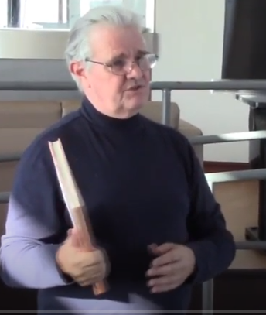
Parliamentarian/Roberts Rules of Order
Parliamentarian
David Mezzera

Slide 7
Consent Calendar
Resolutions are placed on the Consent Calendar if they are considered
Non Controversial
Do not propose reversing an existing ASCCC position
Do not compete with other proposed resolutions
Any registered attendee can remove a item from consent (without explanation) until 8:20 on Saturday
Are there any items on the consent that you would like to pull right now?

Slide 8
Order of Resolutions
In order to allow for discussion and debate on resolutions across the topics the Chair will call the resolutions in this order
All .01 Resolutions and amendments
All .02 Resolutions amendments
All .03 Resolutions and continuing through the resolutions
For Example
1.01
1.01.01
3.01
4.01
1.02
3.02

Slide 9
Pro and Con Debate
Any attendee can participate in Debate
Debate is about the issues in the resolution not the individual person
Each speaker can speak for up to 3 minutes and the total debate on the topic will be 15 minutes (unless debate is extended by parliamentary motion)
Yes there will be a time keeper
To debate in the chat (alternating)
PRO, Name, College or
CON Name, College
The chair will call on the next person to speak

Slide 10
Parliamentary Questions and Motions
Any registered attendee can ask a clarifying question at the Parliamentary “Mic”
Type in PM, Name, College into the Chat
PM questions and motions will be called on before Pro or Con debaters
Time for PM queries and motions is included in the 15 minutes per resolution.
Only delegates can make Parliamentary Motions
Motions to divide the resolves or whereas
Motions to approve by acclamation
Motions to refer to the Executive Committee
Motions to Call the Question
Motion to Extend debate
Move to re-order the resolutions

Slide 11
Voting/Motions (require seconds)
Motion to Divide the Resolution Debatable Majority
Motion to Refer to Exec Debatable Majority
Motion to Extend Debate Not Debatable Majority
Move to Re-order Resolutions Not Debatable 2/3
Move to Close Debate Not Debatable 2/3
Most Resolutions pass with a simple majority
Resolutions that reverse a previous position of the require a 2/3 vote of the delegates

Slide 12
Sample Resolution (Yes it is absurd)
13.01 Increasing the Efficiency of local Academic Senate Meetings
Whereas, Mondays are the first day of the college work week;
Whereas, Faculty are more efficient in the morning; and
Whereas, Meeting on Mondays allows faculty to address concerns from the meeting during the work week;
Resolved, That the Academic Senate for California Community Colleges to schedule their local Senate Meetings on Mondays;
Resolved, That The Academic Senate for California Community Colleges schedule their meetings before 10am in the morning.

Slide 13
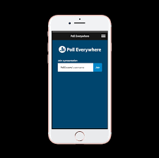
Voting

Slide 14
Questions
????????????????????????????????????????????????????????????

Slide 15
RESOLUTIONS 2020
SEE YOU TOMORROW!

