Slide 1
Accreditation During Changing Times

Slide 2
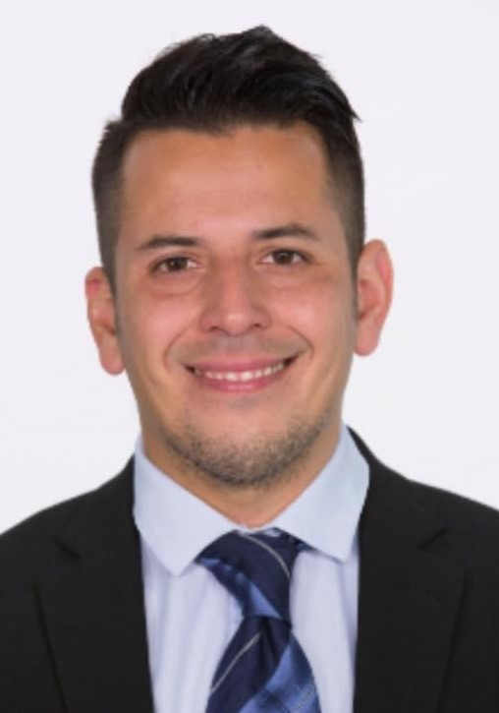
Virtual Session Presenters
Randy Beach, Southwestern College, Academic Commissioner ACCJC
Dr. Ricardo Castillo, Pasadena City College
Dr. Sharyn Eveland, Taft College
Amber Gillis, ASCCC South Representative
Robert L Stewart Jr, ASCCC South Representative

Slide 3
Virtual Session Description
The Academic Senate for California Community Colleges (ASCCC) Accreditation Committee is delighted to invite you to join your colleagues to discuss the ever-shifting landscape of accreditation in the California Community College system. With changes in accreditation at the federal level and new accreditation standards on their way, faculty will play a pivotal role in guiding their colleges to meet accreditation standards. During this breakout, join us to discuss how faculty can be an effective part of your college’s accreditation infrastructure to leverage the emphasis on accreditation as an agent of continuous quality improvement, innovation, and social justice in support of students.

Slide 4
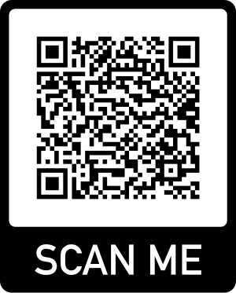
Session Housekeeping
We’re happy to take questions as we go. Raise your hand or write your comment in the chat.
We have an online “parking lot” for us to jot down ideas to save for future sessions and session ideas.
This is a safe environment for robust and constructive conversation and collaboration.

Slide 5
Poll: Accreditation and Me
Accreditation is life: I create evidence folders for fun.
Accreditation is okay; it’s even better when it’s not peak ISER season.
What’s accreditation, and how’d I get on this committee?

Slide 6
What Is Accreditation?
An action officially recognizing an institution as qualified to offer higher education services including the award of certificates and degrees; and
the process of achieving accreditation (Paraphrased from Oxford Languages)
California Community Colleges’ accrediting agency is the ACCJC.
ACCJC Process - Peer-based review of institutional status in comparison to established standards.

Slide 7
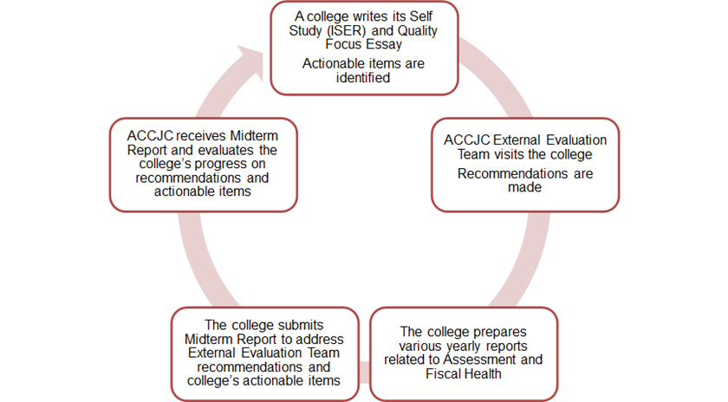
Current Accreditation Cycle

Slide 8
National Accreditation Structure
Notes:
Randy: Infographic on NACIQI, CHEA, Ed Dept

Slide 9
Why Faculty Participation Matters
Accreditation is part of our 10+1 academic and professional matters purview.
“Peer review” process and not punitive.
Faculty may have limited knowledge, no interest, or may feel intimidated with the accreditation process.
Accreditation impacts instructional and non-instructional faculty, curriculum, programs, and services.
Faculty input as the experts.
Districts may appoint faculty to serve as leads in accreditation and may provide release time.

Slide 10
Faculty Participation and Impact in Accreditation
Faculty participation, either through formal governance systems or individual interests, ensures that the “faculty voice” is in the forefront regarding accreditation matters.
Accreditation provides faculty members an opportunity to assess and articulate how well a college is in fulfilling the mission and to continuously work improvements.
Opportunity to highlight the excellent best practices via instruction and within students services.
Opportunity for faculty to examine and make an intentional impact to help improve the quality of programs and educational processes.

Slide 11
Local Senate Leadership in Accreditation Processes
Questions for consideration:
What defined accreditation roles does your college have around ISER writing?
How is your accreditation organizational structure designed and maintained?
Considering your current accreditation organizational structure (or lack thereof), what does this say about your local governance model or campus culture?
How can your local senate empower and educate faculty around accreditation?

Slide 12
Accreditation Changes Over Time
Standards
Process
Innovation
Social Justice Policy

Slide 13
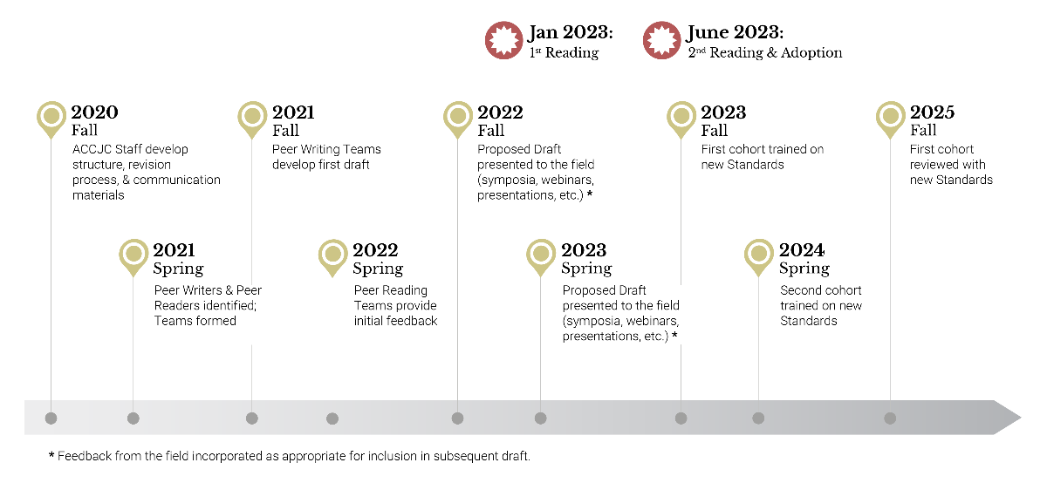
Standards Review in Progress
Notes:
A formal review of the standards occurs every 10 years. The call for reviewers went out in spring 2021. Formal first read of the draft standards occurred in January 2023 after feedback from stakeholder groups in the system, collected in fall 2022, was synthesized. Second read and potential approval of new standards will occur in June 2023.

Slide 14
Standards: Then and Now
Standard | Existing Name | Proposed Name | Existing Number of Standards | Proposed Number of Review Criteria
1 | Mission, Academic Quality and Institutional Effectiveness, and Integrity | Institutional Mission and Effectiveness | 26 over 3 major sections | 16 over 5 standard statements
2 | Student Learning Programs and Support Services | Student Success | 28 over 3 major sections | 31 over 9 standard statements
3 | Resources | Infrastructure and Resources | 39 over 4 major sections | 38 over 10 standard statements
4 | Leadership and Governance | Governance and Decision-Making | (up to) 33 over 4 major sections | 23 over 6 standard statements
Notes:
Then: 126, Now: 108. But, Standard 3 still takes home top prize for most standards!!

Slide 15
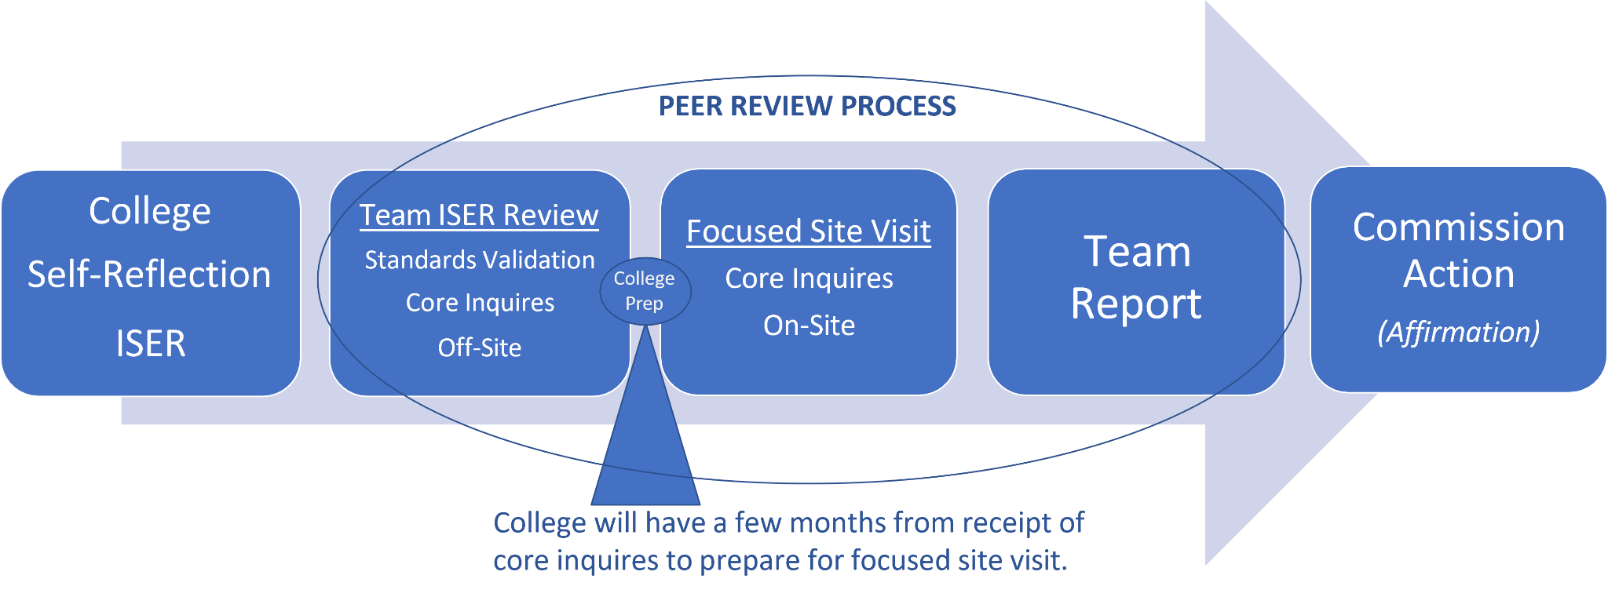
Peer Review Process for the ISER
Notes:
Randy

Slide 16
Using Accreditation to Support Innovation
Establish a mindset of Continuous Quality Improvement (CQI) rather than compliance
Look for ways to use standards to serve unique populations
Review policies for ACCJC to understand national priorities and opportunities
Competency-Based Education
Credit for Prior Learning
Distance and Correspondence Education
Baccalaureate Degrees
Social Justice
Transfer of Credit
Notes:
Randy

Slide 17
ACCJC Social Justice Policy
In June 2021, the Accrediting Commission for Community and Junior Colleges (ACCJC) released its Policy on Social Justice. Historically, institutions of higher learning have operated with firmly established policies and procedures that promote a climate of exclusion, racial inequity and racism towards Black, Indigenous, People of Color (BIPOC). The ACCJC understands that issues around inclusion, diversity, equity and racism are deeply rooted within systemic racists structures and policies that support the very foundation of society. Further, the Commission has determined that people of color have long been disadvantaged by the prejudice, discrimination and implicit biases inherent within higher education that white people have been able to benefit from.

Slide 18
ACCJC Social Justice Policy
Overview of the Commission’s Policy on Social Justice
●Evolution: From diversity to social justice
●Intention: Acknowledge & address structural inequities
●Alignment: Mission-appropriate interrogation of practices & outcomes
The Commission recognizes the moral necessity of promoting equity and diversity through its policies and practices, and creating a climate of inclusion and anti-racism among its membership.

Slide 19
ACCJC’s Policy on Social Justice ends with the following statement:
The Commission is deeply committed to embracing the diversity of its member institutions in the context of their unique mission. It therefore requires member institutions to use data and evidence to inform practices to improve equity and expects that institutional policies and practices foster a sense of inclusion and belonging among its diverse stakeholders. While each institution will address in their own way the opportunities to improve educational equity, support diversity, and create a campus culture of inclusion, the Commission is dedicated to supporting institutions in their pursuit of educational excellence.
Questions for Reflection and Discussion:
•How does your institution use data and evidence to interrogate its practices and improve racial equity? What opportunities for improvement do you see?
•Consider your institution’s policies and practices. Do they foster a sense of inclusion and belonging? Why or why not? What opportunities for improvement do you see?

Slide 20
ACCJC Social Justice Policy as a
Framework for Reflection

Slide 21
Principles/Requirement | Correlating Standards
An institution’s mission and goals reflect a commitment to meeting the educational needs of its students | Standard IA; Eligibility Requirement 6
Provide data disaggregated and effective mechanisms to identify performance gaps, implement strategies to mitigate gaps, and engage in dialog on student equity | Standard IB; Eligibility Requirement 11 and 19
Effective use of delivery modes, teaching methodologies, and learning support services that reflect the diverse and changing needs of its students, in support of equity in success for all students | Standard IIA
Learning outcomes on the ability to engage diverse perspectives | Standard IIA
Providing appropriate, comprehensive, and reliable services to students regardless of service location or delivery method to assure equitable access | Standard IIC; Eligibility Requirement 15
Promoting policies that support diverse personnel and assessment of employment equity and diversity | Standard IIIA
An institution’s mission and goals are the foundation for financial planning to meet the educational needs of its students | Standards IIID; Eligibility Requirement 18
Policies and procedures for decision making roles and responsibilities to ensure appropriate consideration of relevant perspectives | Standard IVA
Ethical and effective leadership throughout the organization guides the accomplishment of the mission and supports institutional effectiveness and improvement | Standard IVA, IVB, IVC

Slide 22
Summary of Supportive Evidence
∙Mission Statement and Goals
∙Disaggregate data that identifies gaps AND strategies to close gaps
∙Program review and Curriculum review processes
∙Demonstrated reflection/ Professional development
∙Access and utilization of student services
∙Diversity in hiring
∙Alignment of strategic goals and resource allocation
∙Collegiality and shared governance

Slide 23
Strategies/Where To Look
Student Equity Plan (past plan with data analysis)
Academic Senate: Processes for Program Review and Curriculum; Professional Development; resolutions; shared governance processes
Equal Employment Opportunity Plan and employment outreach strategies
Institutional Research & Effectiveness
Mission, Vision, Goals development strategies
Student voices

Slide 24
Resources
Accrediting Commission for Community and Junior Colleges (ACCJC)
Council of Regional Accrediting Commissions (C-RAC)
Council for Higher Education Accreditation (CHEA)
U.S. Department of Education: Accreditation Home Page
ACCJC Memo: ACCJC Standards Review Update and Next Steps: Jan 2023
ACCJC Proposed Standards (Draft)

Slide 25
Closing Thoughts/Q&A

Slide 26
THANK YOU!

