Slide 1
We Need You for Statewide Service

Slide 2
Session Presenters
Krystinne Mica, ASCCC Executive Director
Michelle Pilati, ASCCC Open Educational Resources Initiative Project Director
Robert L. Stewart Jr., ASCCC South Representative
Description
If you have ever considered service to our students beyond your college, then participating on a state-level advisory group, task force, or committee might be an opportunity to expand your experience. The ASCCC depends on the faculty volunteers that it appoints to serve on statewide bodies to represent the faculty voice, but state-level service also benefits the volunteers themselves and their colleges. If you are interested in becoming more involved in this important work, join us for this interactive session where we will discuss the appointment process as well as time commitments and responsibilities. In addition, we will talk about the role of the Senate President in approving faculty for statewide service.

Slide 3
ASCCC and Faculty Voice
The Academic Senate for California Community Colleges (ASCCC) is empowered by Education Code and title 5 regulations (§53206) as the official faculty representative to the Board of Governors and the Chancellor on academic and professional matters. Board of Governors Standing Order 332 acknowledges the Academic Senate’s purview, including the Senate’s authority to appoint faculty members to the councils, committees, and task forces that deal with academic and professional matters on a system wide level, and states that the advice and judgment of the Academic Senate will be primarily relied upon regarding all policies that involve academic and professional matters.
California Community Colleges Consultation Council Handbook 2019
Link: https://www.cccco.edu/-/media/CCCCO-Website/Files/Consultation-Council/Handbooks/2019/102019consultationcouncilhandbookfinal.pdf

Slide 4
Statewide-Level Service
Each year the ASCCC appoints faculty members to its Standing Committees, advisory committees, and work groups. It also appoints faculty to Chancellor's Office advisory committees, workgroups, and task forces, as well as number of other statewide committees from system-level organizations.
  The ASCCC has 16 Standing Committees
  In 22-23, the Chancellor’s Office had 28 active committees and workgroups meeting that needed faculty appointments.
  Other intersegmental bodies that require faculty appointments
  Over 300 faculty were appointed to serve at the state-level this year
  C-ID and OERI also need faculty volunteers to serve on the grants

Slide 5
ASCCC Service Opportunities
Accreditation
CTE Leadership
Curriculum
Data and ResearchData and Research Task Force
Educational Policies
Equity and Diversity Action
Faculty Leadership Development Guided Pathways Task Force
Legislative and Advocacy
Math and Quantitative Reasoning Task Force
Guided Pathways Task Force
Noncredit, Pre-Transfer, and Continuing Education
Online Education
Open Educational Resources Initiative (OERI)
Part-Time Faculty
Periodic Review
Relations with Local Senates
Resolutions

Slide 6
And….
Rising Scholars Faculty Advisory
SLO Symposium Ad Hoc
Standards and Practices
Transfer, Articulation, and Student Services

Slide 7
Why Get Involved?
Collaboration and Support
Representation
Building Connections with Colleagues
Innovation
Perspective

Slide 8
ASCCC Open Educational Resources Initiative
The ASCCC Open Educational Resources Initiative (OERI) is a grant funded initiative with a mission to reduce the cost of educational resources for students by expanding the availability and adoption of high-quality Open Educational Resources (OER).
The ASCCC OERI, over the last 5 years has done tremendous work building a statewide infrastructure to create, disseminate, and promote the use of OER materials. This is only possible through the work of faculty volunteers for the initiative.
Two committees inform the work of the OERI: The OERI Advisory Committee and the OER Coordinating Council.

Slide 9
ASCCC OERI Statewide Opportunities
(2023 – 2024)
Area A OERI Regional Lead
Area D OERI Regional Lead
Inclusivity, Diversity, Equity, and Anti-Racism (IDEA) Framework Lead
OERI Discipline Leads
Administration of Justice
Biology
Business
Chemistry
Computer Science
Counseling
Education
Film, Television, and Electronic Media
Humanities
Information Technology and Information Systems
Music
Social Justice Studies

Slide 10
ASCCC OERI – How to Apply
If you previously submitted an application, the ASCCC OERI will have your information and you will be considered for any position you have indicated an interest in it.
If you submitted an application previously and are uncertain as to what you indicated, you may either resubmit the application or submit a letter describing your interests and qualifications to the ASCCC OERI. Both the ASCCC OERI Application and the ASCCC Faculty Application for Statewide Service need to be completed.
Please direct any questions about this opportunity to our general OERI e-mail. (oeri@asccc.org)

Slide 11
Course Identification Numbering System (C-ID)
C-ID is always in need of additional faculty volunteers to support its work. Currently, C-ID is recruiting for the following:
Faculty Discipline Review Group (FDRG) Course Outline of Record Evaluator (CORE)
Accounting
Chemistry
Child & Adolescent Development
Communication Studies
Geography
Geology
Physics
Social Justice Studies
Spanish
Studio Arts
Business
Film, Television, and Electronic Media
Hospitality Management
Nutrition/Dietetics
Social Justice Studies
Sociology

Slide 12
C-ID Faculty Volunteers – How to Apply
If you are interested in participating as a course reviewer (CORE) for C-ID, you may complete the CORE interest survey. If you are interested in becoming a faculty discipline review group (FDRG) member, please complete the FDRG interest survey.
If you would like more information regarding these roles, you may email c-idsupport@asccc.org or visit the C-ID website (c-id.net).

Slide 13
ASCCC Standing Committees - Application
The Academic Senate continuously collects Application for Statewide Service online via the Volunteer to Serve Form.
Yearly, the ASCCC is asked to appoint close to 800 faculty volunteers to various committees, workgroups, task forces, initiatives and grants, both within the community college system and intersegmentally, to represent the voice and expertise of faculty in academic and professional matters. Representation of the varied perspectives, collective wisdom, and expertise of 58,000 faculty members, demands a rich and diverse pool to populate the variety of appointments necessary to best serve our students.
The chair of each ASCCC standing committee is responsible for putting together the proposed membership of the committee. All committee appointments are subject to the approval of the president. The final list of appointed faculty will be approved at the August Executive Committee meeting.
You will receive an automated message once you submit your application but will only hear back if you are selected to serve on a committee.

Slide 14
ASCCC Standing Committees - Appointments
ASCCC Standing Committee chairs review the list of interested faculty and select members based on criteria. The committee chair may also search the Senate directory or solicit the local senate presidents for additional nominations.
  Criteria for selection include:
    Diversity (membership such as stated racial/ethnic identity, gender identity, geographical location (i.e. North/South representation, Area representation, and no more than two faculty from the same district), college size (e.g. large urban college, small rural college, large rural college, etc.), discipline, full-time/part-time status, and experience (little or lack of experience should not necessarily preclude a faculty member from participating).
    Previous ASCCC assignments or appointments
    Experience (local or statewide)
Committee chairs will contact selected faculty to confirm willingness to serve. Faculty members will be notified in mid-August of appointment.

Slide 15
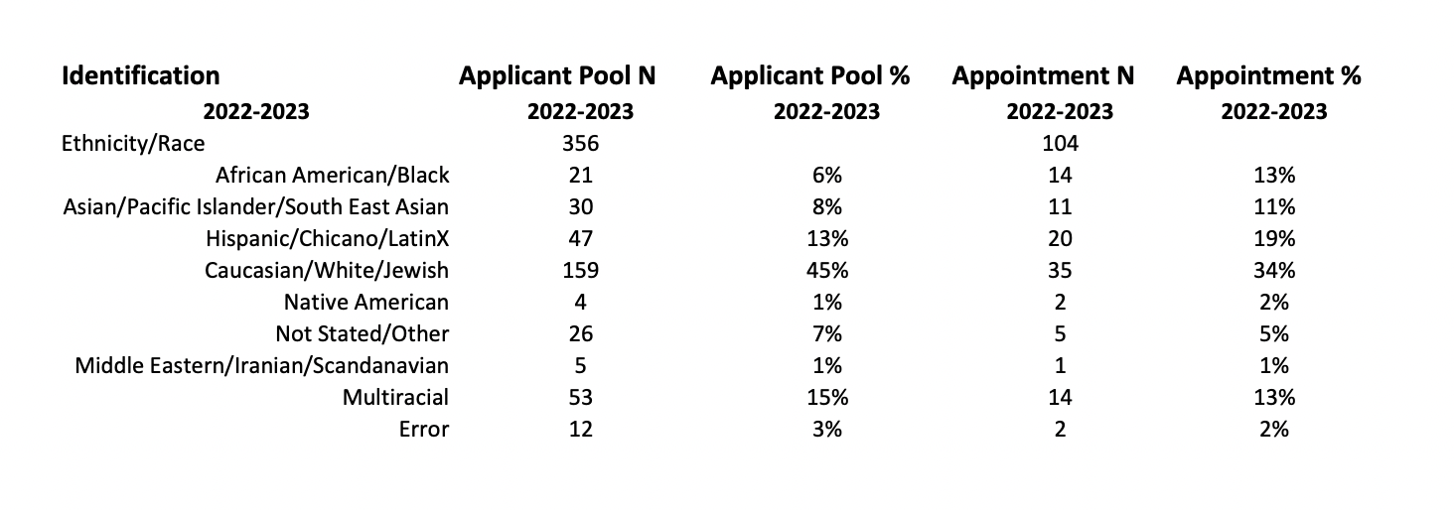
ASCCC Standing Committees – Diversity Representation 22-23
Link to full Diversity Representation Report: https://asccc.org/sites/default/files/IV.%20C.%20%282%29%20CommitteeComposition%20August%202022.pdf

Slide 16
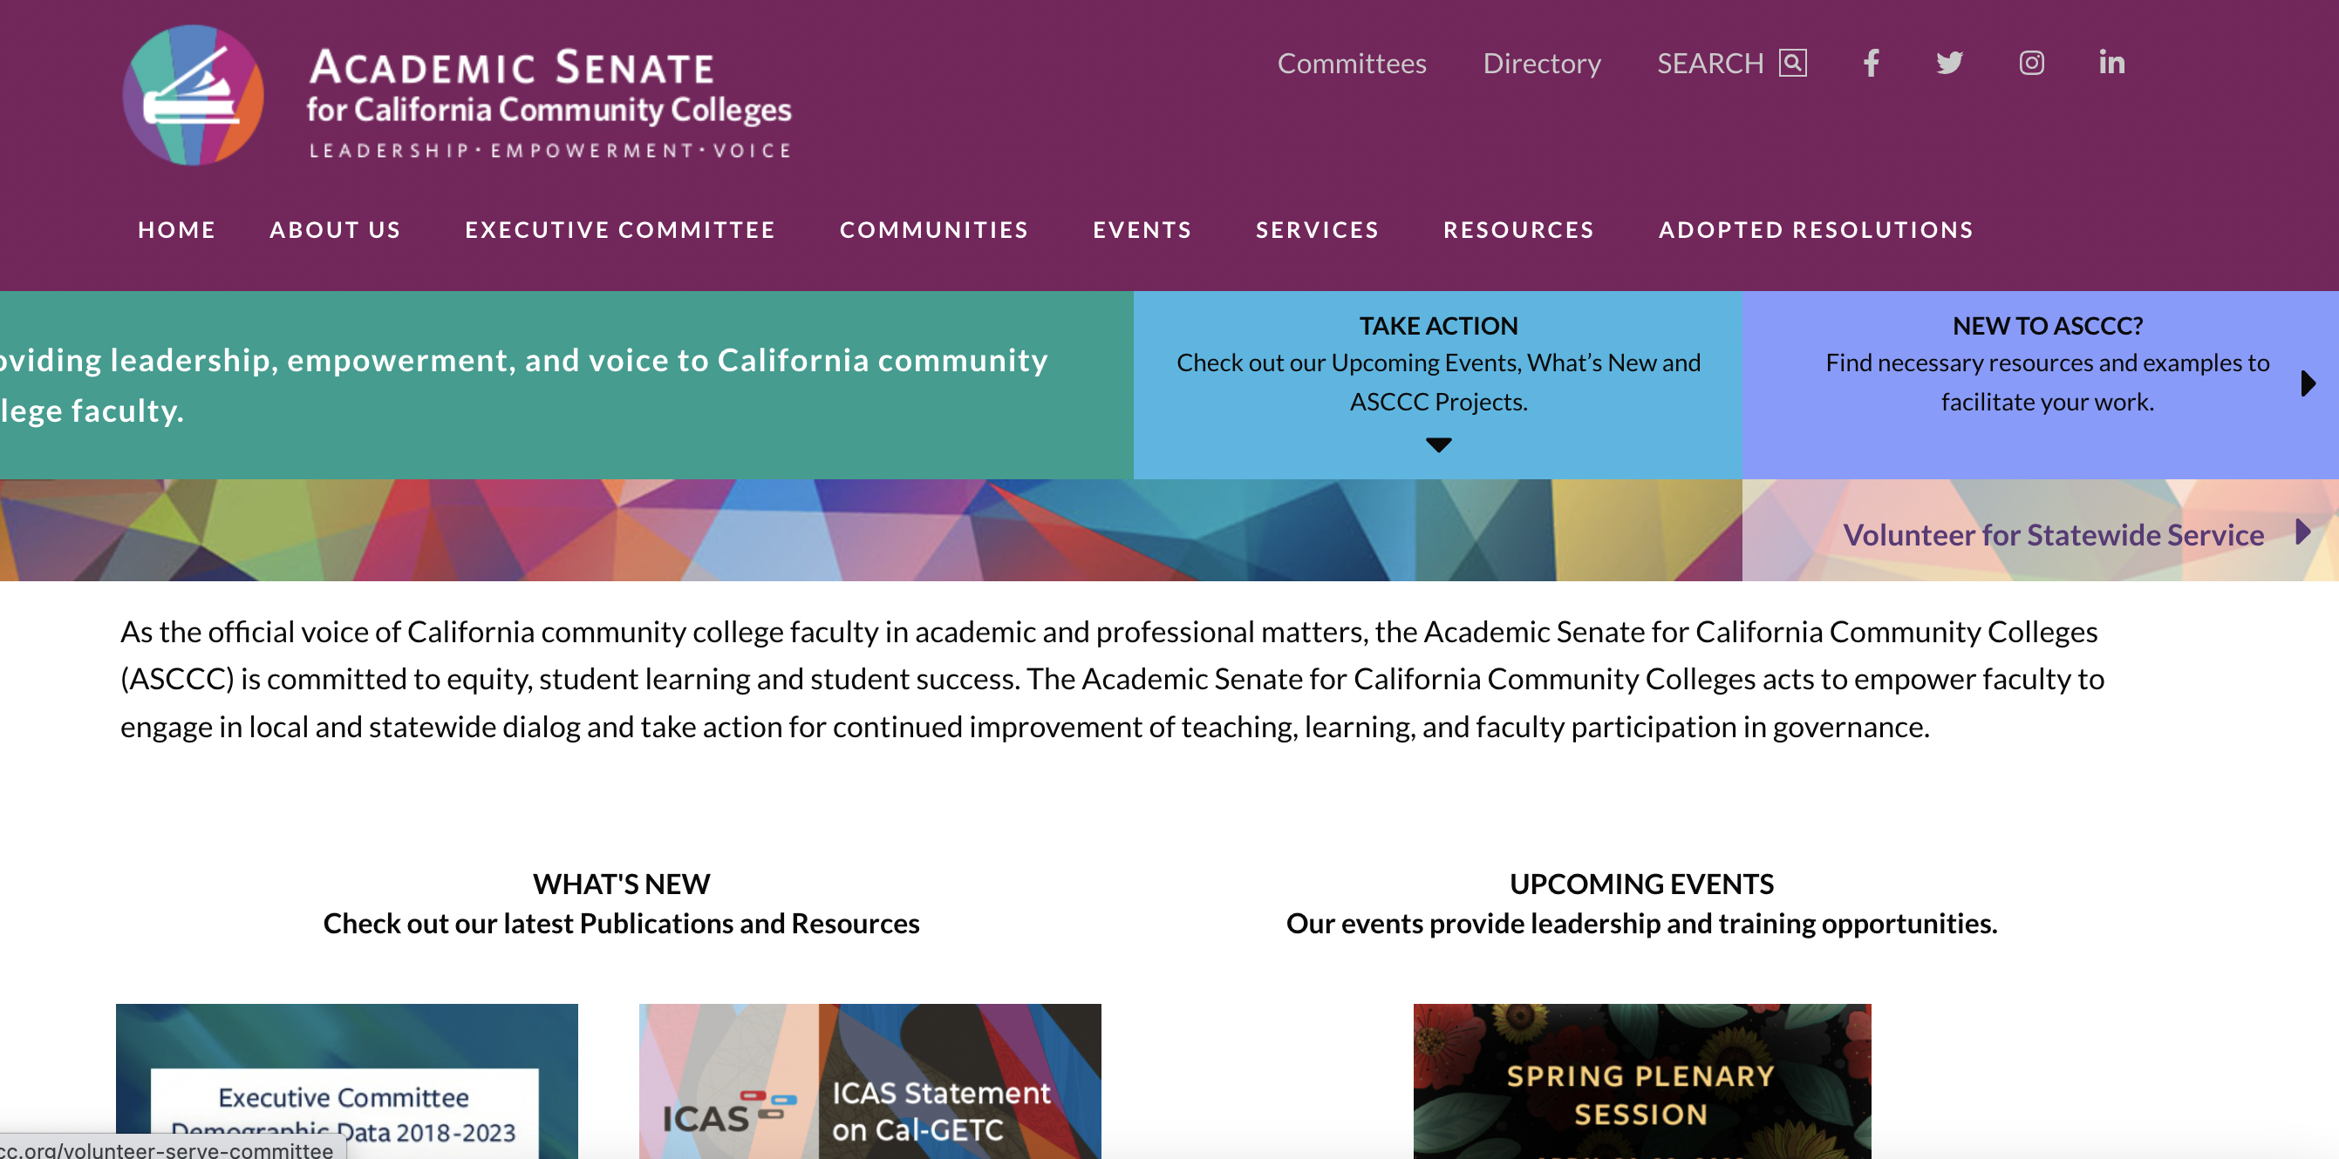
ASCCC – How to Sign Up

Slide 17
Resources/Questions?
Contact us: INFO@ASCCC.ORG
ASCCC Website: www.asccc.org
OERI: oeri@asccc.org | www.asccc-oeri.org
C-ID: c-idsupport@asccc.org | www.c-id.net
Sign up for Discipline Listservs: https://asccc.org/sign-our-newsletters

