Slide 1
Finding
Open Educational Resources
Search Tips and Resource Suggestions
Adapted from a presentation by Rachel Arteaga; Butte Community College
CC-BY
Presenters
Suzanne Wakim: Butte Community College
Shagun Kaur: De Anza College

Slide 2
Ice Breaker: Please state in 30-45 seconds
Name
College
What are you excited about learning today?
ce Breaker: Please state in 30-45 seco

Slide 3
Searching for OER can be overwhelming
How do you know where to start?
What is the most effective method of searching?

Slide 4
Cool4Ed
CSU, UC, CCC
Showcase reviews quick place to look before extensive search
Does not have extensive selection
Thorough reviews by California faculty
Already passed accessibility; includes detailed report

Slide 5
Take a few minutes to search.

Slide 6
A Few Good Repositories
https://textbooks.opensuny.org/
https://openstaxcollege.org/
https://courses.candelalearning.com/catalog/lumen
https://www.valleycollege.edu/open-education-resources/faculty/oer_by_subject.php

Slide 7
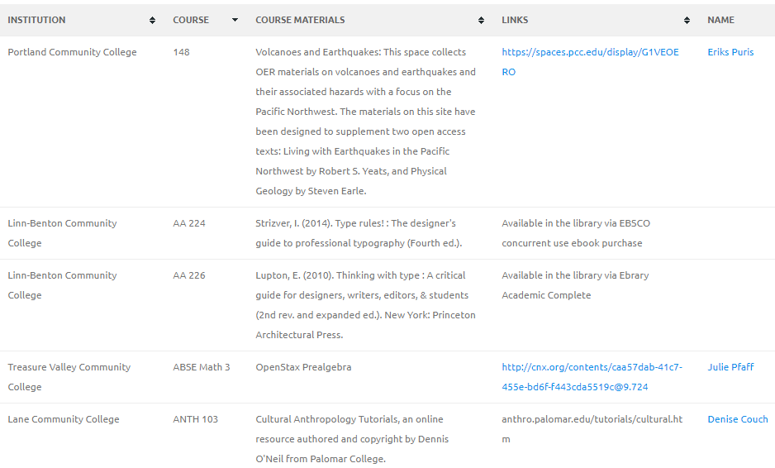
Open Oregon
Extensive list with information on actual classes - institution, course, materials, instructor
Links to materials and further information
Contact information of instructors so you can ask questions

Slide 8
Searching OER Repositories or Collections
Search Tips
Keyword searching is often limited
Browse by discipline/subject matter

Slide 9
University of Minnesota’s Open Textbook Library
High quality collection
New books added frequently
Reviews available

Slide 10
BC Campus
OpenEd
High quality collection
Reviews available
Specialized content

Slide 11
Take a few minutes to search.

Slide 12
The Power of Limiters
Use limiters to narrow down resources
Discipline/subject
Audience or education level
Material type - textbook, module, assessment
Licence type or conditions of use

Slide 13
OER Commons
Easy to search and narrow results
Search by discipline
Creation tools available

Slide 14
Take a few minutes to search.

Slide 15
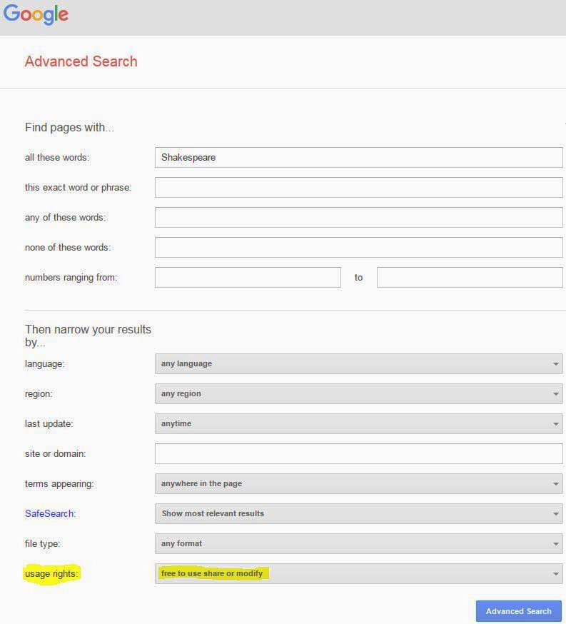
Google Advanced Search
Go to advanced search (search in Google, look under settings, bottom of page)
Type in keywords
Narrow results by usage rights
Choose “free to use, share, or modify”
You will need to verify license and determine exact terms of use

Slide 16
Take a few minutes to search.

Slide 17
TakeAways
Thought
Feeling
Action

Slide 18
Further Questions
Suzanne Wakim - wakimsu@butte.edu
Shagun Kaur - kaurshagun@fhda.edu
http://deanza.edu/academic-services/oer/index.html

