Slide 1
Refocusing on Student Success Through Faculty Hiring:
Second Minimum Qualification as an Equity Framework
John Stanskas, ASCCC President
Michelle Bean, ASCCC Area C Representative
Luke Lara, MiraCosta College
Fall Plenary
Newport Beach
November 8, 2019
3:45--5:00 p.m.

Slide 2
Session Description
Per Ed Code and Title 5 regulations, the 2nd minimum qualification for hiring faculty and academic administrators is a demonstration of “sensitivity to and an understanding of the diverse academic, socioeconomic, cultural, ability, and ethnic backgrounds of our community college students.” In this session we will discuss how we can center student success through the application of an equity framework in hiring practices by emphasizing the 2nd minimum qualification. This session will provide a space for participants to engage in authentic dialogue, discussing the opportunities we have as local senate leaders and providing some effective practices.

Slide 3
Today, we will
Discuss why diversity matters
Emphasize the 2nd minimum qualification
Apply an equity framework to hiring
Notes:
1 min--Michelle

Slide 4
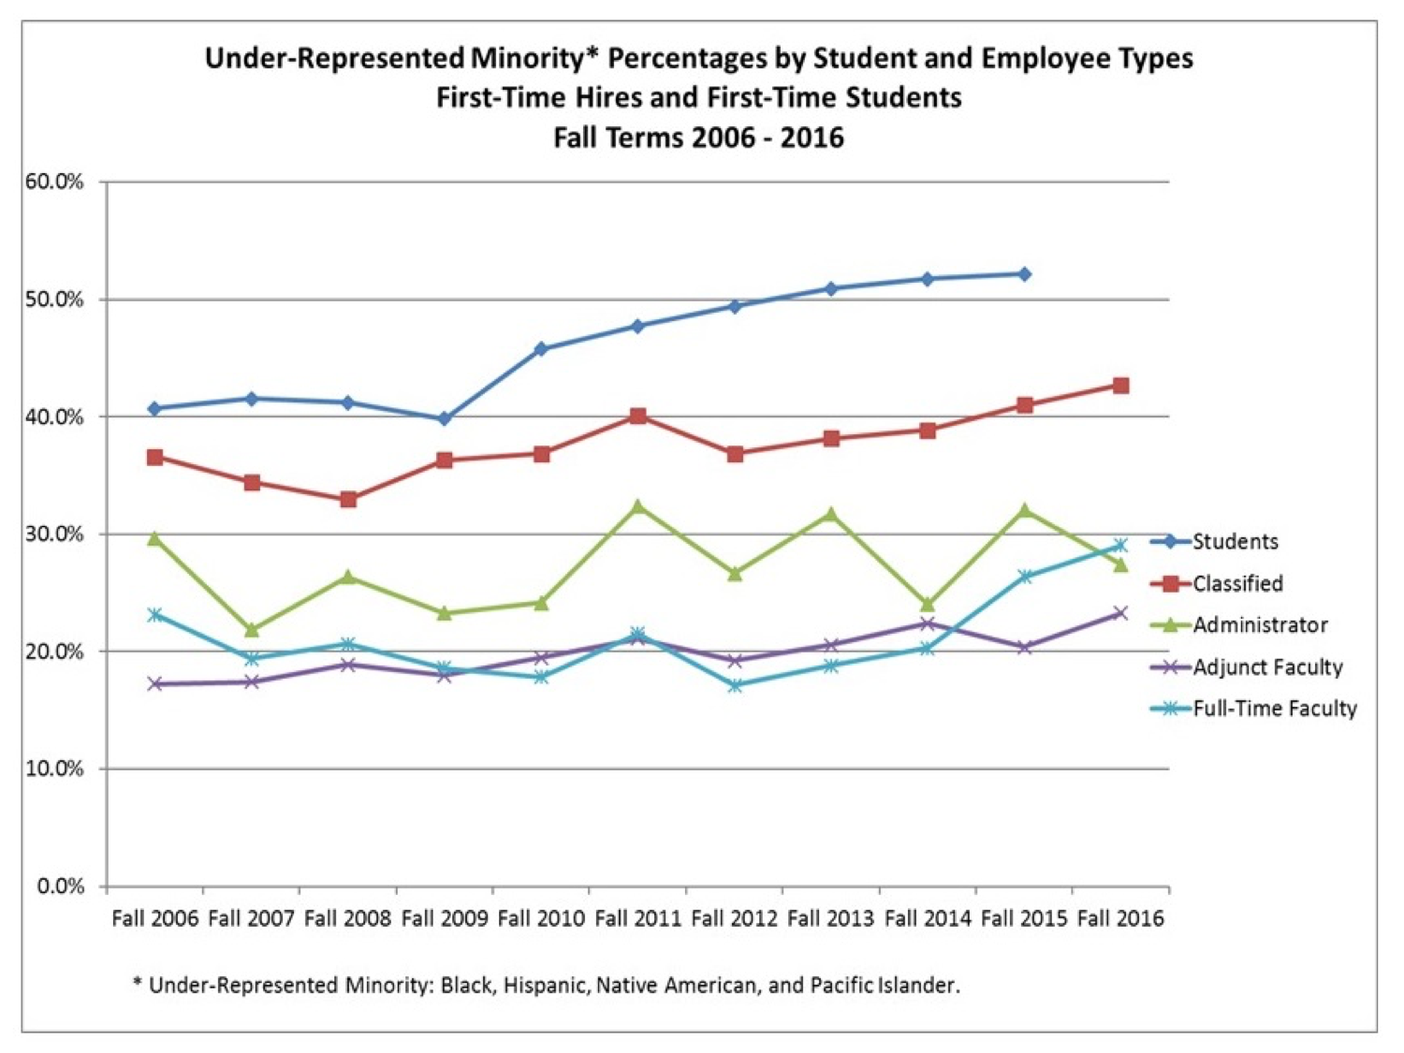
Notes:
5 min--John

Slide 5
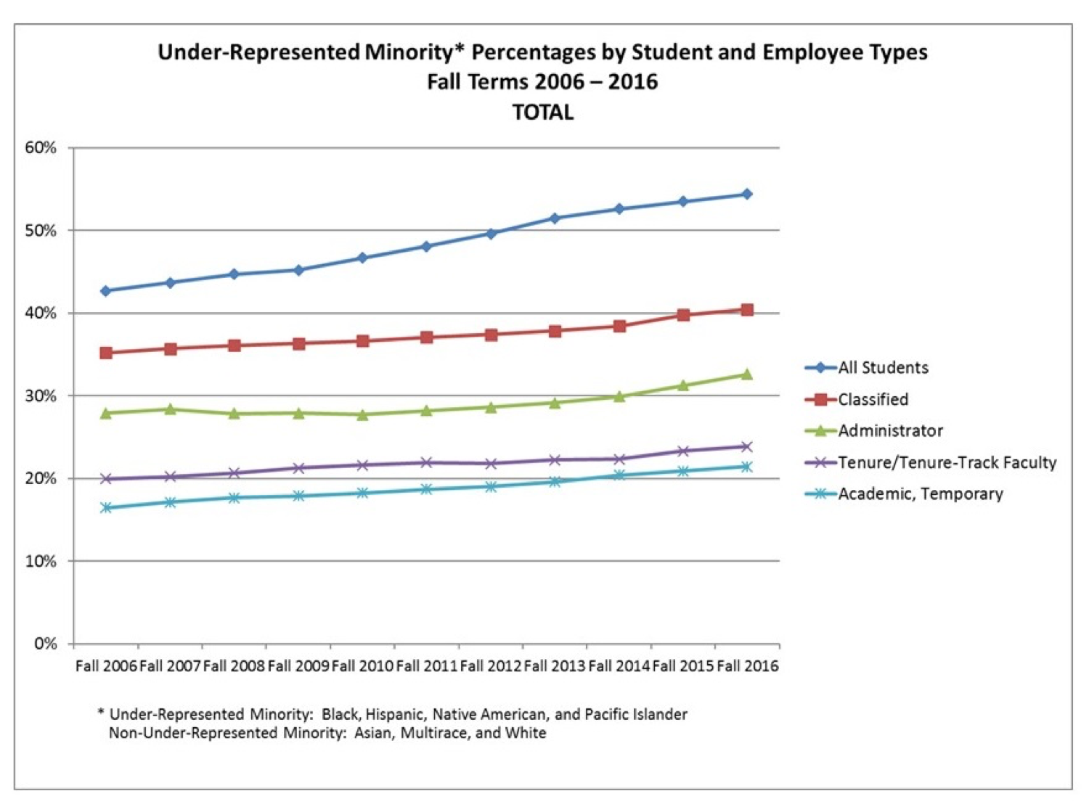

Slide 6
Why Diversity Matters
Equitable Outcomes for Students in Relation to Race and Ethnicity
Community College Goals:
Serve community of diverse learners
Prepare students for global community
Close student equity gaps
Increase racial and ethnic diversity of faculty and staff
Hire the most qualified candidates
Seeking Equity-mindedness in the Hiring Processes
Equitable Hiring Outcomes in Relation to Race and Ethnicity
Notes:
3 min--John

Slide 7
Challenge for Lawful Hiring (EEO)
Can we consider protected status (e.g., race) in the hiring process?
Can we be committed to diversity through hiring and not lower standards?
Notes:
2 min--Luke

Slide 8
Seeking Diversity, Excellence, and Equity-Mindedness
Apply an equity framework to examine policies, procedures, and practices
Expand/update what you consider to be job-related
Evaluate candidates against job-related criteria
Notes:
2 min--Luke

Slide 9
Apply an Equity Framework to Policies, Procedures, and Practices
Do hiring related BPs/APs advance diversity, equity, and inclusion principles?
Is the policy anti-racist?
What unintended consequences are attributed to the policy?
What departmental or institutional practices contradict the intention of hiring related BPs/APs?
Where are the discriminatory loopholes?
Notes:
10 min--Luke
Share our stories/experiences--Michelle, John, Luke

Slide 10
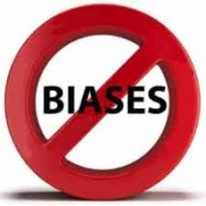
Expand/Update What You Consider to be Job-Related
2nd minimum qualification is about diversity and equity-mindedness
Search committees need to equitize conceptualization of merit and fit
Notes:
2 min--Luke

Slide 11
Diversity is Job-Related
Education Code section 87360 states that Academic & Administrative applicants must demonstrate:
“Sensitivity to and understanding of the diverse academic, socioeconomic, cultural and ethnic backgrounds of community college students.”
Notes:
3 min--Luke
Applicant should demonstrate this in pedagogy
Should not be reduced to ONE question--equity-minded framework infused throughout

Slide 12
Equity-Mindedness is
Job-Related
Equity-mindedness is about
Taking individual responsibility
Being culturally proficient (i.e., race conscious) to meet the needs of a diverse student community
Being systemically aware and institutionally focused
Taking action on equity based on evidence
Applying an equity framework to your hiring process allows you to focus on a candidate’s knowledge, skills, and abilities (KSAs) related to equity-mindedness, which is job-related (2nd min qual).
Notes:
5 min--Luke

Slide 13
Traditional Conceptions of Merit and Fit
MERIT
FIT
Traditional Conceptions:
Institutional prestige (e.g., known schools)
Degrees (e.g., doctorate)
Connections (e.g., insider track)
Experience (e.g., many years in CC)
Traditional Conceptions:
Reflecting existing faculty background (e.g., looks like us)
Collegiality (e.g., doesn’t rock the boat)
Shared interests (e.g., agrees with us)
Adapted from: Center for Urban Education, USC
Notes:
5 min--Michelle
Share scenarios--Luke, Michelle, John

Slide 14
Equitized Conception of Merit and Fit
MERIT
FIT
Equity Conceptions:
Experience teaching/counseling minoritized students
Engage in culturally proficient approaches
Experience acting as an equity advocate
Engages in evidence-based self-reflection to improve practice
Equity Conceptions:
Reflects and connects with student’s multiple identities
Holds high expectations for racially minoritized students
Can support and further college’s equity efforts
Adapted from: Center for Urban Education, USC
Notes:
5 min--Michelle
It’s not our candidate pools that need expanding.
It is our conceptualization of WHO merits the position and WHO fits in with our culture.

Slide 15
Evaluate Candidates Against Job-Related Criteria
Focus on Knowledge, Skills and Ability (KSAs) related to 2nd MQ
Job announcements need to clearly identify KSAs related to 2nd MQ
Search committee members need agree to evaluation criteria prior to reviewing applicants
Interview questions, prompts, and demos should reflect an equal or greater emphasis on 2nd MQ as compared to the degree/experience (1st MQ)
EEO compliance officers need to be integrated into search committees at all levels
Notes:
5 min--John
Begin conversation for equity-minded objectives/criteria BEFORE application reading and interviewing begins.
Spend time--invest in a focus on the student not ourselves.

Slide 16
Why Focus on KSAs?
It’s the law
Provides meaningful inquiry into candidate’s sensitivity to diversity with a focus on students
All candidates are evaluated on same criteria (e.g., objectivity, integrity, credibility)
Non-traditional candidates have the opportunity to show they are highly qualified
Well-developed questions/prompts lead to answers focused on KSAs
Notes:
3 min--John and Luke

Slide 17
Job Announcements Determine Evaluation Criteria
What do you want the candidate to be able to do?
Who are the students that the candidate will serve?
What are the professional activities the candidate will be required to participate in?
What KSAs are relevant to the position, especially diversity and equity-mindedness?
Pair Share:
Who creates the job announcements at your institution?
How do you develop evaluation criteria, questions, prompts, and demos based on the job announcement?
How can you use equity-minded objective to frame the hiring process?
Notes:
15 min - Did your committee have any investment or contributions in the job announcement?
2 intro slide
3 Pair share
10 Share Out

Slide 18
Recap
Diversity and equity-mindedness are job-related
An equity framework strengthens your ability to assess the job-related KSAs for diversity needs
The 2nd minimum qualification is about the student and should be equivalent in weight to other qualifications
Notes:
3 min--Luke

Slide 19
Questions, Comments, and Next Steps
Notes:
5 min

Slide 20
Other Resources
ASCCC paper “A Reexamination of Faculty Hiring Processes and Procedures”
ASCCC presentations “Evaluation Institutional Bias in Organizational Structures” and “Effective Hiring Committee Training”
California Community College Vision Resource Center module “Improving Equity in Campus Hiring”
Unconscious Bias resources from University of California San Francisco
Harvard Implicit Bias tests
Notes:
1 min

Slide 21
Thank you for joining us!
Contact Information:
Michelle Bean (mbean@riohondo.edu)
John Stanskas (jstanskas@valleycollege.edu)
Luke Lara (llara@miracosta.edu)

