Slide 1
Sequencing and Scheduling to Facilitate Student Success
Jennifer Johnson, Bakersfield College, CCC Curriculum Committee (5C), ASCCC representative
Sarah Harris, College of the Sequoias
Don Miller, College of Alameda, CCC Curriculum Committee (5C), CIO representative

Slide 2
Zoom Etiquette and Reminders:
During this session, you may use the chat window in Pathable to make comments or ask questions. As a reminder, the chat feature in Zoom is disabled – please use Pathable to chat.
We will pause throughout the session to address chat and other questions. If you wish to speak, please use the "Raise Hand" feature to speak and unmute your mic when called on. Please mute again when you have finished speaking.
Please be patient with and respectful of colleagues as we all work to navigate this virtual format! We will do our best to address everyone's questions and comments.

Slide 3
Session Outcomes
Provide an overview of considerations for course sequencing
Discuss effective practices for scheduling
Understand the perspectives of key stakeholders, including
Articulation officers
CIOs
Curriculum specialists
Curriculum committee chairs

Slide 4
Session Description
Student access and success is ultimately dependent on effective sequencing and scheduling of courses within a program. If students cannot take required courses, particularly sequenced courses like those needed in the sciences and many CTE disciplines, they cannot progress in a program or meet their educational goals. This session will provide an overview of considerations for sequencing and a discussion about effective practices for scheduling, with special attention to the varying perspectives of articulation officers, chief instructional officers, curriculum specialists, and curriculum committee chairs.

Slide 5
Check In:
5
Poll:
What is your role at your college/ district?
How long have you been working with curriculum?
What are you hoping to learn in this session?

Slide 6
Equity and Student Success
Vision for Success Goals:
Goals 1 & 2: increase the number of California Community College students annually who acquire associate degrees, credentials, certificates, or specific skill sets that prepare them for an in-demand job & increase transfers to CSU & UC
Goal 3: Decrease the average number of units accumulated by California Community College students earning associate degrees,
Goal 5: Reduce equity gaps across through faster improvements among traditionally underrepresented student groups

Slide 7
Equity and Student Success
Chancellor's Office Call to Action - Item 3:
Campuses must audit classroom climate and create an action plan to create inclusive classrooms and anti-racism curriculum.
"As campus leaders look at overall campus climate, it is equally critical that faculty leaders engage in a comprehensive review of all courses and programs, including non-credit, adult education, and workforce training programs. […] Faculty and administrative leaders must work together to develop action plans that provide proactive support for faculty and staff in evaluating their classroom and learning cultures, curriculum, lesson plans and syllabi, and course evaluation protocols. Campuses also need to look comprehensively at inclusive curriculum that goes beyond a single course, such as ethnic studies, and evaluate all courses for diversity of representation and culturally-relevant content."

Slide 8
Questions to Ask:
Before You Get Started
Are there courses in your catalog that are never offered?
Are there programs in your catalog that no longer exist?
Are there certificate and/or degree options that have never been awarded?
Who is responsible for curriculum “clean-up” decisions?
How do you engage in campus-wide clean-up of curriculum/catalog?
Notes:
This is the result of scrolling to the program requirements

Slide 9
First Thing's First Curriculum Clean Up – What does that mean?
Curriculum and discipline experts examine data across the institution
Asking questions – lots of questions – across programs
Not jumping to conclusions
May (or may not) mean discontinuing certain awards, programs or classes
May (or may not) mean creating new awards, programs, classes
May (or may not) mean re-designing
Question what is the end goal of the program – employment and transfer

Slide 10
Program Mapping and Sequencing
An academic program map is a term-by-term sequence of courses required to complete a degree/certificate in a given time (typically two-years for an associate's degree). A program map is intended to communicate to students the most efficient pathway that minimizes the time to degree and the courses they need to take to ensure a seamless completion or transfer.
Sequencing degree/ certificate requirements is part of the new program submission process for COCI. As part of the mapping process, course sequencing is a process whereby discipline faculty, working with counseling faculty and other stakeholders, identify which courses should be taken and in what order.
Notes:
DM will cover

Slide 11
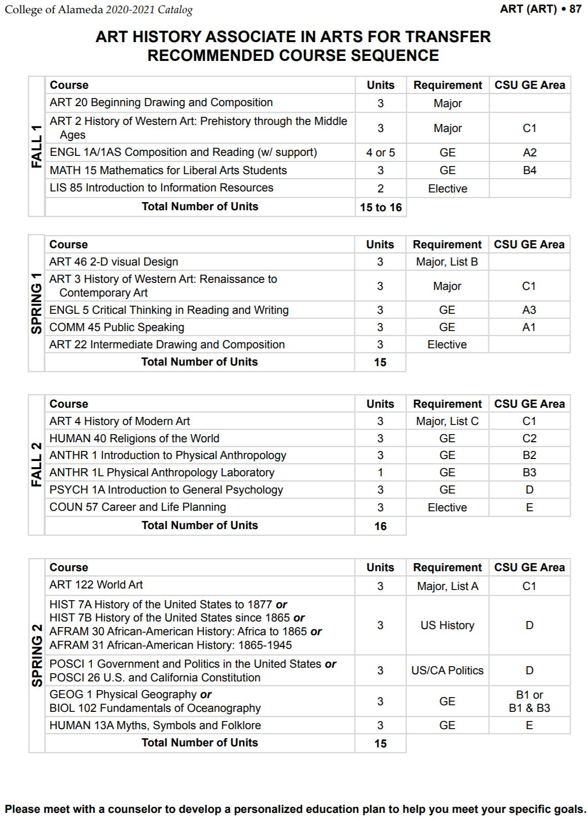
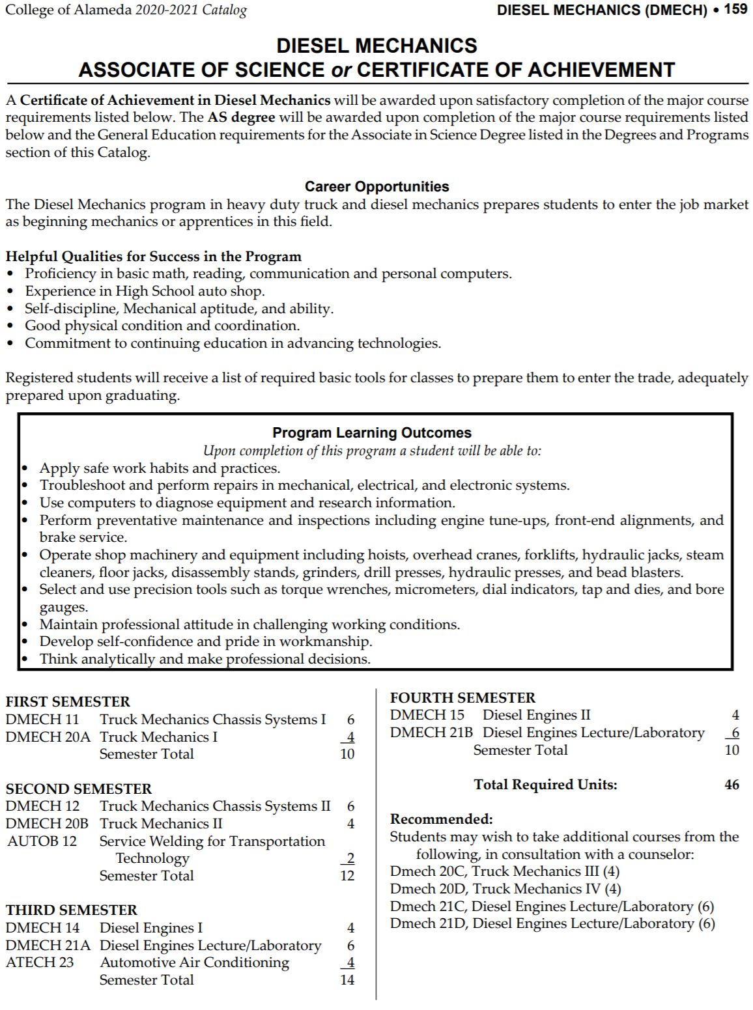
College of Alameda Map Examples
Notes:
DM will cover

Slide 12
Why does a course belong in a specific semester?
Is the course a prerequisite for other courses?
Does the course rigor require preparation?
Does the course represent a milestone in student progress?
Can students use the course to pursue other majors within a meta major if they change major?
Is the course a hook course meant to engage student interest or vet suitability?
Does the course provide an important contribution to campus equity initiatives?
How does the timing/sequencing of the course address equity gaps?

Slide 13
Why does a course belong in a specific semester?
Do you want English and Math in the first semester?
funding formula
enrollment management
what are the potential unintended consequences
conversations with faculty and administration
what about part-time students
Discuss in Chat: What other sequencing considerations are important on your campus?

Slide 14
Course scheduling
Points to consider:
Where does the class fall in the sequence on the program map?
How many students does the program have?
How many sections of the class will you need and in which semester?
What times/days is student demand high for this specific program?
What are the equity needs of students who will take the courses for this degree/certificate?
Have you consider having this certificate/degree as part of a night-time or weekend program?
Do you have the full student support services available to the students if you put the courses in the evenings and weekend?
How many courses in this area are offered at the same days/times?
Are GE courses offered at varying days/times for all student access?
Notes:
DM will cover

Slide 15
Block Scheduling
Notes:
DM will cover

Slide 16
Questions to Ask:
Considerations from Counselors and Articulation Officers
General Education Patterns
Have you included the golden four in the first academic year? (Transfer level English, Math, Communication, Critical Thinking)
What are your students' goals?
Local GE, CSU Breadth, IGETC
How closely do your three patterns (Local, CSU, IGETC) align in their shared areas?
Initial maps and schedules may be based on a "standard" student profile
Beginning at transfer-level ENGL / MATH
Declared transfer institution (UC or CSU not a private)

Slide 17
PAUSE
Remember to use “raise hand” for questions!

Slide 18
Equity-minded Considerations
Since most Community College students are part-time, have you examined the students in your programs? What are their course taking patterns (days, evenings, weekends). How does the schedule align with their needs?
Does the schedule allow for degree completion in a timely manner?

Slide 19
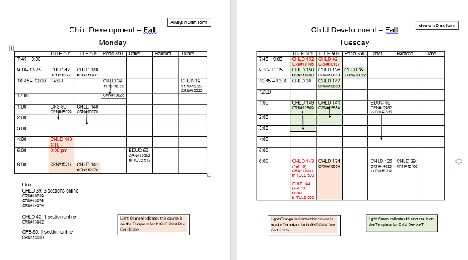
Example: Child Development at COS
Notes:
Over several months, working as a group, the child development faculty at COS reviewed their curriculum, particularly looking at courses that were offered compared to those required by the state, and made the difficult decision to remove courses that were not required. Faculty then used data to create schedules for two hypothetical/ composite students, one day and one evening, listing semester by semester the course students would take. These courses were then slotted into room grids, and faculty found to teach each course.

Slide 20
Focusing on Holistic Student Support Grounded in Equity
Identify potential roadblocks or bottlenecks for students
Give students the information they need to make informed choices
Review Achievement Data, Number and Types of Degrees, and Certificates
Consider “stackability” of programs

Slide 21
Student Support Grounded in Equity
Where do you see opportunities for scheduling and sequencing?
Vision for Success | Core Commitments
Increase credential obtainment by 20% | Focus on students’ goals
Increase transfer by 35% to UC and CSU | Design and decide with the student in mind
Decrease unit obtainment for a degree | Pair high expectations and high support
Increase employment for CTE students | Evidence-based decisions
Reduce and erase equity gaps | Own student performance
Reduce regional gaps | Enable innovation and action
 | Cross-system partnership

Slide 22
Focus on Students
Emphasis on equity – vision for success, call to action principles
How do we use scheduling, sequencing, and pathways to create inclusive classrooms and anti-racism curriculum?
How can these be used to decrease equity gaps and increase students' success?
Proper sequencing/scheduling can be used to decrease the number of overall units students need to complete their academic goals
Transparency and open access for all students is an equity goal! Scheduling and sequencing with student goals and the college mission in mind means making sure courses are available in time for students to achieve their goals.

Slide 23
Baby steps to implement!
Do your course offerings cross am/afternoon/evening time blocks?
When offering online courses, have you considered student's ability to access internet or an electronic device?
How have your student support services adapted to a virtual modality?
Notes:
Don to give an example (or refer back) to move to block scheduling for bullet 1.

Slide 24
Example of program data

Slide 25
Resistance/ Obstacles to Scheduling?
How do you operationalize?
Common challenges:
Faculty preferences/ availability
Local policy and/or contractual agreements
Access to data
Technology and/or facility limitations
Some Solutions:
Work with your Research Office to build data tools
Technology solutions (Starfish, others)
Enrollment management committees
Notes:
List some common challenges here: Faculty preferences/ availability, local guidelines or contractual agreements, access to data, technology or facility limitations. Give example solutions: Sarah – research database, Jennifer, Starfish example, enrollment management on next slide.

Slide 26
Example Solutions
Enrollment Management
Bakersfield College has an Enrollment Management Commitee (EMC) which focuses on improving student success and access by reviewing, monitoring, evaluating and communicating on all aspects of the enrollment life-cycle for Bakersfield College students.
COS is building an in-progress enrollment database in Tableau, which when combined with curriculum data can be used by the curriculum committee when programs are updated.

Slide 27
COS Enrollment Matrix

Slide 28
COS Program Enrollment Form
Notes:
Thank you to LACC, from whom this form was originally adapted.

Slide 29
Questions and Comments
Zoom Etiquette and Reminders:
Please use the "Raise Hand" feature to speak and unmute your mic when called on. Please mute again when you have finished speaking.
You may also use the chat window in Pathable to make comments or ask questions. As a reminder, the chat feature in Zoom is disabled – please use Pathable to chat.
Please be patient with and respectful of colleagues as we all work to navigate this virtual format! We will do our best to address everyone's questions and comments.

Slide 30
Contact
For more info, please contact: info@asccc.org
Join the California Community College Curriculum Chairs Listserv: https://groups.io/g/CCCCurriculumChairs/
Jennifer Johnson, Faculty Curriculum Committee Chair, Bakersfield College: jlwilson@bakersfieldcollege.edu
Sarah Harris, Curriculum & Outcomes Assessment Coordinator, College of the Sequoias: sarahha@cos.edu
Don Miller, Vice President of Instruction, College of Alameda: ddmiller@peralta.edu

Slide 31
Resources
GP Intersection with Enrollment Management
ASCC Enrollment Management Worksheet
Vision for Success
Vision for Success Diversity Inclusion Task Force

