Slide 1
Student Education Planning Tools: Education Planning Initiative (EPI)
Cynthia Rico
David Shippen
Robyn Tornay

Slide 2
Agenda
-Systemwide Portal Progress -Education Planning/Degree Audit -Timeline -Pilot Colleges -Questions, Answers, Dialogue

Slide 3
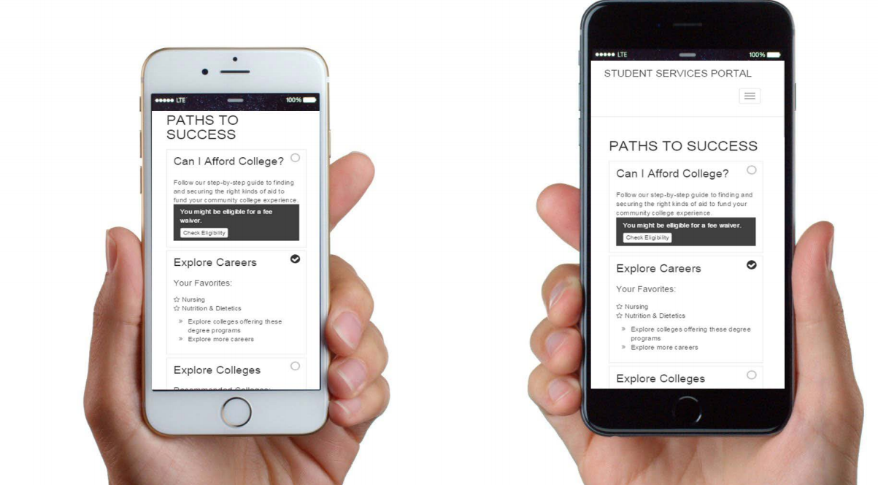
Systemwide Student Portal

Slide 4
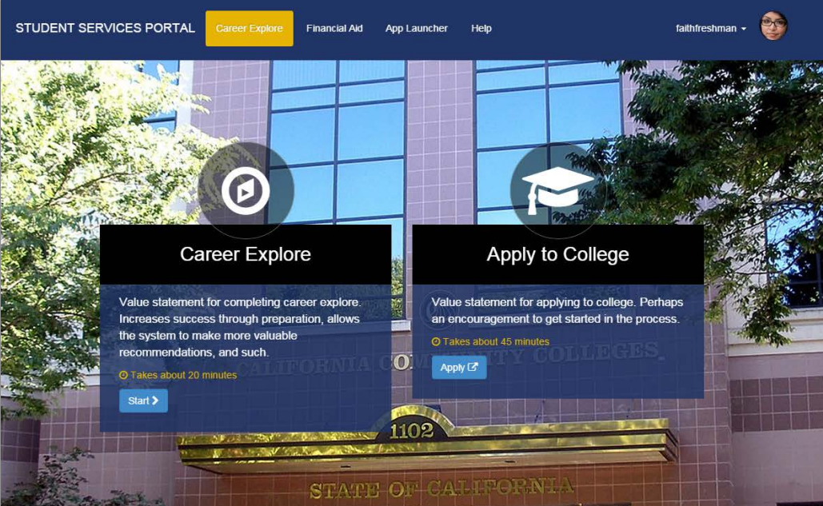

Slide 5
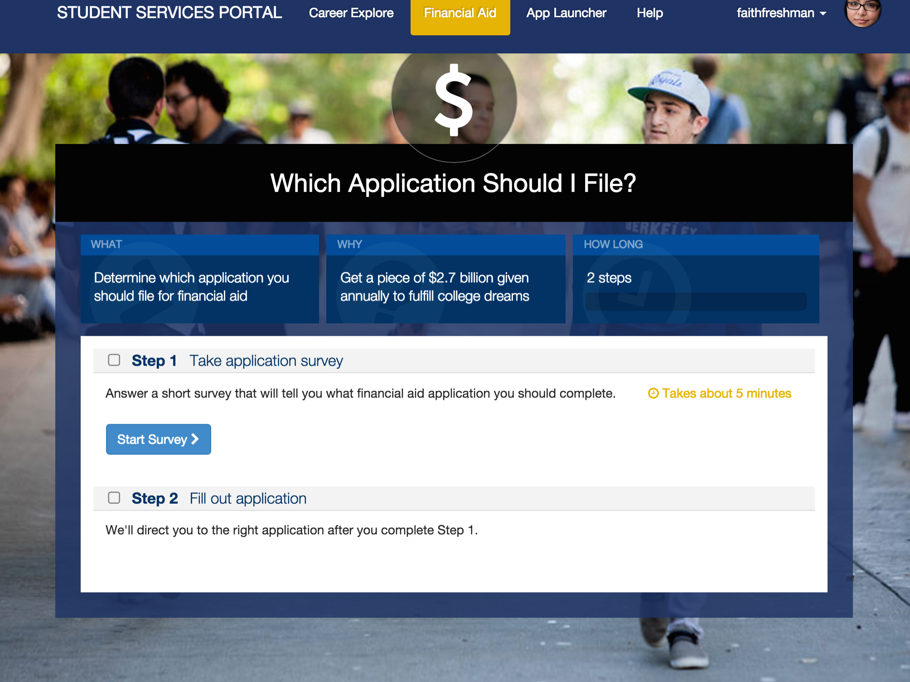
Systemwide Student Portal

Slide 6
Portal – Messaging Students
Apply for Admission
Education Planning
Orientation
Financial Aid
Order Transcripts
Academic advising
Time Management
Transportation
Child Care
Test Anxiety
Substance Abuse
Food Assistance
Basic skills (reading, writing, math)
CalWorks
Career planning
Counseling - personal
Dream Act
DSPS (Disabled Student Programs and Services)
EOPS (Extended Opportunity Programs and Services)
ESL (English as a Second Language)
Health services
Housing information
Employment assistance
Online classes
Re-entry program (after 5 years out)
Scholarship information
Student government
Testing/assessment
Transfer information
Tutoring services
Veteran’s services
Athletics
Foster Youth
TANF/SSI/General Assistance
LGBT

Slide 7
Education Planning/Degree Audit System
Builds from historical course offerings
Term-by-term degree layouts
Requirement checklists for student to complete degree objective
Ability to email, print, share education plans
Early Alert system to increase retention and reduce withdrawals
Identify at-risk students, concerns and connect students with resources.

Slide 8
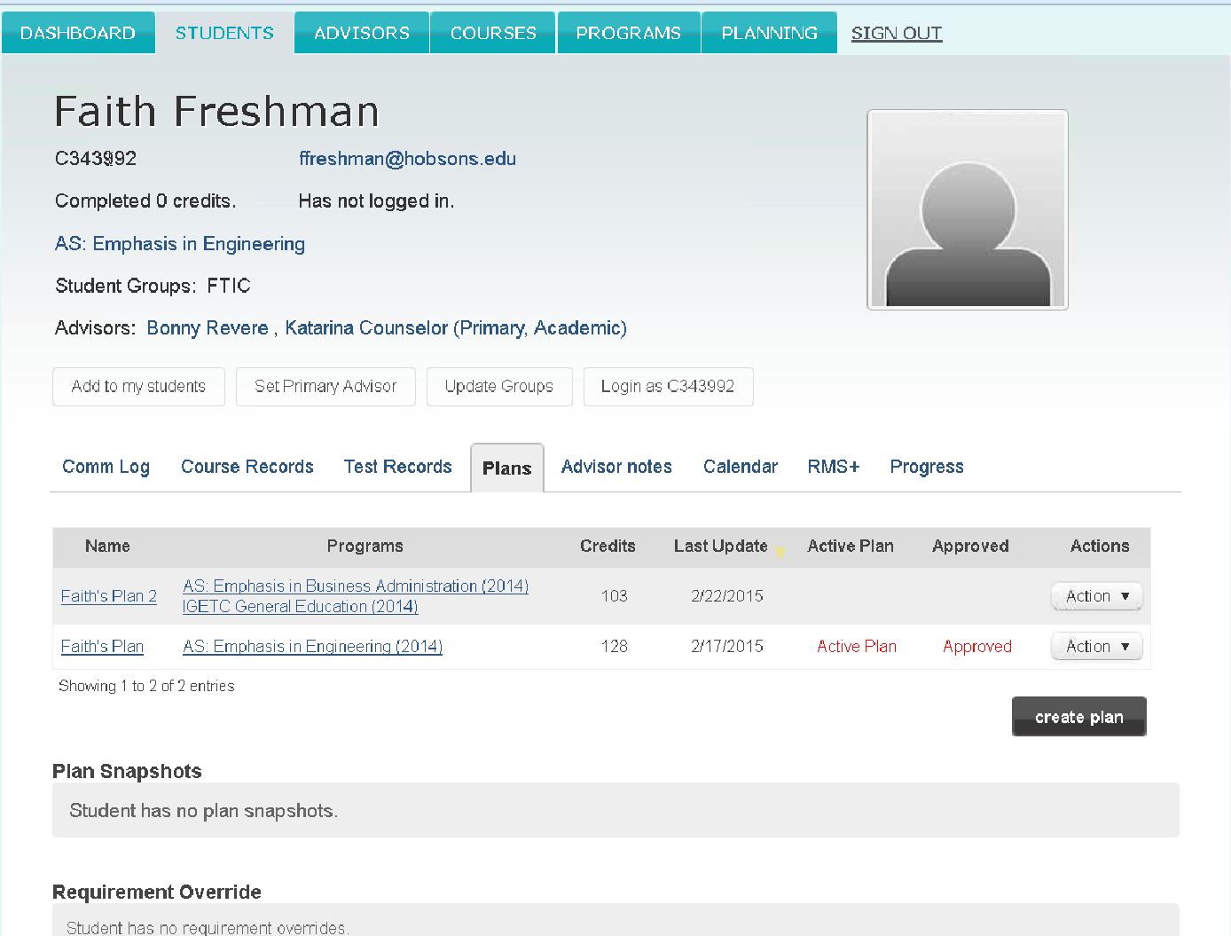

Slide 9
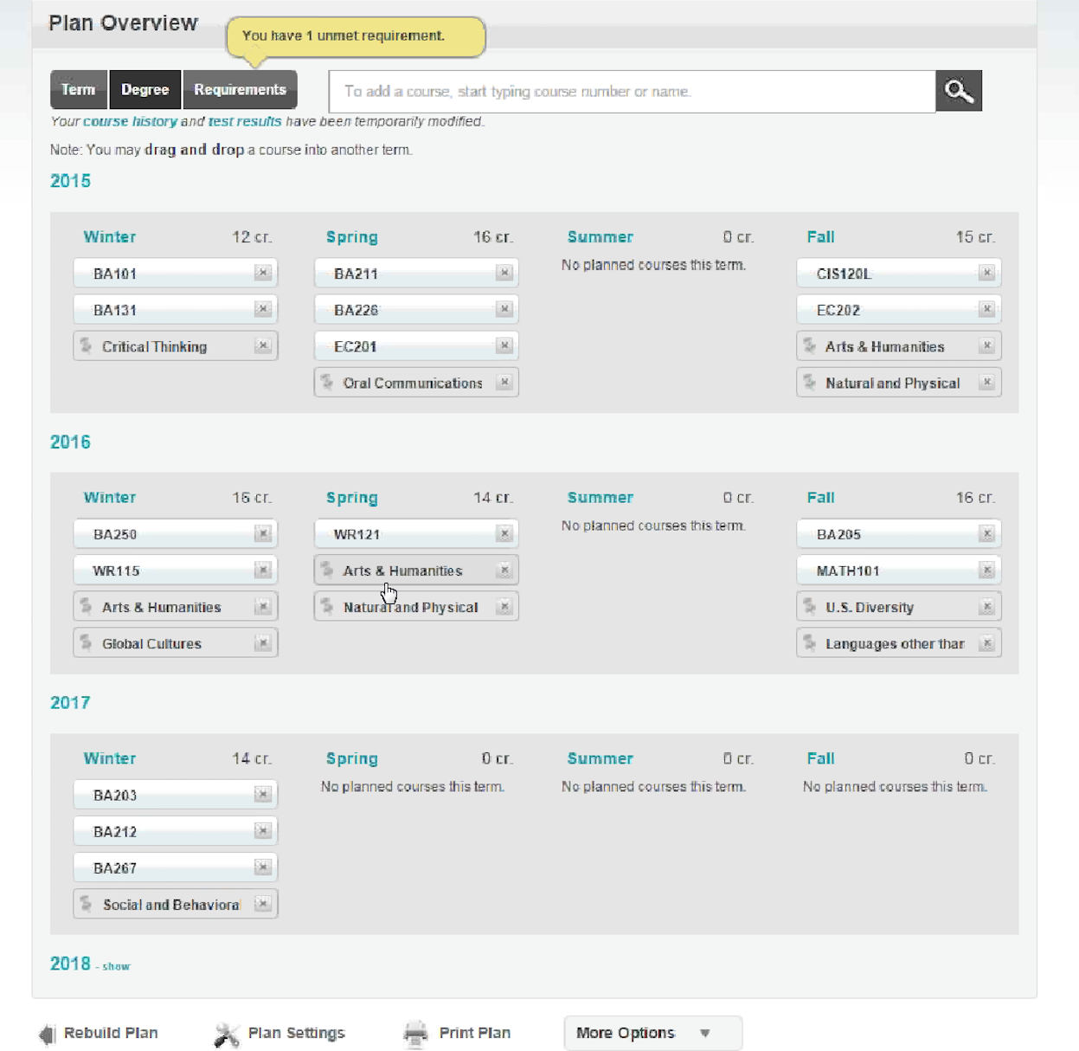

Slide 10
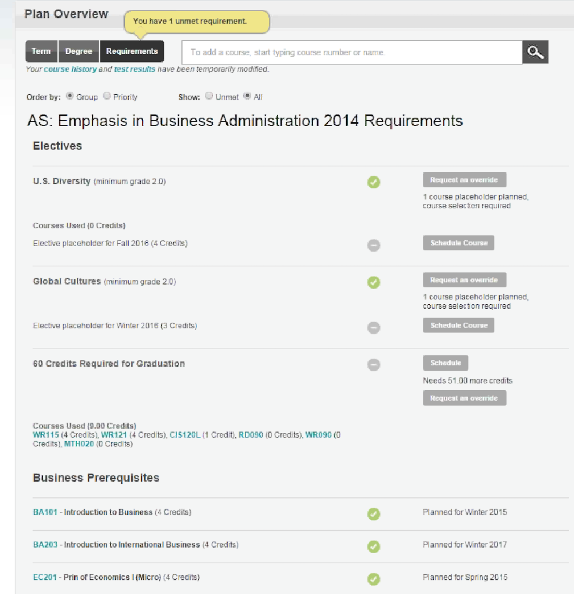

Slide 11
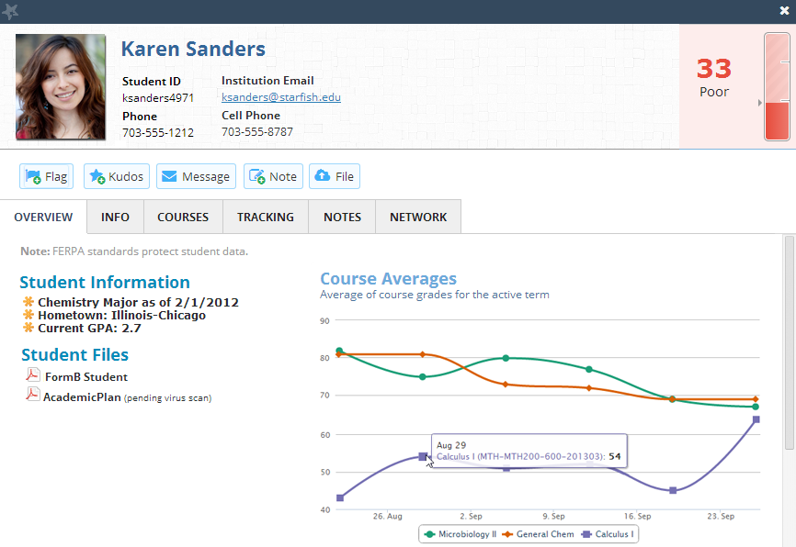

Slide 12
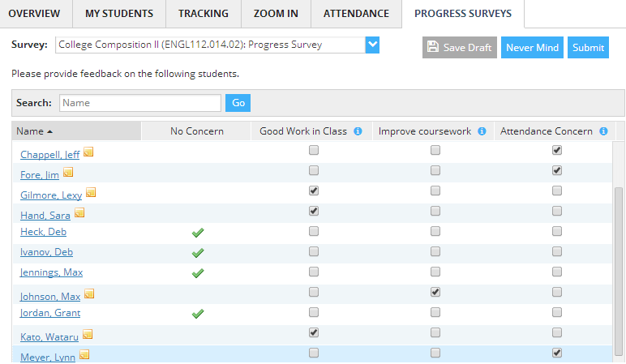
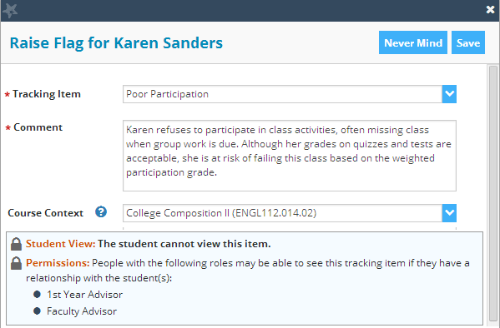

Slide 13
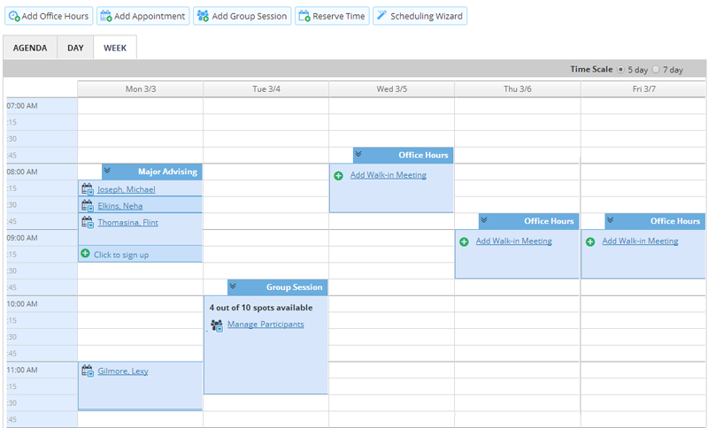
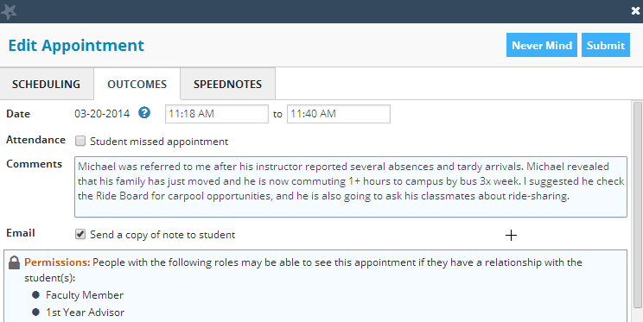

Slide 14
Education Planning Tool/Degree Audit System
10 pilot colleges
-City College San Francisco -Crafton Hills College
-El Camino College -Fresno City College
-Fullerton College -Los Medanos College
-Mt. San Jacinto College -Santa Barbara City College
-Santa Rosa Junior College -Victor Valley College

Slide 15
Release Timeline
Function | Q3 14-15 Jan - Mar | Q4 14-15 Apr - Jun | Q1 15-16 Jul - Sep | Q2 15-16 Oct - Dec | Q3 15-16 Jan - Mar | Q4 15-16 Apr - Jun
EdPlan/DAS
RFP | Intent to Award Issued
Implement
Pilot |  | June start
Release
Portal | UX/UI Features underway
Implement
Release

Slide 16
Additional Developments
Online Orientation RFP- being drafted
Self Assessment and Career Exploration RFP- being drafted

Slide 17
Questions, Answers, Dialogue

