Slide 1
25 Recommendations for a Strong Workforce
Adopted by the Board of Governors
www.DoingWhatMATTERS.cccco.edu
#StrongWorkforce
@CalCommColleges @WorkforceVan

Slide 2
Student Success
CCCCO Implementation
Student Success
Task Force
CCCCO Implementation
2011
2012
2013
2014
2015
2016
2017
2018
2019

Slide 3
California needs 1 million more AA, certificates, or industry-valued credentials.
#StrongWorkforce
The Goal

Slide 4
Career Technical Education (CTE): The Path Out of Poverty
$60,771
($29.22/hour)
2-parent with
one working adult, 2-child
Source: CA Budget Project
$66,000
AA – Career Technical Education
5-years later
Source: Salary Surfer, CA Community Colleges
$38,500
AA - General Education
5-years later
Source: Salary Surfer, CA Community Colleges

Slide 5
25 Strong Workforce Recommendations
#1-2 Student Success
#3 Career Pathways
#4-6 Workforce Data & Outcomes
#7-12 Curriculum
#13-16 CTE Faculty
#17-20 Regional Coordination
#21-25 Funding

Slide 6
Legislation
#1F Assembly Bill 1892 (Medina)
Cal Grant C – competitive Cal Grant C supplemental award & new entitlement award for short-term CTE programs
#4a, 5a, 5b Senate Bill 66 (Leyva)
Data sharing – align state and federal reporting requirements and access employment and licensure data from Department of Consumer Affairs

Slide 7
Budget
#21, 22, 23: $200M Trailer Bill Language
Expand the availability of quality CTE
Key components:
Regional planning
Allocation model
Allowable expenditures
Maintenance of effort

Slide 8
Workforce Data & Outcomes
#4a. Common workforce metrics
#4b. Recognition of ‘skills builder’ in student success
#4c. Report outcomes by student demographics characteristics
#5. Student identifier
#5a. Share employment, licensing, certification, and wage outcome information
#6. Improve the quality, accessibility, and utility of student outcome and labor market data

Slide 9
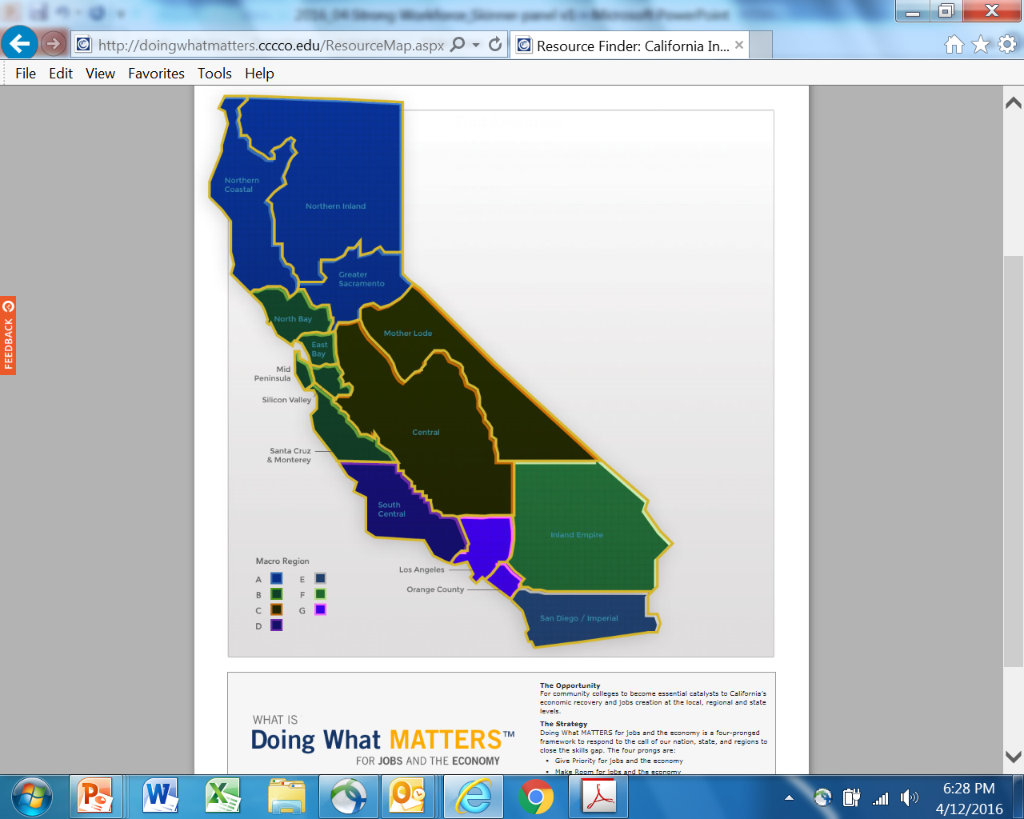
#17a&b Regional Coordination
☑ regional economic clusters
☑ regional employers
☑ regional business associations
☑ regionally mobile workforce
☐ regional coordinated workforce development

Slide 10
Curriculum & Pathways
Streamline Program Approval Process
Nonsubstantial courses
Stand-Alone Course Approval
SACC recommendations to Consultation Council and Board of Governors
CTE Course Identifier (C-ID) Curriculum Models
Standardized numbering system
Program and Course Approval Handbook (PCAH)
Statewide Curriculum Approval
Control numbers, MIS, Apportionment

Slide 12
QUESTIONS?

