Slide 1

Structured Career Pathways
Kris Costa
Articulation Liaison
Academic Senate for California Community Colleges
Dr. Grant Goold
American River College

Slide 2
ASCCC Initiatives related to Career Pathways
Course Identification Numbering (C-ID) System
    C-ID fulfilled the mandate of SB 1415 (2004), which called for common course numbering system for CSUs and CCCs
Framework for the Associate Degree for Transfer
    Guaranteed admission to CSU in majors with Transfer Model Curriculum
Statewide Career Pathways (SCP) Project
  SB1070 (Steinberg, 2012), Education Code §88532.
  Develop and strengthen linkages and CTE pathways between HS and CCC to accomplish specified objectives
  Products:
    Articulation Templates
    Program of Study Templates
    “Alternative Methods For The Awarding Of College Credit: Credit By Examination For Articulated High School Courses”

Slide 3
What is a Career Pathway?
Rigorous, sequential, and clearly articulated coursework
Multiple entry and exit points
Transition support between levels of the pathway
Career counseling/navigation services that are proactive and integrated within pathways
Organized and comprehensive support services
Employer engagement
Work-based learning and contextualized instructional strategies
Strategies that accelerate educational and career advancement

Slide 4

How is Coursework Organized?
Industry Sectors
  15 as outlined by CA and grouped by commonalities
  Knowledge and skills as stated by industry
Career Pathways
  Knowledge and skills as stated by education
  Sequential courses in a program of study
Programs of Study…a comprehensive picture
  Courses in years 9-14 (cohorted, in an HS academy)
  Transitional opportunities – Credit by Exam, Articulation, etc
  Work Based learning, mentor, job shadows
  Concurrent Enrollment and/or Dual Enrollment
  Options at the Community College
Business Management
Financial Services
International Business
CSU/UC
Certificate/Degree
Transfer

Slide 5
Statewide Programs of Study
Source documents to inform local pathway design
Discipline Faculty from K-12/CC convened
Include:
  HS Course Sequences…CTE and GE
  College Course Sequence …CTE and GE
  Articulation and Dual Enrollment
  Occupations by Education Level
  Certifications and Credentials
Agriculture, Business, Early Childhood Education, Elementary Education, Film/TV/Media, Theatre Arts
The basis for Online Counselor Toolkit

Slide 6
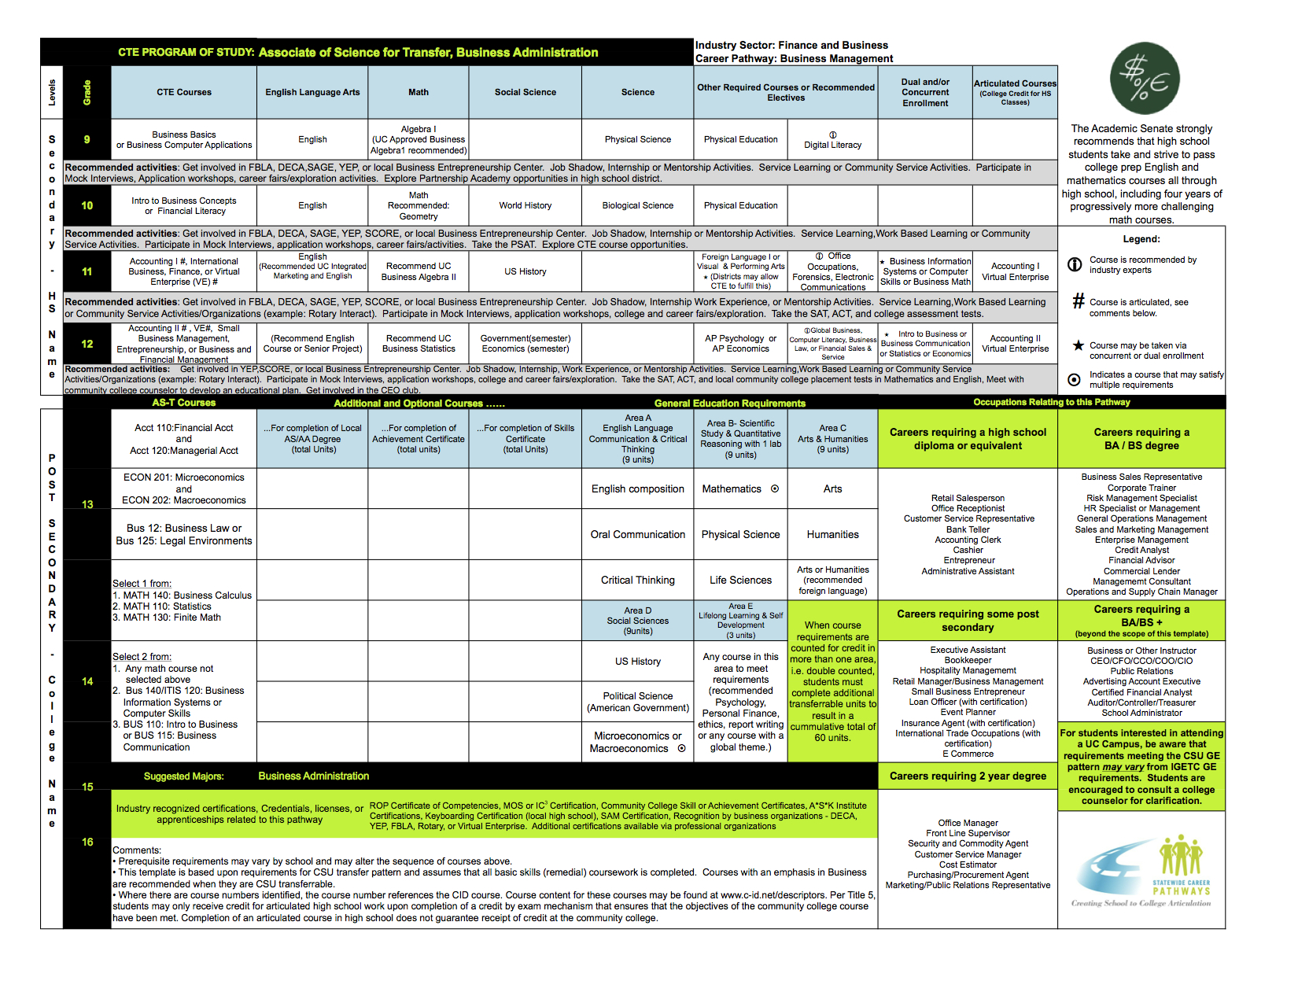
Statewide Template
Notes:
Kris

Slide 7
What is C-ID?
Faculty-driven system
Assigns numbers to courses
  C-ID number ties a course to a “descriptor”
  Developed discipline faculty, reviewed statewide
  Transferable and Non-Transferable courses.
Individual college courses are compared to the minimum requirements set by these descriptors.
Any community college course that bears the C-ID supranumber conveys that faculty have determined it meets the published course content, rigor, and student learning outcomes.
To Review Descriptors: www.c-id.net
To identify courses aligned to descriptors: c-id.net/course_compare

Slide 8
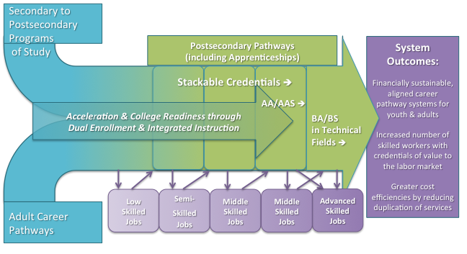
Multiple Entry and Exit Points

Slide 9
Student Support
Transition support between levels of the pathway
  Dual Enrollment Coordinator
  High School Counselor
  Campus Hubs
  Designated CTE Counselor
Career counseling/navigation services that are proactive and integrated within pathways
  College and Career Choices Curriculum (10 Year Plan)
  Counselor Toolkit
Organized and comprehensive support services
  Student Remediation
  Contextualized Learning
  Small Learning Communities

Slide 10
Counselor Toolkit Online
Created to assist counselors in college and career conversations with students
Programs of Study are aligned to C-ID descriptors and AD-T majors
Represent all 15 sectors and 54 Career Pathways
CTE Majors and Non-CTE Majors
Can be customized to reflect local pathway sequences and opportunities
http://www.programsofstudy.com

Slide 12
The Online Toolkit Applications…
One-on-one counseling with students
Pathway conversations in introductory course
As a group in AVID course
Notes:
Kris

Slide 13
Integrating the “Real World”
Employer Engagement
  Advisory Boards
  Teacher Externships
Work Based Learning
  Contextualized Instruction
  Internships
  Job Shadow and Mentorships

Slide 14
Acceleration
Dual Enrollment
  High school and college course taught on the high school campus (usually) by the high school teacher as adjunct for the college.
    Dual Credit - Automatic
Concurrent Enrollment
  Student enrolls in a college course taught by college faculty (full-time or adjunct). No enrollment in high school course during the same time.
    Dual Credit – Student takes college transcript to high school registrar
High School Articulation
  high school course or courses that college faculty in the appropriate discipline…have determined to be comparable to a college course
Credit By Examination
  End of Course Assessment deemed appropriate by college faculty
  Mechanism to transcript
    Residency?

Slide 15
Dual Enrollment
AB 288
  Authorizes the governing board of a community college district to create partnership agreements to establish protocols for information sharing, joint facilities use, and parental consent for high school pupils to enroll in community college courses.
  Authorizes specified high school pupils to enroll in up to 15 units if those units are required for these pupils’ partnership programs
  Authorizes a community college district to exempt special part-time and full-time students taking up to a maximum of 15 units per term from specified fee requirements.
  Prohibits a community college district from receiving a state allowance or apportionment for an instructional activity for which a school district has been, or will be, paid an allowance or apportionment under a concurrent enrollment partnership agreement.

Slide 16
Title 5 Language: Articulation
§ 55051. Articulation of High School Courses.
(b) The governing board of a community college district may adopt policies to permit articulated high school courses to be applied to community college requirements in accordance with this section. Articulated high school courses may be accepted in lieu of comparable community college courses to partially satisfy:
  Requirements for a certificate program, including the total number of units required for the certificate; or
  The major or area of emphasis requirements in a degree program.
(c) Articulated high school courses used to partially satisfy certificate or major/area of emphasis requirements shall be clearly noted as such on the student's academic record. Notations of community college course credit shall be made only if community college courses are successfully completed or if credit is earned via credit by examination.
(d) Except through credit by examination, as defined in section 55753, high school courses may not be used to satisfy:
  The requirement of section 55063 that students complete at least 60 semester or 90 quarter units in order to receive an associate degree; or,
  Any general education requirement for the associate degree established by the district.

Slide 17
Benefits of Articulation & Dual Enrollment
Students see themselves in college
Students start a transcript
Students save $ ($46/unit)
  3 unit course = $138, 12 units = $552
State saves $
  CC Savings: 3units@$5,997/FTE÷12= $1,449
  CSU Savings: 3units@$12,506/FTE÷12 = $3,126
  UC Savings: 3units@$22,428/FTE÷12 = $5,607

Slide 18
Benefits of C-ID course system
One Descriptor
  For CSU Articulation
  For High School Articulation
Common metric to determine college major requirements
High Schools can begin with the end in mind.
A course taken as dual enrollment will go to any college in the state that offers an aligned course.

Slide 19
Kris Costa
Articulation Liaison
Statewide Career Pathways Project
Academic Senate for California Community Colleges
kris@asccc.org
Dr. Grant Goold
Paramedic Department
American River College
Gooldg@arc.losrios.edu

