Slide 1

The Benefit of Online Education for the Improvement of Veteran Services & Accessibility
Silvester Henderson, At-Large Representative
Dr. Andrew Jones, Interim President, LA Technical Trade College
Rugmini Vasquez, SSCCC Regional Affairs Director, Region VII
ASCCC Academic Academy – 2019
The Queen Mary, Long Beach
September 12-14, 2019
,
[Date]

Slide 2
Presentation Highlights
Overview of Assembly Bill 1786
Overview of Senate Bill 1071
American Council on Education: “Credit for Prior Learning”
Council for Adult and Experiential Learning (assessment and credentialing)
How are students granted curricular college credit using prior military experiences – “Joint Service Transcript”
Student Senate for California Community Colleges (SSCCC) – Overview/Legislative Priorities – Resource
Undergraduate Student Veterans - Highlights
Online Education Initiative (OEI) Goals: A Form of Equity & Student Support Services”
Saddleback College- “Non Curricular Support Services”
Military Connected Students - Characteristics and Behaviors
Cultural Differences: Civilian Culture versus Military Culture
Questions and Comments?

Slide 3


AB-1786 Community Colleges: Academic
Credit for Prior Military Experience
What is a California Assembly or Senate Bill ?
An idea or concept introduce by the California Legislature for the purpose of “Legislative” consideration to become a Law! The process begins when a Assembly Member or Senator decides to author a bill.
http://www.leginfo.ca.gov/bil2lawx.html
What is Assembly Bill 1786 – SECTION 1
Section 66025.7 of the Education Code is amended to read:
(a) By March 31, 2019, the Chancellor of the California Community Colleges shall establish an initiative to expand the use of course credit at the California Community Colleges for students with prior learning. The initiative shall identify best practices for the use of course credit for students with prior learning, locate and collect available resources, and provide professional development in connection with the identified best practices. The initiative shall identify the best practices for purposes of establishing potential pilot programs and shall provide recommendations for internal system wide policy changes to expand the use of course credit at the California Community Colleges for students with prior learning.
Honorable Assemblywoman Shirley Cervantes - Author

Slide 4

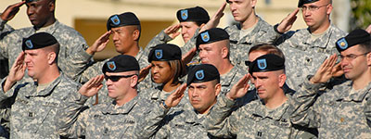
SENATE BILL - SB 1071 - (William Roth, Author)
Public postsecondary education: Chancellor of the California Community Colleges: policy to award course credit for prior military education, training, and service
Senate Bill 1071
Section 66025.71 to the Education Code, relating to public postsecondary education.
This bill would require, by September 1, 2019, the office of the chancellor, in collaboration with the Academic Senate for the California Community Colleges, to develop a consistent policy to award military personnel and veterans who have an official Joint Services Transcript course credit for California Intersegmental General Education Transfer Curriculum, California State University General Education Breadth, or local community college general education requirements, as specified. The bill would also require the office of the chancellor and the academic senate to review and adjust this uniform policy to align it with policies of other public postsecondary educational institutions.
https://leginfo.legislature.ca.gov/faces/billTextClient.xhtml?bill_id=201720180SB1071
Joint Service Transcript: The Joint Services Transcript (JST) provides a description of military schooling and work history in civilian language. It serves as a counseling tool for academic and career counselors in advising service members and veterans.
https://www.military.com/education/timesaving-programs/the-joint-services- transcript.html
This bill would

Slide 5

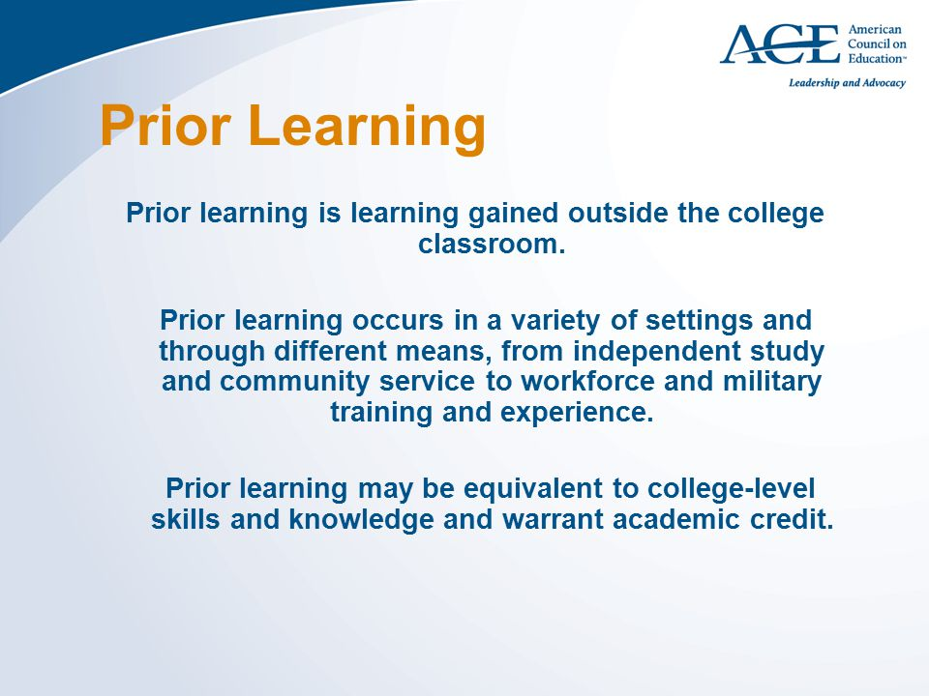
” Credit for Prior Learning”
Overview
For more than 60 years, ACE has been a nationally recognized leader in the evaluation of workforce and military training, providing standards, practices, and tools that higher education institutions can rely on. Many nontraditional students can demonstrate college-level knowledge and competencies. Such learning—gained from experiences outside postsecondary education—often merits academic credit. Credit for Prior Learning (CPL) provides a range of options from recognition of military and workforce training to national examinations and portfolio development. With more options comes the increased likelihood for greater numbers of learners to complete credentials.
https://www.acenet.edu/higher-education/topics/Pages/Credit-for-Prior-Learning.aspx.
ACE, the major coordinating body for the nation’s colleges and universities, is a membership organization that mobilizes the higher education community to shape effective public policy and foster innovative, high-quality practice. ACE is the only major higher education association to represent all types of U.S. accredited, degree-granting institutions: two-year and four-year, public and private. Our members represent two out of every three students in all accredited, degree-granting institutions.
https://www.acenet.edu/Pages/default.aspx

Slide 6
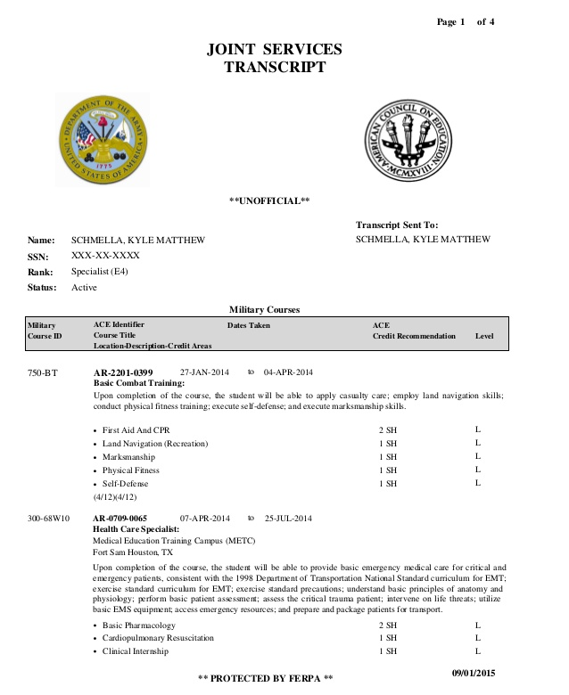
How are students granted curricular college credit using prior military experiences – “Joint Service Transcript”
Joint Service Credit
The Joint Services Transcript (JST) provides a description of military schooling and work history in civilian language. It serves as a counseling tool for academic and career counselors in advising service members and veterans. It serves as an aid in preparing resumes and explaining Army, Coast Guard, Marine Corps, National Guard and Navy work experience to civilian employers. It also saves time and money by awarding academic credits, which means less tuition to pay and less time spent in the classroom.
The JST is accepted by more than 2,300 colleges and universities.

Slide 7

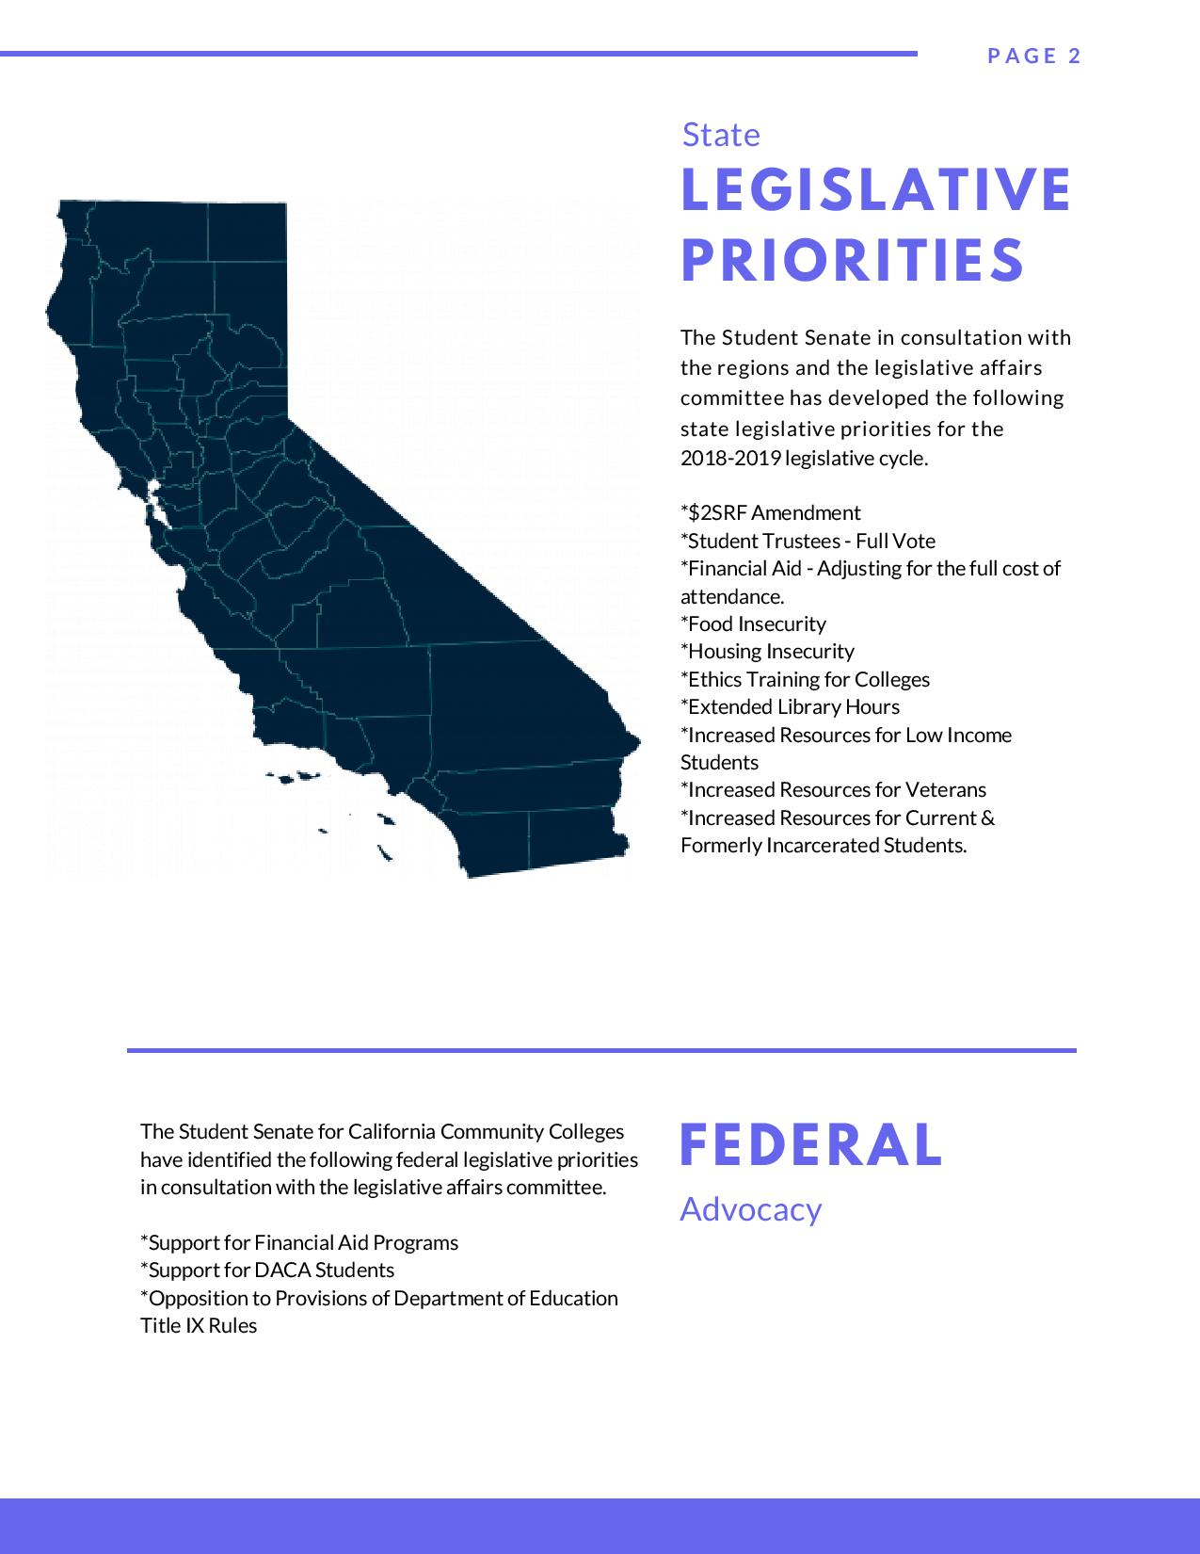

Student Senate for the California Community Colleges – Legislative Priorities: Resources/Veterans

Slide 8
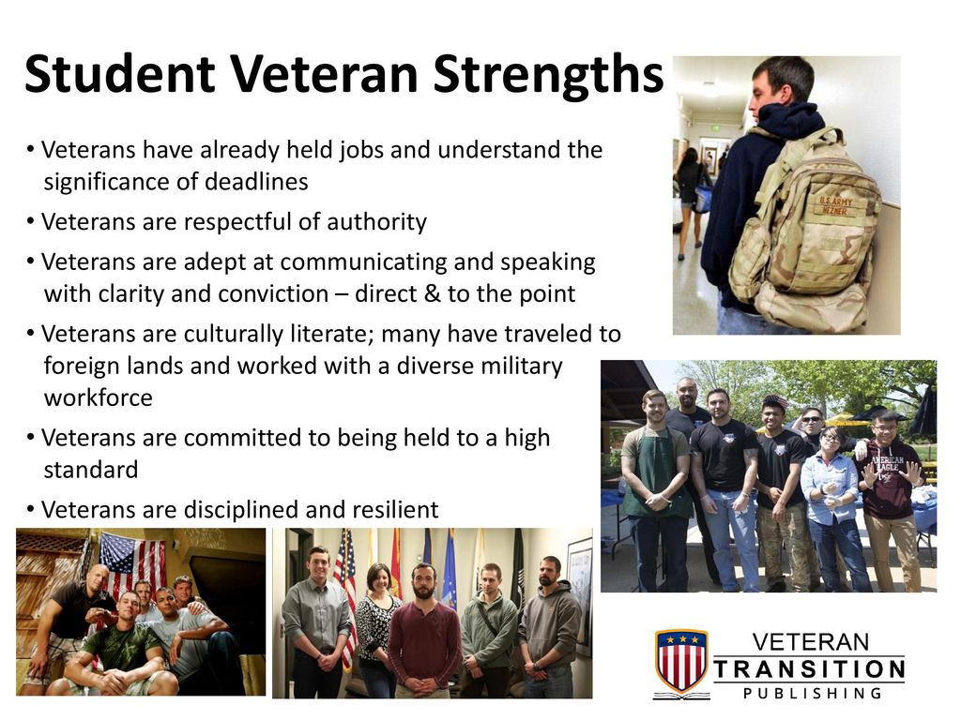
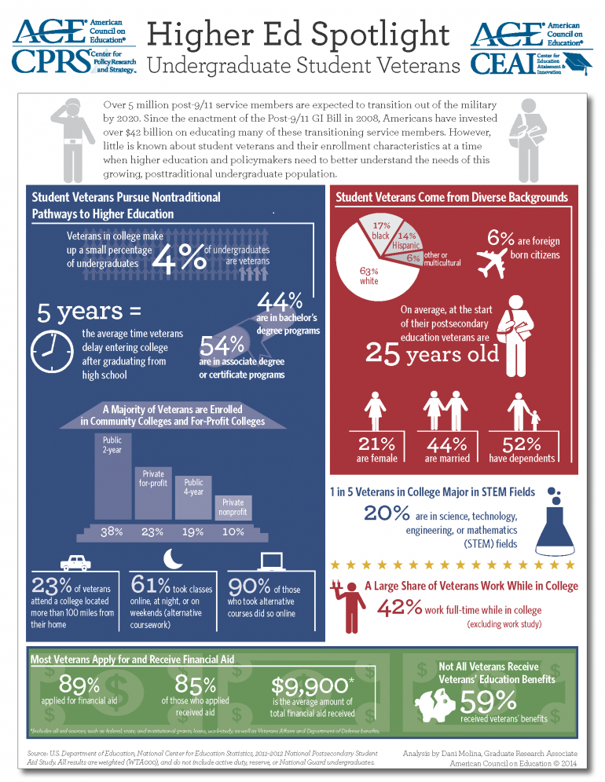
Undergraduate Student Veterans – “Highlights”

Slide 9

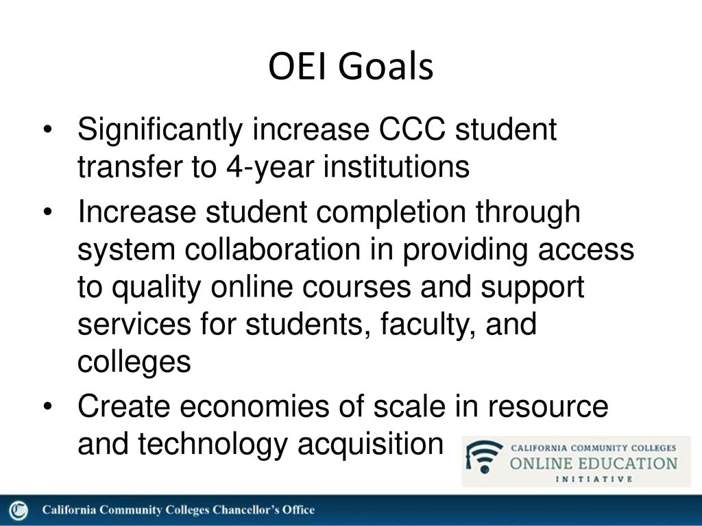

Online Education Initiative (OEI) Goals: A Form of Equity & Student Support Services”

Slide 10
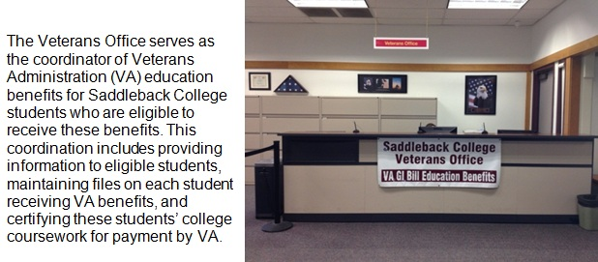
Saddleback College
“Non Curricular Support Services”
Saddleback College:
Summary of Services
The VETS Program directly provides support services and acts as a bridge to external support services for student Veterans, active military personnel, and their loved ones. VETS Program services include but are not limited to:
New student guidance,
Veteran Counseling
Scholarship and Financial Assistance
Access to Emergency Grants
Link to the Veterans Student Council
Outreach to the Military Affiliated Community
Venue for Community - Building
https://www.saddleback.edu/vets

Slide 11

What are some of the characteristics and behaviors that you associate with military-connected students?
The most non-traditional of non-traditional students.
They are more likely to be
First-generation college students
Married
Have at least one dependent
They also have unique military experiences!

Slide 12
Cultural Differences
Civilian Culture | Military Culture
Emphasis on individuality | Emphasis on unit cohesion
Individual achievement | Emphasis on the mission
Personal Freedom | Devotion to duty
Fluid social relationships | Chain of command

Slide 13


Questions & Comments
Please feel free to contact each of us for more information.
Silvester Henderson
Shenderson@losmedanos.edu
Dr. Andrew Jones
ajone1950@gmail.com
Terrence Nelson
tnelson14@saddleback.edu
Michelle Pilati
mpilati@riohondo.eu
Rugmini Vasquez
rugminivasquez@gmail.com

