Slide 1
Transfer Alignment (ADTs & UCTPs)

Slide 2
Presenters & Session Description
Krystinne Mica, ASCCC Executive Director
John Stanskas, ASCCC Immediate Past President
Eric Wada, C-ID Curriculum Director
California community colleges are charged with preparing students to transfer, and most agree there is room for improvement. Presenters will review the data regarding transfer from the California Community College system and the current structure of associate degrees for transfer (ADTs), University of California transfer pathways (UCTPs), and locally articulated degrees. Presenters will also highlight plans for aligning ADTs with UCTPs, barriers to alignment and to transfer, and next steps for moving forward to improve systems of transfer between CCCs and university partners.

Slide 3
Overview
Data on transfer
TMCs and ADTs
UC Transfer Pathways
ADT and UCTP Alignment
Next Steps

Slide 4
CCC Transfer Data - CSU
AY 2019-20
Snapshot for Fall 2019
  Application Total: 102,141
  Admitted 88,569
  Enrolled: 54,839
Transfer Pathway to CSU – total transfer: 54,839
  ADT transfer not using guaranteed path: 9,709
  ADT transfer using guaranteed path: 13,009
  Transfer with AA/AS: 7,632
  Transfer with no degree: 24,489
  Total using ADT or AA/AS: 30,350
Source: https://tableau.calstate.edu/views/FirstTimeFreshmanandCollegeTransfers/SummaryView?iframeSizedToWindow=true&:embed=y&:render=true&:showAppBanner=false&:display_count=no&:showVizHome=no

Slide 5
CCC Transfer Data - CSU
AY 2019-20
Top 10 CSU Transfer Disciplines:
  Business, Management, Marketing, and related Support Services – 9,728
  Psychology – 5,486
  Social Sciences – 5,368
  Communication, Journalism, and related programs– 3,509
  Health Professions and related programs – 3,102
  Visual and performing arts – 3,038
  Engineering – 2,944
  Computer and Information Sciences and Support Services – 2,613
  Homeland Security, Law Enforcement, Firefighting and Related Protective Services – 2,383
  Liberal Arts and Sciences, General Studies, and Humanities – 2,341
Source: https://tableau.calstate.edu/views/FirstTimeFreshmanandCollegeTransfers/SummaryView?iframeSizedToWindow=true&:embed=y&:render=true&:showAppBanner=false&:display_count=no&:showVizHome=no

Slide 6
CCC Transfer Data - CSU
AY 2019-20
Ethnicity Demographics – enrolled
  American Indian | Alaska Native – 114
  Asian – 7,231
  Black | African American– 2,207
  Hispanic/Latino – 24,555
  Native Hawaiian | Other Pacific Islander – 197
  Non-resident Alien – 3,550
  Race and Ethnicity Unknown – 2,120
  Two or More Races – 2,092
  White – 12,773
Source: https://tableau.calstate.edu/views/FirstTimeFreshmanandCollegeTransfers/SummaryView?iframeSizedToWindow=true&:embed=y&:render=true&:showAppBanner=false&:display_count=no&:showVizHome=no

Slide 7
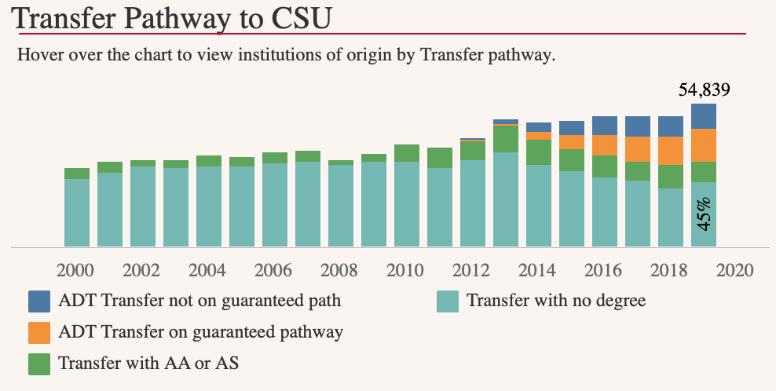
CCC Transfer Data - CSU
AY 2019-20
Source: https://tableau.calstate.edu/views/FirstTimeFreshmanandCollegeTransfers/SummaryView?iframeSizedToWindow=true&:embed=y&:render=true&:showAppBanner=false&:display_count=no&:showVizHome=no

Slide 8
TMCs and ADTs
Legislated by SB1440 and SB440
Students guaranteed to transfer to a CSU in a similar major
  Link to CSU similar degrees
Currently 40 TMCs
TMCs are the basis for ADTs
ADT – Associate Degree for Transfer
TMC – Transfer Model Curriculum

Slide 9
UCTP
No associated legislation
20 most sought-after majors in UC
Single set of major preparation courses for any of the 9 undergraduate UC campuses
UCTP – University of California Transfer Pathway

Slide 10
ADTs and UCTP Alignment
ASCCC Resolution F17 15.01 Aligning Transfer Pathways for the California State University and the University of California
Resolved: That the Academic Senate for California Community Colleges work with the Academic Senates of the California State University and the University of California to identify a single pathway in each of the majors with an Associate Degree for Transfer to ensure that students will be prepared to transfer into either the California State University or the University of California systems.

Slide 11
ADTs and UCTP Alignment
The Intersegmental Committee of Academic Senates (CCC/CSU/UC) reviewing degrees for areas where there may be overlap and begun discussions with faculty to identify disciplines where there is enough similarity to create one degree that can be accepted by both the CSU and the UC.
TMC and UC Transfer Pathways were reviewed for differences and a list of 7 disciplines that appear to align well was developed.
  The group discussed convening the C-ID Faculty Discipline Review Groups (FDRGs) for each of the disciplines to begin discussions regarding the creation of degree templates

Slide 12
ADTs and UCTP Alignment - 7 Disciplines
Anthropology
Business Administration
Economics
History
Mathematics
Philosophy
Sociology
Pathway in each TMC that aligns with the UCTP
Requires the use of IGETC general education pattern for transfer to CSU or UC and an oral communication course would be required for transfer to CSU
A slight modification to the TMC may be needed

Slide 13
ADTs and UCTP Alignment: Initial Findings
Near perfect alignment:
  Anthropology
  History
  Sociology
Identified challenges:
  Additional courses needed for UCTP not included in the ADT
  Some TMC courses may not be UC transferable
  High-unit majors may mean discussing more disciplines to the IGETC for STEM list.
  CSUs choose to determine if an ADT is similar to a major (i.e. and ADT is not broadly applicable to CSU). UCs all agree that the UCTP is a common set of requirements for admission eligibility.

Slide 14
ADT and UCTP Alignment – Next Steps
Examination of existing C-ID structures and processes
Selection of next round of disciplines to align ADT and UCTP
  As FDRGs meet to review TMCs and ISMCs, UCTP alignment will be a separate question.
Engaging articulation officers in C-ID process
Discipline convening

Slide 15
Questions?
THANK YOU!
Please email info@asccc.org if you have any questions.

