Slide 1
Understanding ESL, Equity, and Diversity: The carts or the horses?
ASCCC Academic Academy 2016
Presenters:
Sydney Rice, Kathy Wada, Leigh Anne Shaw
Facilitator: Dolores Davison

Slide 2
Presenters
Sydney Rice - Imperial Valley College
Associate Professor/Dept Chair, ESL
President, CATESOL
Kathy Wada - Cypress College
Professor, ESL
Leigh Anne Shaw – Skyline College
Professor, ESOL

Slide 3
Terminology for this Presentation
ELL – English Language Learner
Not necessarily in an ESL class
Could be graduate of U.S. high school
Could be long-term or recent arrival
ESL student – A student in an ESL class or program

Slide 4
What does ESL accomplish?
Discuss with the person next to you (1 minute)
State Data Tracking Perspective: Provides English language learners with language proficiency to facilitate the pathway to transfer, degrees, and certificates
This is the sole criteria on which CCC ESL is evaluated despite several data tracking gaps
Another perspective: Provides English to a population that increases the diversity of CCCs, the workforce, and our communities
This criteria is not measured

Slide 5
Goals for this Session
Examine the connection between equity and ESL
Highlight beliefs about credit and noncredit ESL and how they are different

Slide 6
Agree or Disagree?
Most ESL courses do not possess the academic rigor of a college course and therefore should be offered only as noncredit.
ESL CORs are frequently on par with foreign language courses
Advanced ESL requires higher research writing and documentation skills than transferable/degree applicable foreign language classes

Slide 7
Comparison of ESL and Transfer-Level Spanish – Cypress College
When comparing language competencies, ESL CORs ≥ Foreign Language CORs
Foreign Language aim: conversational and cultural fluency, functional reading and writing in the target language
Academic ESL goals: To access and respond to college-level content presented in the target language
Notes:
Yellow handouts

Slide 8
Agree or Disagree?
ELLs who do not complete the top-level ESL class are less likely to achieve their goals.
Fact: Goals of ELLs can range from fulfilling personal and professional needs to preparing for an academic degree or certificate
Data tracking gap #1: Many ELLs in CCC ESL programs attain enough English to reach their goals, but goals may not include transfer, degrees, or certs

Slide 9
A Million-Dollar example
Xiaomei Zhang
Founder and chairman of a multi-million futures company in Silicon Valley
Brings clients from China to invest in futures
Is enrolled in Level 3 credit ESL to improve
Reading of complex, sophisticated texts
Knowledge of subtle cultural nuances
Writing of clear emails to professional clientele
Use of advanced vocabulary for business contexts

Slide 10
Agree or Disagree?
ELLs need Freshman Composition in order to be successful in transfer/GE courses.
Data tracking gap #2: Many ELLs are successful in transfer/GE courses despite not transitioning from ESL into Freshman Composition

Slide 11
Case Study: 2 ESL Students
Fact:
Many ELLs take Math, Physical Education, humanities, business, and technical coursework in tandem with ESL coursework

Slide 12
Maria (from Mexico)
Currently taking:
- ESL (one-level below Freshman Comp.)
- Intro to Psychology
- Survey of Medical Terminology
She has already taken and passed:
- ESL
- History of the United States
- Pre-Algebra
- Algebra 1
- Algebra II

Slide 13
Quang (from Vietnam)
Currently taking:
- ESL (one-level below Freshman Comp.)
- Intro to Programming
- Intro to Programming concepts in C++
- General Physics III (a 200 level course)
He has already taken and passed:
- ESL
- Calculus I
- Calculus II
- Computer Information Systems
- Elementary Physics
- General Physics
- Educational Planning
Notes:
He is in his 4th semester.

Slide 14
Agree or Disagree?
Since both ESL and native speakers at one level below transfer have Freshman Comp as their target, their cognitive development is equivalent.
Some ESL students have post-secondary degrees (foreign bachelors, masters, or doctorates).
ESL students add contrastive linguistics, language learning strategies, culture, and development of identity in a foreign language to the rigors of one-level-below coursework
Notes:
Sydney

Slide 15
What Skills Are Taught in These Courses?
sentence structure paragraph structure essay structure reading comprehension | academic vocabulary critical analysis comparative/ contrastive analysis presentation skills | research text-based writing current events writing writing for disciplines
Freshman Composition | ESL 1 Level Below | ESL 2 or more levels below
Notes:
Leigh Anne will coordinate this handout for this activity: handouts in small groups – 5 minutes, 5 minute share-out
Pink

Slide 16
What Skills Are Taught in These Courses?
Freshman Composition | ESL 1 Level Below | ESL 2 or more levels below
essay structure academic vocabulary critical analysis compar./contrast. analysis presentation skills research text-based writing current events-based writing writing for disciplines | sentence structure paragraph structure essay structure reading comprehension academic vocabulary critical analysis compar./contrast. analysis presentation skills research text-based writing current events-based writing writing for disciplines | sentence structure paragraph structure essay structure reading comprehension academic vocabulary critical analysis compar./contrast. analysis presentation skills research text-based writing current events-based writing writing for disciplines
Notes:
Activity: handouts in small groups – 5 minutes, 5 minute share-out

Slide 17
What constitutes a credit offering?
“I know it when I see it?”
Program Course Approval Handbook guidelines for credit offerings:
"coursework is truly at a college level …incorporates critical thinking…”
"Grading policy…that demonstrates proficiency in subject matter by means of written communication…“
“For each hour of lecture required, the course requires two hours of study and/or laboratory and/or assigned activity.“

Slide 18
What constitutes a credit offering?
Program Course Approval Handbook guidelines for credit offerings:
“Intensity and rigor…must require students to study independently outside of class time."
“Difficulty and level…which ensure…course requires critical thinking, learning skills, and vocabulary appropriate for a college-level course”

Slide 19
What constitutes a credit offering?
LAO Report, 2012 (p. 22):
“…credit coursework generally should include instructional content that requires students to possess and demonstrate college-level knowledge and skills, whereas noncredit content should be accessible for less-advanced students.”

Slide 20
What constitutes a noncredit offering?
Program Course Approval Handbook guidelines for noncredit offerings:
Designed to "assist [students] in reaching their personal, academic, and professional goals" (p. 95).
"…provides pathways to a variety of academic, career-technical, and personal growth opportunities" (p. 96).

Slide 21
Statements Supporting Credit ESL
TESOL
Resolutions 1987/1995
Position on acquisition of academic proficiency – 2010
Position on academic credit – 2012
Notes:
Give highlights from each resolution. Handout with key points of each resolution (keep it to fit on 1 paper, if possible)
Green handout

Slide 22
Statements Supporting Credit ESL
CATESOL
Position on the role of ESL in Public Postsecondary Education
Position on the differences between ESL and Basic Skills Instruction at Post-Secondary Levels (1994)
Position Statement on Degree-Applicable Credit ESL Courses in Community Colleges (1994)
Notes:
Give highlights from each resolution. Handout with key points of each resolution (keep it to fit on 1 paper, if possible)

Slide 23
Statements Supporting Credit ESL
ASCCC
9.04 Fall 14 – Definition of Basic Skills (separate definitions for Basic Skills and ESL)
9.14 Fall 15 – Support of Credit ESL
Notes:
Give highlights from each resolution. Handout with key points of each resolution (keep it to fit on 1 paper, if possible)

Slide 24
Statements Supporting Credit ESL
National Council of Teachers of English (NCTE – CCCC) (2014)
“recognize and take responsibility for the presence of second-language writers in their language classes…”
“develop instructional practices that are sensitive to linguistic needs”
“include second-language perspectives…”

Slide 25
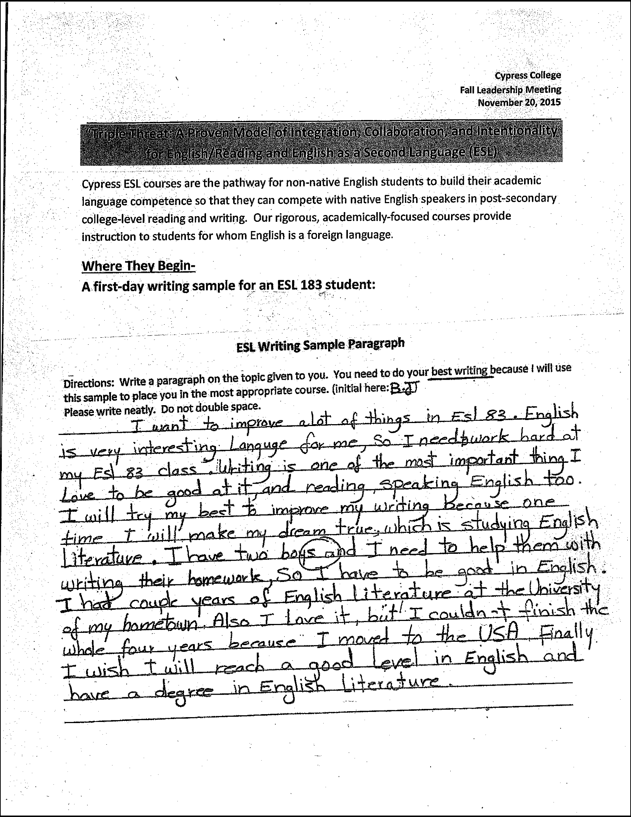
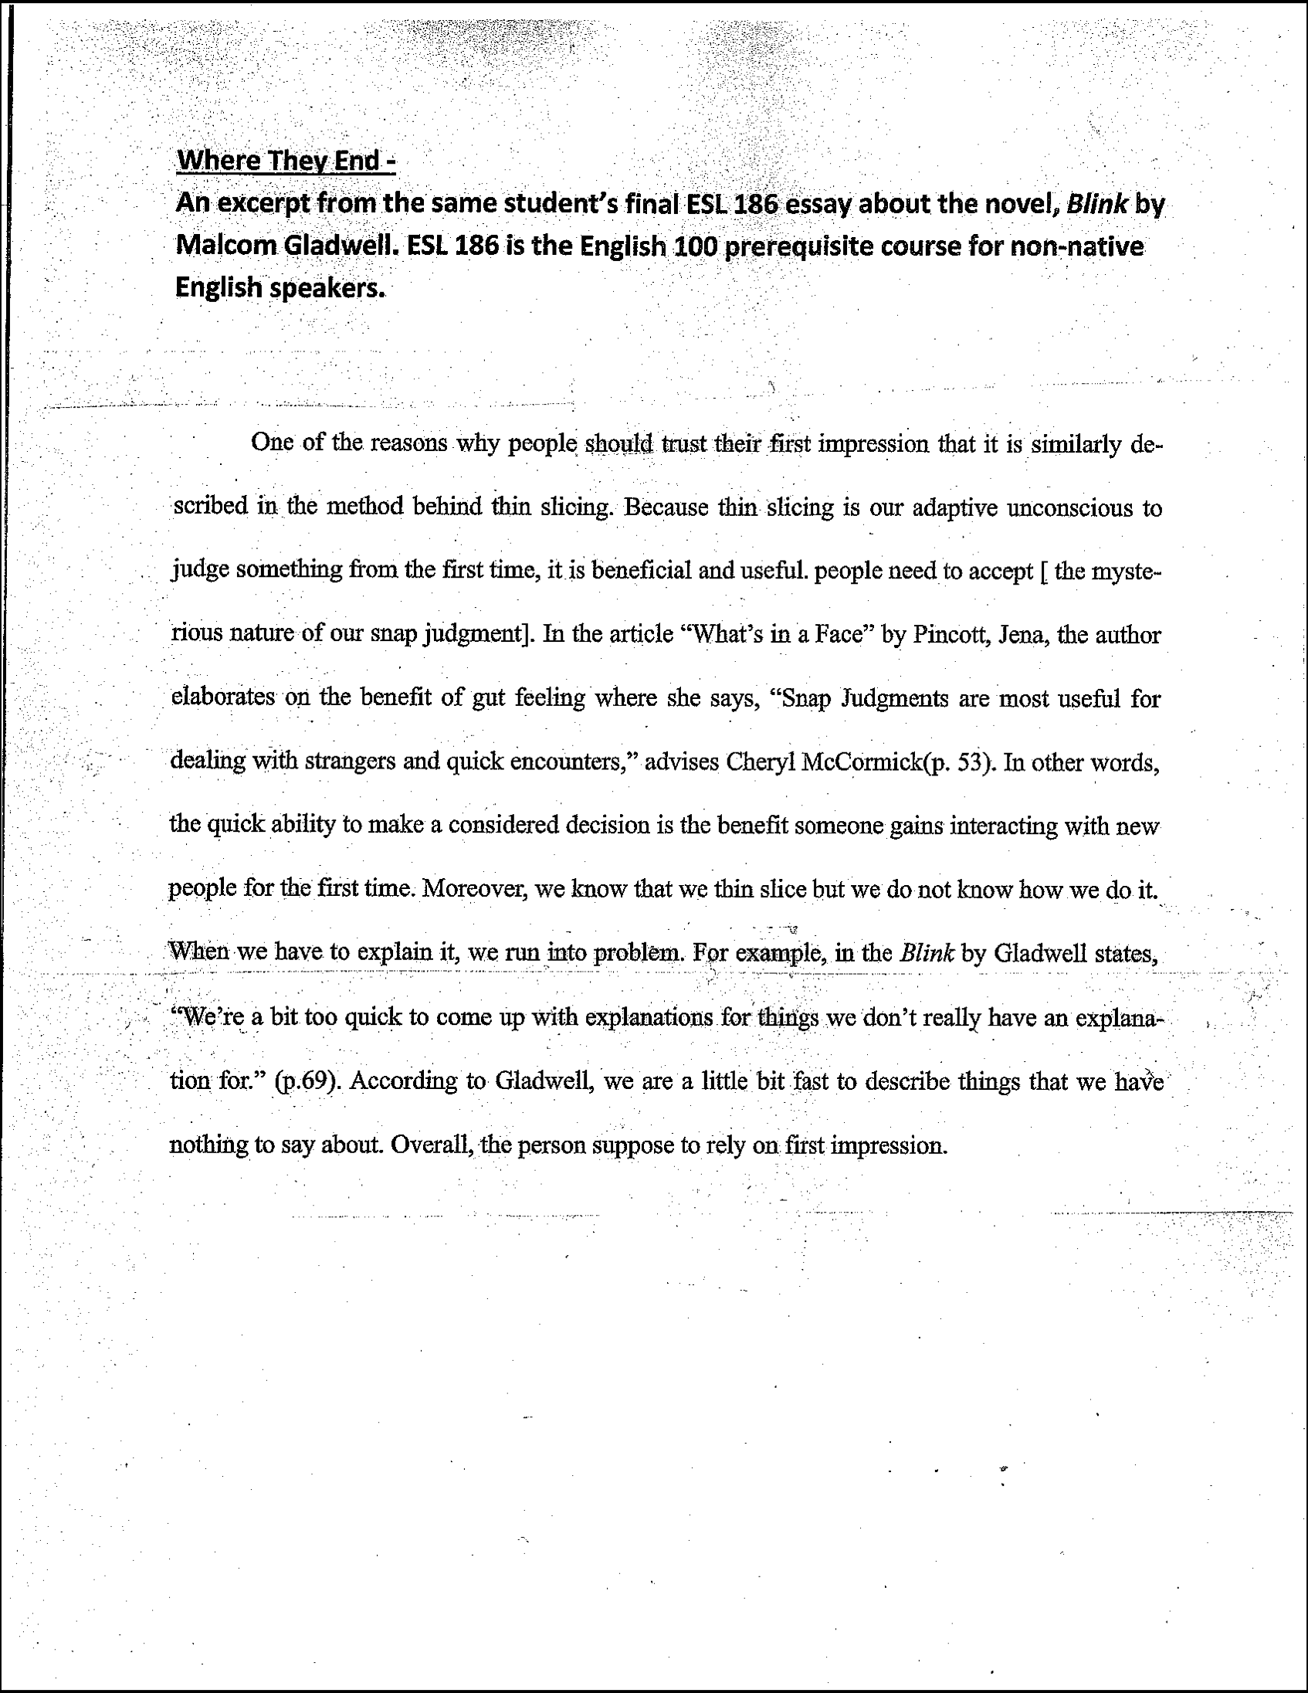
Where We Get ‘em …
Where We
Take ‘em …
Notes:
Blue handouts

Slide 26
ESL & Equity: the carts or the horses?
!
Should ESL inform how we approach equity and diversity, or should our approach to equity and diversity drive how we look at ESL?
Five segments to the Equity Plan
Access
Course Completion
Basic Skills & ESL
Degrees & Certificates
Transfer

Slide 27
ESL & Equity: the carts or the horses?
ESL is implicated in ACCESS
If we let them into college, we must provide appropriate support to succeed in an academically rigorous environment
ESL is implicated in Course Completion
We must track how ESL aids course completion outside of the transition from credit ESL into Freshman Comp

Slide 28
ESL & Equity: the carts or the horses?
Categorizing ESL with Basic Skills “creates the erroneous notion that students [in] basic skills courses and …ESL courses have the same goals and needs” (ASCCC Resolution 6.04 F11)
ESL ≠ remediation
CCCCO says | TESOL says
Basic Skills are those foundation skills in reading, writing, mathematics, and English as a Second Language, as well as learning skills and study skills, which are necessary for students to succeed in college-level work. | Postsecondary ESOL coursework is designed to continue the normal cognitive, academic, linguistic, and cultural development that accompanies the acquisition of an additional language, and does not equate with remediating first language skills.
Notes:
Leigh Anne’s Tweak – ditch it, revise it, keep it?

Slide 29
ESL & Equity: the carts or the horses?
ESL is critical for ELLs seeking Degrees and Certificates, and Transfer
Our students are already achieving these…why aren’t we tracking them?
Is it myopic to assume that equity for ESL ends at Freshman Composition?
How can we speak about equity when we only acknowledge an entire demographic’s challenges until that demographic successfully passes Freshman Composition?
Notes:
Further tweaks?

Slide 30
ESL as a College Demographic
We track
ELLs, in contrast, are seen less as a demographic to be served, and more as a problem to be remedied
Viewing ELLs through a lens of “Deficit model thinking” = lack of equity
Foster Youth Women
Veterans Re-entry students
Various ethic groups ROP/EDD students
Students with disabilities

Slide 31
Our Hope
You will leave with a better understanding of the nature of credit ESL, its connection to equity and diversity, and its rightful place in CCC credit programs.
You will advocate to keep the pathway for ESL students and ELLs to achieve their academic success at our colleges.

Slide 32
Thank you
Sydney Rice - sydney.rice@imperial.edu
Kathy Wada - kwada@cypresscollege.edu
Leigh Anne Shaw – shawl@smccd.edu

