Slide 1
Using Student Learning Outcomes to Guide Math Pathways
Janet Fulks, Guided Pathways Lead Academic Senate for California Community Colleges
Ginni May, Treasurer Academic Senate for California Community Colleges
SLO Symposium Jan 25, 2019

Slide 2
Description
Many of the recent challenges associated with realigning curriculum to key legislative issues (like AB 705, SB 1440 and Guided Pathways) may be clarified with Student Learning Outcomes analyses and alignment. What quantitative reasoning outcomes relate to specific programs? Join us as we explore how learning outcomes can be used to define and identify the appropriate mathematics or quantitative reasoning courses for program pathways that are based upon employment or transfer expectations.

Slide 3
Key Issues in Mathematics and Quantitative Reasoning
Capacity to use mathematics
Technology associated with mathematics and data
The role of Algebra II/Intermediate Algebra
Effects of Common Core
Rigor
Barriers
Articulation
B-STEM vs SLAM
Equity
Notes:
Ginni

Slide 4
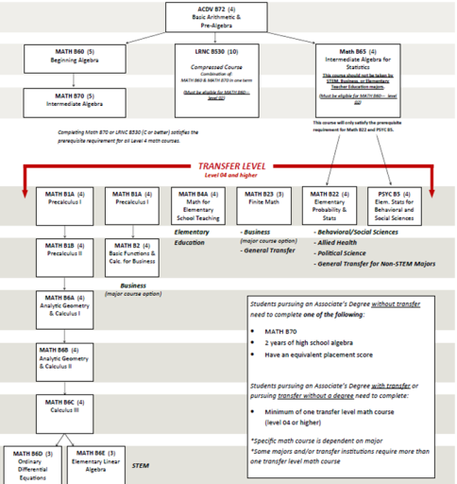
Traditional Mathematics Pathways
Notes:
Sample of previous life – with many levels - Janet

Slide 5
Redesigning Math by Outcomes
“National studies reveal that 50 percent to 70 percent of community college students are required to take developmental, or remedial, math courses upon enrollment, and only 20 percent of developmental math students ever successfully complete a college-level math course. Recent reforms have sought to improve students’ success rate by revising developmental math course structure and sequence into compressed instructional modules or multiweek (rather than semester-long) courses, or by placing developmental students into college-level classes with added supports. Though these initiatives have shown some promise, they have seldom addressed the math content of developmental and college-level math courses, which emphasize algebra rather than the quantitative literacy and statistics skills required in most of today’s professions.” Laying the Foundations: Early Findings from the New Mathways Project (April 2015) MDRC
Notes:
Janet

Slide 6
Thoughts…
Should the process to redesign math be solely an attempt to get people through, even if:
it results in placing them into courses they cannot pass,
requiring them to take support courses, and
accepting high failure rates?
If not, what are the alternatives?

Slide 7
Default Rules for SLAM
High School Performance Metric for Statistics/Liberal Arts Mathematics | Recommended AB 705 Placement for Statistics/Liberal Arts Mathematics
HSGPA ≥ 3.0 Throughput rate of 75% | Transfer-Level Statistics/Liberal Arts Mathematics No additional academic or concurrent support required for students
HSGPA from 2.3 to 2.9 Throughput rate of 48% | Transfer-Level Statistics/Liberal Arts Mathematics Additional academic and concurrent support recommended for students
HSGPA < 2.3 Throughput rate of 29% | Transfer-Level Statistics/Liberal Arts Mathematics Additional academic and concurrent support strongly recommended for students

Slide 8
Default Rules for B-STEM
High School Performance Metric BSTEM Mathematics | Recommended AB 705 Placement for BSTEM Mathematics
HSGPA ≥ 3.4 or HSGPA ≥ 2.6 AND enrolled in a HS Calculus course Throughput rate of 74% | Transfer-Level BSTEM Mathematics No additional academic or concurrent support required for students
HSGPA ≥2.6 or Enrolled in HS Precalculus Throughput rate of 54% | Transfer-Level BSTEM Mathematics Additional academic and concurrent support recommended for students
HSGPA ≤ 2.6 and no Precalculus Throughput rate of 28% | Transfer-Level BSTEM Mathematics Additional academic and concurrent support strongly recommended for students
Presumes completion of Intermediate Algebra or Integrated Math III

Slide 9
Thoughts…
Using Guided Pathways and Onboarding processes students should be directed to the Career, Program, Major, and Math appropriate to the students’ educational goals – getting students to the right math!
Notes:
Animated Slide – from Laying the Foundations: Early Findings from the New Mathways Project Elizabeth Zachry Rutschow John Diamond with Elena Serna-Wallender (2015)

Slide 11
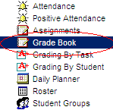
Career Counseling
Select a Metamajor and/or major
Clarify your educational goal
Identify appropriate General Education (GE)
Select English/ESL and Mathematics/
Quantitative Reasoning Pathways
Review other Relevant Data
Interests
Wages
Benefits
Skills
Long term plans
Life values
Personality
Occupational research
Location
Responsibilities
Employment trends
What you love
STEM (Science, Technology, Engineering, or Math
Business and Accounting
Education
Social Sciences & Public Safety, Communication, Allied Health, Human Resources, Journalism
Humanities, Hospitality, Technical Majors
Public Safety
Other
Complete guaranteed transfer degree to CSU
Complete AA and transfer
Complete short-term certificate or local AA
Complete a course or two for work advancement
Complete courses for individual interest
English
English as a Second Language (ESL)
Mathematics/Quantitative Reasoning by major
STEM calculus
Business
Education
Statistics
Career Technical
High School GPA
High School Courses & other curriculum
test scores e.g. AP, SAT
CLEP test results
Employment experience
Military Experience
Time available for classwork & support
Financial needs
See default placement using high school GPA
Transfer to CSU or private college – CSU breadth
Transfer to UC - IGETC
No transfer local degree or certificate – local GE
No GE requirements

Slide 12
What is Quantitative Reasoning?
It is the ability to solve and interpret problems using both computation and logic. It may include, but is not limited to:
understanding the power of compound interest in finance, or exponential growth in populations and climate change;
uses and misuses of statistics, especially in understanding a statistical analysis in order gauge the accuracy or validity of statistical results and ultimately a statistical study;
or how to use the principles of logic and rhetoric to make sound and valid arguments.

Slide 13
What is Quantitative Reasoning?
The ability to reason quantitatively is a stable combination of skills and practices involving:
the ability to read, comprehend, interpret, and communicate quantitative information in various contexts in a variety of formats,
the ability to reason with and make inferences from quantitative information in order to solve problems arising in personal, civic, and professional contexts,
the ability to use quantitative methods to assess the reasonableness of proposed solutions to quantitative problems,
the ability to recognize the limits of quantitative methods. Quantitative methods include the methods of computation, logic, mathematics, and statistics. Quantitative information is traditionally found in subject areas like mathematics, statistics, computer science, and logic.
From CSU QRTF Recommendations: https://www.asccc.org/sites/default/files/V.%20G.%20QRTF%20Final%20Report%2008-01-2016.pdf

Slide 14
Mathematics and Quantitative Reasoning

Slide 15
The New Mathways Project Design Dana Center of Austin Texas
1. Multiple math pathways with relevant and challenging content aligned to specific fields of study. Colleges should offer at least two math pathways, beginning at the developmental level, for students to complete their program-specific, college-level math requirements. At least one math pathway should be non-algebra intensive and focused on the statistical and quantitative reasoning skills needed in many current professions.
2. Acceleration that allows students to complete a college-level math course more quickly than they would in the traditional developmental and college-level math sequence. The NMP focuses on shortening the developmental math course trajectory to allow students to reach and complete a college-credit math course in one year or less.
3. Intentional use of strategies to help students develop skills as learners. Colleges should integrate learning theory and skills within math courses and link these skills with a student
4. Curricular design and pedagogy based on proven practice. Math curricula and pedagogy should center on evidence-based instructional and content practices and be continuously improved as new evidence becomes available.

Slide 16
Activity
In Groups of 3 or 4 review the math problem you were provided.
Answer the following questions:
What quantitative reasoning learning outcomes are targeted?
What majors might incorporate this kind of quantitative reasoning?
What kind of collaboration was necessary to develop this lesson?
Be prepared to share your group discussions and conclusions.

Slide 17
The Intersection between Program Mapping, Metamajors and Quantitative Reasoning
CSU Area B4 Quantitative Reasoning and IGETC Area 2 Mathematical Concepts and Quantitative Reasoning
Statewide data - 1629 transfer quantitative reasoning courses
Different Course types – 483 unique variations
Individual Colleges average 14 different transfer level courses that fill these requirements
Many of these courses are not counted in the KPI’s (key performance indicators) or CCCCO Scorecard
Programming Methods & Computer Discrete Math (Computer Science); Behavioral Statistics; Biostatistics; Business Calculus, Business Math, Liberal Studies Math

Slide 18
Meta Majors with Program Mapping
Notes:
Better Guidance at All Levels
Helps to Find Majors
Exploration
Demonstrates the Starting and Ending Points
Informs Choices
Reduce Excess Units
Related Careers and Salaries
Register for the Correct Math and General Education
Math Pathways – Depends on Major

Slide 19
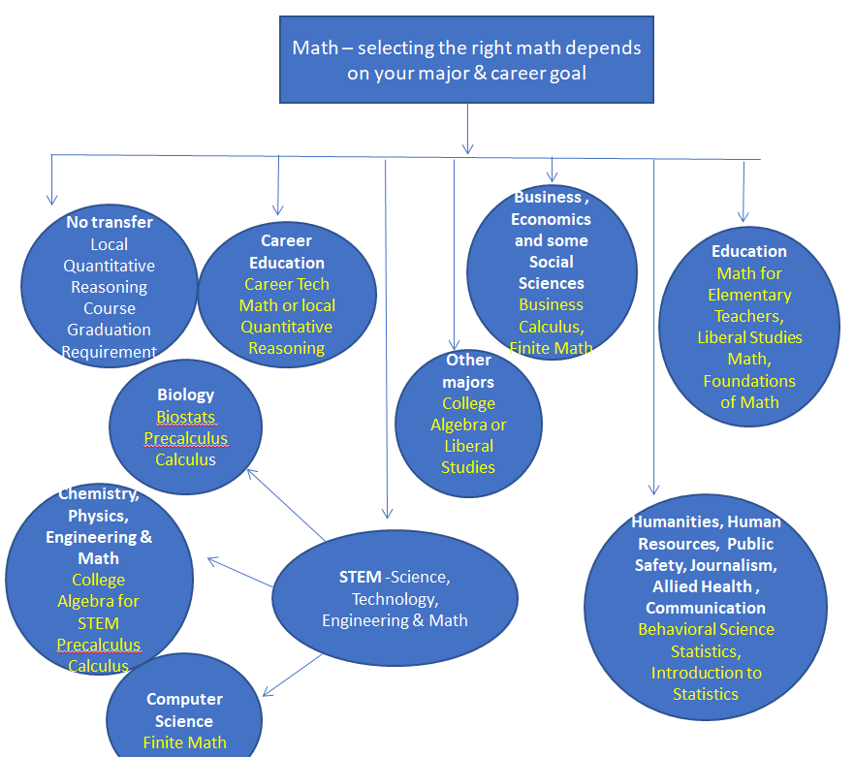

Slide 20
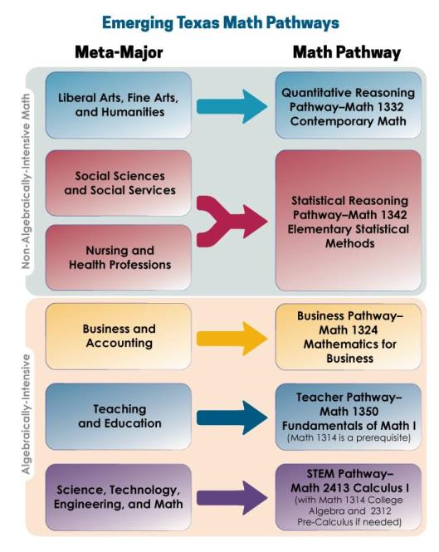
Notes:
A little deeper dive into quantitative reasoning/mathematics requirements help some grouping activities. Here the Dana Center in Texas exams some of the potential matches between meta Major and required math. Link in last slide

Slide 21
Multiple Paths FORWARD: Diversifying Mathematics as a Strategy for College Success
Notes:
Recent articles say that California is ahead of the country in this thinking – link on last slide

Slide 22
Questions and Comments

Slide 23
Additional ASCCC Resources
MQRTF Recommendations
DEGREES OF FREEDOM: Diversifying Math Requirements for College Readiness and Graduation (Report 1 of a 3-part series) (Burdman, 2015)
https://www.edpolicyinca.org/publications/degrees-freedom-diversifying-math-requirements-college-readiness-and-graduation-report-1-3-part-series
Reforming Math Pathways at California’s Community Colleges, PPIC 2017 http://www.ppic.org/publication/reforming-math-pathways-at-californias-community-colleges/
Laying the Foundations: Early Findings from the New Mathways Project (April 2015) MDRC https://www.mdrc.org/sites/default/files/New_Mathways_ES.pdf

