Slide 1
Strong Workforce Session
May 13, 2022
10:40-12:00pm

Slide 2
Presenters & Session Co-leads
Monica Romero - Dean, San Diego Mesa College
Tasha Frankie - Faculty, San Diego Mesa College
Marvin DaCosta - Faculty, Los Angeles Trade Technical College
Dr. Armine Javadyan - Faculty, Los Angeles Trade Technical College
ASCCC - CNEI session co-leads
Manuel J. Velez - ASCCC South Representative
Christie Dam, PhD - ASCCC CTE Leadership Committee

Slide 3
Monica Romero
Strong Workforce Program
More and Better Career Technical Education to Increase Social Mobility and Fuel Regional Economies with Skilled Workers
Developed 25 workforce recommendation in 7 areas.
Training and career pathways that result in high-skill and high-wage employment and propel the local and regional economies of the State of California.
$248 million annually for Career Education.
Strong Workforce Overview

Slide 4
Strong Workforce: Metrics
CTE FTES
Unemployment Rates
Job Openings
CTE Progress Towards Awards
Award Obtainment
Transfer
Job Related to Field of Study
Earnings
Living Wage
Resources:
Launchboard
https://www.calpassplus.org/LaunchBoard/SWP
CTEOS
https://cteos.santarosa.edu

Slide 5
Strong Workforce: Funding Structure
In Each Region:
60% to each District
40% to the Region
Base Funding
Job Openings - ⅓
Unemployed Adults - ⅓
Incentive Funding - ⅓ (based on weighted points for each metric)
Completed +9 CTE Units
CTE Award Earned or Completed Noncredit Workforce Milestone
CTE Students who Transferred
Annual and Increased Earnings
CTE Students who Attained a Living Wage

Slide 6
Example: Regional Structure & Function
Regional Chair
San Diego Imperial Counties Community College Association (SDICCCA)
Regional Consortium
Manages Regional Funds
Coordinates Regional Priorities and Projects
K-12
Data Informed
Equity Lense
myworkforceconnection.org
Fiscal Agent
CC Regional Oversight Committee (ROC)
VPIs
Deans’ Council
Regional Workforce Development Council (WDC)
Implementation Committee
Chair: Ben Gamboa
Workgroup Leads
*Career Pathways
Pathway Navigation
WBL & Job Placement
Retention, Success & Support
Employer Engagement & Job Development
*Marketing
Data & Research
Employer Relations Liaisons
Industry Relations Coordinators

Slide 7
Example: District Structure & Function
Dean Workforce Development
Collaborates and supports all District CTE Deans / Associate Deans
Partners with all District services in support of Campus CTE Offices
Coordinates with CTE across the Region, including K-12
Manages the High School and Continuing Education (non-credit) Credit by Exam for College Credit
Vice Chancellor Educational Services
Dean Workforce Development
Regional CTE
Campus CTE

Slide 8
Example: Campus Structure & Function
Associate Dean - CTE
Reports to both Instruction & Student Services
Responsible for all Local and Regional SW funding and projects
Collaborates and supports all CTE programs
Partners with all campus support services
Coordinates CTE across the District and Regional
Manages Work-Based Learning Program
Dean Business & Technology
Dean Student Develvelopment
Associate Dean CTE
Work-Based Learning
Strong Workforce Program

Slide 9
Tasha Frankie
SW Faculty Lead position
Opportunity for leadership
Faculty voice
Legitimacy in other campus conversations
Face of Strong Workforce
Responsibilities
Help colleagues understand the relevance of campus, district, regional, and state initiatives and projects
See (and help others see) the “big picture” that includes K-12 and community
Emphasize the importance of the faculty role in CTE - Strong Workforce
Faculty role in shaping SWF in the classroom

Slide 10
Strong Workforce Structures
Strong Workforce Faculty Lead
Local Committees
Regional Involvement
Regional Committees
Regional Grants
Strong Workforce Faculty Institute

Slide 11
Strong Workforce Faculty Institute
Regionally sponsored professional learning opportunity to
Foster strong collaboration and engagement among faculty, researchers, and deans
Encourage self-reflection, inquiry, and research-based decision-making
Inspire teaching and learning from a culturally inclusive perspective
Faculty complete an investigative research and reflection, then create an action plan to implement ideas in the classroom
Improved experiences for students
Locally
SW Faculty Lead works with deans and researchers to plan professional learning events to complement the institute
Generates great cross-discipline faculty discussions
Helps us understand faculty needs from SW

Slide 12
Faculty Driven Improvement:
Budget & Allocation
Previously, only annual requests considered
Problem: Sometimes programs need to make purchases mid-year!
Solution: Tiered allocation process
< $500 Associate Dean of CTE can approve
Turnaround time: ~1 week
< $5000 SW Budget & Allocation Subcommittee can approve
Turnaround time: ~1 month
> $5000 SW Budget & Allocation Subcommittee recommends approval to SW Committee
Turnaround time: ~1 year
This faculty-driven change has allowed our programs to be more responsive to student needs in the classroom

Slide 13
Marvin DaCosta
LATTC and Metro Partnership
High School Students
•Transportation Career Academy Program (TCAP)
Incumbent Workers
•Metro JAC
SWF for CTE programs: JAC & Metro

Slide 14
Transportation Career Academy Program (TCAP)
Pre-Pandemic
80% enrolled in COOP ED
In-person (hourly compensation)
200 – 250 students | 11th and 12th graders
Weekly In-Service training
Resumes/Interview
Project-based assignments
Transit/Transportation Overview
During Pandemic
90% enrolled in COOP ED
Virtual (stipend)
100 – 125 students | 11th and 12th graders
Weekly In-Service training
Resumes/Interview
Project-based assignments
Transit/Transportation Overview

Slide 15
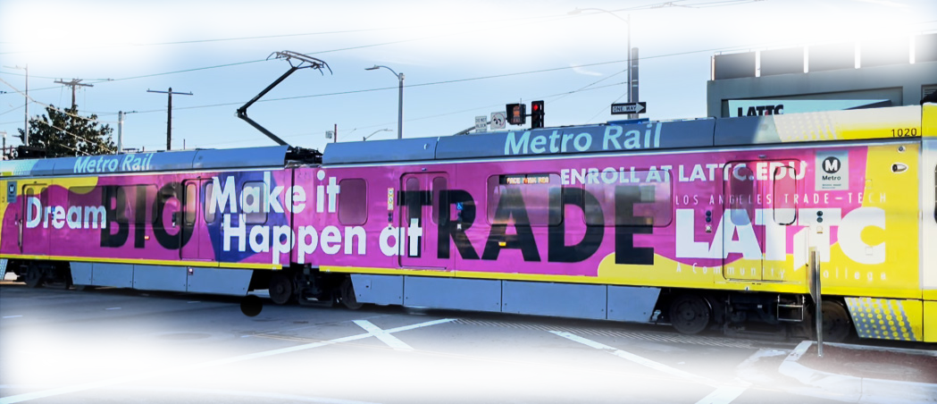
Metro JAC
Incumbent Worker Training
Preparation for Rail Maintenance Technician
Developed 6 VOC ED courses
Rail Safety, Shop Tools, Mechanical Systems, Electrical Systems, Car Monitoring and Communications, Electronics, Diagnostic Equipment
80% hands-on | 20% lecture

Slide 16
Dr. Armine Javadyan
History
PACTS survey results
Faculty, employer and student comments
Purpose
Help students succeed in their academic, career, and personal pursuits through getting exposure to their industries and the programs of study
Structure
Voc Ed course
54 hours
Taught over 3 weeks
First 2 weeks-general study and employability skills
Third week-industry specific skills
SWF in Pathway Ready & Noncredit Vocational Education

Slide 17
Course Content
One main instructor but multiple guest speakers to address different topics throughout the course
Four main areas covered during the first 2 weeks
Information about the college, financial aid, classes, etc (Ed Plans completed for each student by the counselor during the class)
On campus and off campus resources available to the students and how to look for/apply for those resources (including scholarships)
Study skills (English/math, netiquette, how to read a textbook, how to take notes, etc.)
Employability skills (including resume and cover letter, mock interviews, and portfolio basics; finding info about the industry, finding/applying/prepping for the position; soft skills, such as time management, team building, etc.
During the 3rd week students learn industry specific competencies and spend one day in each of the programs in the Pathway

Slide 18
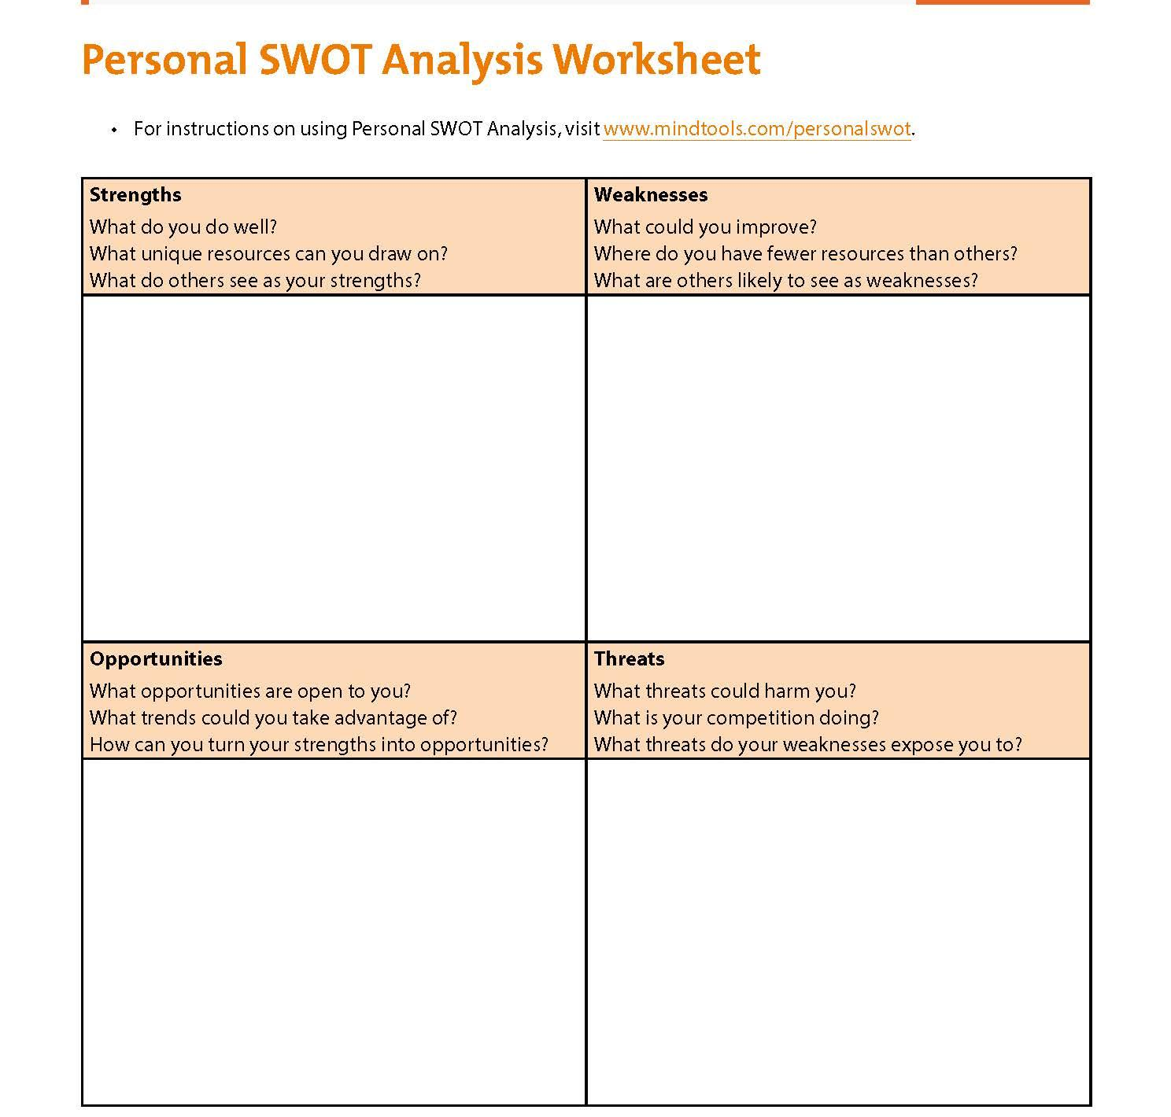
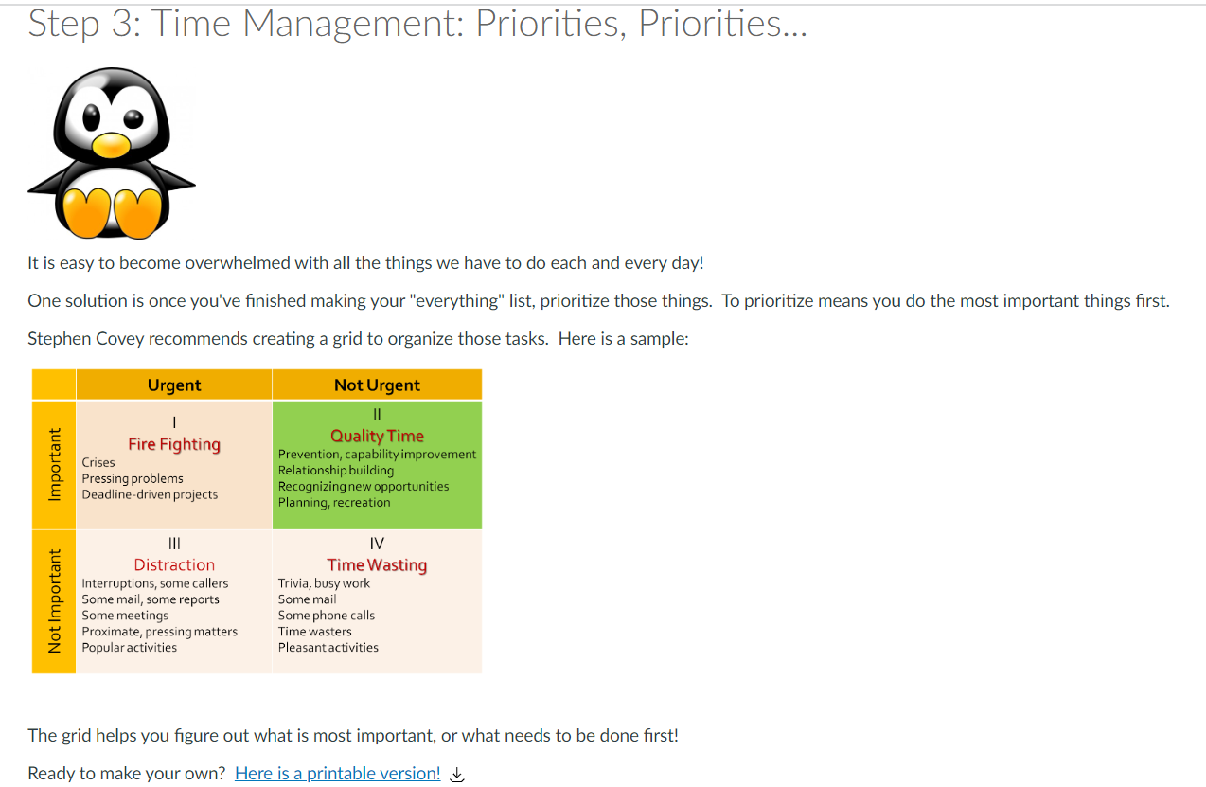
Student Assignment Samples

Slide 19
ANY QUESTIONS?

