Slide 1
Contextualized Curriculum
Mayra Cruz, Area B Representative ASCCC, CTE Leadership Committee
Richard Weinroth, Ed.D, San Diego Continuing Education
Notes:
Session description:
This breakout will offer a brief overview of contextualized learning and an opportunity to explore ideas for partnering with English, math, and ESL colleagues to contextualize learning in order to enhance student performance and success. Attendees will be encouraged to share lessons learned and to consider ideas for contextualizing basic skills across the curriculum.

Slide 2
Background
60% of community college students enroll in at least one developmental course*
“Since the adoption of the Master Plan for Higher Education in 1960, the California Community Colleges, in addition to their primary missions of academic and vocational instruction, were also tasked to provide “remedial instruction for those in need of it.”**
“1986, title 5 regulations required that colleges employ multiple measures in order to provide placement recommendations for students. “ **
*Retrieved from https://www.usatoday.com/story/news/nation/2013/07/25/stateline-remedial-education/2586013/
**AA 18-40 June 11, 2018 Memo Retrieved from https://asccc.org/sites/default/files/AA%2018-40%20AB%20705%20Implementation%20Memorandum__0_0.pdf

Slide 3
“In the late 1990s and early 2000s when there was a significant growth in the development of English, English as a Second Language (ESL), and mathematics course sequences designed to address students’ perceived skill gaps in order to help them be more prepared for college-level course work.”*
“Scaffolded course sequences were designed by faculty as a way to build student success by developing a foundation that would logically lead to transfer-level course success and ultimately college graduation and completion.”*
“This approach also did not yield successful results as expected.”*
*AA 18-40 June 11, 2018 Memo Retrieved from https://asccc.org/sites/default/files/AA%2018-40%20AB%20705%20Implementation%20Memorandum__0_0.pdf

Slide 4
AB 705: Impetus & Opportunity
AB 705 requires community college districts to maximize the probability that a student will enter and complete transfer-level coursework in math and English within a one-year timeframe by utilizing assessment measures that include high school performance to achieve this goal.
Vision for Success Outcomes
Outcomes Increase the numbers of students who enter and complete transfer-level English and mathematics/quantitative reasoning in one year
Minimize the disproportionate impact on students created through inaccurate placement processes
Increase the number of students completing transfer-level English within three years
AA 18-40 June 11, 2018 Memo Retrieved from https://asccc.org/sites/default/files/AA%2018-40%20AB%20705%20Implementation%20Memorandum__0_0.pdf

Slide 6
An Effective Practice: Roots & Story of Contextualized Learning
Progressive Era 1890-1950
John Dewey introduced experiential learning to make learning more meaningful to students
1970s
Functional context education
Literacy task analysis
Notes:
Functional context education
“an instructional strategy that integrates the reaching of literacy skills and job content to move learners more successfully toward their education & employment goals. (Wilder Opportunities for Women, 2009)”
Literacy task analysis
Curriculum which integrated academic and vocational competencies-reading, writing compotation and communication competencies (piloted by the US military)
Retrieved from https://learningfromexperience.com/downloads/research-library/experiential-learning-theory-guide-for-higher-education-educators.pdf
“A conception of teaching and learning that helps teacher relate subject matter to real world situations.”
(2001 US Department of Education Office of Vocational & Adult Education; Berns & Erickson 2001)
” A diverse family of instructional strategies designed to more seamlessly link the learning of foundation skills and academic and occupational content by focusing teaching and learning squarely on concrete applications in a specific context that is of interest to the student. (Mazzeo 2008.)

Slide 7
1990
Creating intentional connecting between student academic preparation and workforce readiness
1990 Secretary Commission on Achieving Necessary Skills (SCANs), School-to-work Initiatives Act & Carl D. Perkins Career & Technical Education Act
2001
“A conception of teaching and learning that helps teacher relate subject matter to real world situations.”
Diverse family of instructional strategies were designed
Notes:
A diverse family of instructional strategies designed to more seamlessly link the learning of foundation skills and academic and occupational content by focusing teaching and learning squarely on concrete applications in a specific context that is of interest to the student.

Slide 9
Experiential learning framework & concepts in several of the many disciplines of higher education
Notes:
Educator’s role and teaching in the learning cycle

Slide 10
Learning Theories that Support Contextualized Learning
Motivation theory
Problem-Centered Theory
Social Learning Theory
Learning Styles
Brain Research

Slide 11
Models for Implementation
Stand-alone classrooms
Infuse academics and focused on academic skill building
Infused occupational – academic skills taught in the context of vocational competencies
Linked courses or learning communities

Slide 12
San Diego Continuing Education Certificate Programs
Accounting/Business Information Worker Video
Automotive
Child Development Video
Computer System and Network Administration Video
CISCO Certified Networking Associate Video
Culinary and Bakeshop Academy Video
Digital Design and Development
Electronics
English As A Second Language Video
Fashion and Textiles Video
Heating Ventilation & Air conditioning (HVAC)
Healthcare Careers Video
High School Diploma/Equivalency Video
Plumbing
Small Business & Project Management Video
Upholstery
Welding Video
Notes:
Video links are all live (provided as a supplemental resource.)

Slide 13
San Diego Continuing Education Welding Program
Students are provided instruction and practical experience necessary to:
Understand welding industry principles and practices
Safely perform shielded metal arc welding utilizing steel plates and shapes with fillet and groove welds to American Welding Society acceptable standards.
Integrate and apply workplace skills such as math, communications, and business ethics.
Upon completion of 600 hours students may receive a welding certificate from the American Welding Society (AWS) and SDCE. Video
Notes:
Video stop at 1.12 (one minute 12 seconds)

Slide 14
San Diego Continuing Education EL Civics Program
Students are provided instruction and practical experience necessary to ensure that they understand the rights and responsibilities of being a citizen. The EL Civics Program supports effective practices through curriculum linked to civics education. Program objectives include:
Cultural differences
Communicating with a child’s school
Interacting with health professionals
Research careers and career opportunities
Transition to college
Communicating at work
Notes:
EL Civics is a federal program that helps people who are new in the United States. The skills developed in these lessons promote success on the job and in school.

Slide 15
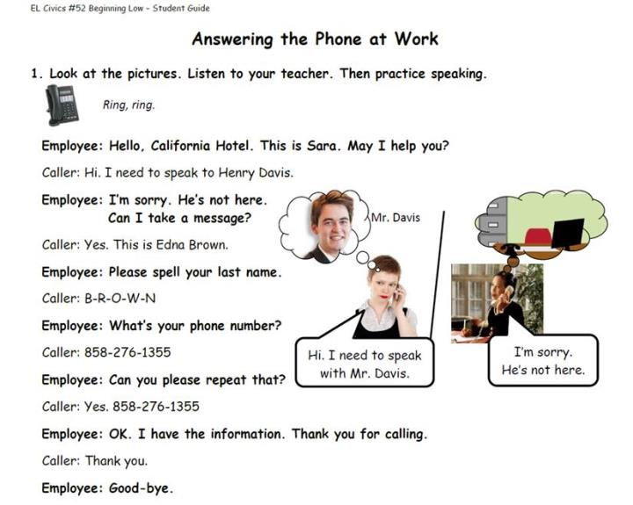
EL Civics Program Student Guide
EL Civics Beginning Low-Student Guide
Notes:
EL Civics Objective #52 focuses on workplace communication skills. There are two Beginning Low-Student assessments:
1. Speaking test
Task 1 - Answer the phone and take a message.
2. Writing test
Task 2 - Write about the supplies in the office and the supplies needed.

Slide 16
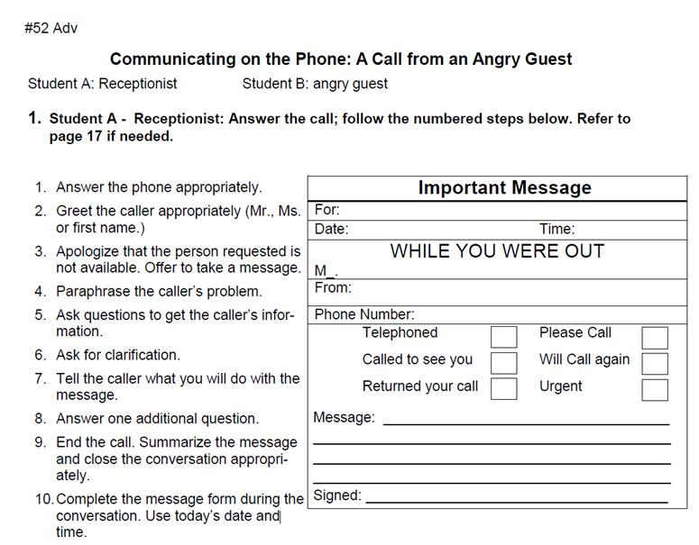
EL Civics Program Student Guide
EL Civics Advanced-Student Guide video
Notes:
Video start at 1.12 stop 1.33 (15 seconds)
EL Civics Objective #52 focuses on workplace communication skills. There are two Advanced Level assessments:
1. Oral Assessment:
Task 1 - Answer a business phone and take a message.
Task 2 - Report that message to the intended recipient.
2. Written Assessment:
Task 3 - Write a 3-4 paragraph business letter using appropriate words and correct format.

Slide 17
Pre-Vocational ESL
Project Success 6-level Series
Notes:
Project Success is a six-level series focused on workplace skills geared toward adults. This video-based program teaches English through scenarios with an emphasis on real-life professional situations. (Pearson, 2014).
https://pearsonerpi.com/en/elt/integrated-skills/project-success

Slide 18
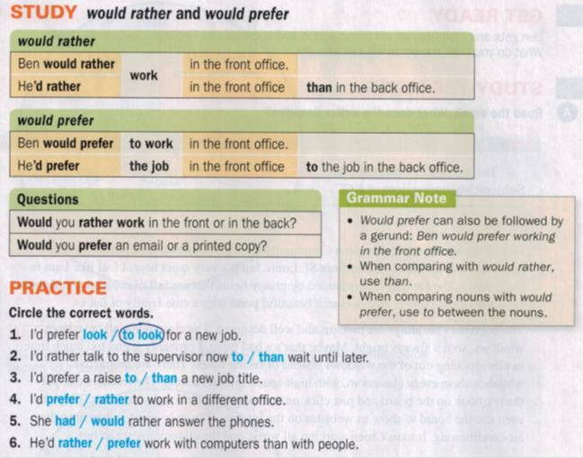
PS 4: Asking for a Promotion
Video link
Notes:
Project Success is a six-level series focused on workplace skills geared toward adults. This video-based program teaches English through scenarios with an emphasis on real-life professional situations. (Pearson, 2014).
https://pearsonerpi.com/en/elt/integrated-skills/project-success (Video play up to 1 min 30 sec)

Slide 19
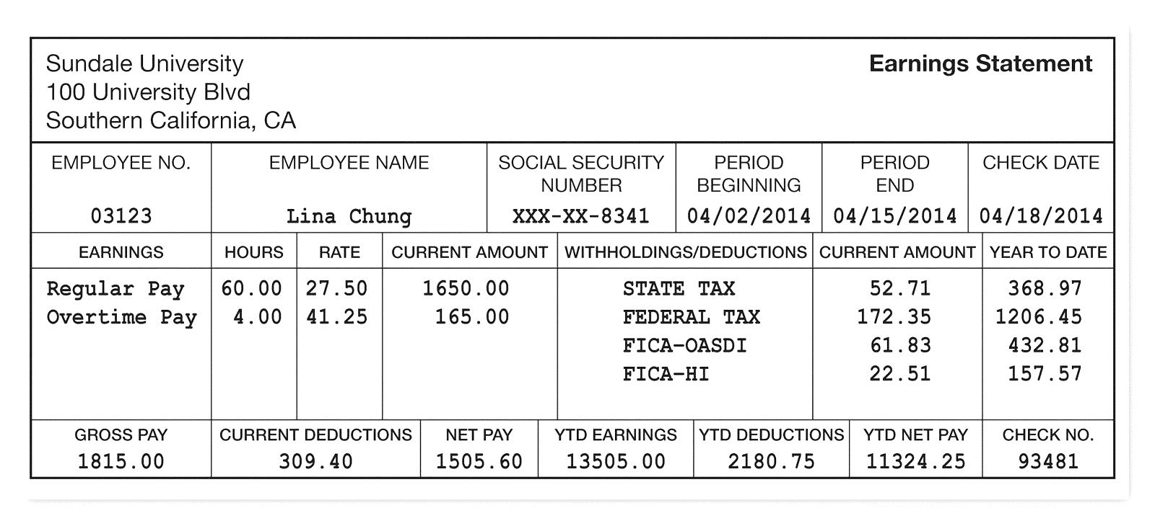
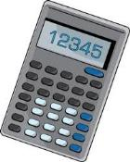
PS 4: Reading a Pay Stub
What is Lina’s current net pay? a. 1505.60 b. 11324.25 c. 1650.00 | How much has Lina paid so far this year for hospital insurance? a. 157.57 b. 22.51 c. 61.83
Which amount is the highest? a. current overtime pay b. current FICA c. current federal tax | What is Lina’s year to date earnings so far this year? a. 1815.00 b. 13505.00 c. 11324.25
Notes:
Project Success is a six-level series focused on workplace skills geared toward adults. This video-based program teaches English through scenarios with an emphasis on real-life professional situations. (Pearson, 2014).
https://pearsonerpi.com/en/elt/integrated-skills/project-success

Slide 20
Elements of Contextualized Learning
Faculty collaboration
Curriculum/Instructional Material Development
Relevant context
Interactive teaching
Professional development
Institutional support
Continuous improvement
Improved outcomes

Slide 21
Exploring ideas for partnering with English, math, and ESL colleagues
Partner to contextualize learning in order to enhance student performance and success
My story with ESL Linked Courses & Child Development
Example in English & Math (from participants)
Washington Integrated Basic Skills and Training (I-Best) Video
https://www.sbctc.edu/colleges-staff/programs-services/i-best/

Slide 22
https://youtu.be/A_xoRJGODU0
Notes:
Provided as a resource/example

Slide 23
Impact on Student Outcomes: Key Questions
How do we evaluate the impact on student outcomes? Longitudinal data on student success?
How do we assess its effectiveness?
What longitudinal data can be evaluated to determine if this strategy is preparing workers for specific jobs?

Slide 25
For more information contact:
Mayra Cruz, M.A.
cruzmayra@deanza.edu
Area B Representative ASCCC
Richard Weinroth, Ed.D.
rweinroth@sdccd.edu
San Diego Continuing Education

Slide 26
Resources
ASCCC (Spring 2009) Contextualized Teaching & Learning: A Faculty Primer A Review of the literature and faculty practices with implications for California community colleges practitioners. https://www.asccc.org/papers/contextualized-teaching-learning-faculty-primer
Kolb, Alice Y. & Kolb, David A. 2017 Experiential Learning Theory as a Guide for Experiential Educators in Higher Education. ELTHE: A Journal for Engaged Educators, Vol. 1, No. 1, pp. 7–4400

Slide 27
For more information contact:
Mayra Cruz
cruzmayra@deanza.edu
Area B Representative ASCCC

